Slide 1





Figure 1
$$w_{max}$$
Fitness (W)
$$\hat{µ}$$
Replication Fidelity$(1−µ)$
Investment in Replication Fidelity
$$\frac{dw}{dµ}< \frac{1}{N_{e}}$$
Drift Barrier
Fitness (W)
Replication Fidelity$(1−µ)$

Slide 2
300
Figure 2
O2MA1.2
O2MA2.2
O2MA3.2
………….
O2MA100.2
O2MA1.1
O2MA2.1
O2MA3.1
………….
O2MA100.1
150
Generations of MA
O1MA1
O1MA2
O1MA3
………….
O1MA100
….
PS1
PS2
PS3
PS48
0
Ancestor (GO)
Day 1
Day 3
Day 7
Day 11
Day 14
F1
F2
F3
P
LX.1
LX.1
LX.1
LX.1
Thaw
LX
LX
LX.7
LX.7
LX.7
LX.7
Assay Plate
Competitor

Slide 3
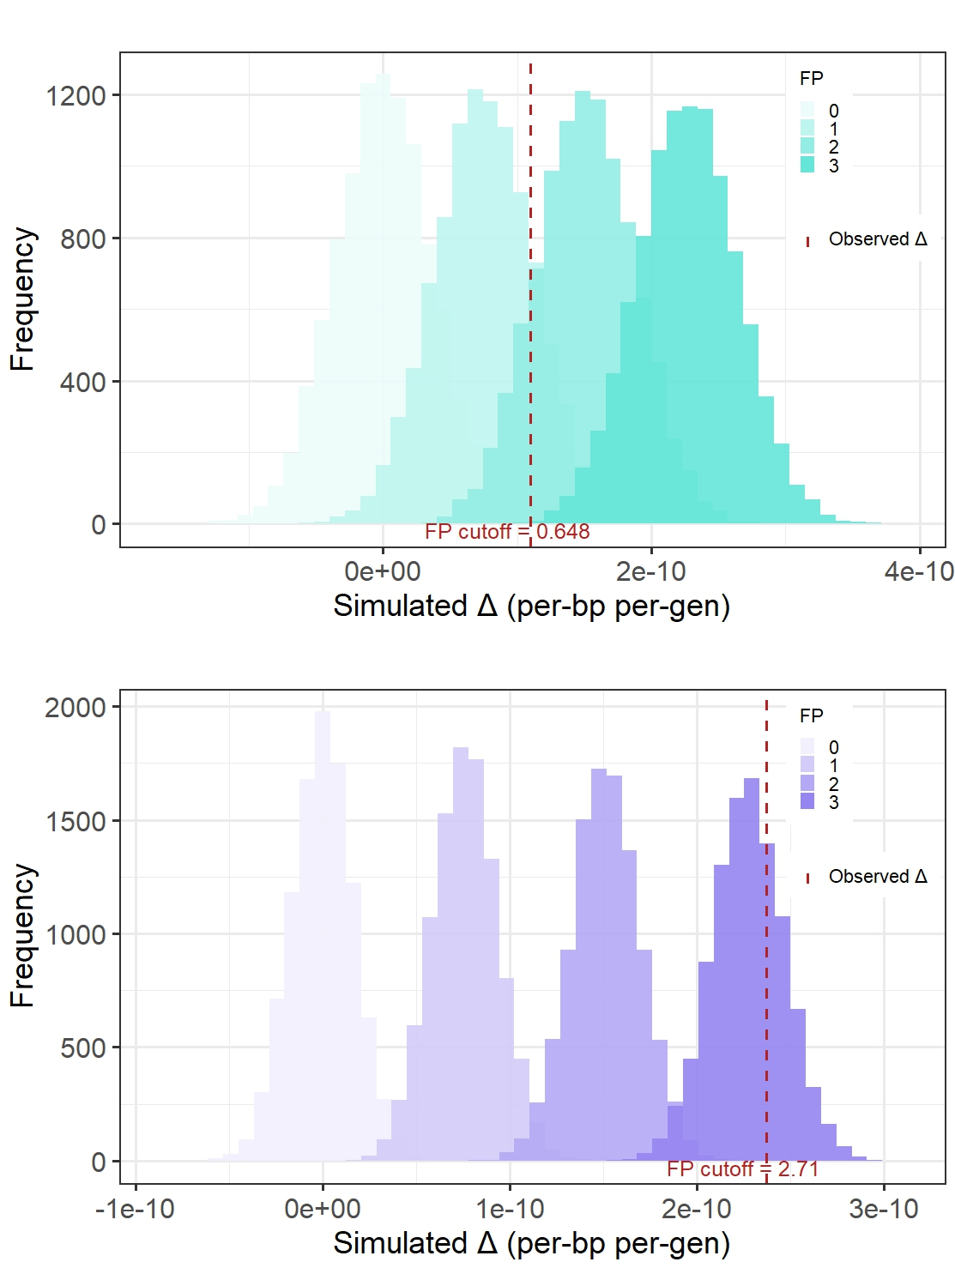
Figure 3

Slide 4
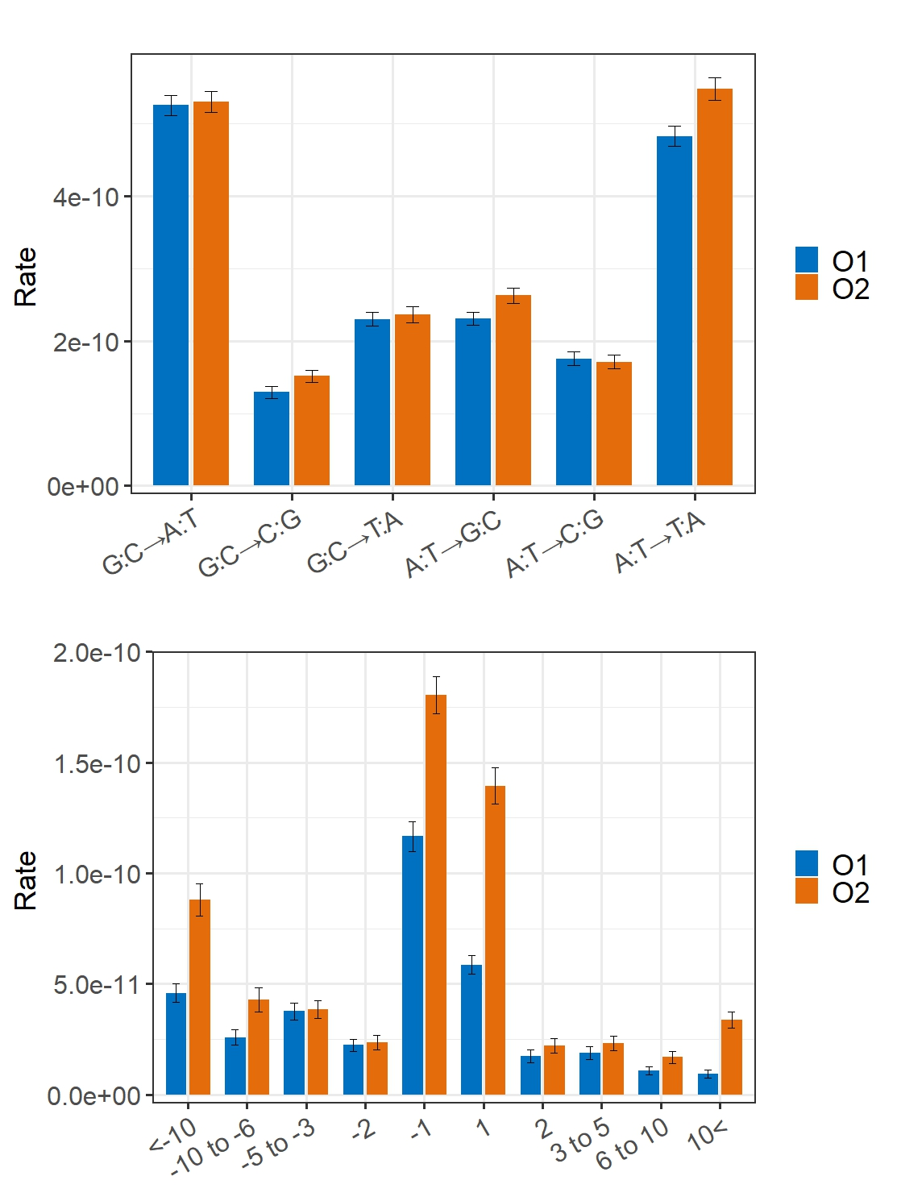
Figure 4

Slide 5
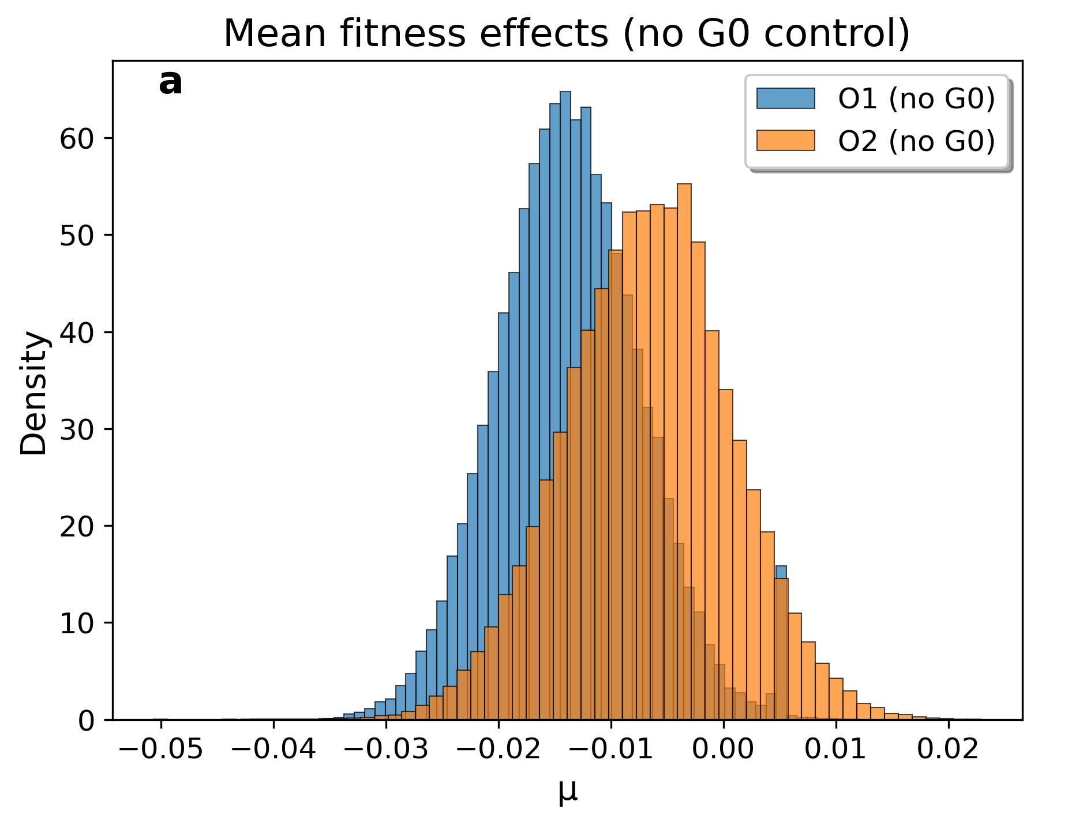
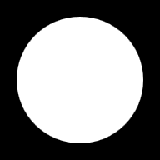
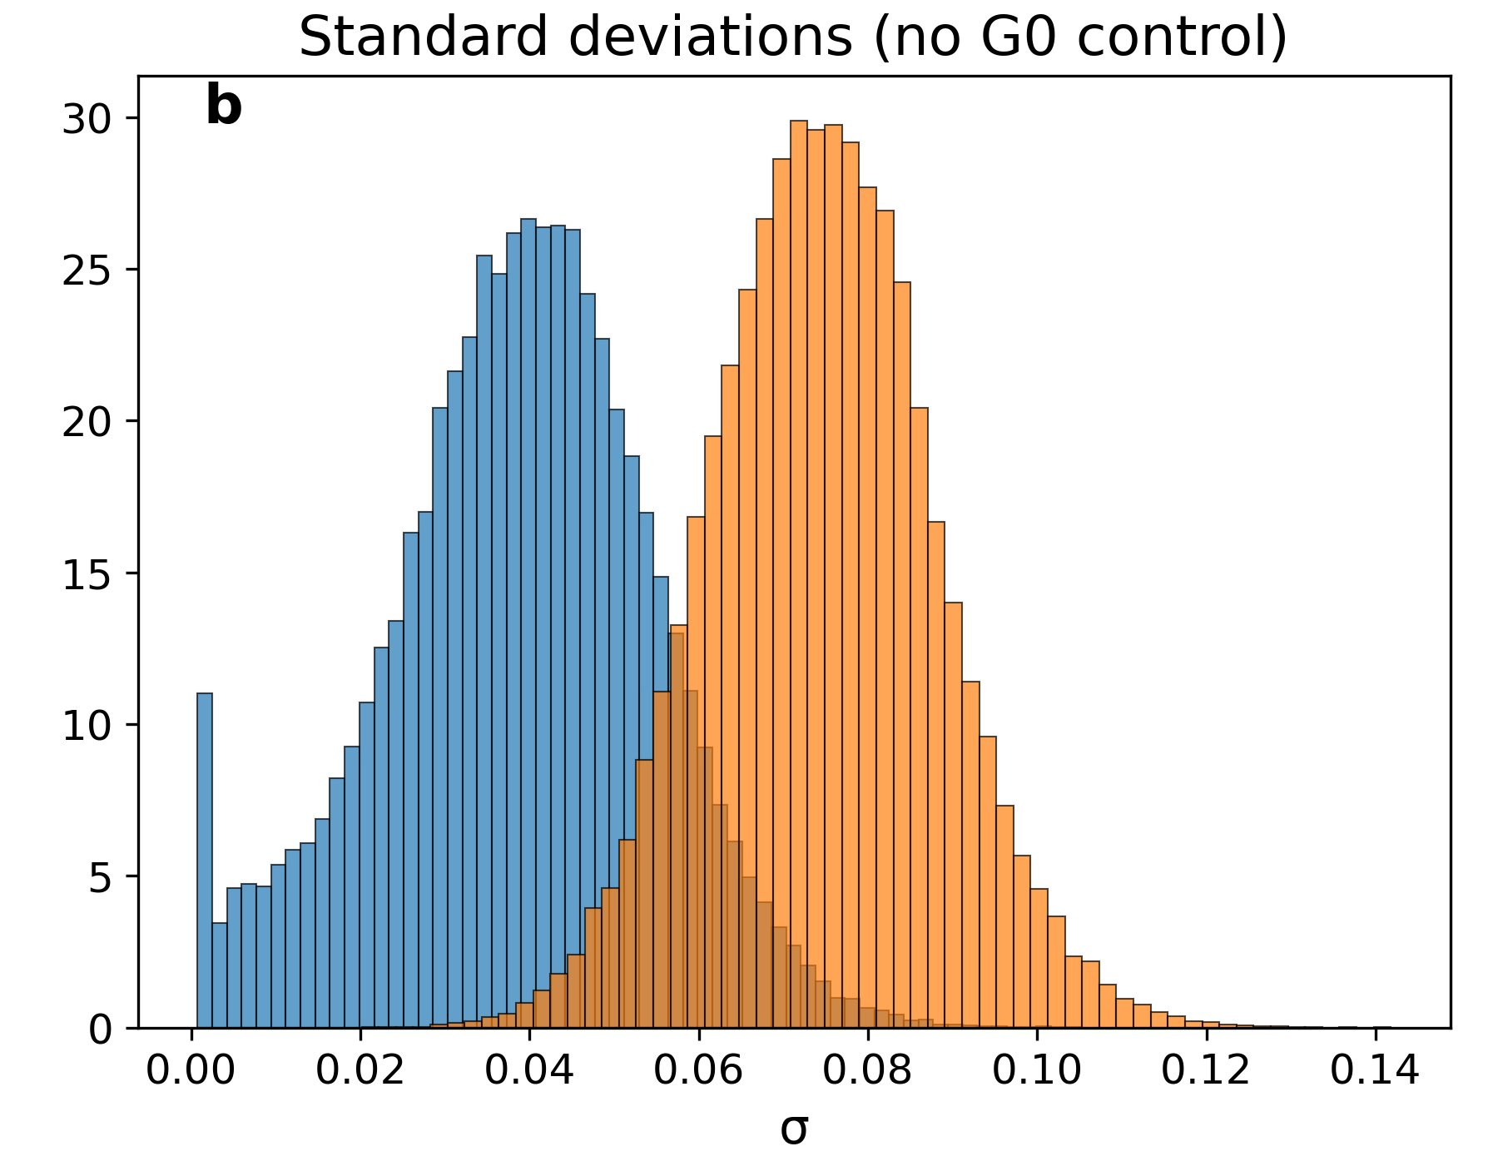
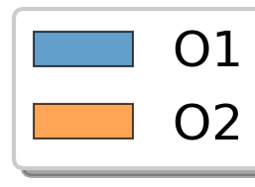
Figure 5
u_{W}
Density
σ_{W}

Slide 6







Supplementary Figure 1
$$w_{max}$$
$$\frac{dw}{dµ}< \frac{1}{N_{e}}$$
Drift Barrier
Drift Barrier
$$W(μ)$$
$$σ_{W}^{2}=s$$
$$σ_{W}^{2}=2s$$
$$µ_{opt}$$
M$utation Rate (µ)$

Slide 7
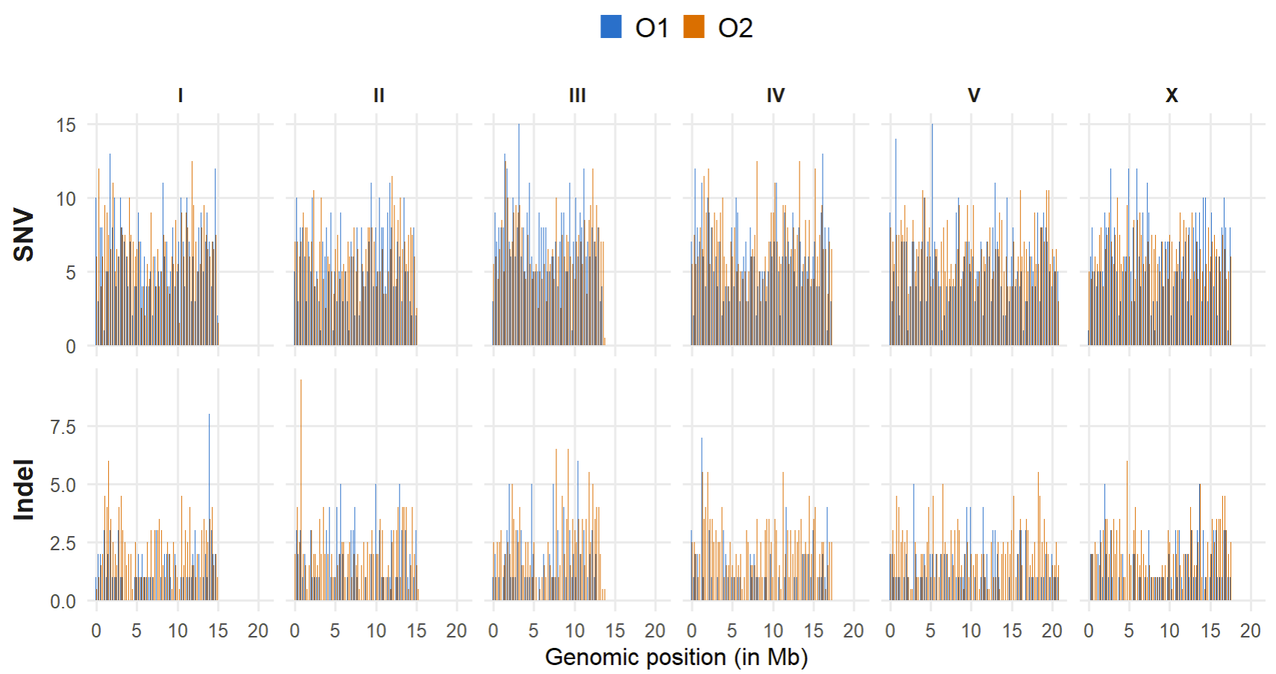
Supplementary Figure 2

Slide 8
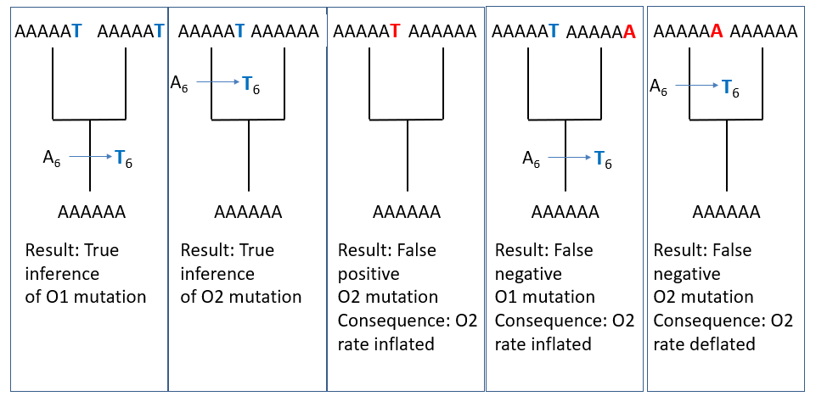
Supplementary Figure 3

Slide 9
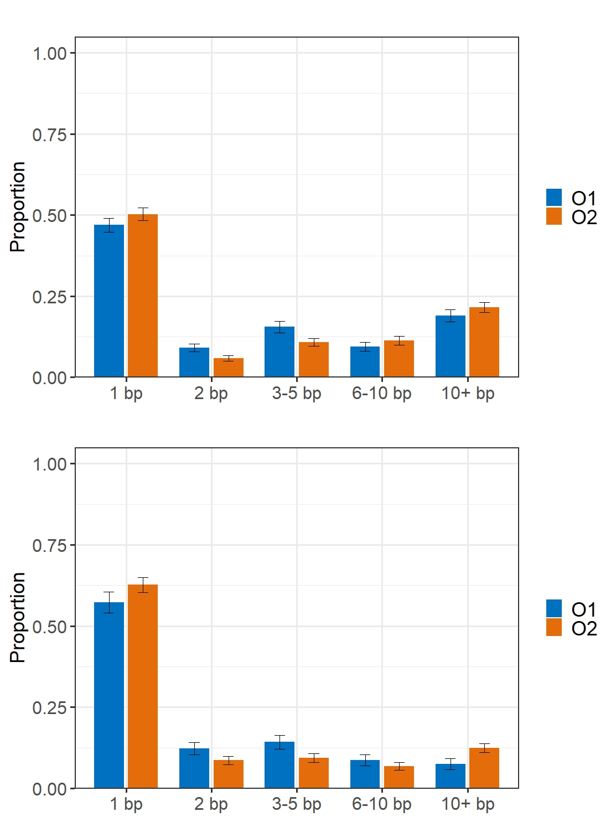
Supplementary Figure 4

Slide 10
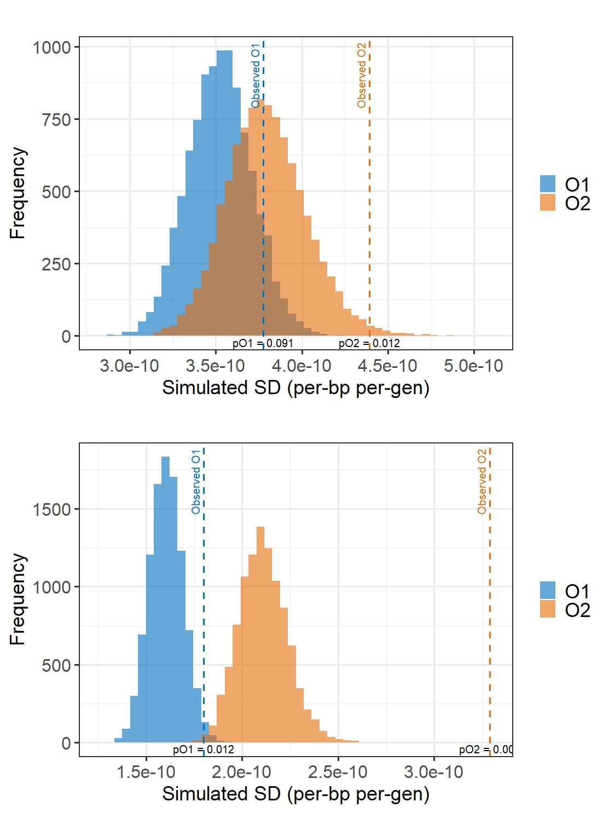
Supplementary Figure 5

Slide 11
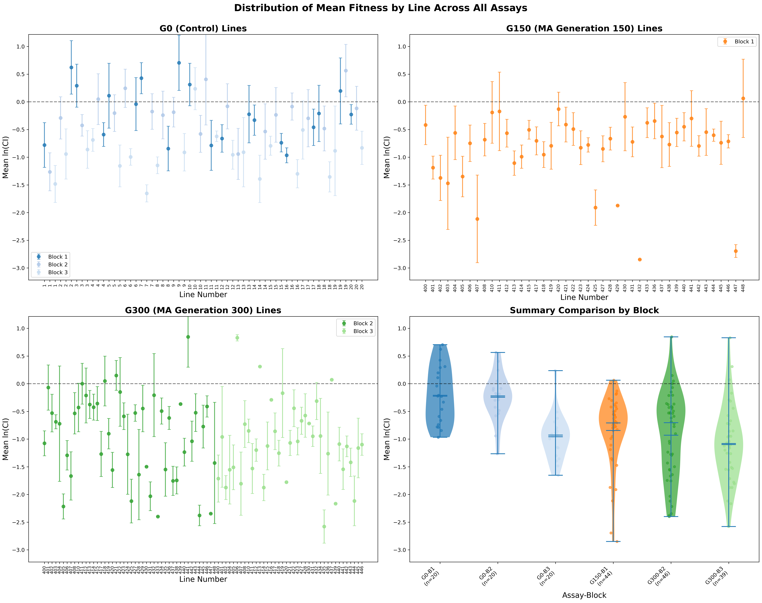
Supplementary Figure 6

Slide 12
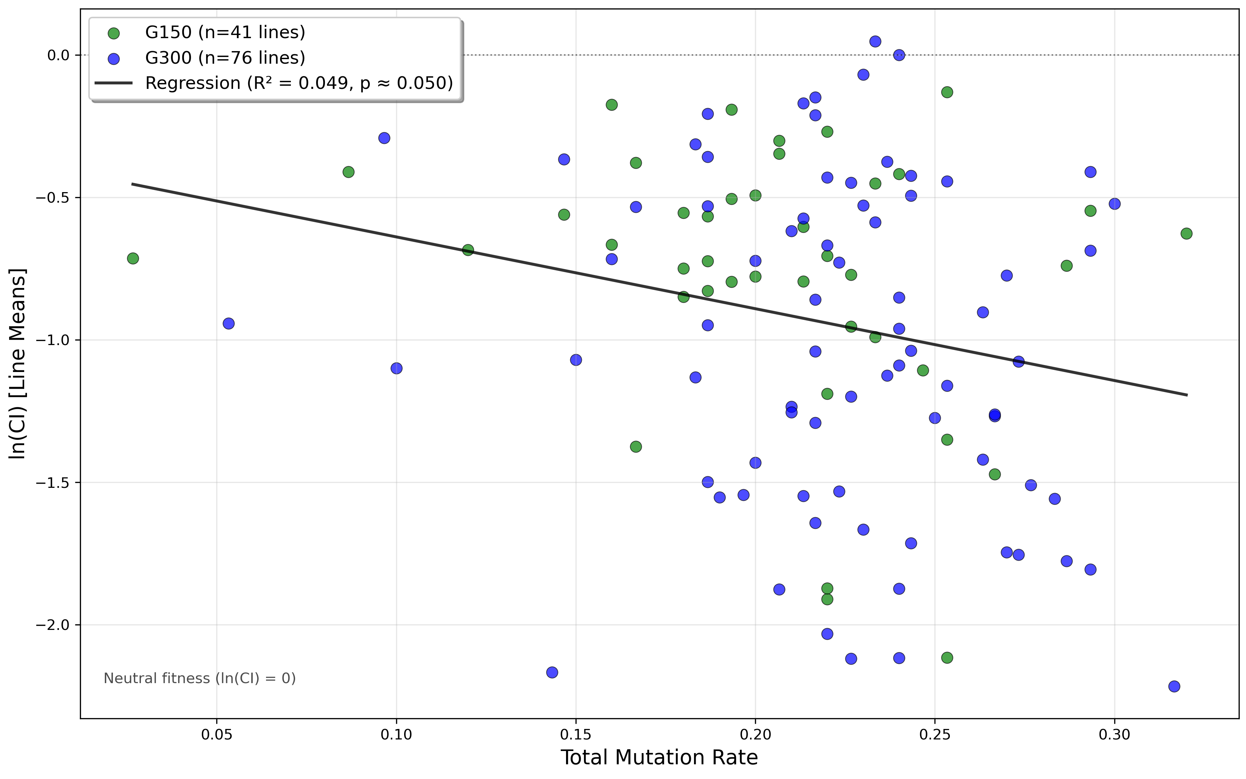
Supplementary Figure 7
W
µ_{TOTAL}

