Slide 1
Business Process Analyst and Software Architect [Jakob]
Test Manager and Software Architect [Fabian]
Configuration and Change Manager [Yann]
Project Manager [Joel]

Slide 2
Table of contents
Construction
Technical ability (product)
Organisation
VCS (GIT)
Elaboration
Vision
Use cases
SRS
Projectmanagement
Jira
Kanban
Scrum

Slide 3
Elaboration: Vision
Most important instance in company?
Tribute to SchülerVZ
Connect employees
“Find people that have the same kind of humor as you and you will never be alone”
“Humor for humanity”

Slide 4
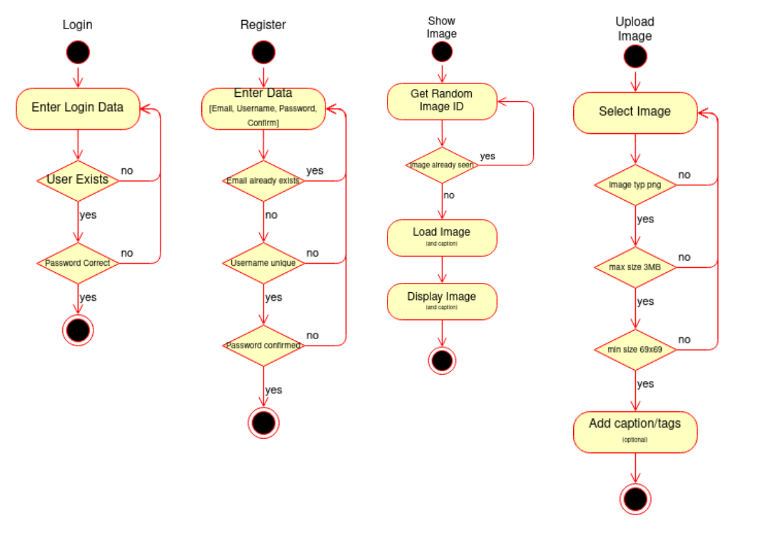
Elaboration: Use Cases

Slide 5
Elaboration: SRS
https://github.com/BaerJoel/Doc-MemeVZ/blob/gh-pages/SRS.md

Slide 6
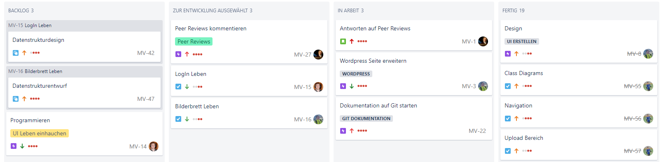
Projectmanagement: Kanban

Slide 7
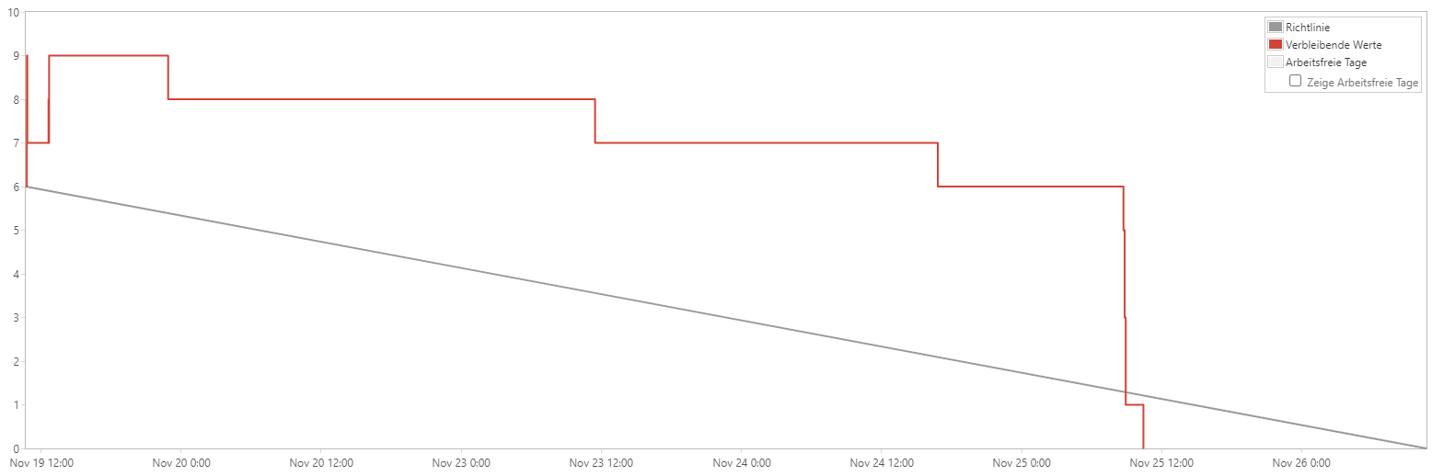
Projectmanagement: Scrum - Elaboration

Slide 8
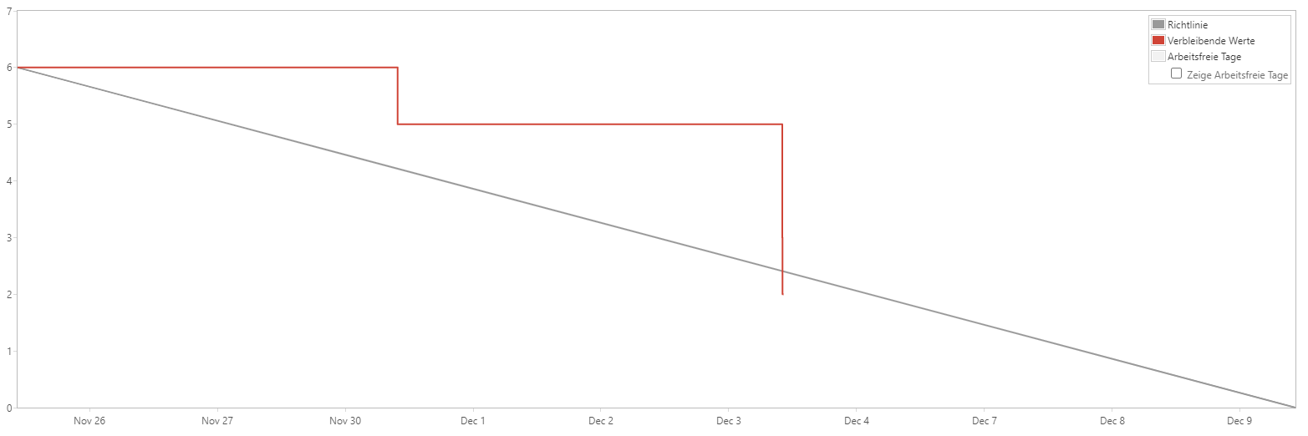
Projectmanagement: Scrum - Construction

Slide 9
Construction
Technical abilitys

Slide 10
Organisation
https://github.com/BaerJoel

