Slide 1
Business Process Analyst and Software Architect [Jakob Heitzmann]
Test Manager and Software Architect [Fabian Hepke]
Configuration and Change Manager [Yann Dambrowski]
Project Manager [Joel Bär]

Slide 2
Table of contents
Elaboration
Use Cases
Organisation
VCS (GIT)
Construction
Technical ability (product)
Elaboration
Vision
SRS
Projectmanagement
Jira
Kanban
Scrum

Slide 3
Elaboration: Vision
Tribute to SchülerVZ
Connect people
“Find people that have the same kind of humor as you and you will never be alone”
“Humor for humanity”

Slide 4
Elaboration: SRS
https://github.com/BaerJoel/Doc-MemeVZ/blob/gh-pages/SRS.md

Slide 5
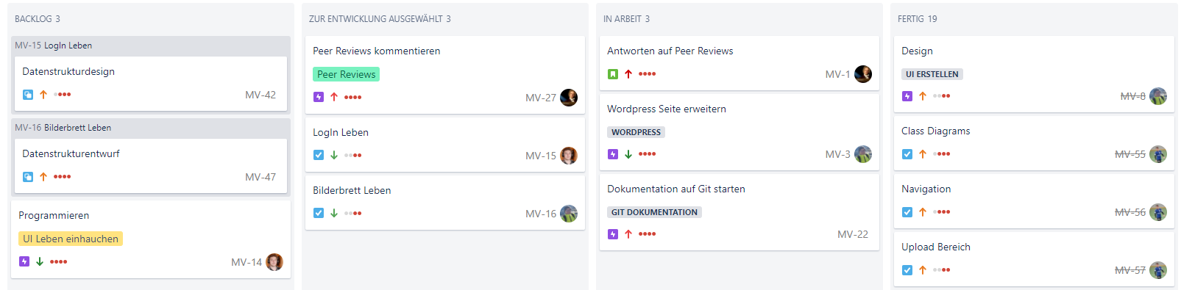
Projectmanagement: Kanban

Slide 6
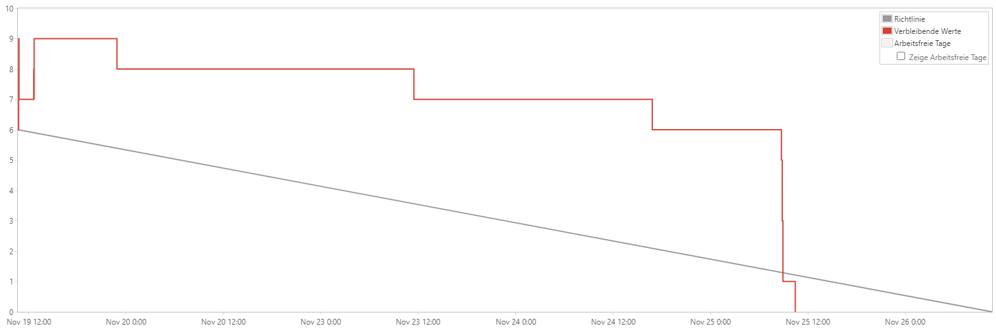
Projectmanagement: Scrum - Elaboration

Slide 7
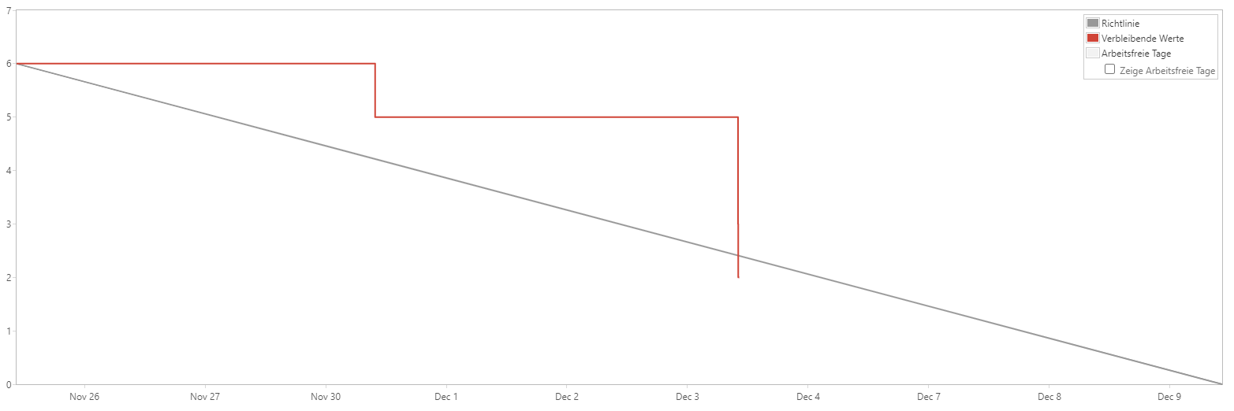
Projectmanagement: Scrum - Construction

Slide 8
Burndown-charts

Slide 9
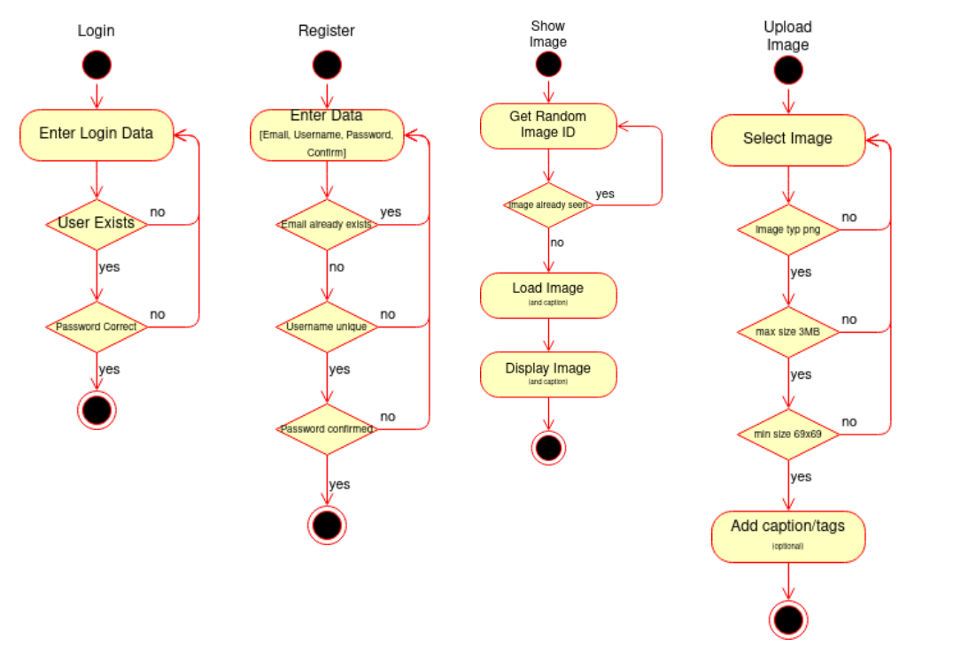
Elaboration: Use Cases

Slide 10
Organisation
https://github.com/BaerJoel

Slide 11
Construction
Technical abilitys

