Slide 1


Usedvehiclespricepredictor
Artificial intelligence and data engineering
Data mining and machine learning project
Giulio bello - 603078
Federico Frati - 596237

Slide 2



Project goals
Allow the user to ask for a price evaluation of an used vehicle
Merge different dataset and preprocess them
Find the best regressor to evaluate an used vehicle’s price
Compare different models using different metrics
Perform cross-validation
Create a simple application to provide this service

Slide 3
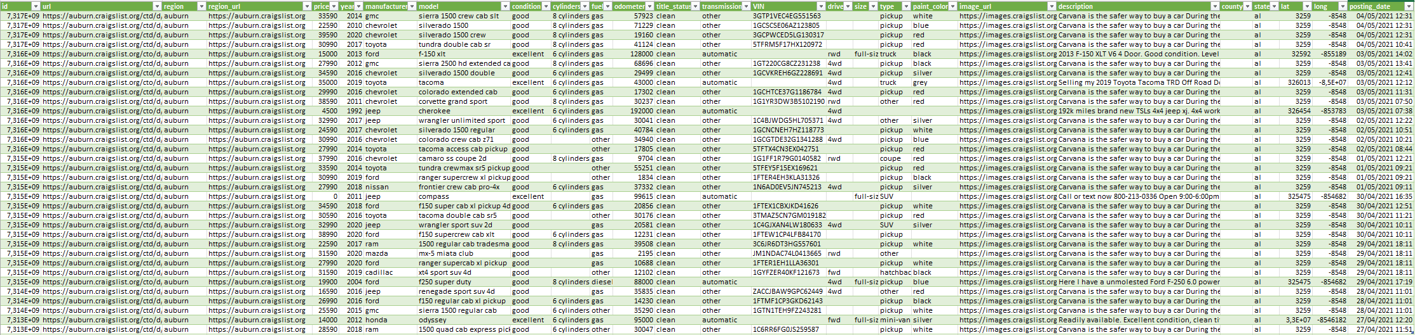
Dataset
Dataset found on CraigList.org
Different versions (one for each year)
Vehicles in our dataset inserted between 2020 and 2022
26 attributes
1 326 489 rows

Slide 4
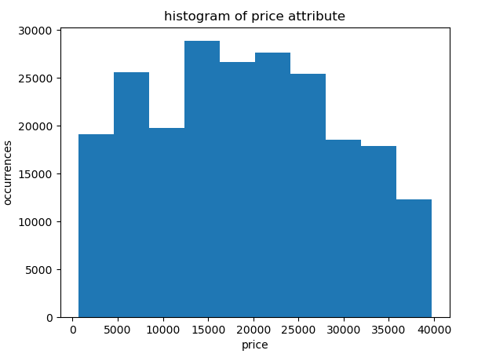
Preprocessing
Initial problems:
Useless columns
Missing values
Unbalanced price attribute distribution
Outliers
Solutions:
Removed columns that are visibly useless
Removed missing values (excepted for condition)
Removed columns basing on mutual correlation
Removed columns that are uncorrelated with price
Rebalance of dataset
Removed deciles and checked z-scores
Substitution of year and posting_date with a new attribute, age

Slide 5
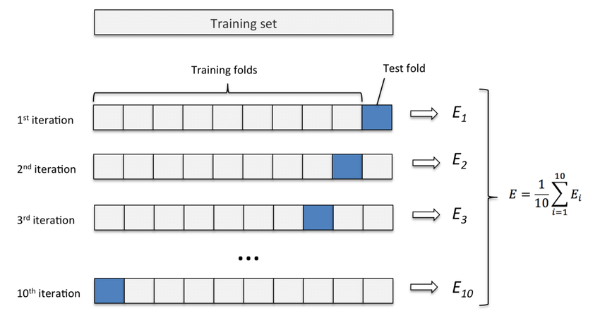
K-fold Cross validation
To have results that are not dependent on how the data was divided into test and train, we decided to use a K-Fold Cross-Validation (with K=10) for each model tested.
For each possible division, we calculate all the metrics to verify the robustness and model generalization.
After that, we trained the model using all the data.

Slide 6
Regressor comparison
 | Random Forest | Adaboost | M5 Rules | 5-NN
R-squared | 0.912 | 0.592 | 0.861 | 0.673
RMSE | 3045.68 | 6558.21 | 3822.29 | 5870.39
MAE | 1657.15 | 5219.52 | 1827.14 | 3737.27
Percentage error | 8.7% | 27.4% | 9.6% | 19.6%
With «Percentage error» we consider the percentage of MAE related to the mean price of vehicles in our dataset after preprocessing ($ 19049)

Slide 7
Random forest vs m5 rules
 | Load time | Execution time | Memory occupied
Random Forest | 30.50 s | 0.08 s | 5 515 115 kB
M5 Rules | 1.02 s | 0.002 s | 15 531 kB
Random Forest has a higher accuracy score compared to M5R, but the latter has the great advantage of being much faster both in the model loading phase and in the prediction phase.
In the loading phase, M5R is about 30 times faster, while in the execution phase it is even 40 times faster.
Which is the best one? It depends on the requirements of the application…

Slide 8
What happens without preprocessing?
We tried to perform regression without pre-processing. The mean absolute error resulted is very very high and the R-squared value is a not deterministic one.
We tried also to perform regression without balancing price. We observed a bias in the predictions, in fact the predicted values ​​tended to approach the most represented price ranges.
We can conclude that having a preprocessing like this one is fundamental to have good results.

Slide 9

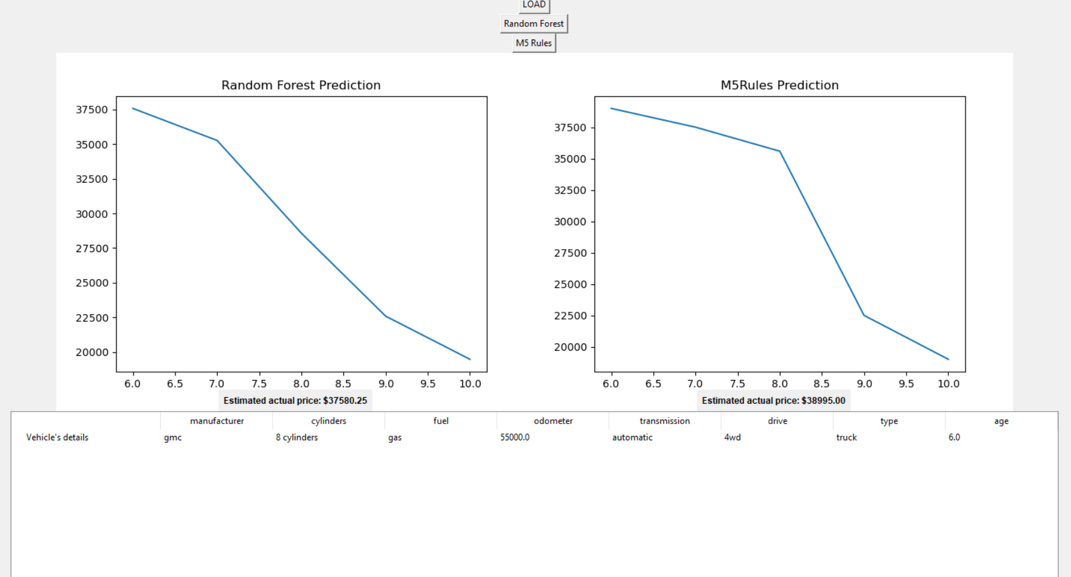
APplication
Step to have a price prediction:
Click on «Load» button
Choose the csv file with vehicle’s details
Vehicle’s details will appear in a table
Choose the model to use: Random Forest or M5 Rules and click on the button
A graph will appear with the prediction of the price’s trend during next 5 years. Behind the graph will appear an extimation of the actual price.

Slide 10

THANKS FOR YOUR ATTENCTION

