Slide 1
Team : BWD Cloud
-Balaji Chinnathambu
-William Robert
-Dayanithi Jothi
Problem Statement : Verizon Operations teams publish new AMI's with updated security patches every 90 days. Application teams are expected to update their running EC2 instances with the new AMI's within 30 days after they are published. Implement a solution that detects a new AMI and triggers a process to deploy a simple hello world application using the new AMI while terminating the old running instances
Solution Description :
Automated end to end through CICD pipeline
Use Lambda/Jenkins to identify the new VZ AMI and spin up a new EC2 instance
Mount the middle ware binary EFS to newly created EC2 and install the latest application.
Test the newly created EC2 instance and create an application AMI
Spin up new EC2 instance using new application AMI and update the ELB with EC2 ID
If application is using auto scaling, AMI instance need to updated in launch configuration
Destroy the OLD EC2 instance
Link for Github/Pipeline/Application :
https://github.com/Wills2607/bwdcloud
http://ec2-35-167-222-60.us-west-2.compute.amazonaws.com:8080/view/OPERATIONS%20AMI%20ROLLOUT/
http://bwd-elb-600827985.us-west-2.elb.amazonaws.com.bwdcloud.com/bwd/

Slide 2
















BWD Cloud : Design Architecture
Spin Up EC2 using new AMI and install APP
AMI
Application
Application AMI
SNS
Build Application AMI & Publish
EC2-OLD AMI
EC2-NEW AMI
Update ELB with New EC2 and Terminate Old EC2
Benefits
No Downtime to application
QA certified new application AMI’s
Speedy and transparent AMI switch
Notification in all stages
Can extend to Auto Scaling
Tools & Services Used
EC2, Jenkins, GitHub
ELB , EFS
Lambda
SNS
Cloud Formation , Auto Scaling

Slide 3










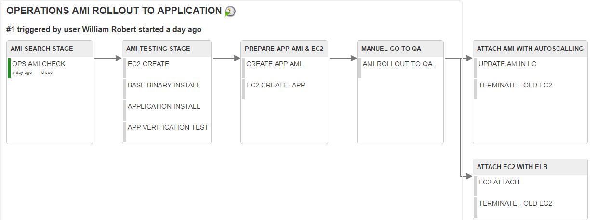
BWD Cloud : Auto scaling and Delivery pipeline.
Spin Up EC2 using new VZ AMI and install
“Hello World” APP
Spin Up EC2 using new VZ AMI and install
“Hello World” APP
VZ AMI
VZ AMI
Application AMI
Hello World
Application AMI
Hello World
SNS
SNS
Build Application AMI & Publish
Build Application AMI & Publish
EC2-OLD AMI
EC2-NEW AMI
EC2-OLD AMI
EC2-NEW AMI
Update ELB with New EC2 and Terminate Old EC2
Auto Scaling Launch Configuration for New EC2 Spin UP and Terminate Old EC2
Delivery Pipeline End to End

