Slide 1

Healthcare Project
Group – 2
Yogesh Vijay Patil
Vedisha Amar Usakoyal
Sulakshana Kulkarni
Swati Sanjay Jadhav
Bagary Jayasree

Slide 2


Project Summary
This dataset provides an extensive overview of financial and operational aspects across multiple healthcare facilities. Each entry includes facility identifiers, geographic location, operational status, and several revenue metrics, both at the gross and net levels. The data spans multiple years and is segmented quarterly, supporting trend and comparative analysis across facilities and regions.

Slide 3
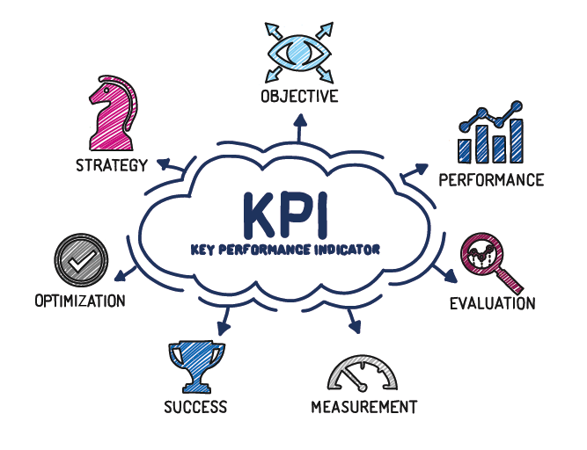
Key Performance Indicators (KPI’S) List
Total Discharge - 2,106
Net Patient Revenue - $71.41M
Total Hospital - 603
Total Days - 12,546
Patient Stays - 6 Days
Total Patient Visit - 26.59K
Gross Inpatient Revenue - $193.13M
Gross Outpatient Revenue - $106.1M

Slide 4
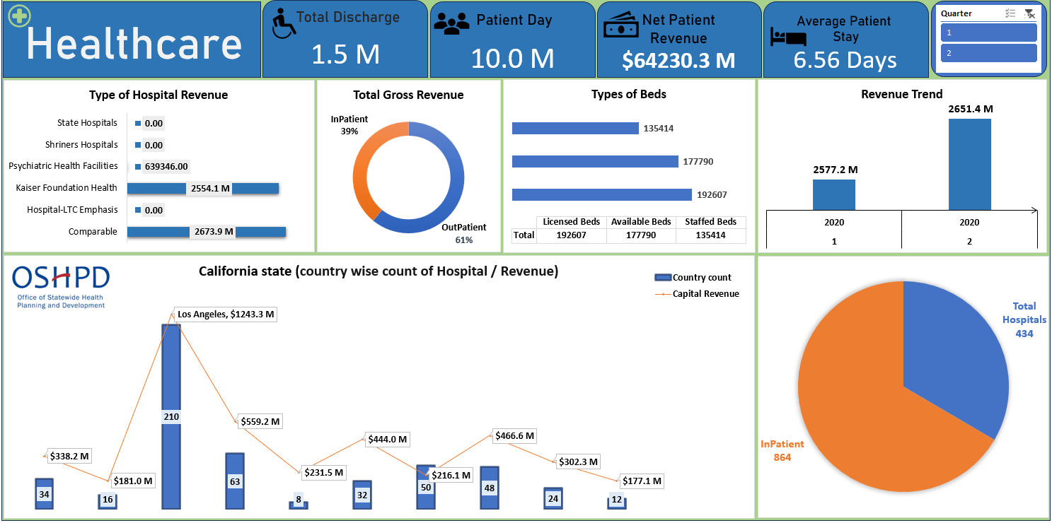
Excel Dashboard

Slide 5
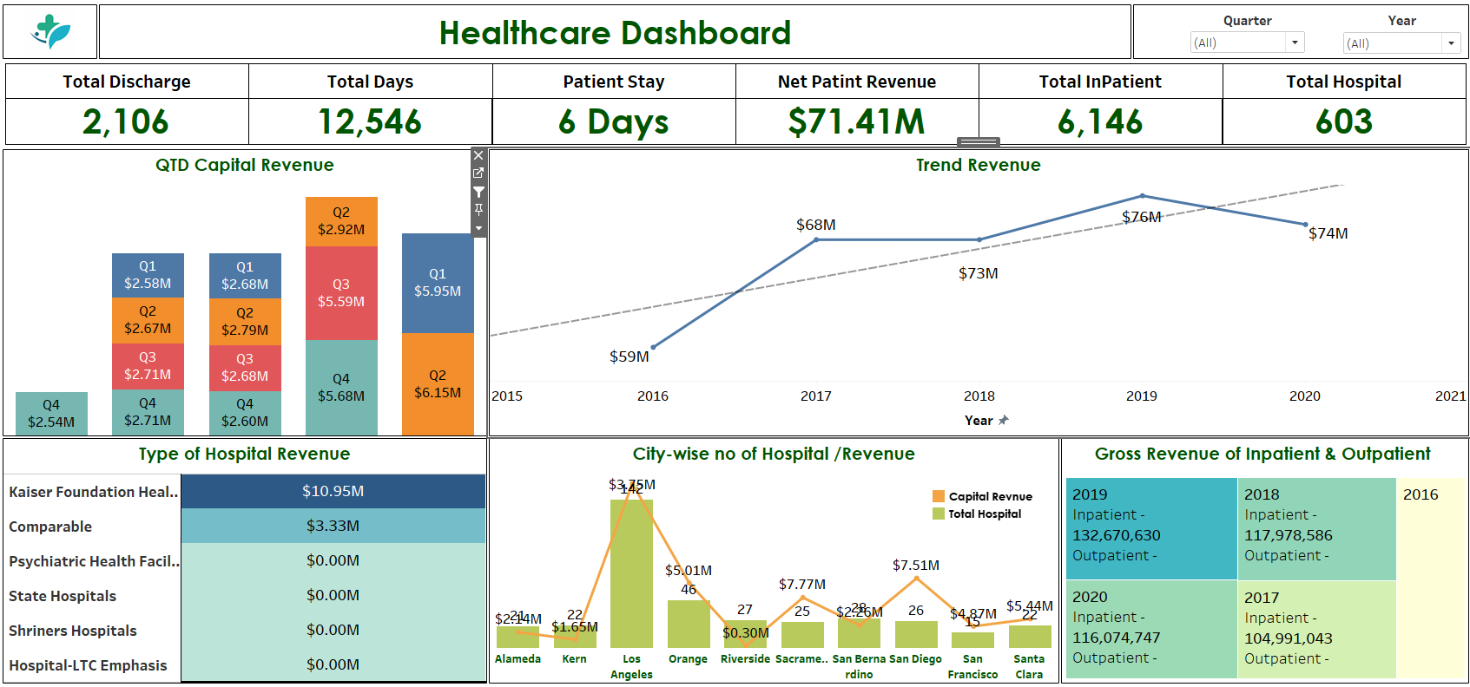
Tableau Dashboard

Slide 6
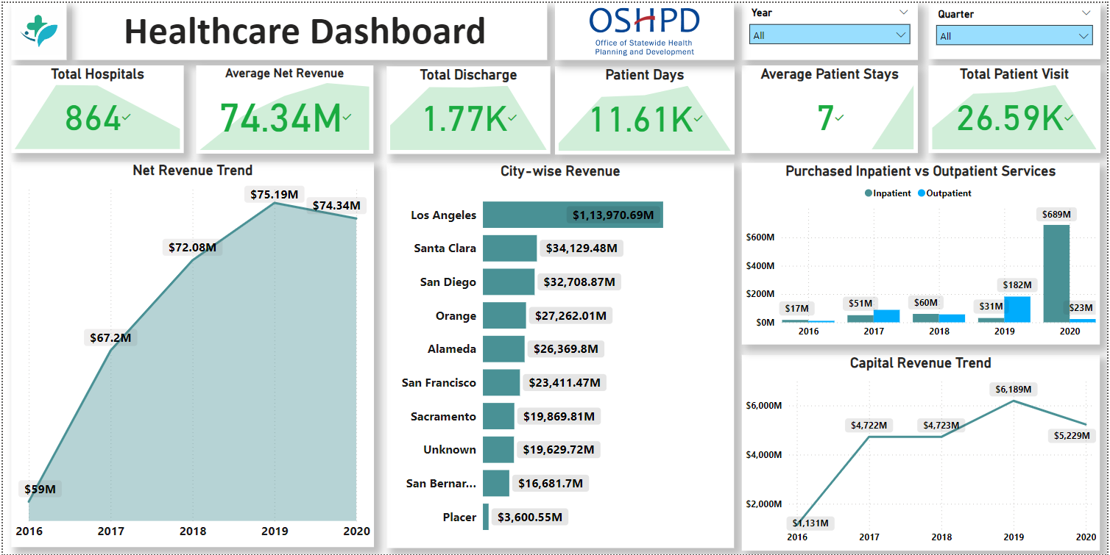
Power BI Report

Slide 7
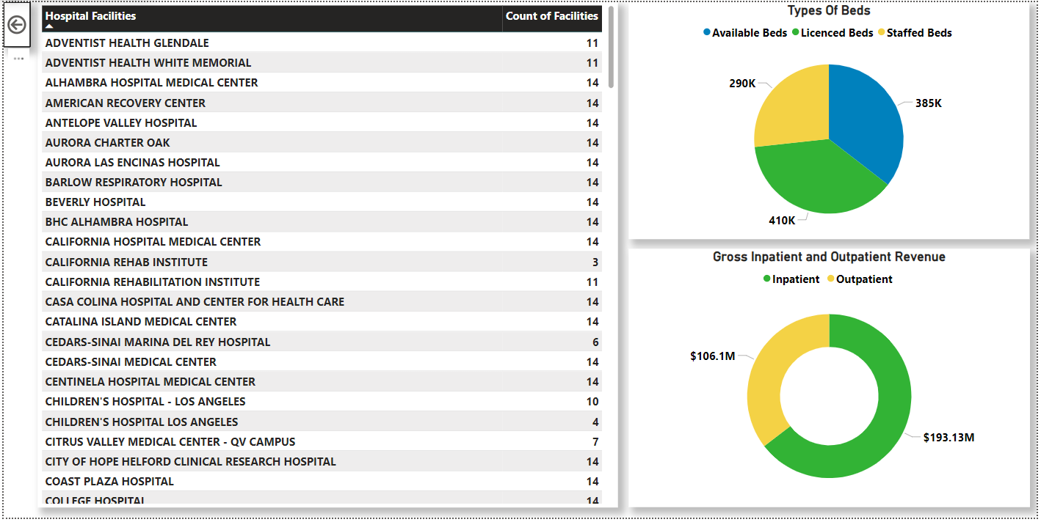
Power BI Report

Slide 8
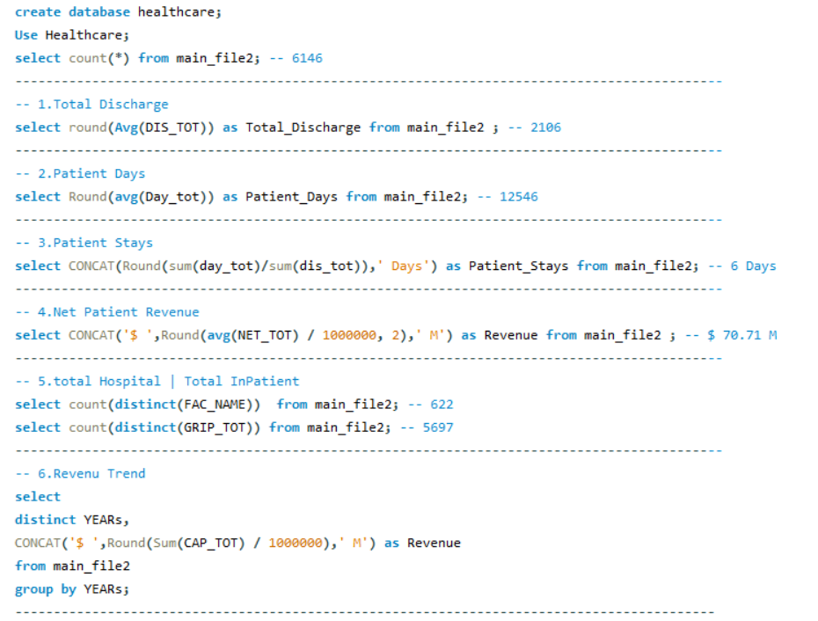
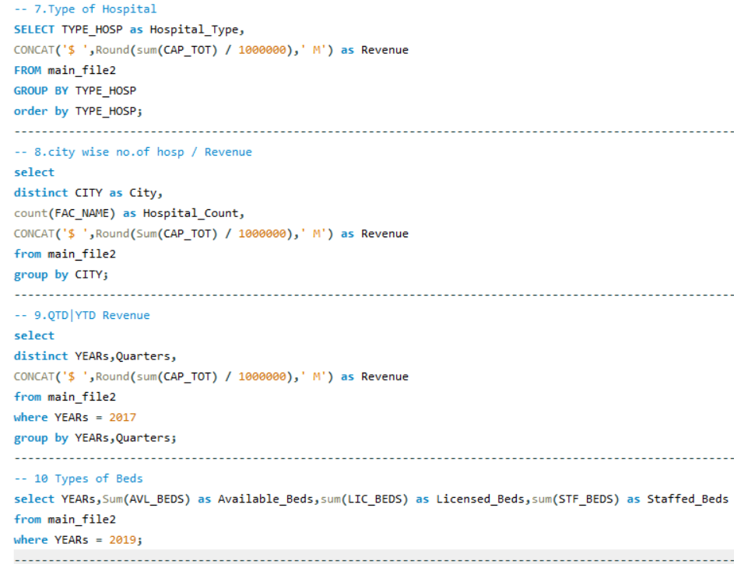
SQL Queries

Slide 9

Strategic Insights for Healthcare Optimization
Revenue Analysis📈
Highlights the differences in revenue performance between inpatient and outpatient services, indicating areas for potential revenue growth. This insight can support data-driven decisions on where to allocate resources for maximum profitability.
Operational Status 🏥
Segmentation by operational status provides a clear picture of service accessibility and identifies regions that may lack sufficient healthcare facilities, which is crucial for discussions on improving healthcare access.
Quarterly Trends 📅
Seasonal or quarterly revenue trends help with planning and resource allocation, allowing for adjustments during peak or low seasons to optimize operations and reduce costs.
Regional Focus 📍
Emphasizing county-level performance and accessibility variations enables the identification of high-priority regions for strategic interventions and resource investments.

Slide 10

Key Takeaways
Patient Care Efficiency: With an average patient stay of 6 days and over 2,100 discharges, hospitals manage patient throughput efficiently.
Revenue Growth: Revenue trends show consistent growth until 2019, with a slight dip in 2020, potentially reflecting external factors like economic conditions or the healthcare industry changes.
City and Hospital-Type Revenue: The disparity in revenue across different hospital types and cities indicates areas for potential growth, particularly in cities like Los Angeles and San Diego, which contribute significantly to total hospital revenue.
QTD Revenue Patterns: Q3 revenue stands out with significant growth compared to other quarters, suggesting seasonality or strategic improvements during this period.
Inpatient vs. Outpatient Revenue: Outpatient services consistently generate more revenue than inpatient services, pointing to a shift towards outpatient care as a key driver of profitability.

Slide 11


Conclusion
This analysis highlights the need for targeted strategies to maintain revenue growth and optimize patient care services, especially in underperforming cities or hospital types. Identifying opportunities in these areas can improve overall performance and profitability.

Slide 12
THANK YOU

