Slide 1

Department of Information Technology​
Major Project
AUTOMATIC EYE DISEASE DETECTION USING MACHINE LEARNING
Presented by : Batch – 13
D.Tharun Kumar -20N31A1251
B.Bhargav-20N31A1235
B.Jhansi-20N31A1228
Guided by
P.Shilpa
Associate Professor

Slide 2
Modules:
Upload Pupillometry Dataset
Run Filtering
Run Features Extraction
Run Features Reduction
Run SVM On Right Eye
Run SVM On Left Eye
Run OR Ensemble Algorithm(Left & Right SVM)
Run Extension BILSTM
Accuracy Graph With Metrics
Predict Disease

Slide 3
Content:
Modules and Explanation
Implementation(Sample code)
Test cases
Execution(Flow of Execution(Flow of execution Screens)

Slide 4
Upload Pupillometry Datase : Using this module we will upload raw data which contains continuous recording of pupils data.
2.Run Filtering: Raw data contains huge number of buggy values and we will filter that raw data to extract only useful information such as pupil min and max diameter
3. Run Features Extraction: Using this module all pupil min and max features extracted from raw data.
4.Run Features Reduction: Using this module we will remove unnecessary features from raw data such as camera name, position etc to reduce features set. In this module we will extract features such as Patient ID, MAX, MIN, DELTA, CH etc. Extracted data can be used to split into train and test data
5.Run SVM On Right Eye: Using this module we will train SVM with right pupil data
6.Run SVM On Right Eye: using this module we will train SVM with left Pupil data and then apply SVM on test data to calculate prediction accuracy, sensitivity and specificity.
7. Run OR Ensemble Algorithm(Left & Right SVM): Using this module we will combine both classifier to get classifier with high prediction accuracy.
8. Predict Disease: using this module we will upload test data and then apply SVM classifier to predict disease.

Slide 5
Implementation
Sample code:
def upload():
global filename
filename = filedialog.askdirectory(initialdir = ".")
pathlabel.config(text=filename)
text.delete('1.0', END)
text.insert(END,'Pupillometric dataset loaded\n’)
def featuresExtraction():
f = open("left.txt", "w")
f.write(left)
f.close()
f = open("right.txt", "w")
f.write(right)
f.close()
text.delete('1.0', END)
text.insert(END,'Both eye pupils extracted features saved inside left.txt and right.txt files \n')
text.insert(END,"Extracted features are \nPatient ID, MAX, MIN, Delta, CH, Latency, MDV, CV and MCV\n")

Slide 6
ID | Summary | Steps | Expected result | Actual result | Status
1 | Data upload | 1.Upload dataset folder. 2.Click on Upload Pupillometry Dataset 3.Dataset loaded | 1.Succesfully data loaded. | 1.Sucessesfully data loaded | Pass
2 | Filtering | 1.Run filtering button to perform filtering on dataset to ignore raw data. 2.It display number of patients. | 1.Total patients found in dataset | 1. Total patients found in dataset | pass
3. | Feature Extraction | 1.Click on run feature extraction. | 1.Patients Features Found. | 1.Patients Features Found | pass

Slide 7
ID 4. 5. 6.
Summary | Steps | Expected output | Actual output | Status
Feature Reduction | 1.Click on Run Feature Reduction. | 1.Pupil Diameter Graph will be displayed on the Screen. | 1. 1.Pupil Diameter Graph will be displayed on the Screen. | pass
SVM on Right Eye | 1.Click On Run SVM on Right Eye. | Right pupil SVM Prediction Results 1.Right pupil SVM Accuracy 2.Right pupil SVM Algorithm Sensitivity 3.Right pupil SVM Algorithm Specificity Values are displayed. | 1. Right pupil SVM Prediction Results 2.Right pupil SVM Accuracy 3.Right pupil SVM Algorithm Sensitivity 4.Right pupil SVM Algorithm Specificity Values are displayed. | pass
SVM On Left Eye | 1.Click ON Run SVM On Left Eye. | Left pupil SVM Prediction Results 1.Left pupil SVM Accuracy 2.Left pupil SVM Algorithm Sensitivity 3.Left pupil SVM Algorithm Specificity | Left pupil SVM Prediction Results 1.Left pupil SVM Accuracy 2.Left pupil SVM Algorithm Sensitivity 3.Left pupil SVM Algorithm Specificity | pass

Slide 8
ID | Summary | Steps | Expected Output | Actual Output | status
7. | OR Ensemble Algorithm(Left & Right SVM) | 1.Click On OR Ensemble Algorithm(Left & Right SVM) | Optimized Ensemble Prediction Results 1.Ensemble OR Accuracy 2. Right pupil Ensemble OR SVM Algorithm Sensitivity 3.Right pupil Ensemble OR SVM Algorithm Specificity | Optimized Ensemble Prediction Results 1.Ensemble OR Accuracy 2. Right pupil Ensemble OR SVM Algorithm Sensitivity 3.Right pupil Ensemble OR SVM Algorithm Specificity | pass
8. | Extension BILSTM | 1.Click ON Run Extension BILSTM | 1.Extension BI-LSTM Accuracy Bi-LSTM Model Summary can be seen in black console for layer details 2.Right pupil Extension BI-LSTM Algorithm Sensitivity 3.Right pupil Extension BI-LSTM Algorithm Specificity | 1.Extension BI-LSTM Accuracy Bi-LSTM Model Summary can be seen in black console for layer details 2.Right pupil Extension BI-LSTM Algorithm Sensitivity 3.Right pupil Extension BI-LSTM Algorithm Specificity | pass
9. | Accuracy Graph With Metrics | 1.Click On Accuracy Graph With Metrics | 1.All Algorithm Accuracy Comparison Graph is Displayed on The Screen. | 1.All Algorithm Accuracy Comparison Graph is Displayed on The Screen. | pass
10. | Predict Disease | 1.Click On predict Disease. 2.Select test.txt file from the folder and click on open button. | 1.Result is Displayed on screen whether Disease predicted or Not. | 1.Result is Displayed on screen whether Disease predicted or Not. | pass

Slide 9
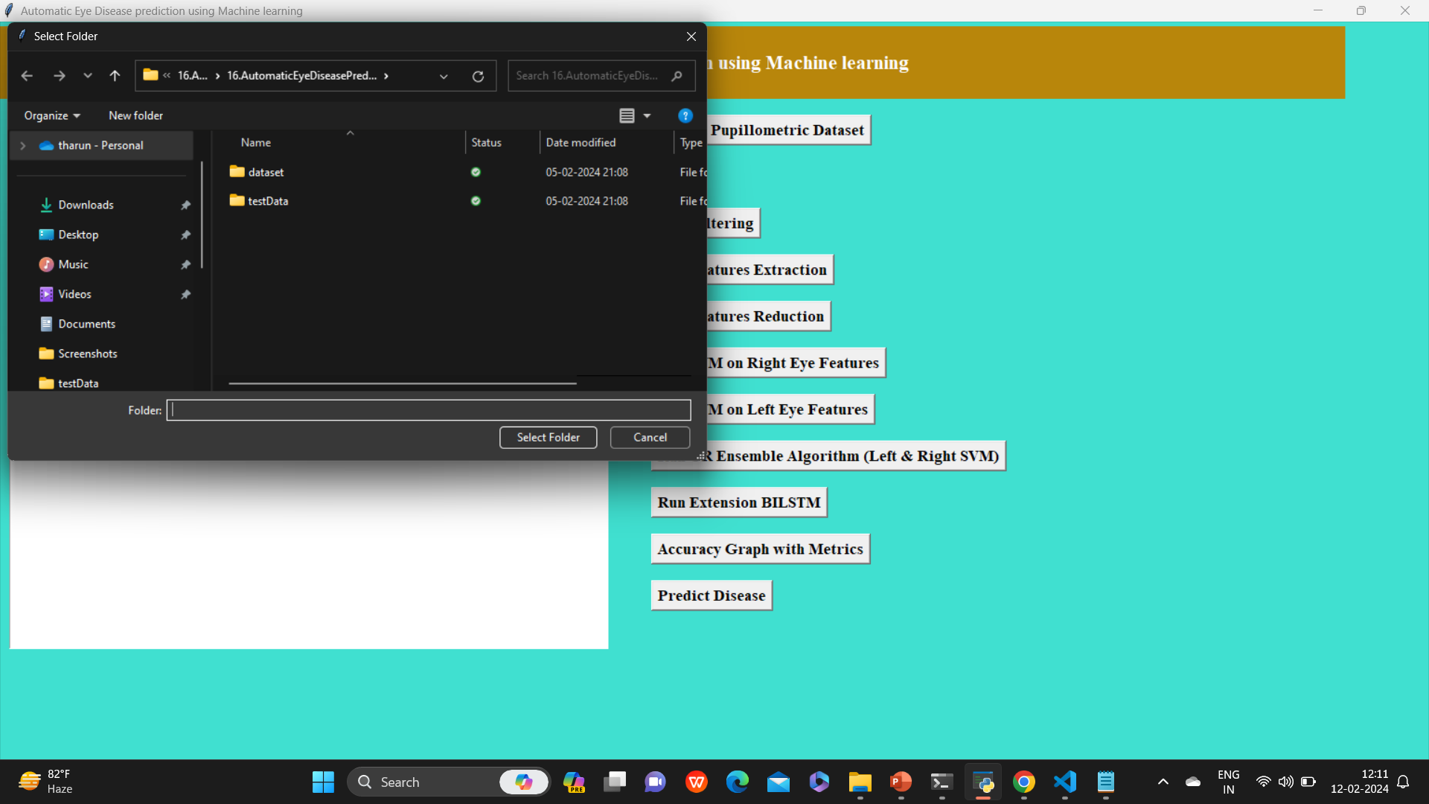
Execution(Flow of execution screens)

Slide 10
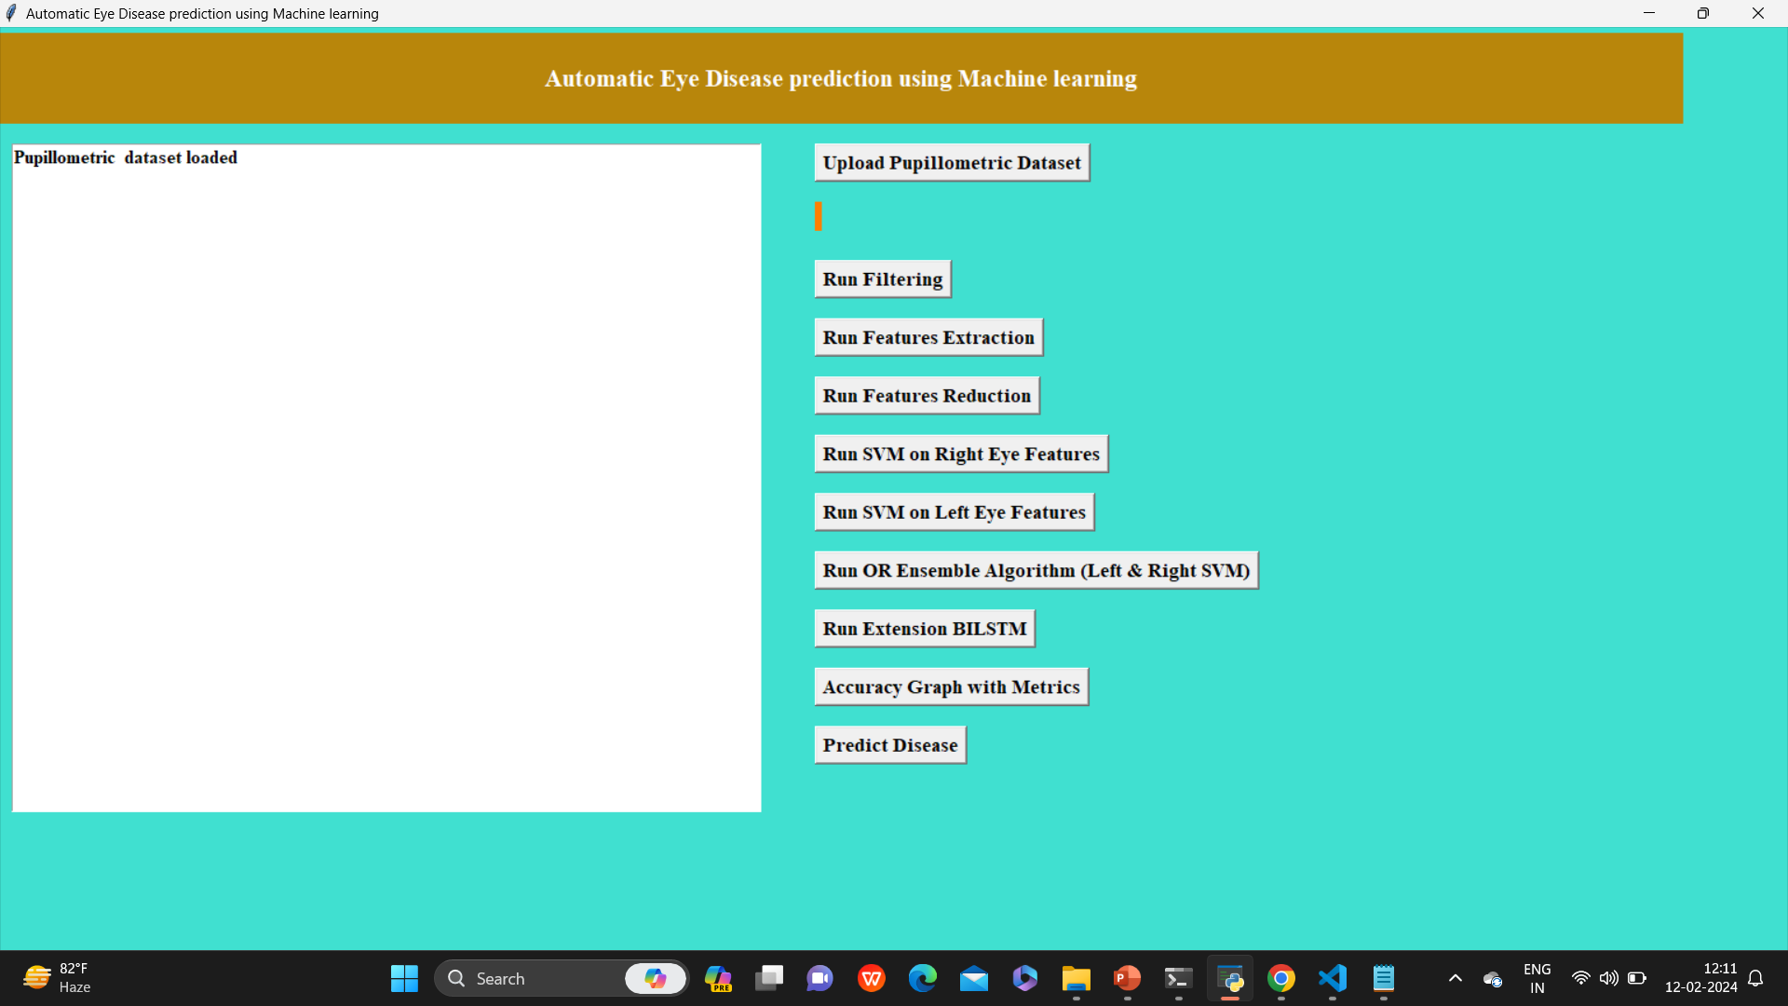

Slide 11
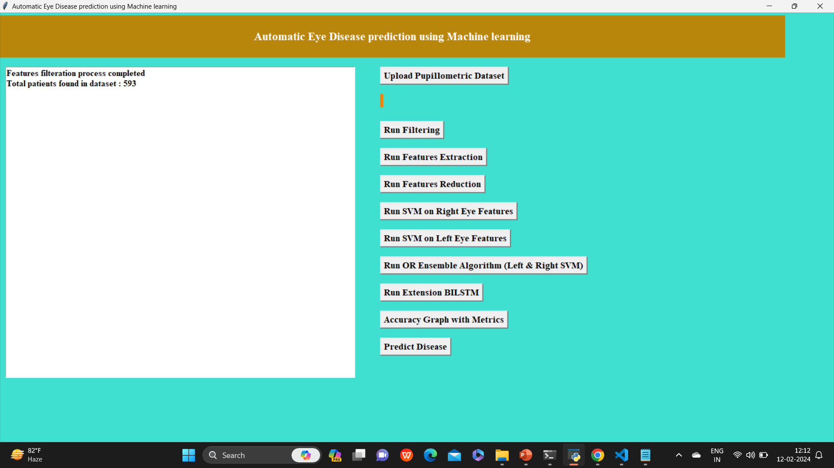

Slide 12


Slide 13
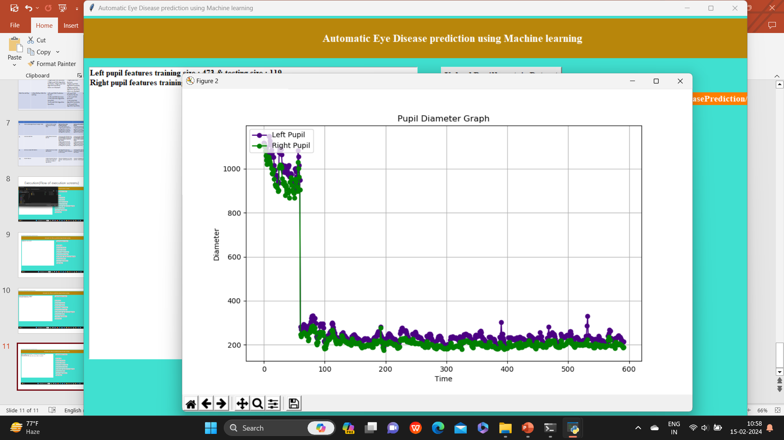

Slide 14
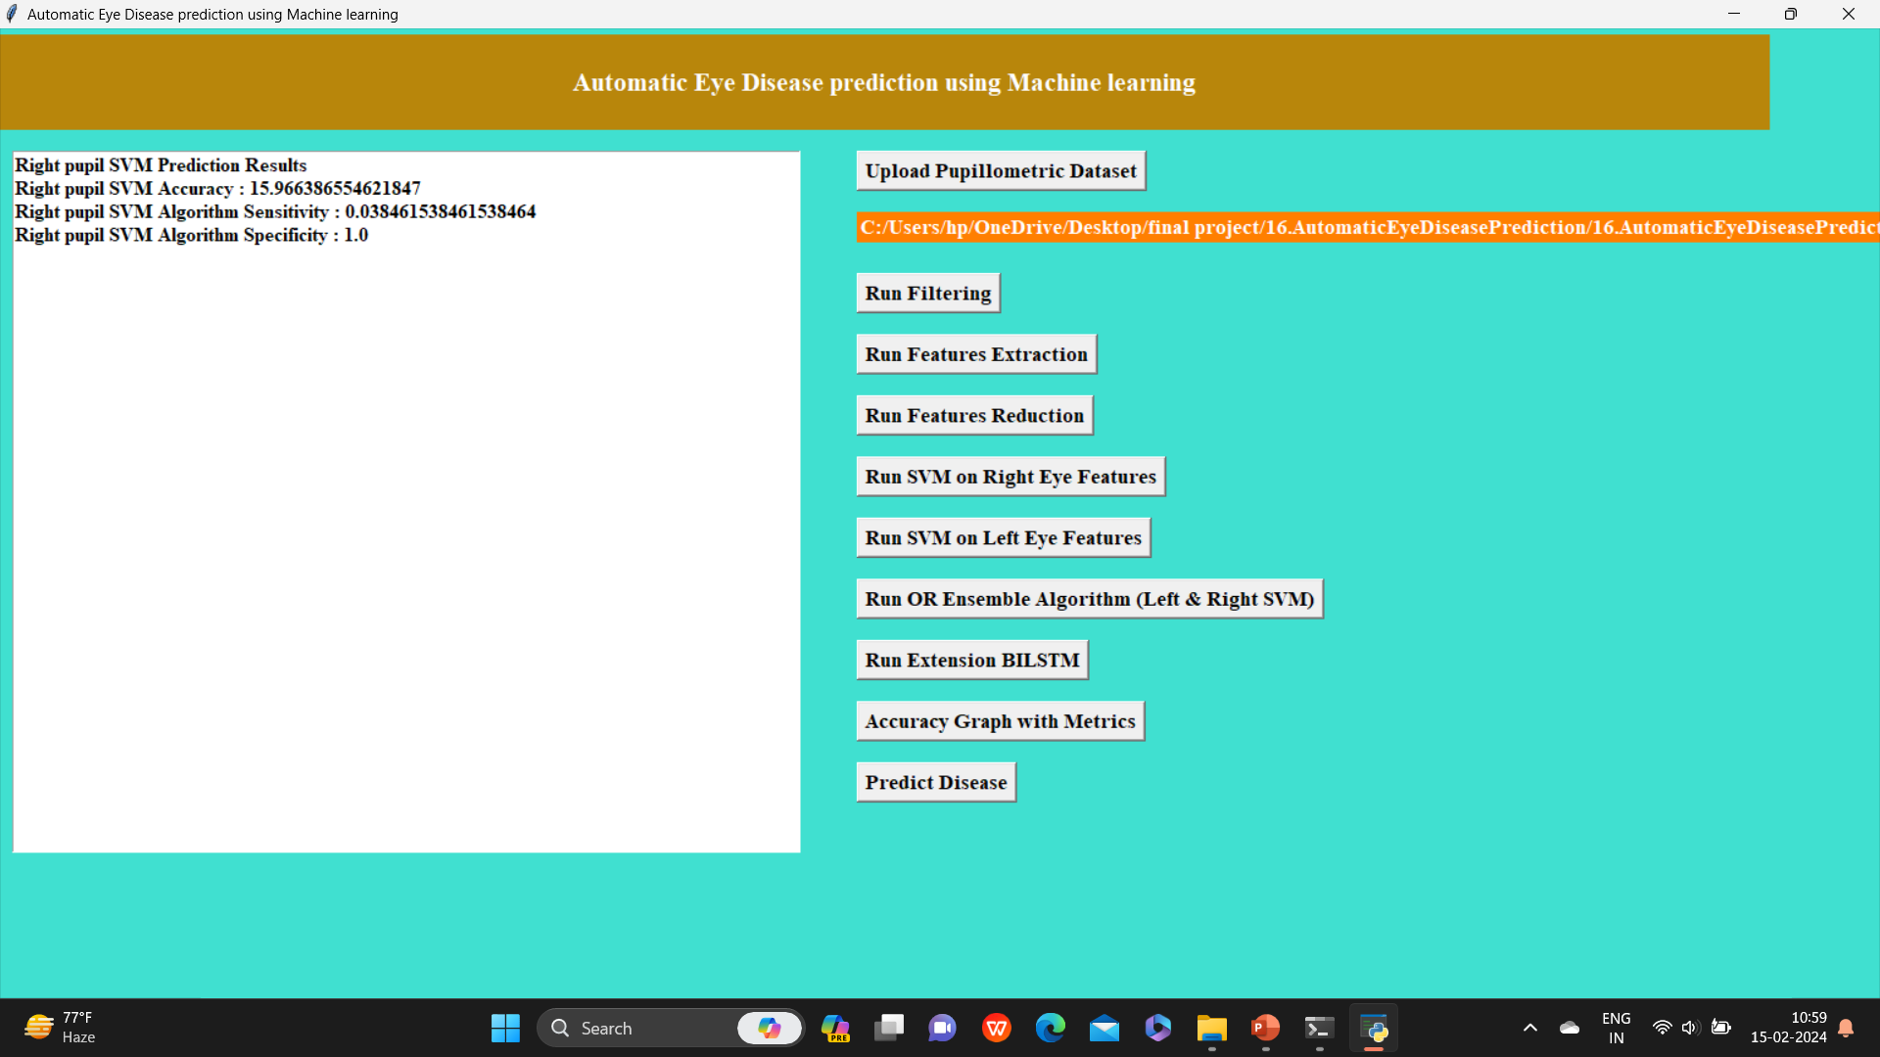

Slide 15
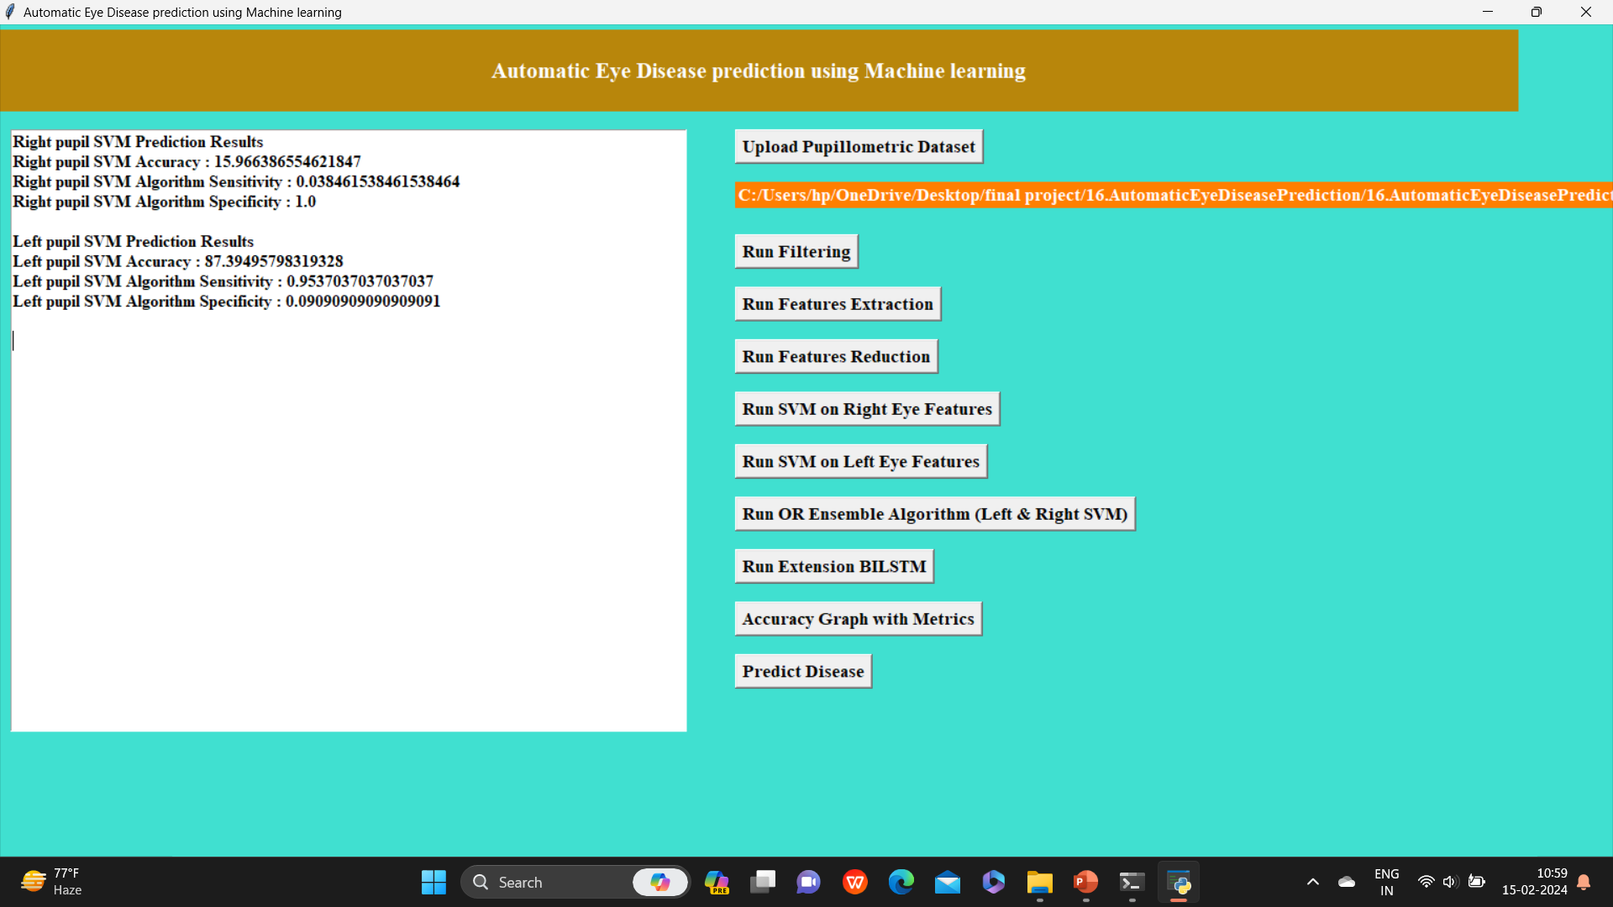

Slide 16
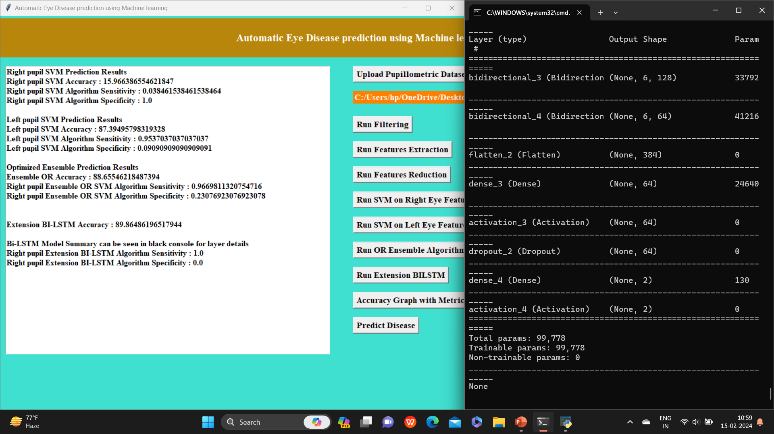

Slide 17
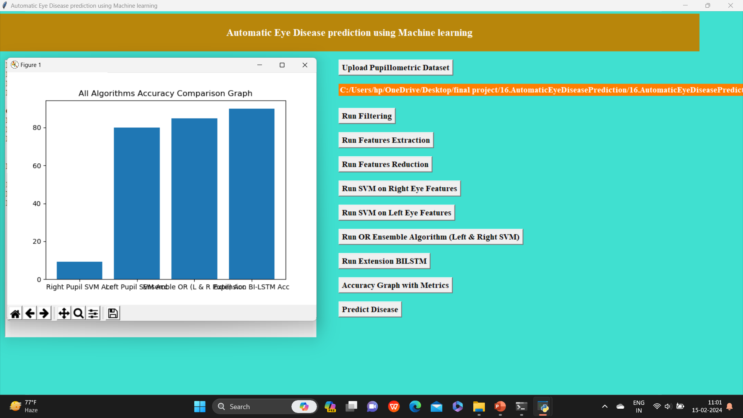

Slide 18
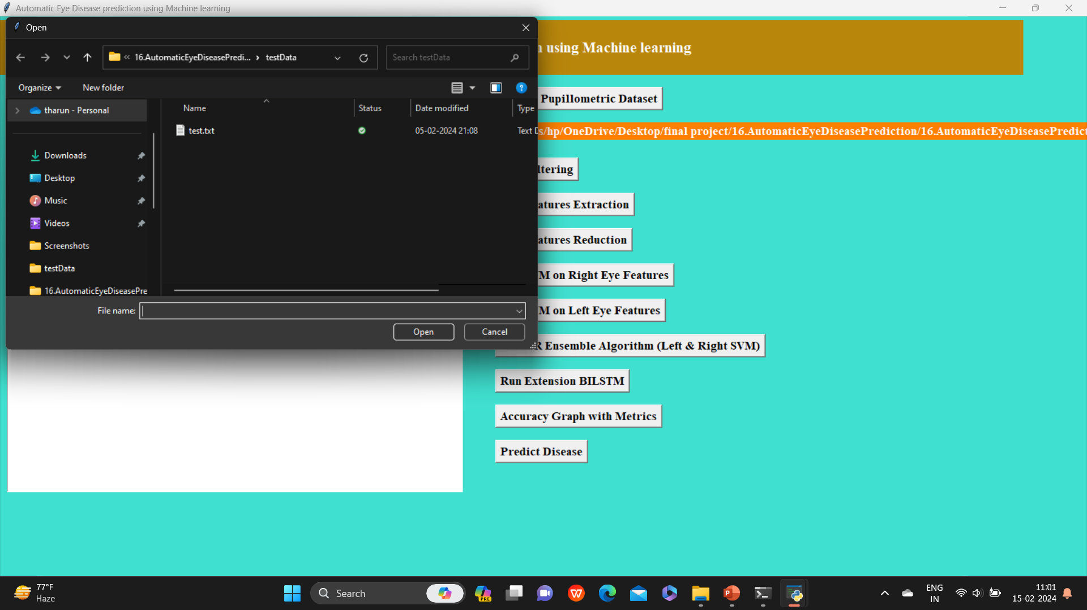

Slide 19
