Slide 1


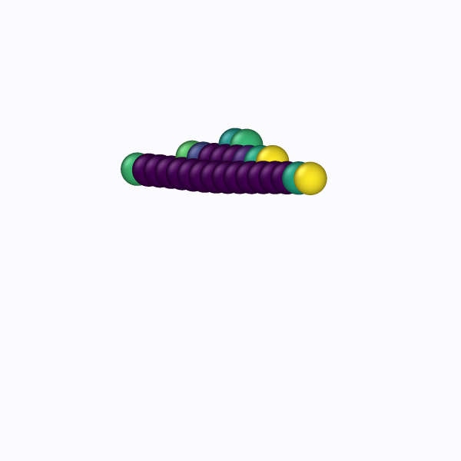
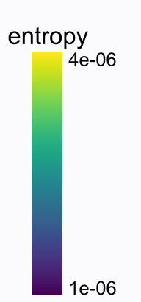

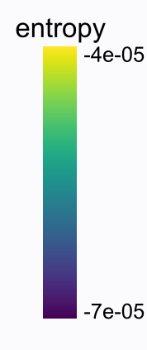
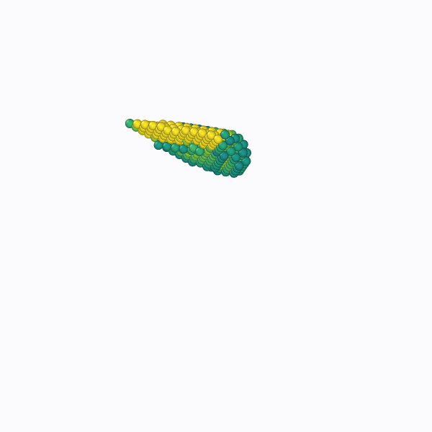
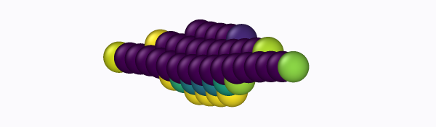
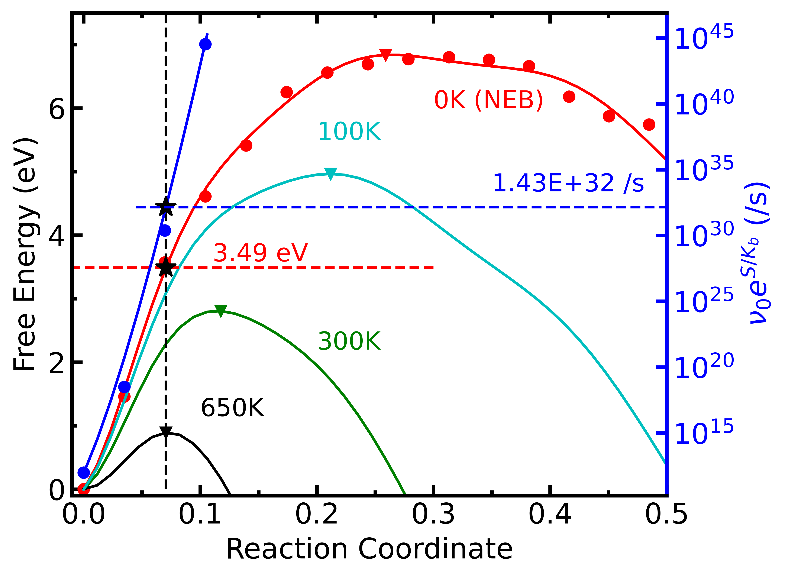
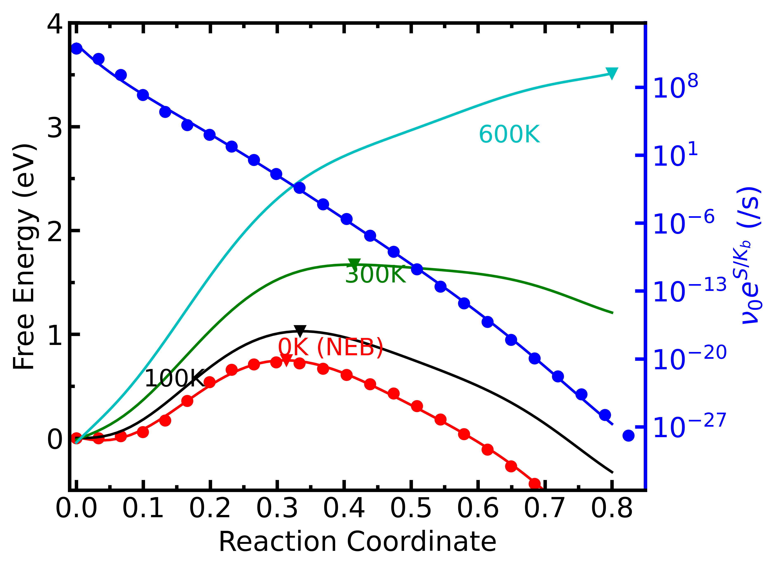
a.
rc = 0.075
b.
rc = 0.075
rc = 0.125
rc = 0.05
rc = 0.25
rc = 0.125

Slide 2
2% compression
2% tension
rc = 0.075
rc = 0.125
rc = 0.05
rc = 0.075
rc = 0.25
rc = 0.125

