Slide 1

GNR 607 PROJECT- Implementing gray scale erosion, dilation, opening and closing and comparing with inbuilt functions
Komal Meena, Baggam Rakshan Tej, Ansh Charak

Slide 2

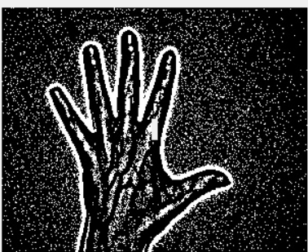

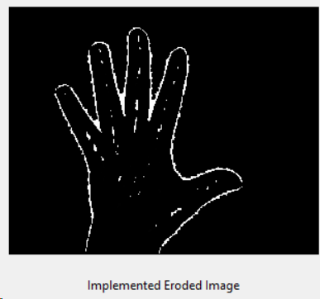
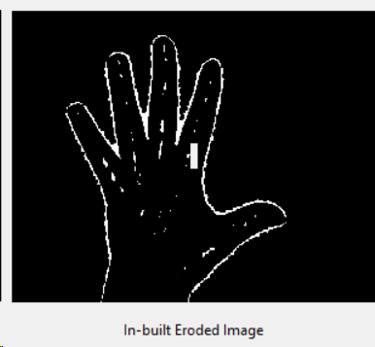
Erosion
Erosion removes pixels at the boundaries, emphasizing object details.

Slide 3
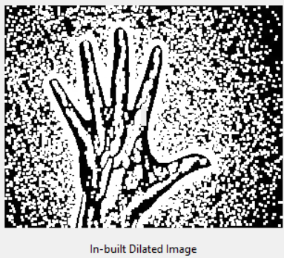
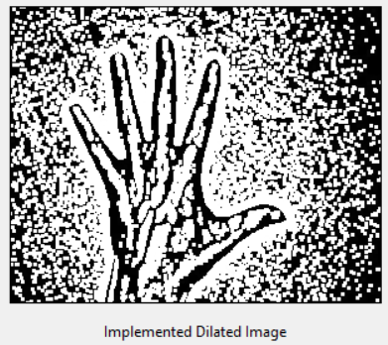
Dilation
Dilation expands object boundaries, enhancing their visibility.

Slide 4
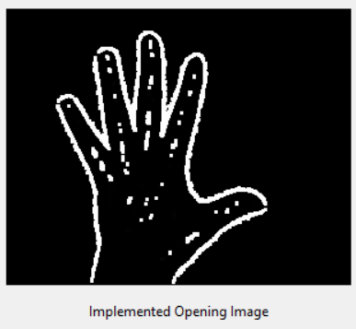
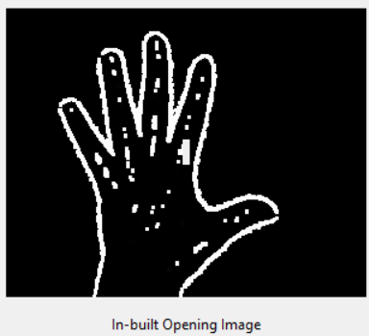
Opening
Erosion followed by Dilation
Opening smoothes object contours and breaks narrow connections
eliminates protrusions
breaks thin joints

Slide 5
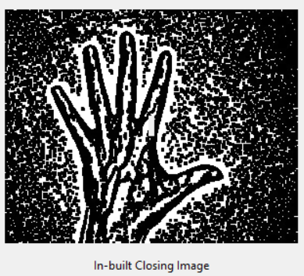
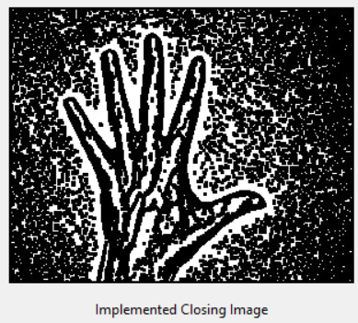
Closing
Dilation followed by Erosion
smooth contour
fuse narrow breaks and long thin gulfs
eliminate small holes
fill gaps in the contour

Slide 6
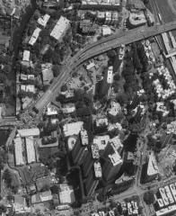
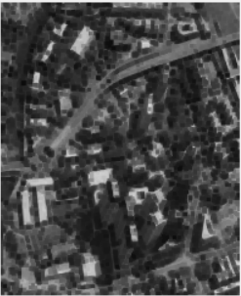
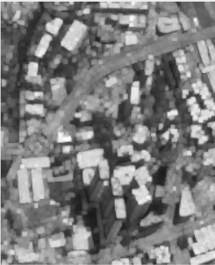
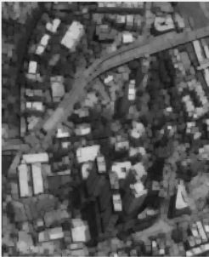
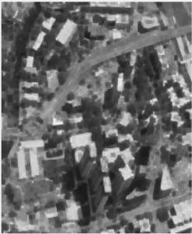
Original Image
Eroded Image
Dilated Image
Opening Image
Closing Image

Slide 7
Thank you!!

