Slide 1
Online Retail Project

Slide 2
Executive Summary
This report summarizes the analysis performed in the Jupyter notebook
'Online_retail_project.ipynb'. It extracts key findings, data preparation steps,and technical details.

Slide 3
Project Objectives
Analyze Online Retail dataset for key trends and insights
Understand customer purchase behavior
Identify top-selling products and high-value customers
Support data-driven business decisions using analytics

Slide 4
Dataset & Tools
Dataset: Online Retail transactional data
Key Fields: InvoiceNo, StockCode, Description, Quantity, InvoiceDate, UnitPrice, CustomerID, Country
Tools: Python, Pandas, Matplotlib/Seaborn for visualization
Environment: Jupyter Notebook

Slide 5
Data Preparation & Cleaning
Loaded raw dataset and inspected schema
Handled missing values and duplicates
Filtered invalid transactions (negative/zero quantities, missing Customer IDs)
Converted date fields into datetime format
Ensured consistency of product descriptions

Slide 6
Analysis & Findings - Part 1
Sales distribution over time (monthly, weekly trends)
Peak purchasing times identified
Seasonality observed in purchase patterns
High volume of sales concentrated in UK market

Slide 7
Analysis & Findings - Part 2
Top-selling products identified by frequency and revenue
High-value customers segmented (RFM Analysis)
Geographic distribution of customers across countries
Basket analysis: frequently bought together items

Slide 8
Business Insights
Majority of revenue driven by a small set of loyal customers
Evening hours show peak online activity
UK dominates sales but international markets show potential
Cross-selling opportunities identified from frequent item pairs

Slide 9
Technical Achievements
Processed large dataset efficiently using Pandas
Implemented robust data cleaning pipeline
Generated insightful visualizations for business stakeholders
Structured analysis for easy reproducibility

Slide 10
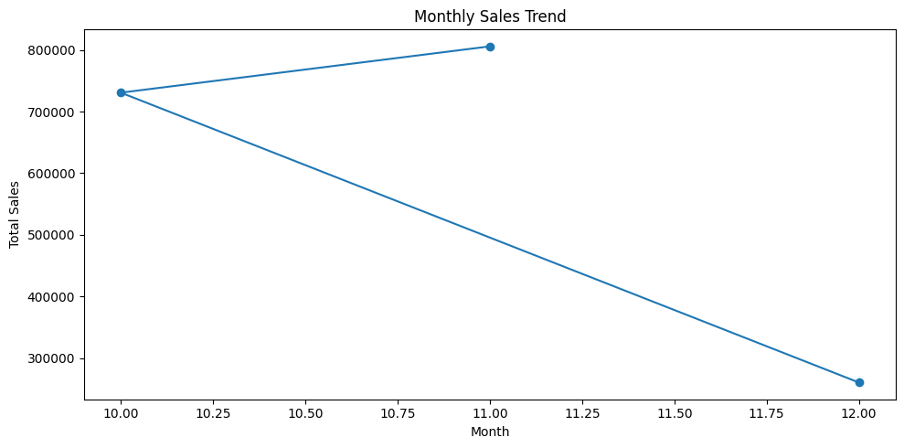
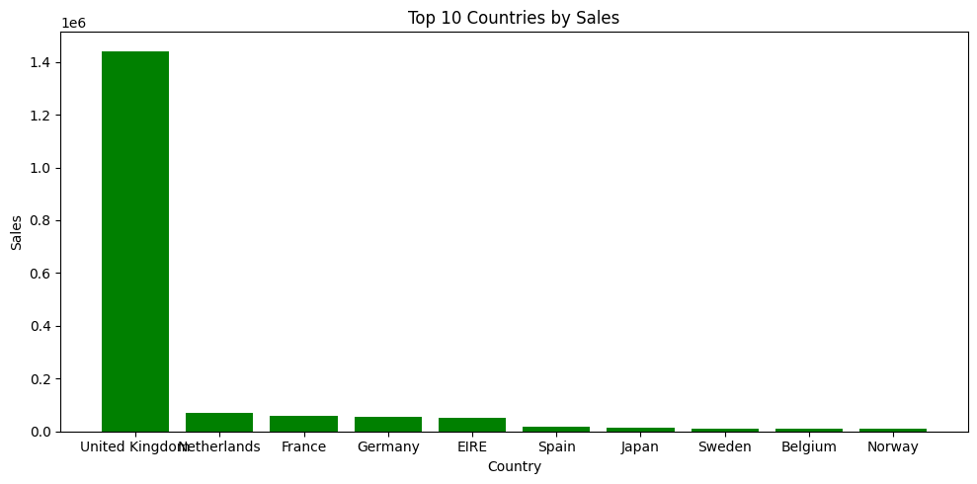
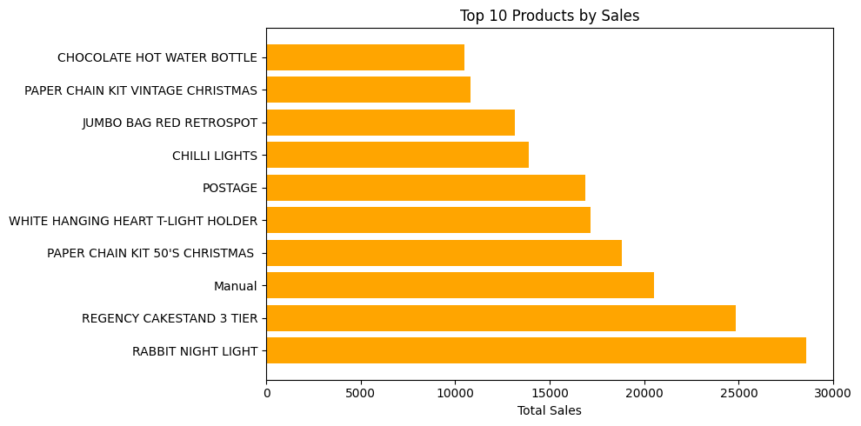

Slide 11
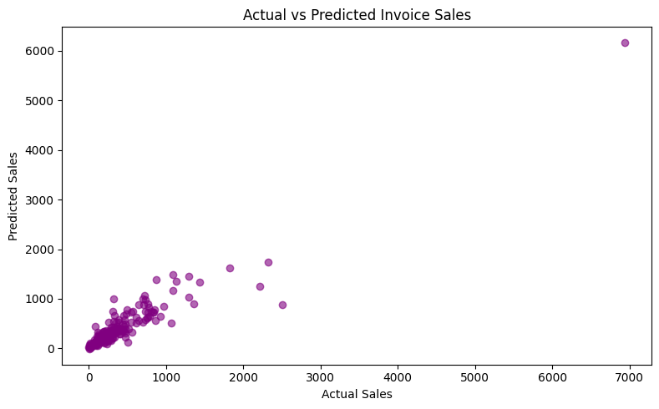

Slide 12
Conclusion & Next Steps
Analysis of Online Retail dataset revealed key patterns in customer behavior and sales
Insights support targeted marketing and inventory optimization
Future work: Predictive modeling for demand forecasting
Integrate findings into dashboards for real-time monitoring

