Slide 1
Speech Analysis for Emotion Detection
Bagiya Lakshmi
21011101029
Chunduri Suhasini
21011101036
Cynddia Balamurugan
21011101037
Harini CJ
21011101045
First review
Date : 09/10/2024
Mentor : Anushiya Rachel
Shiv Nadar University Chennai

Slide 2
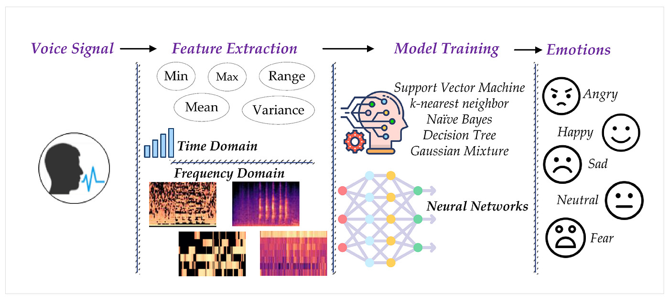
Introduction
Objective: To develop a reliable speech analysis system capable of accurately classifying emotions in real-time, even in challenging conditions, for broader applications across various fields.
Problem Statement: This project addresses the challenge of accurately detecting and classifying emotions through speech analysis in real-time, aiming to improve reliability across diverse populations in fields like mental health, customer service, and human-computer interaction.

Slide 3
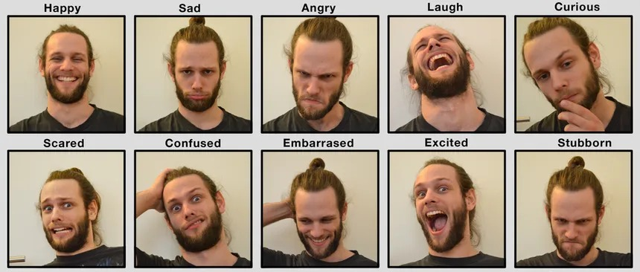
Motivation
Understanding Emotional Impact on Speech
Improving Speech Therapy Outcomes
Supporting Real-Time Monitoring
Enhancing Adaptive Learning Systems
Our model serves as a foundation for
developing applications mentioned above

Slide 4
Literature Review
Transforming the Embeddings: A Lightweight Technique for SER: Utilizes x-vector embeddings with MFCC in CNN models to achieve efficient SER with fewer parameters​.
Discriminative Adversarial Learning for Speaker-Independent Emotion Recognition: Proposes an adversarial approach to create speaker-independent emotion features, improving SER robustness​.
Sequential Modeling by Leveraging Non-Uniform Distribution of Speech Emotion: Introduces chunk-level emotional patterns to improve SER by focusing on local emotional changes within sentences​.
Automatic Measurement of Affective Valence and Arousal in Speech: Predicts valence and arousal levels in speech using prosodic and text features with support vector regression​.
Perception of Emotional Valence Projected by Prosody in News Announcements: Investigates how listeners can anticipate emotional valence based solely on prosody in speech

Slide 5
Software Components and Dataset Used
Software Components:
Python: Primary programming language for code development and model building.
Librosa: A Python library used for audio and music analysis. Specifically, it helps in feature extraction like MFCCs (Mel-frequency cepstral coefficients).
Models: LSTM, CNN, Resnet
2D mel spectrogram: Represents the frequency content of an audio signal over time, using a mel scale to emphasize perceptually relevant frequencies for human hearing.
Dataset:
IEMOCAP Database Overview: A multimodal, multi-speaker dataset with approximately 12 hours of audiovisual data, including speech, video, facial motion capture, and text transcriptions.
Data Collection: Features dyadic sessions where actors perform improvisations or scripted scenarios designed to elicit emotional expressions.
Annotations: Labeled with categorical emotions (e.g., anger, happiness, sadness) and dimensional labels (valence, activation, dominance) by multiple annotators.

Slide 6
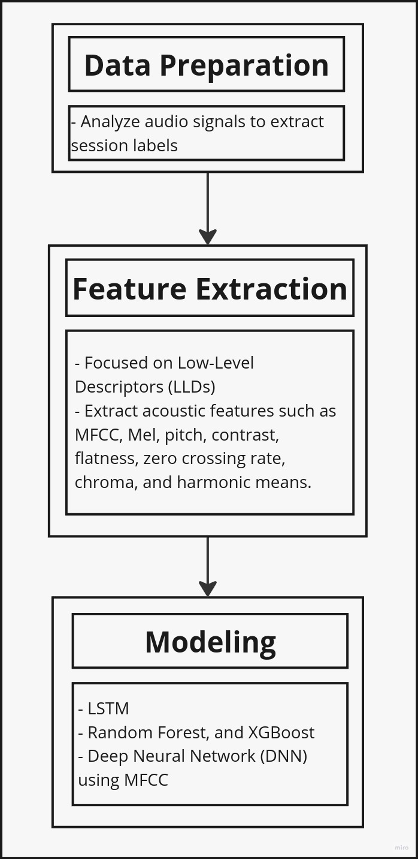
Proposed Solution
1. Data Preparation:
Analyze audio signals to extract session labels, with each session tagged with different emotions based on timestamps.
2. Feature Extraction:
Focus on Low-Level Descriptors (LLDs) expected to capture emotion-related information.
Extract acoustic features such as MFCC, Mel, pitch, contrast, flatness, zero crossing rate, chroma, and harmonic means.
Applied aggregators and summarizers like mean, min, max, and standard deviation to enhance feature representation.
Two labels ( feature and resulting emotion)
3. Modeling:
Acoustic Feature-Based Models:
LSTM model, Mel Spectrogram, CNN (2D vector – MFCC)

Slide 7
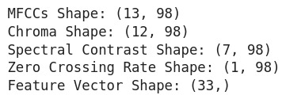
Progress Overview: Feature Extraction
MFCC: mfcc(*[, y, sr, S, n_mfcc, dct_type, norm, ...])
Mel-frequency cepstral coefficients (MFCCs)
First 13 coefficients represent the most significant information about the power spectrum while reducing dimensionality.
Chroma Shape: chroma_stft(*[, y, sr, S, norm, n_fft, ...])
Compute a chromagram from a waveform or power spectrogram.
12 in chroma features comes from the 12 semitones in the Western musical scale, which divides an octave into 12 equal intervals
Spectral Contrast Shape: spectral_contrast(*[, y, sr, S, n_fft, ...]
Compute spectral contrast
7 refers to the standard practice of dividing the audio spectrum into 7 frequency bands
Zero Crossing Rate Shape: (y, *[, frame_length, ...])
Compute the zero-crossing rate of an audio time series.
1 refers to a single scalar value that represents the zero-crossing rate for a given time frame of the audio signal.
Feature Vector Shape:
represents a set of numerical features that encapsulate the important characteristics of speech signals.

Slide 8
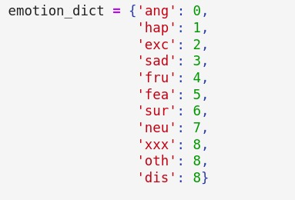
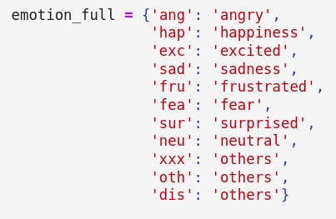
Progress Overview: LSTM model
LSTM :
Trained an LSTM model using acoustic feature as embeddings to the model
Input - > LSTM(128) -> Dropout (0.3) -> Dense(SoftMax)
Optimizer = ‘Adam’, Metrics = ['accuracy']
X: 33 acoustic features extracted

Slide 9
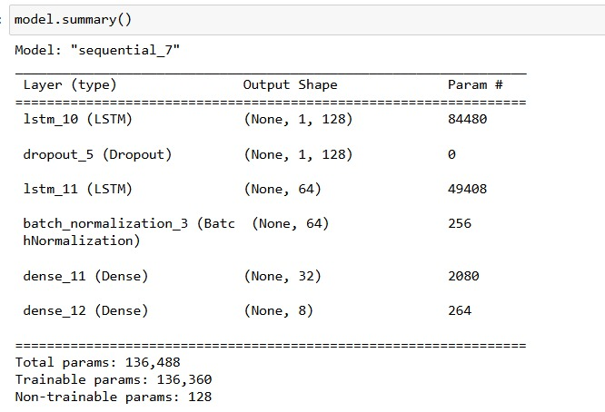
Progress Overview: LSTM model Architecture

Slide 10
Future Objectives
Develop a multi-output model to predict emotion, valence, activation, and dominance, as only emotion is currently being predicted.
Build text-based model using transcript text.
Use the audio signal to generate images of mel-spectrograms.
Understand that a spectrogram is a representation of speech over time and frequency.
Utilize 2D convolution filters to capture 2D feature maps in any given input.
Recognize that such rich features cannot be extracted and applied when speech is converted to text and/or phonemes.
Leverage spectrograms, which contain extra information not available in just text, to enhance capabilities in improving emotion recognition.

Slide 11
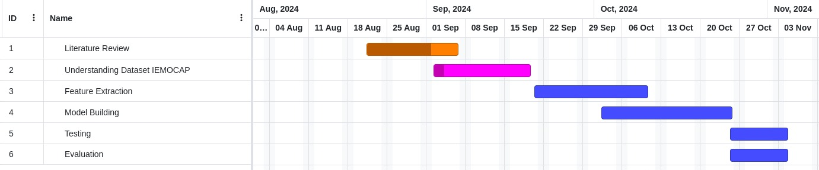
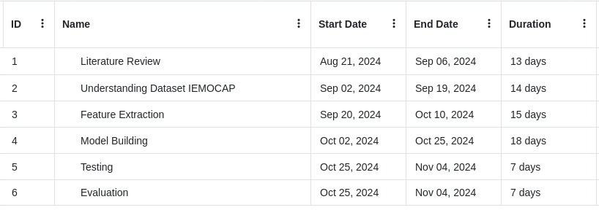
Project Gantt Chart

