Slide 1

MLR INSTITUTE OF TECHNOLOGY
PROJECT PHASE – I
AI – Based Speech Recognition System
For Smart Devices
19R21A0462 – B . Sai Kiran
19R21A0464 – B . Shashanth
19R21A0497 – O . Pradeep
19R21A04B0 – Satya Prakash Das
Project Guide – Dr . Bittu Kumar
Department of ECE

Slide 2

TABLE OF CONTENTS
1 . Introduction
2 . Objective
3 . Components
4 . Block Diagram
5 . Working
6 . Applications
7 . Conclusion

Slide 3
Introduction
Speech recognition :
Speech Recognition is the technology that allows human beings to use their voices to speak with a computer interface & converts human speech into readable text.
AI based Speech Recognition :
Speech recognition with AI means adopting digital assistants, automated support & human – robot interactions in the form of voice user interfaces (VUIs) to streamline their services.
Smart Devices :
Smart device is an electronic device, generally connected to other devices or networks via different wireless protocols (such as Bluetooth, Zigbee, near-field communication, Wi-Fi, LiFi, or 5G)
IOT :
IoT stands for the ‘Internet of Things’. It refers to the innovation that empowers devices and appliances to convey over the internet.

Slide 4
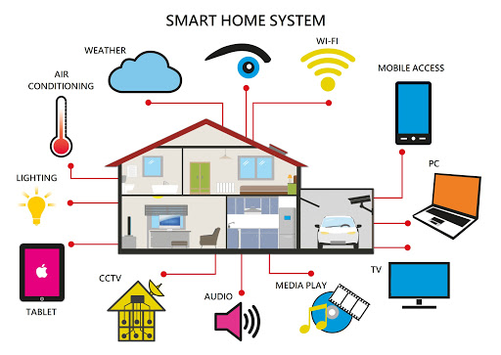
Objective
Develop a low cost home automation system which is easy to install and configure.
Provide a secure and reliable web portal for the user to control the home appliances through the internet.
Embed a speech control interface for controlling the electrical appliances for physically challenged people.

Slide 5
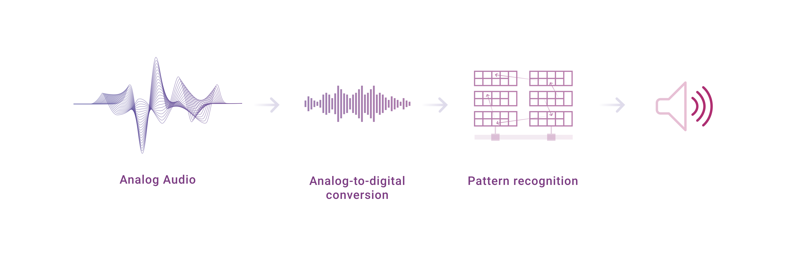
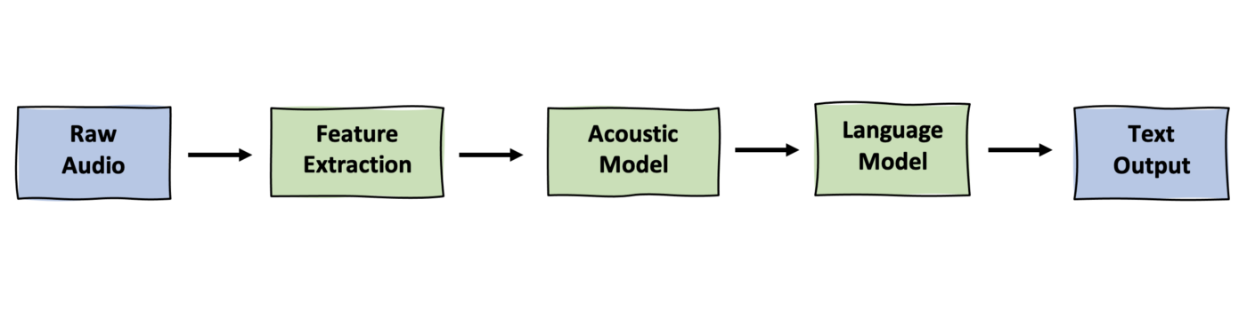
Block Diagram

Slide 6
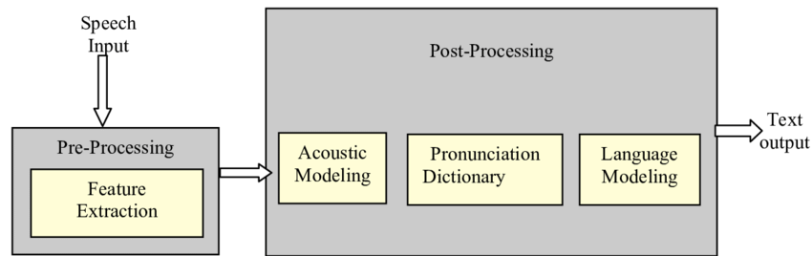
Feature Extraction
It is fundamental step in the Automatic Speech Recognition (ASR) process.
In this pre processing relevant data are extracted from a speech while removing background noise and irrelevant information.

Slide 7
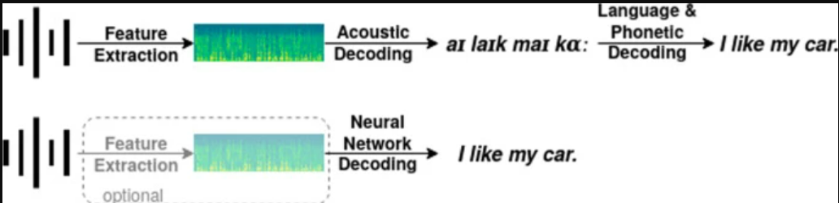
Acoustic Model
The acoustic model (AM), models the acoustic patterns of speech & maps raw data feature to phonemes based on accent .
The job of the acoustic model is to predict which sound or phoneme is being spoken at each speech segment identified by HMM or GMM.

Slide 8
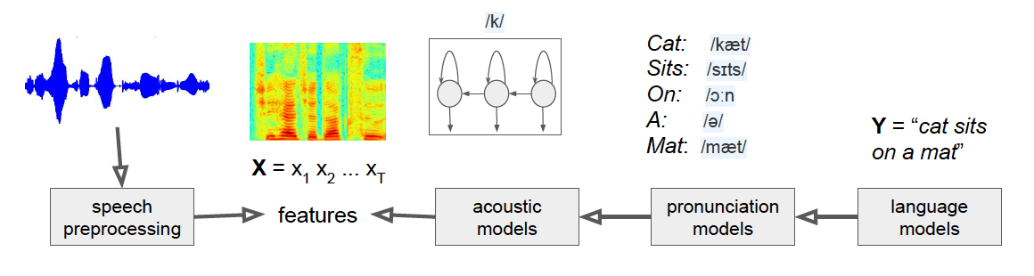
Lexicon Model
This is phoneme to word mapping.
This model contains pronounciation models which describes how words are pronounced phonetically.

Slide 9
Language Model
This defines how words are connected to each other in a sentence.
It learns which sequences of words are most likely to be spoken, and its job is to predict which words will follow on from the current words and with what probability & finally it produces output.

Slide 10
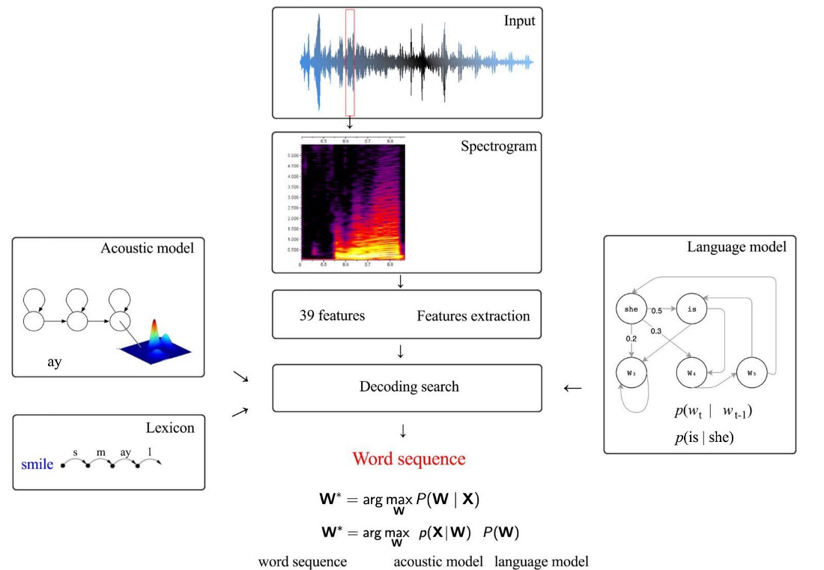
Proposed Methods
Implementation of ASR system :-
Training the model by acoustic, lexicon models.
Testing the model by language model.
At the end performance is evaluated by decoding.

Slide 11
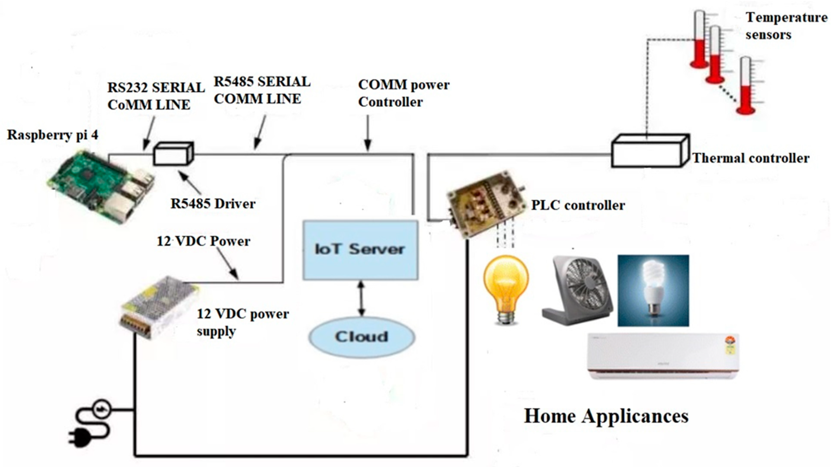
Proposed Methods
Implementation in Hardware(IOT) :-
In this project, the advanced version of developed (to be developed by us) ASR technologies are to deploy into hardware for estimating their real time performance.

Slide 12
Advantages
It can help to increase productivity in many businesses. Such as healthcare industries.
It improves security by eliminating agents from data processing.
It can capture speech much, faster than you can type.
You can use text to speech in real time.
The software can spell the same ability as any other writing tool.
It allows for hands-free work.

Slide 13
Disadvantages
Accuracy is always imperfect
Some voices don’t come across well
Time cost and Productivity
Background noise interface

Slide 14
Applications
Automatic subtitling with speech recognition & translation.
Media Monitoring : Speech-to-Text APIs can help broadcast TV, podcasts, radio.
Robotics
In car systems : To initiate phone calls, select radio stations or play music.
Hands free computing : Speech Recognition Computer of user interface.
Health care : Medical Transcription.
Virtual assistants : Apple’s Siri.
Telematics : Vehicle navigation systems.

Slide 15
THANK YOU

