Slide 1
Development of website for a Training Organization
Module Project
Module: Front End Web Development
Course: ITSF - Front End Web Development
Start Date : May, 04 2022
End Date : May, 10 2022
Submission Date : May, 10 2020
Learner Name : I Putu Bagus Nanda Widnyana
Enrollment ID :
Presentation Date : May, 09 2020

Slide 2
Contents
Document History
Version Number | Effective Date of release | Summary of Included Changes | Author
1 | 4th March 2016 | First Edition | Satya CVS
2 | 7th April 2016 | Changed for Module 2 | Shrinivas K R
3 | 2nd April 2018 | Changed for RQF | Shrinivas K R

Slide 3
Contents
Contents
1. Project Definition
2. Development Tools
3. Information Architecture
4. Storyboard
5. Menus
6. Business Process
7. Lead Generation Form Design
8. HTML CatLog
9. HTML Pages
10. CSS Classes
11. Lead Generation Form
12. Pages with Styles
13. User Interface Effectiveness
14 Proposed Changes to User Interface
15. Project Deliverables
16. Project Environment
17. Website Review & Improvements
18. Project Milestones & Tasks
19. Milestone Feedback & Action Taken
20. Project Results
21. Proposed Improvements

Slide 4
1. Project Definition
Project Objective
  Plan a Website & Develop branding, wireframes, information architecture & storyboard.
  Develop a website using HTML, CSS & JavaScript.
  Develop jQuery Menus & Tabs
  Designing a form using HTML, developing JavaScript to validate the form and submit the form using Ajax.
  Execute the test cases and validate the website meets the design requirements
Proposed Solution
  Collect information about the client (like favourite colour, purpose of the project, and target audience)
  Make the information architecture that match with requirement
  Build the simple wireframe don’t forgot to Collab with the client
  Make website prototype

Slide 5








2. Development Tools
Other
  Table generator
  Color pellet
  Unsplash
  Draw.io

Slide 6
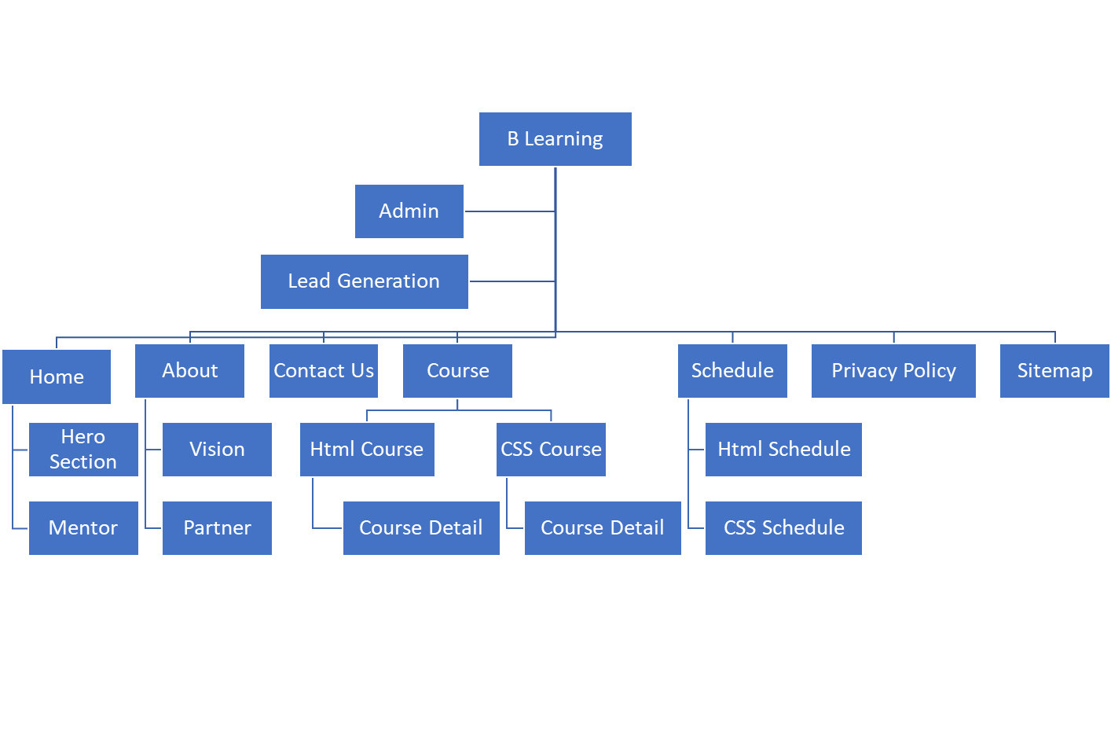
3. Information Architecture
Information Architecture

Slide 7
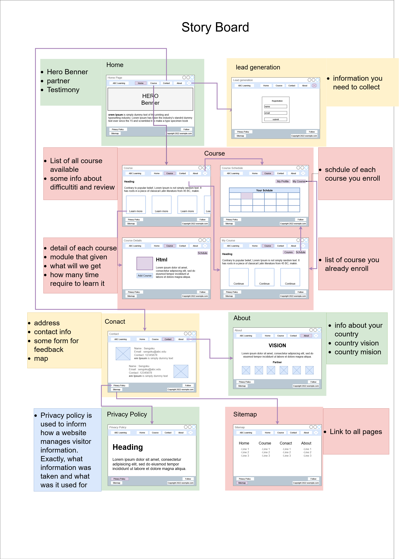
4. Storyboard
Storyboard
the detail version is here:
StoryBoard3.drawio.svg

Slide 8
5. Menu
Company logo
Course, list course are available
About, Vision, partner
Schedule, schedule for course you enroll
Home, hero section, our mentor
Contact, contact info, address, form for contact

Slide 9
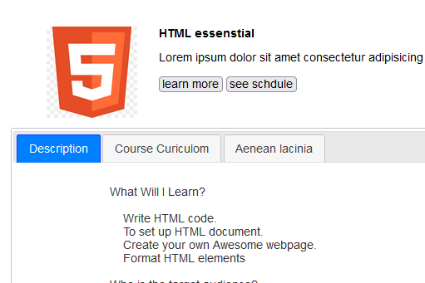
5. Menu
jQuery UI tabs implementation

Slide 10
6. Business Process || Task 2
Popup Form Design
User
Fill the form
read
valid
No
Yes
add
Data store to array
Admin
Local
convert to string
Storage
edit
store on local storage
remove

Slide 11
7. Lead Generation Form
Popup Form Design
Some text
name
email
Course interest
submit

Slide 12
8. HTML Catalog
List of HTMLs to be developed
No | Pages | Information
1 | index.html | Home and landing page
2 | aboutus.html | Company’s profiles page
3 | contactus.html | contact form, address with a map and contact information
4 | courses.html | Courses listing page
5 | Html-course.html | Course detail for html
6 | Css-course.html | Course detail for css
7 | Privacy-policy.html | Privacy policy page
8 | sitemap.html | Sitemap page
9 | Schdule.html | Schedule for enroll course
10 | Thanks-page.html | Show after lead generation
11 | Admin/index.html | Login page for the administration system

Slide 13
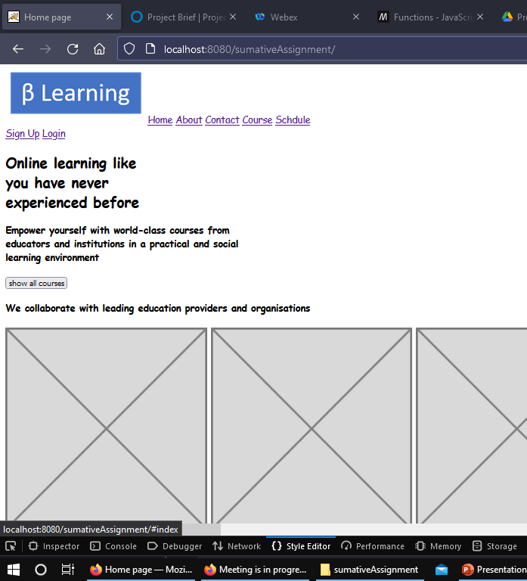
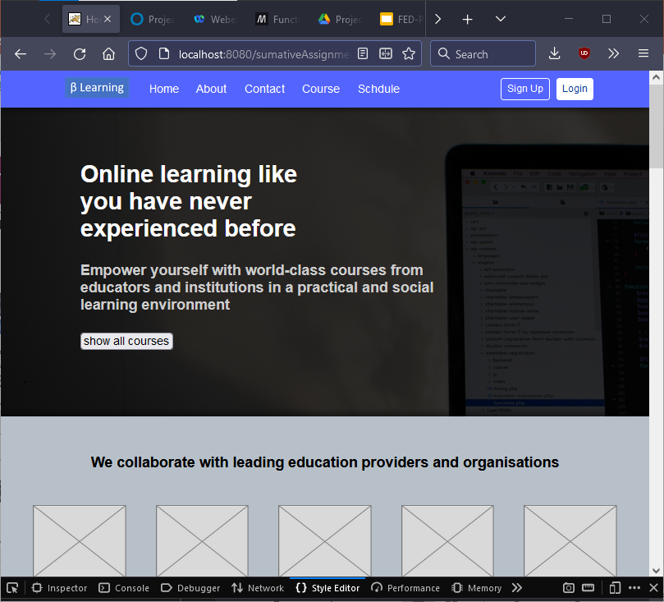
9. HTML Pages
Without CSS
With CSS

Slide 14
10. CSS Classes
CSS Classes
S. No. | Selector | Style to be Created
1 | * | { font-family: Arial, Helvetica, sans-serif; box-sizing: border-box; /* border: 1px solid black; */ font-size: 16px; }
2 | .hero-section | { height: 420px; background-color: rgba(0,0,0,.8); color: rgb(205, 205, 205); padding-left: 36px; }
3 | .partner-section | { box-shadow: 0 0 8px 4px rgba(0,0,0,.4); text-align: center; padding: 24px; background-color: #8091a091; }

Slide 15
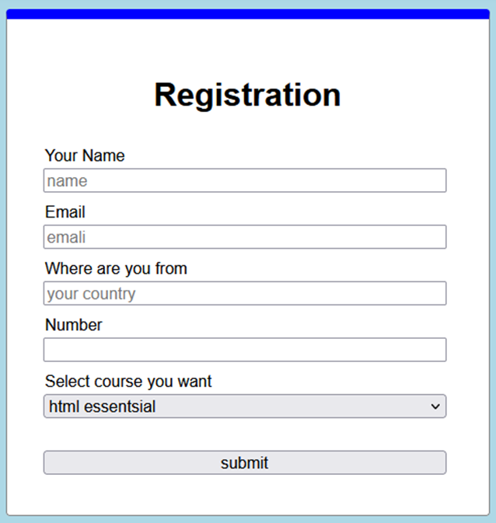
11. Lead Generation Form

Slide 16
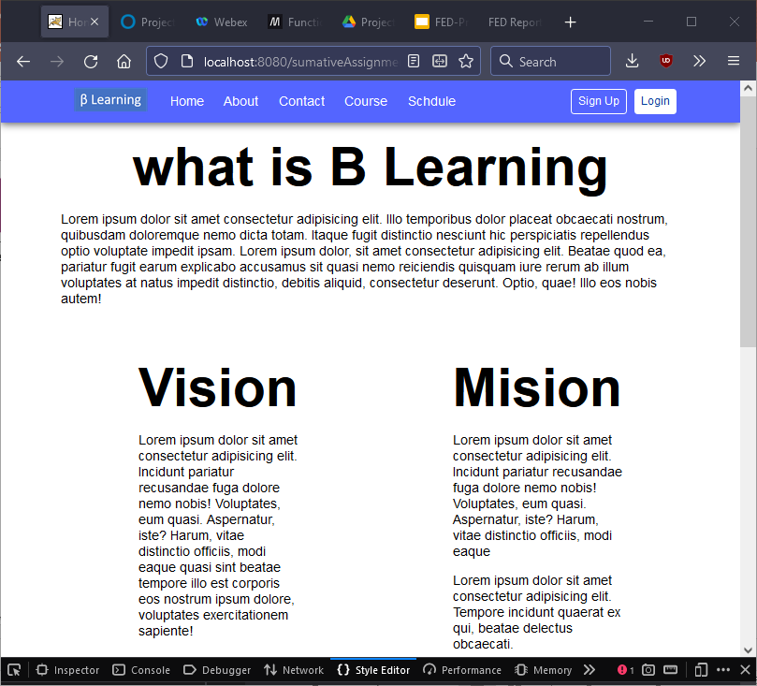
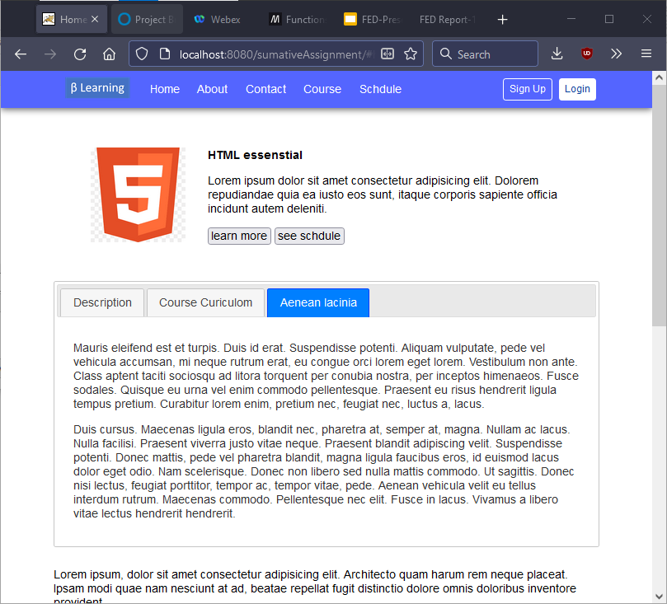
12. Pages with Styles & jQuery
Pages with Styles
About Page
Course detail with jQuery

Slide 17
13. User Interface Effectiveness
Effectiveness Metrics
  efficient lead capture
    Simple form to capture key info – name, email, address, contact no and course of interest under 4 minutes
    does not make users lazy to fill
  Minimal UI
    Use less resource
    Fast load time
  Consistent style
    make user comfortable
    Easier to navigate

Slide 18
14. Proposed Changes to User Interface
Proposed Changes
    Lead Generation Form
      Check and avoid duplicate lead info entries
      Develop signup with google account for time efficiency
    Lead Administrator
      Develop more tool such as search and filter for batter management
      Colour scheme for critical fields for better visualisation
      Check and avoid double lead data
      Increase UI for better look and feal

Slide 19
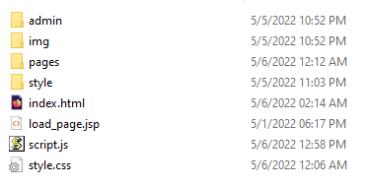
15. Project Deliverables
Project Deliverables
  HTML Pages
  CSS file
  Project Report
  Project Presentation
  Source code
List of Evidences

Slide 20
16. Project Environment
Technical Environment and Tools Used
  Visual Studio Code
  Notepad++
  jQuery library
  Firefox
  Apache Tomcat
  Java Development Kit (JDK)
List of references
  Yogendra's GitHub
  Stack Overflow
  MDN
  W3school
  And more

Slide 21
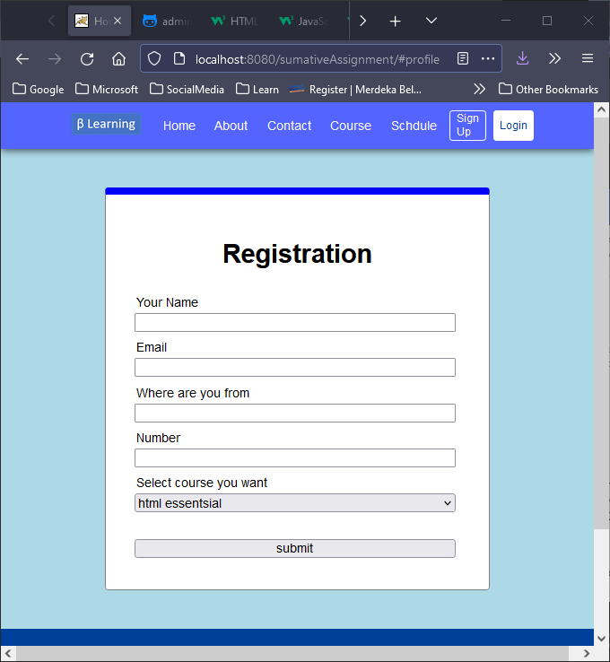
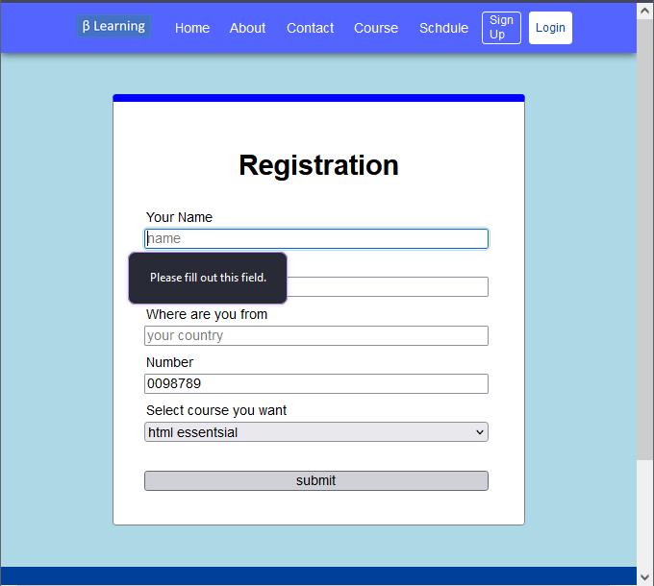
17. Website Review & Improvements
before
After
Placeholder
validation

Slide 22
18. Project Milestones & Tasks
Project Task ID | Project Task Description | Project Milestone ID
1 | Plan a Website & Develop branding, wireframes, information architecture & storyboard | 1
2 | Develop Common Content, Home, About Us, Contact Us, Sitemap, Privacy Policy pages using HTML, CSS & JavaScript. | 1
3 | Execute the test cases and validate the website meets the design requirements | 1
4 | Amend Common Content, Home, About Us, Contact Us, Sitemap, Privacy Policy pages using HTML, CSS & JavaScript. | 1
5 | Develop Courses Listing, Detail and Schedule pages using HTML, CSS, JavaScript & jQuery | 1
6 | Execute the test cases and validate the website meets the functional requirements | 2
7 | Develop Lead Generation Form using HTML, CSS, JavaScript, jQuery & jQuery UI | 2
8 | Amend Home page using HTML, CSS & JavaScript. | 2
9 | Develop Lead Administration Page using HTML, CSS, JavaScript, jQuery & jQuery UI | 2
10 | Execute the test cases and validate the website meets the functional requirements | 3
11 | Develop Project Report, Project Presentation | 3
12 | Package final project deliverables for submission | 3

Slide 23
19. Milestone Feedback & Action taken
Project Milestone ID | Milestone Feedback received from Tutor / Learning Facilitator | Action Taken (Yes / No)
1 | Review and amend wireframes, information architecture & storyboard | Yes
2 | Revise Course Detail and Schedule pages into a single page using HTML, CSS, JavaScript & jQuery | Yes
3 | Revise the proposed changes to the UI of add, edit lead form in Lead Administration
 | Use of browser localStorage as the medium to store lead info from lead form, later use in the administration page | yes

Slide 24
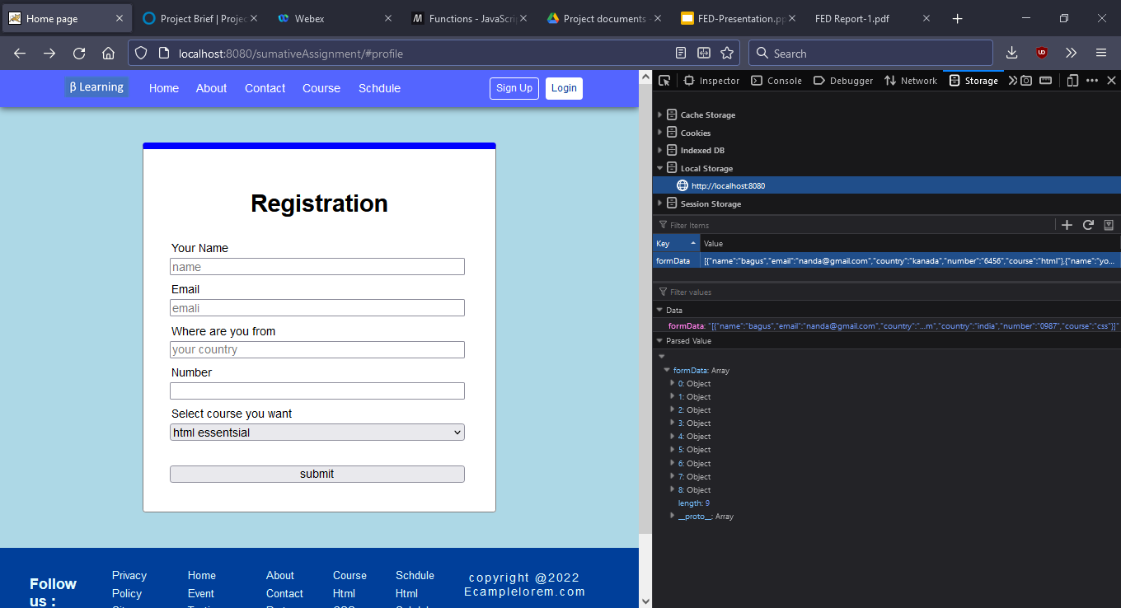
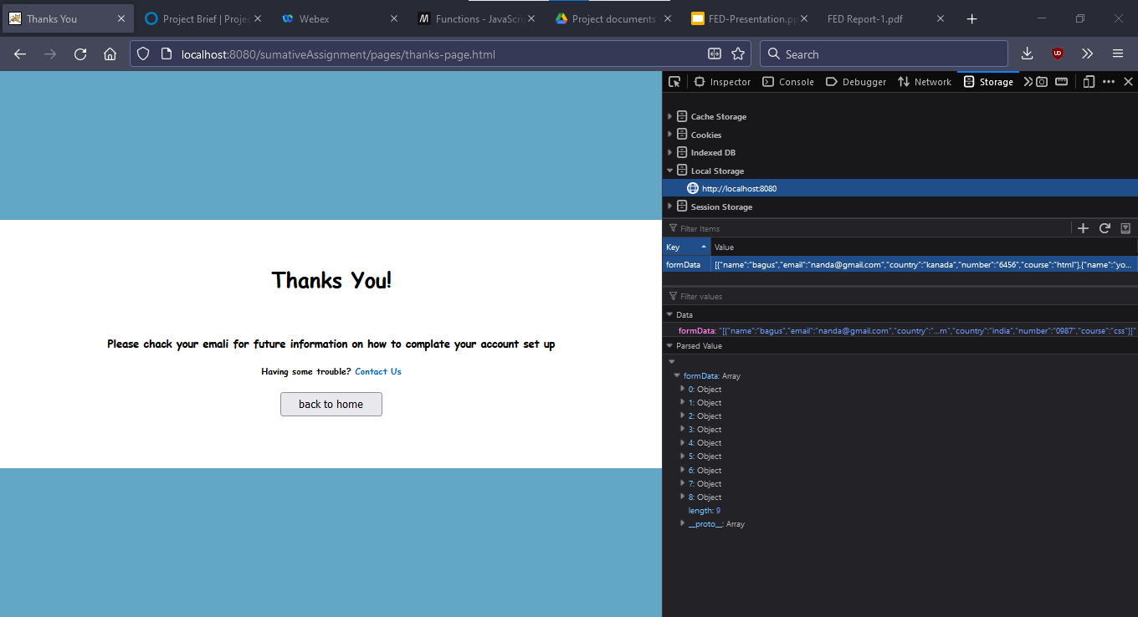
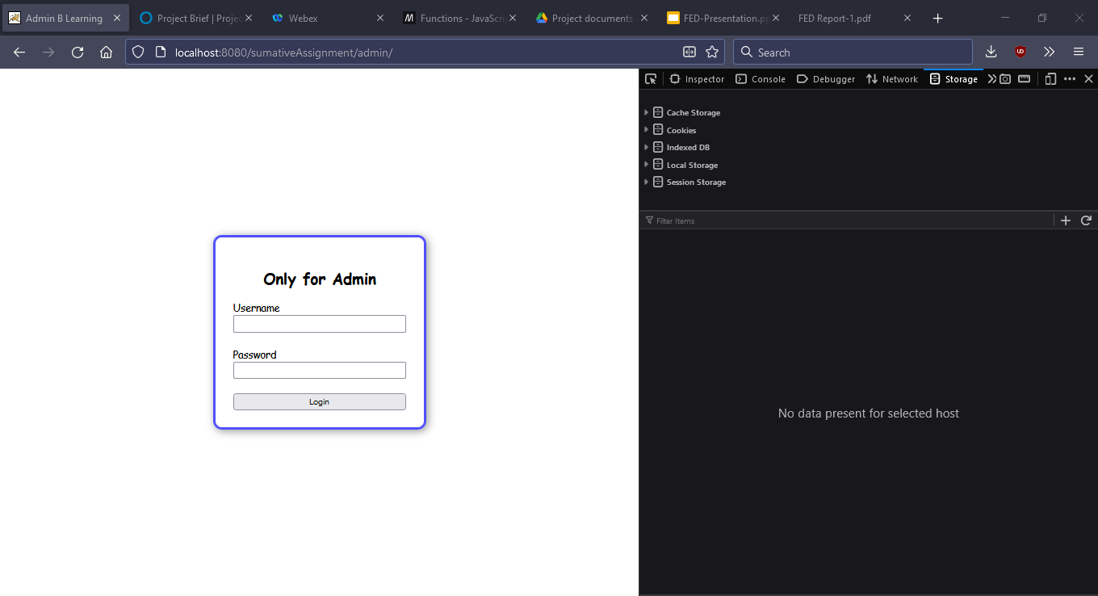
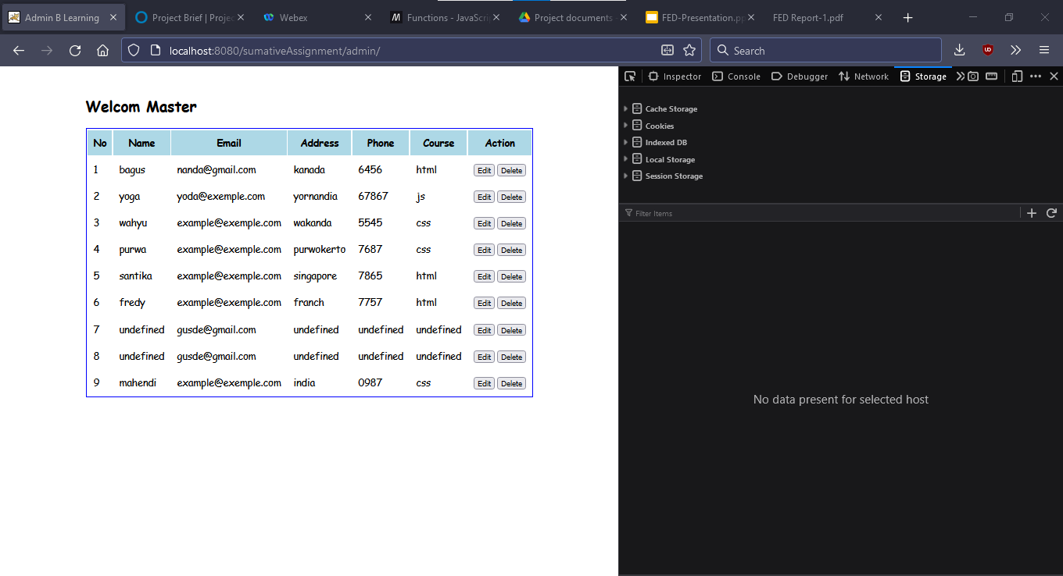
20. Project Results (1/2)
Screen Shots of Evidences lead generation
Lead Administrator

Slide 25
20. Project Results (2/2)
Link for the Project Walkthrough
  B Learning Index
    http://localhost:8080/sumativeAssigment
  B Learning Administrator
    http://localhost:8080/sumativeAssignment/admin

Slide 26
21. Proposed Improvements
List of Improvements
  <List areas of improvement which you have identified after completion of the project>
  ……
  ……
  ……
  ……
  ……
  ……

