Slide 1

Mini Portfolio
BY :
BAGUS RADITYA NIARTO
Analyze the Behavior of Loan Property Customers
(with Python, Google Colab, and Ms. Excel)

Slide 2
Overview
A bank provides loan services for money to buy property. The customers of this program are customers of the bank. You are provided with data that contains all customer personal data as well as a track record of credit in one period. You are currently asked to analyze the behavior of customers who apply for loans to banks.

Slide 3
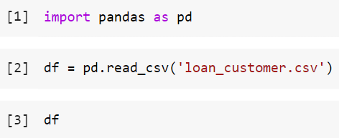

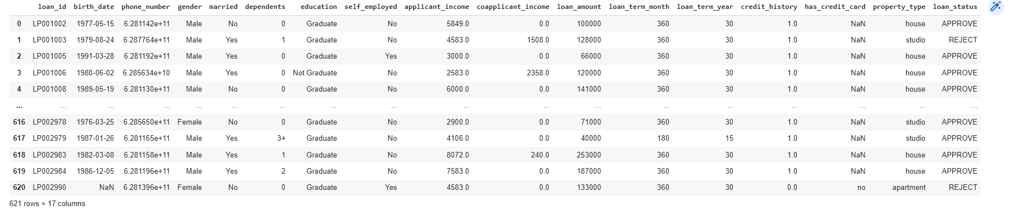
INTRODUCTION
Initial table. To display the table, the following syntax code is required:
The results obtained are as follows:

Slide 4
SECTION 1
DATA PREPROCESSING

Slide 5

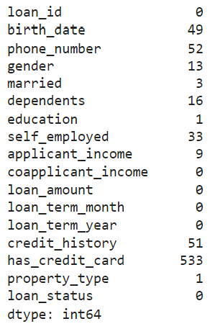


Data Preprocessing
SECTION 1
a. Handling Missing Value
The required syntax to display how much data is missing in each column is:
The Results
The results obtained: there are several variables that have missing values with all variables.

Slide 6

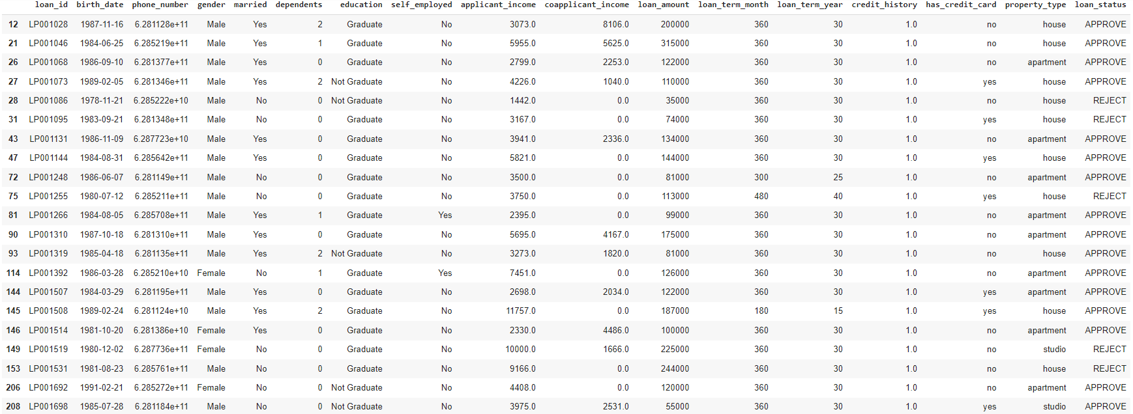

Data Preprocessing
SECTION 1
a. Handling Missing Value (advanced)
If we have enough data and the amount of data that is missing is not significant, the trick is to simply delete the rows with missing data with the following syntax:
The Result
The result will show the dataframe after some rows are deleted.

Slide 7

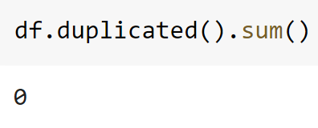

Data Preprocessing
SECTION 1
b. Handling Duplicated Data
Checking the number of duplicate values in the data frame can be done with:
The Results
The results show that there are no duplicate data.

Slide 8
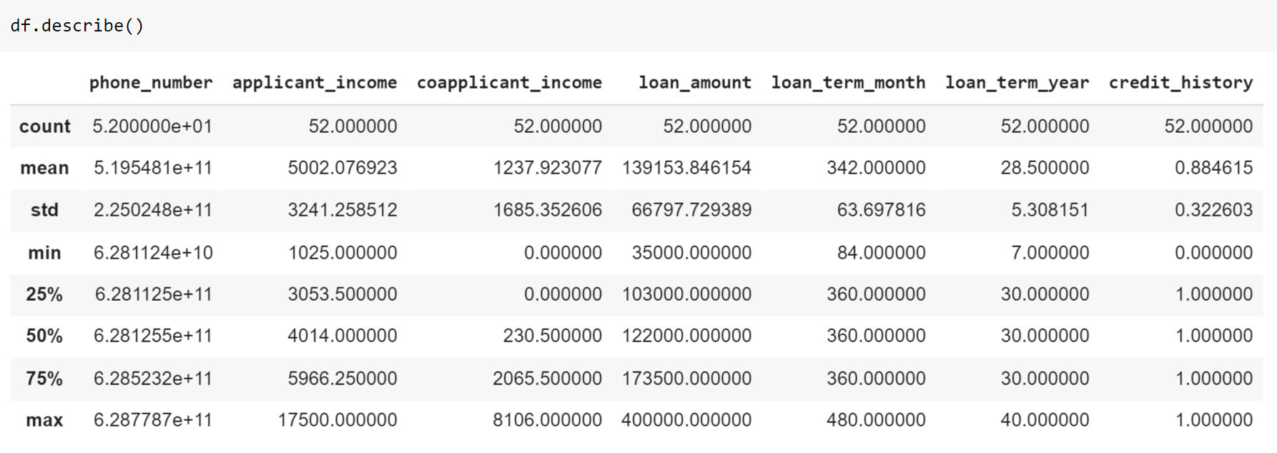

Data Preprocessing
SECTION 1
c. Handling Outlier
Outliers are data points (rows) whose values are extremely different from other data in general. Outliers can cause our machine learning models to underperform.
A descriptive statistical test is performed first, with the df.describe( ) syntax, before checking whether there are outliers or not in the data.

Slide 9
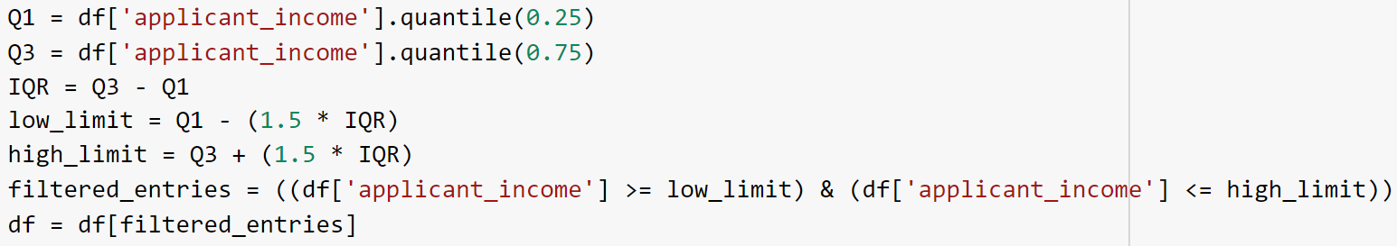
Data Preprocessing
SECTION 1
c. Handling Outlier (advanced)
The next step is to determine outliers based on IQR (Inter Quartile Range).
Q1 = Bottom Quartile
Q3 = Top Quartile
IQR = Q3 - Q1
Here is the code syntax to delete rows based on outliers in the 'applicant_income’ (as an example) column using IQR:

Slide 10
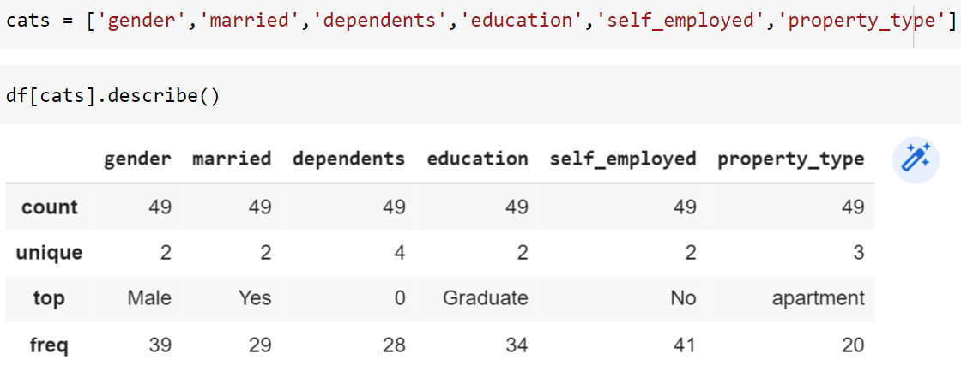
Data Preprocessing
SECTION 1
d. Feature Encoding
Feature encoding is the process of changing features categorical into numeric features. The method used is Label Encoding, which is a categorical feature changed to numeric by assigning a different number to each value that is unique.
In this case, the columns used include: ‘gender’, ‘married’, ‘dependents’, ‘education’, ‘self_employed’, and ‘property_type’.
The first step is to find information regarding the column to be changed with the code df[cats].describe( )

Slide 11
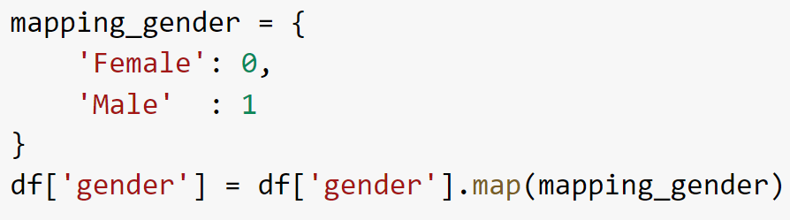
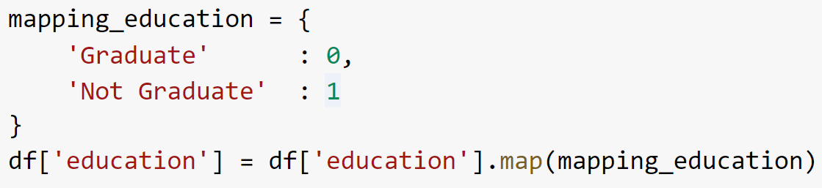
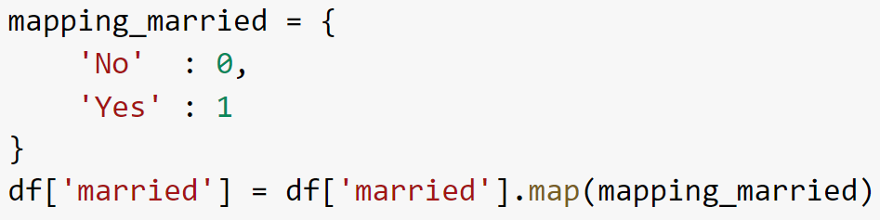
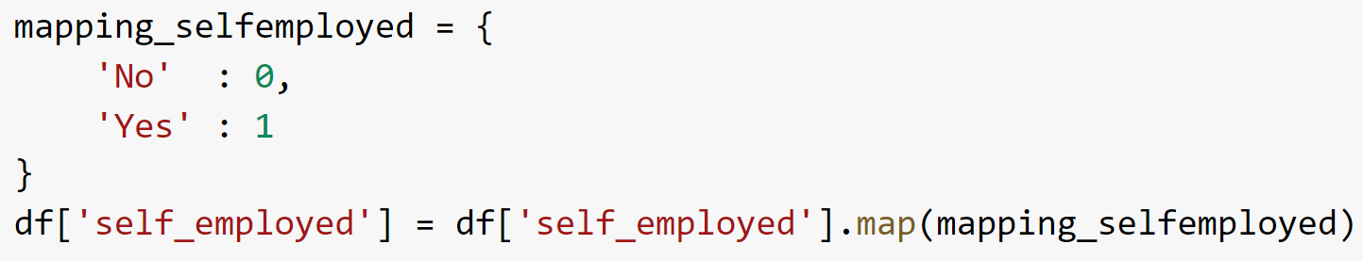
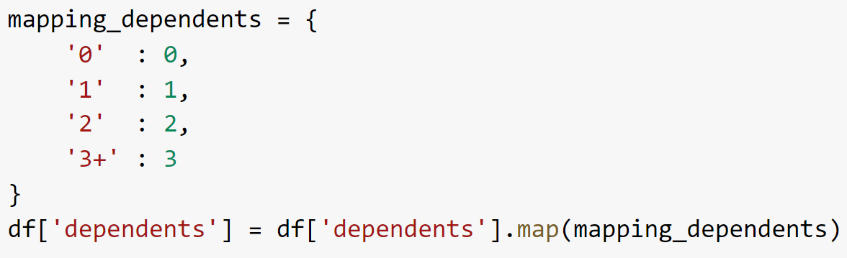
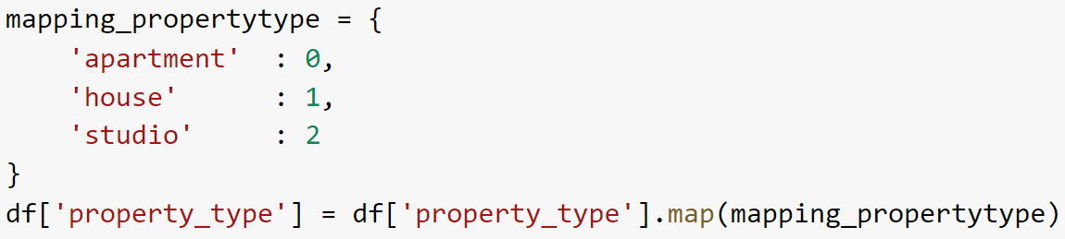
Data Preprocessing
SECTION 1
d. Feature Encoding (advanced)
Next is to enter the code for the Label Encoding technique.

Slide 12

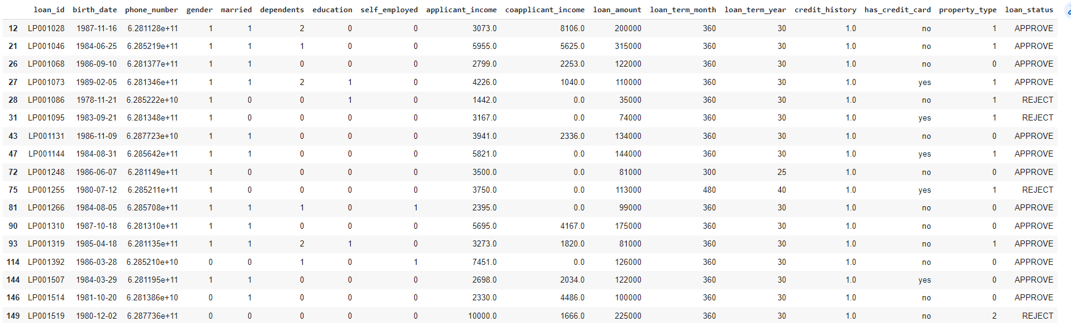
Data Preprocessing
SECTION 1
d. Feature Encoding (result)
Categorical
After entering all the code, the output that comes out is:
Categorical

Slide 13
SECTION 2
ANALYZE CUSTOMER INTEREST BY PROPERTY TYPE

Slide 14

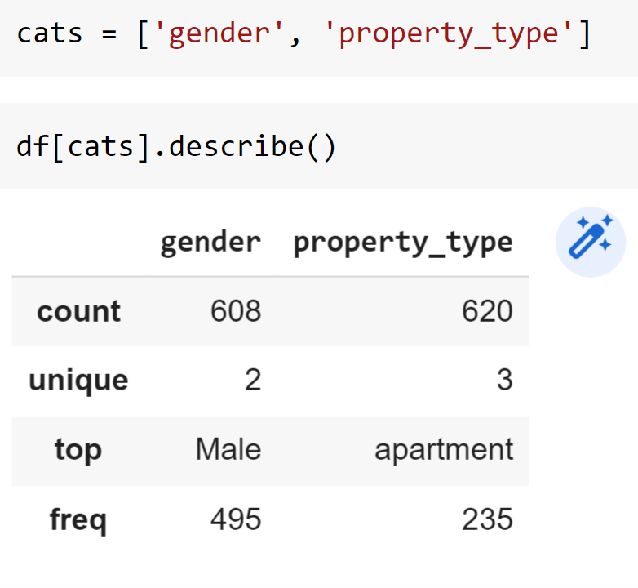
Analyze Customer Interest by Property Type
SECTION 2
A Table Comparing the Number of Loan Applications Made by Female and Male
Customers for Each Property Type
The first step is to create descriptive statistics from the variables ‘gender’ and ‘property_type’.
Gender :
Female = 113
Male = 495
Missing Value = 13
Property Type :
Apartment = 235
House = 206
Studio = 179
Missing Value = 1

Slide 15
Analyze Customer Interest by Property Type
SECTION 2
A Table Comparing the Number of Loan Applications Made by Female and Male
Customers for Each Property Type (advanced)
GENDER | VALUE
Female | 113
Male | 495
Missing Value | 13
VARIABLE | VALUE
Female with Apartment | 55
Male with Apartment | 174
Female with House | 34
Male with House | 169
Female with Studio | 24
Male with Studio | 151
Female without Property | 0
Male without Property | 1
PROPERTY TYPE | VALUE
Apartment | 235
House | 206
Studio | 179
Missing Value | 1

Slide 16
Analyze Customer Interest by Property Type
SECTION 2
A Data Visualization of the Comparison of the Number of Loan Applications Made by Female and Male Customers for Each Property Type (using Microsoft Excel)
BAR CHART

Slide 17
Analyze Customer Interest by Property Type
SECTION 2
A Data Visualization of the Comparison of the Number of Loan Applications Made by Female and Male Customers for Each Property Type (using Microsoft Excel)
PIE CHART

Slide 18
Analyze Customer Interest by Property Type
SECTION 2
Interpretation
Based on previous calculations, the number of borrowers with a male gender is greater than that with a female.
The type of property with the highest number is an apartment; the second is a house; and the last one is a studio.
The variable with the highest number is a male borrower with a house property, and the lowest number is a female borrower with a studio property.

Slide 19
SECTION 3
ANALYSIS OF THE EFFECT OF MARITAL STATUS ON THE TIME LOAN PERIOD

Slide 20
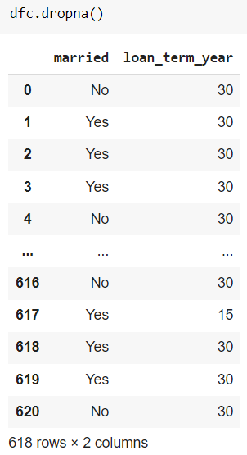
Analysis of The Effect of Marital Status on The Time Loan Period
SECTION 3
The Table Below Shows the Number of Customers That Have Been Grouped Based on Marital Status for Each Loan Period
The first step is to delete the empty data rows with the syntax code dfc.dropna ( ).
Married :
No = 215
Yes = 403

Slide 21
Analysis of The Effect of Marital Status on The Time Loan Period
SECTION 3
The Table Below Shows the Number of Customers That Have Been Grouped Based on Marital Status for Each Loan Period (advanced)
To analyze the relationship between two or more variables and find out whether there is an effect of the independent variable on the dependent variable, regression analysis is needed.
By using getting ‘married’ as the independent variable and the ‘loan_term_year’ as the dependent variable, the following results are obtained:
 | df | SS | MS | F | Significance F
Regression | 1 | 180,5604 | 180,5604 | 6,429662 | 0,01146905
Residual | 616 | 17298,76 | 28,0824
Total | 617 | 17479,32

Slide 22
Analysis of The Effect of Marital Status on The Time Loan Period
SECTION 3
Data Visualization of the Number of Customers That Have Been Grouped Based on Marital Status for Each Loan Period (using Microsoft Excel)
BAR CHART

Slide 23
Analysis of The Effect of Marital Status on The Time Loan Period
SECTION 3
Interpretation
Based on the calculation results, most marital statuses are married with 403, while those who are not married have 215.
Based on the calculation results, the loan period with a term of 30 years is the highest with a total of 532, while the minimum is 1 year with a value of 1.
For the regression calculation, a p-value of 0.011 is obtained, which is less than 0.05, so it can be concluded that there is an effect of marital status on the length of time loan in years.

Slide 24

THANK YOU

