Slide 1

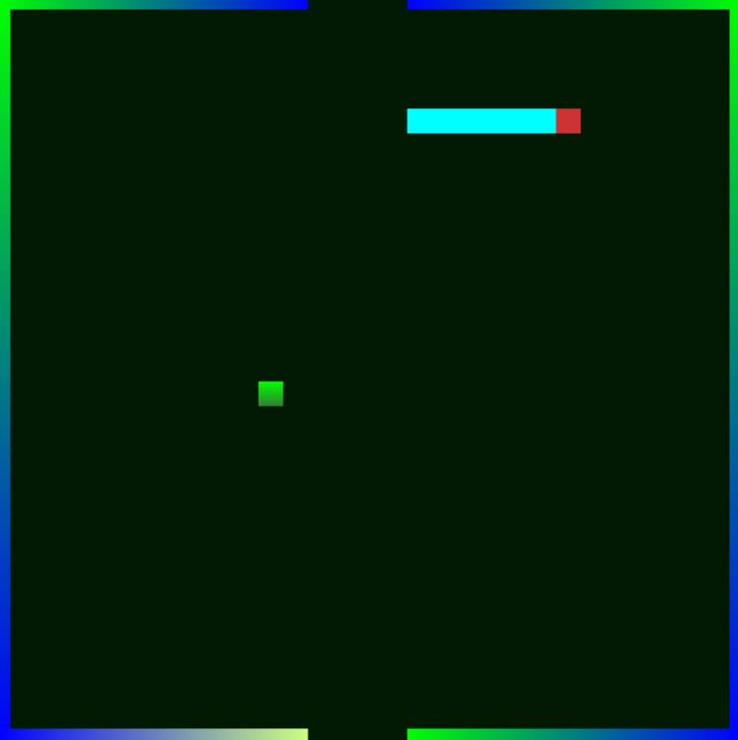
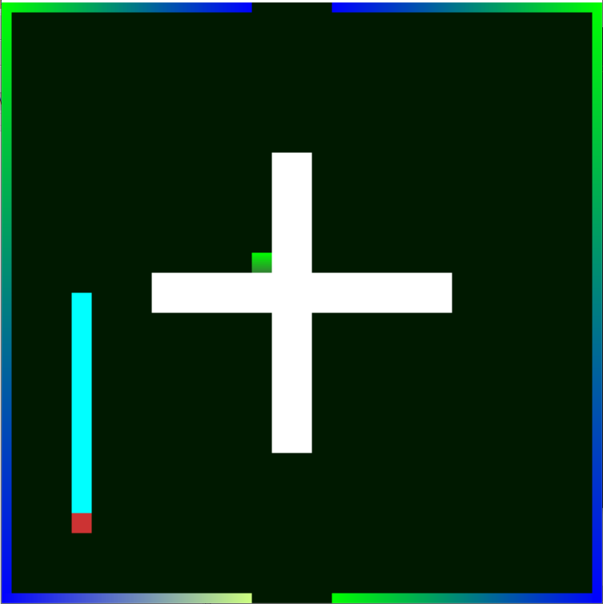
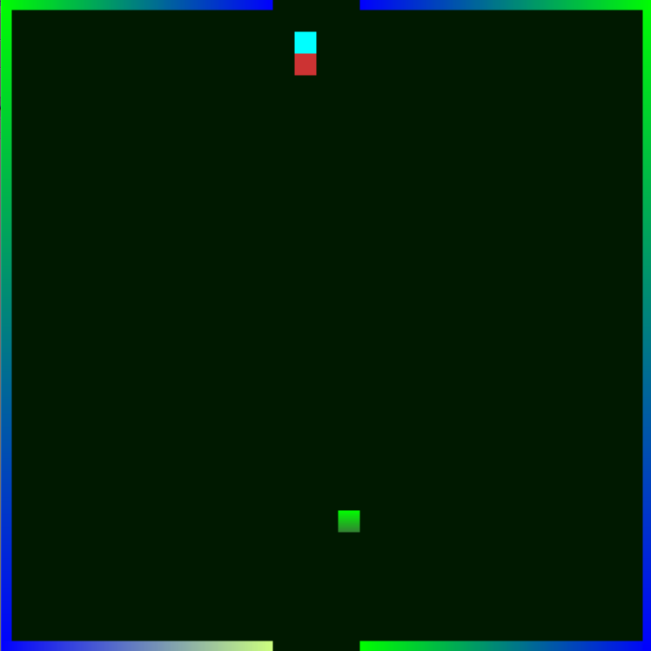


Snake Game
CSCI 452-02
Abstract
A game made by c++ ,opengl, freeglut and glew library. The snake game is a famous game and nearly most of the people know it. It is a game that consists of a snake hunting down and trying to eat his prey all over the land or the boundries of his map. The code is about a boundries drawn by opengl vertexs function and the snake code is drawing and erasing the snake head, body and tail by the GLbegin Quads which is a function in the Opengl as well. To make the snake looks like the body and his tail is following his head. And the snake will die if strangled or hit the walls.
I. Introduction & Problem Definition
Snake game is the game that we all used to play while we were young with the old Nokia phone. Snake is the reference to the predator which search for his prey all over his land to hunt it and eat it. For example, you can keep crawling all over the map or the land to try to eat your prey without biting yourself accidently and die, you might also crash to a collider or a wall. They are also a reference to getting out of your safe zone where you can become an easy target for the other predators. And you win by eating all of your preys.
III. Results
As it mentioned previously in the introduction section, the snake game is an enjoyable game and easy to control. Most of the people know it so its familiar too. It is intended for gamers all around the globe. Specifically, for those who want a chill and easy experience. And, not worrying about a high PC specs.
IV. Conclusion & Discussion
Snake game is a small PC game that offers a new entertaining and fascinating experience for its users, and it revolves around a moving Snake controlled by the player trying to eat its preys and pass a different challenging levels. And once you eat a 25 prey you will win the game with a display text tells you congratulations you won.
II. Methodology
Using C++, Opengl, freeglut and glew library. We have made a boundary function to set the boundaries of the map. And a prey function so it can be summoned randomly between the map boundaries and to keep it challenging for the snake. Also, there are two important function which are the erase and draw function to keep drawing and erasing the snake body to make it real to the players that the snake is really moving with its body following the head. And there is a keyboard function which allows the players to move the snake using the arrow keys of the computer.
References
https://docs.microsoft.com/en-us/windows/win32/opengl/glvertex2i
https://github.com/GOKU-Instinct/SnakeGame-with-CPP-OpenGL/blob/master/Snake.cpp
(3) https://docs.microsoft.com/en-us/windows/win32/opengl/glvertex2f

