Slide 3
Qatar faces an urgent economic challenge that requires comprehensive stabilization and recovery plans
IMF 2026 macroeconomic forecasts before and after the conflict
Qatar records the sharpest downgrade to 2026 growth
Qatar now carries the highest inflation outlook
Qatar shifts from surplus to deficit with the largest fiscal deterioration
Qatar records the sharpest downgrade to 2026 growth
Qatar now carries the highest inflation outlook
Qatar shifts from surplus to deficit with the largest fiscal deterioration
2026 real GDP growth forecast
2026 real GDP growth forecast
2026 inflation forecast
2026 inflation forecast
2026 fiscal balance forecast
2026 fiscal balance forecast
-14.7
-14.7
-4.5
-4.5
-3.8
-3.8
-1.9
-1.9
-1.4
-1.4
-0.5
-0.5
+1.3
+1.3
+0.4
+0.4
+0.5
+0.5
+1.6
+1.6
+0.3
+0.3
+0.2
+0.2
-4.7
-4.7
-0.8
-0.8
+0.1
+0.1
+0.2
+0.2
+1.1
+1.1
+4.2
+4.2
6.1%
6.1%
3.9%
3.9%
27.6%
27.6%
26.5%
26.5%
5.0%
5.0%
5.2%
4.5%
5.2%
4.5%
4.9%
4.8%
4.9%
4.0%
4.8%
3.9%
4.0%
3.9%
2.6%
2.6%
2.6%
3.5%
2.6%
3.5%
2.5%
3.3%
2.5%
3.3%
2.4%
3.1%
2.4%
3.1%
3.1%
3.1%
2.3%
2.2%
2.3%
2.2%
1.3%
2.0%
1.3%
2.0%
2.0%
2.0%
1.0%
1.7%
1.0%
1.5%
1.7%
1.5%
0.8%
0.8%
-3.4%
-3.4%
-3.5%
-3.7%
-3.5%
-0.5%
-3.7%
-0.6%
-0.5%
-0.6%
-9.9%
-8.6%
-9.9%
-8.6%
-10.6%
-10.6%
Source: International Monetary Fund (IMF), April 2026
Pre-conflict
Current forecast
Pre-conflict
Current forecast

Slide 4
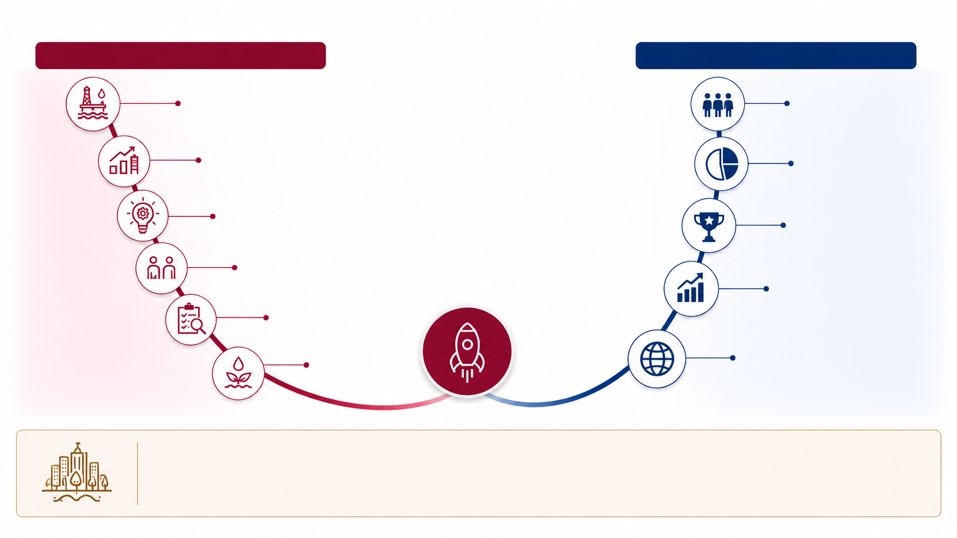
Qatar can use the 2026 landing point as a reset moment to address structural challenges and launch the New Economy
Illustrative Trajectory From Current Economic Pressure to Renewed Long-term Growth
Structural Challenges to Address
New Economy Outcomes
Hydrocarbon dependence
Productive workforce; Balanced population structure
Unclear sector income plans; Limited growth engines
Diversified and resilient economic base
Low productivity and innovation
Dynamic private sector
Labor and skill mismatch
Fiscally sustainable economy
Policy execution gaps
Resource pressures
Globally competitive economy
2026 Landing Point: Moment to reset the growth trajectory
Existing initiatives provide a starting point (e.g., National economic resilience plan, Government blueprint, Competitiveness report, Local investments, National champions),
but the 2026 reset requires one economic direction to connect them to the New Economy

Slide 5







Qatar’s long-term growth path requires addressing structural challenges to diversification and competitiveness
Qatar’s Structural Challenges Themes
High dependence on hydrocarbons
Fiscal revenues and exports remain tied to hydrocarbons and future LNG cycles
Unclear income plans for diversification sectors
Diversification sectors lack income plans with clear investment needs, expected returns, support mechanisms, and champions roles
Limited private sector growth engines
Firm scale, tradable activity, competition and financing remain below what diversified growth requires
Low productivity and innovation
Non-hydrocarbon productivity, innovation and firm competitiveness remain below peer benchmarks
Labor market and skills mismatch
Skills gaps and segmentation constrain workforce outcomes and national participation
Policy execution and evidence gaps
Data, measurement and feedback loops remain insufficient to track impact and adjust policy
Resource and environmental pressures
Resource efficiency, water energy nexus pressures and environmental externalities create additional long-term constraints on the growth model

Slide 6









Multiple initiatives already target parts of the challenges, but they remain fragmented without an overarching economic framework
Current initiatives landscape and integration need
Major initiatives already in motion
Initiative
Purpose
Fit to clarify
Role of the New Economy Framework
Clarify how current initiatives fit together and contribute to Qatar’s 20-year economic direction
National Economic Resilience Plan
Respond to the current crisis,
protect economic continuity
and support recovery
Connection to long-term
economic transformation
Purpose
What each initiative is meant to achieve
Government Blueprint
Strengthen government
excellence, resilience and
execution capacity
Role in enabling delivery
of the new economy agenda
Fit
Competitiveness Report
Surface priority competitiveness
gaps and areas for reform
Link to growth, investment
and productivity priorities
Where each initiative sits within the
economic architecture
Linkages
QIA Local Investment
Channel strategic domestic
capital toward national
economic priorities
Target sectors, capabilities
and firms for catalytic
investment
How initiatives reinforce or depend
on one another
National Champions
Build Qatari firms with the scale
and capabilities to compete
beyond Qatar
Prerequisites required
for firms to scale and
compete globally
Contribution
How each initiative supports
Long-term outcomes
A unified framework can move Qatar from fragmented initiatives to a coherent economic agenda
with clear outcomes, priorities and delivery logic
Source: Team Analysis

Slide 7





The 20-year New Economy Framework can organize Qatar’s economic priorities into one long-term direction under the National Vision
Positioning of the New Economy Framework within the national vision architecture
NEW QATAR NATIONAL VISION
New Economy
Framework
Define Qatar’s 20-year economic direction and programs
Social & Population
Framework
Shape population structure, social outcomes and human development priorities
Security Framework Protect national security and strategic stability
Fiscal Framework Guide fiscal discipline,
budget choices and
financial sustainability
Economic architecture to organize current initiatives
01
02
03
04
Why the New Economy Framework matters
It gives leadership one economic architecture to
organize current initiatives, clarify their contribution
to long term outcomes, and guide Qatar’s transition
from crisis response to a new economy over the
coming 20 years
Direction
Architecture
Outcomes
Continuity
Defines the long-term economic ambition
Shows where current
initiatives fit
Clarifies the economic
end state to pursue
Links current crisis
response to long-term
transformation
Source: Team Analysis

Slide 8

The New Economy Framework translates the economic vision and mission into outcomes, policy directives, national programs and implementation governance
ILLUSTRATIVE
Proposed architecture for discussion
Economic
vision
A dynamic, competitive and resilient economy with diversified engines of growth Built for the next 20 years, not only for the current shock
01
Economic
mission
Demand-driven and long-term economic planning, leveraging legacy, and committed to international partnerships Driving consistent economic planning time horizons
02
Illustrative
20-year outcomes to refine
Population
structure Responsible citizenship, skill mix
and social mobility
Diversification
mix
Hydrocarbon versus
nonhydrocarbon
balance
Private sector
scale
Productivity, champions
and export capacity
Fiscal
sustainability
Fiscal rules, debt
ceiling and budget
discipline
Global
competitiveness Quality FDI, innovation
and global positioning
03
3.1
3.2
3.3
3.4
3.5
Indicative
policy directive
areas
Fiscal and
budget policy
Discipline, sustainability
and resource
allocation
Investment and
capital policy
Capital directed
toward strategic
economic priorities
Labor, visa and
population policy Workforce and
population alignment
with the economic model
Education and
skills policy Social mobility and
labor market
readiness
Business
environment policy Entry, ownership,
investment and
scale
Capital market
Policy Deeper markets and
broader financing
channels
04
4.1
4.2
4.3
4.4
4.5
4.6
Examples of multi-year National Programs
Fiscal robustness
Fiscal rules,
debt ceiling and
budget discipline
Domestic investment program
SWF governance and strategic domestic investment
Business entry and investment climate
Ease of doing business, company formation and
foreign ownership
Talent and
mobility reform Labor law
modernization
and visa reform
Capital market
activation Listing rules, debt market and market maker framework
Education and
social mobility
Education reform, and job market performance
FDI and national champions
FDI, national champions,
and R&D synergies
05
5.1
5.2
5.3
5.4
5.5
5.6
5.7
Implementation
Governance and Budget
Program owners Clear accountability
for each national program
Funding
Budgeting and resource
allocation rules
Delivery governance World-class governance to manage
implementation
Escalation mechanism Resolution path for bottlenecks and decisions
Review cadence Regular progress,
risk and next step reviews
06
6.1
6.2
6.3
6.4
6.5
Source: Team Analysis

Slide 9










Horizon 1 will establish strong economic foundations by fixing the plumbing and earning the right to scale
ILLUSTRATIVE
Horizon 1: First five-year priorities and sequencing logic
HORIZON 1: FOUNDATIONS AND MAJOR UNLOCKS
Economic and fiscal discipline
Capital governance and markets
Business environment
Talent and mobility
Cross cutting enablers
Conduct economic diagnosis and data-driven assessment
Achieve macro stability
Modernize fiscal rules and debt ceiling
Reduce leakages such as pensions
Enable transparent sovereign wealth fund (SWF) governance
Deepen capital markets
Strengthen stock market: listing requirements
Develop debt market
Create a framework for market makers
Achieve ease of doing business
Simplify company formation
Enable foreign ownership
Modernize labor law
Reform visa process
Reform education system geared toward social mobility and job market performance, public & private sector
Build and attract talent
Ensure access to capital
Strengthen institutions and governance
Leverage data and digital infrastructure
HORIZON 1: FIRST FIVE YEARS
Horizon 1 earns the right to scale by resolving structural challenges before Qatar accelerates FDI, champions, and global competitiveness
SEQUENCING BEFORE SCALING
Ease of doing business + regulatory quality
Capital market depth + talent reforms
National champions + R&D
A business-friendly environment and regulatory clarity are prerequisites to attract quality foreign investment
Access to capital and a strong talent base enable the creation of national champions
Competitive champions and R&D investments are prerequisites for global competitiveness
FDI Attraction
National Champions
Global Competitiveness
Source: Team Analysis

Slide 10
The New Economy Framework must answer strategic questions on Qatar’s future economic model
Key questions
Strategic questions
Issues, choices, and trade-offs
1
What economic future does Qatar want over the next 20 years, and what outcomes will prove it is more competitive and resilient?
Economic purpose: how should the framework balance growth, national wealth, economic resilience and quality of life?
2
What policy choices must align behind a competitive and resilient national economic model?
Policy coherence: where do current fiscal, investment, labor and industrial policies reinforce or dilute the intended model?
3
Where should Qatar place its economic priorities, and what will make selected sectors and champions compete, adapt and scale?
Growth focus: which sectors, champions and ecosystem plays deserve priority given scale, exportability, competitiveness and resilience potential?
4
What must improve across the system to enable firms, capital, talent and innovation to scale faster in Qatar?
Binding constraints: which constraints most limit productivity, talent attraction, private sector scale and export competitiveness?
5
How will Qatar turn ambition into funded priorities, accountable owners and governed delivery?
Delivery integration: how should existing efforts fit within one funded, governed and accountable economic agenda?
Source: Team analysis

