Slide 1
Localization Demand Commitment (LDC): Implementation Guide
DRAFT

Slide 2
AUDIENCE FOR THIS DOCUMENT
PIF portfolio companies looking to leverage LDC mechanisms as an avenue for localization
Disclaimer:
This implementation guide is current as of November 2024 and represents the details of the LDC journey at that time. The information was compiled from multiple public sources that are referenced in the document for general guidance in enabling LDC agreements in the Kingdom of Saudi Arabia. The Public Investment Fund (PIF) does not warrant the completeness, reliability, or suitability of the provided information. Buyers are strongly encouraged to conduct independent research and seek professional advice tailored to their specific circumstances before making decisions based on this implementation guide. PIF disclaims all and any liability for errors, omissions, or consequences arising from the use of this information as it may change in time with respect to each specific entity.

Slide 3
What the implementation guide is and is not about
The document is:
The document is not:
A guide on how to implement a Localization Demand Commitment (LDC) mechanism, including
An explanation of all localization concepts, beyond localization demand commitments (e.g., co-investment)
A step-by-step walk-through to orchestrate an LDC arrangement, explaining all the terms, definitions, processes, categorization¹
A prescriptive/binding document, as buyers:
Illustrations of the LDC process and content, and how it can be developed
Methodologies, “plug and play” templates, and output examples for critical deliverables in the LDC process
Must tailor tools / analysis to their supplier base and their ways of working
Have at their disposal additional resources for assistance
1. LDC arrangement is a specific type of a supplier-buyer arrangement. Thus, each buyer will have their own workflows to manage a supplier-buyer relationship

Slide 4
Executive Summary
LDC implementation guide – How to…
…Select products for LDC
…Assess feasibility of LDC products
…Tender and award LDC supplier agreements
…Define LDC terms and conditions
…Monitor LDC progression and impact
…Set up and operate an LDC governance
Appendix (additional data and information)
1
2
Contents
3

Slide 5
What is LDC?
What does it solve for?
Long-term demand commitment from the buyer, contingent on a localization investment by the supplier
Typically required to incentivize localization of complex products with limited local supply and high risk for investors
Binding agreements that can be offered through two mechanisms, with different levels of guaranteed requirements from the buyer
Preferred supplier agreement
Take-or-pay agreement
Increases local content (LC) score: PIF LC target of 60% hinges on the successful localization of supply chain opportunities
Helps unlocks greenfield and brownfield investment localization opportunities
Absent LDC, localization of high-risk greenfield/brownfield investments may face challenges: Private-sector suppliers and financial investors may be hesitant to invest owing to demand volatility, price uncertainty, or other considerations

Slide 6
Accelerated localization, contributing to LC targets through:
Signaling effect – increasing localization awareness and urgency to suppliers (i.e., fear of missing out on limited LDC opportunities)
Spillover effect – one LDC agreement increases market confidence in future demand for other products procured
Strengthening the project financing case for suppliers
Supply chain security of raw materials
Leverage in negotiating with existing suppliers regarding price, quantity, specifications, and intellectual properties
Lower overall costs in the long term such as manufacturing, inventory, and logistics
LDC benefits

Slide 7
In order to execute a successful LDC for a product, you will need to follow five stages
Stages
1. Product selection
2. Feasibility and terms assessment
3. Tendering and LDC award
4. LDC agreement sign-off
5. LDC execution and monitoring
Activities
Select appropriate products for LDC
Conduct initial and informal supplier sensing to understand high-level requirements
Conduct detailed feasibility assessment to understand the need for take-or-pay mechanism
Understand associated risks
Issue Request for Information (RfI) and evaluate supplier response
Draft and issue Request for Proposal (RfP)
Review bids and finalize the supplier
Revise RfP, if needed (in case of suboptimal supplier response)
Sign contract with LDC terms and commitment
Establish monitoring and reporting processes
Continuously monitor LDC execution
Track and implement mitigating measures to minimize buyer risk
Outcomes
Confidence in a portfolio of products essential for localization and requiring demand commitment
Alignment on most suitable LDC mechanism (Preferred Supplier Agreement (PSA) or take-or-pay)
Articulation of ideal contractual terms
Understanding of supplier requirements
Finalization of the RfP
Selection of supplier(s)
Formalization of contract (and public announcement)
Institutionalization of governance
Progress update on LDC execution
Knowledge that can inform other LDC agreements, basis past experience

Slide 8
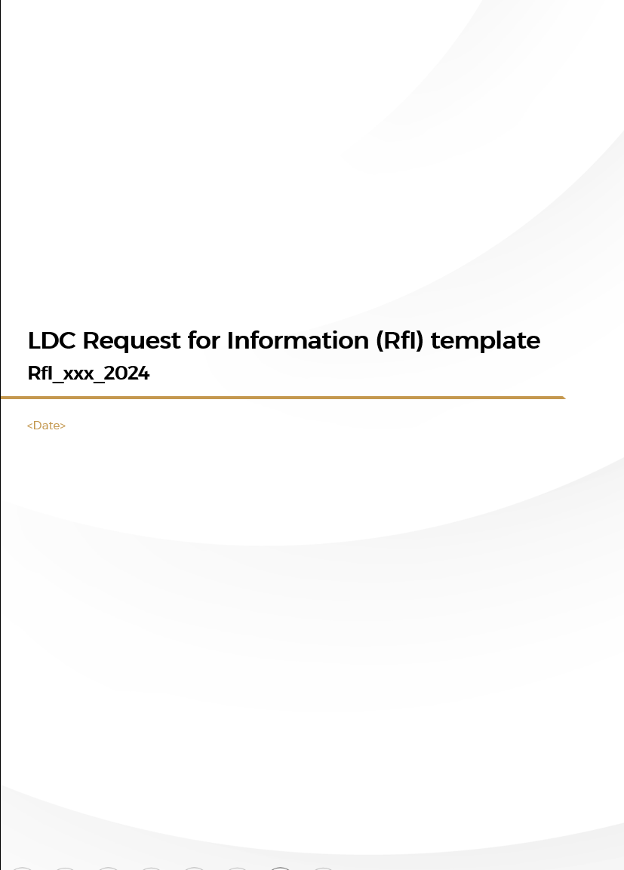
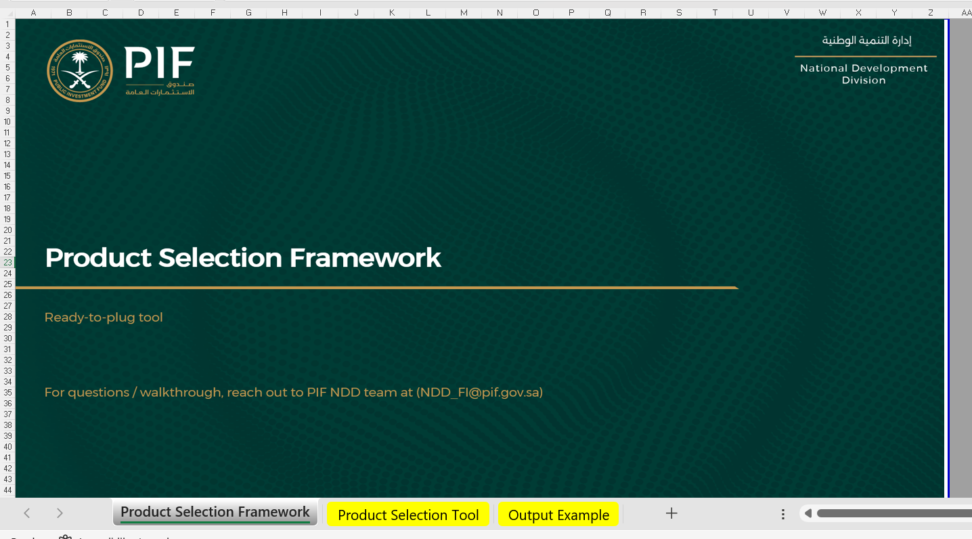

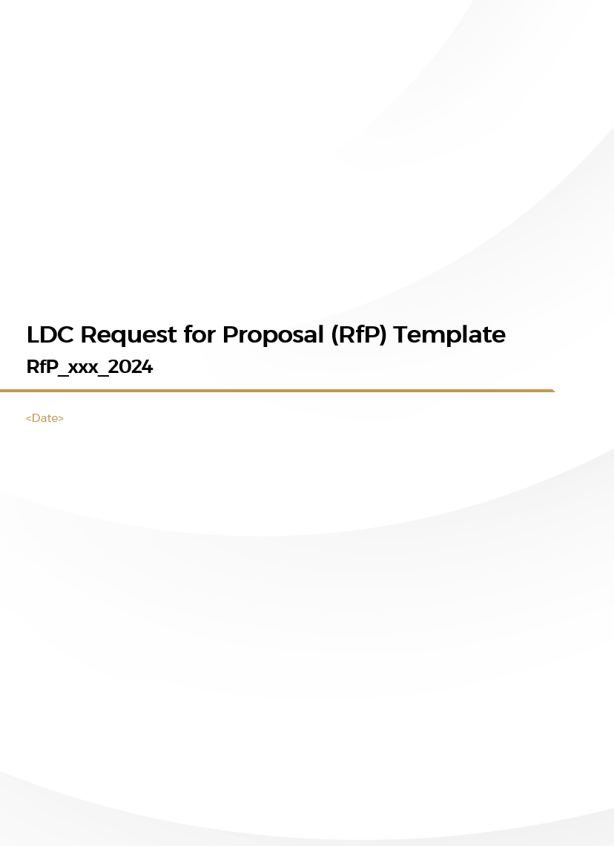
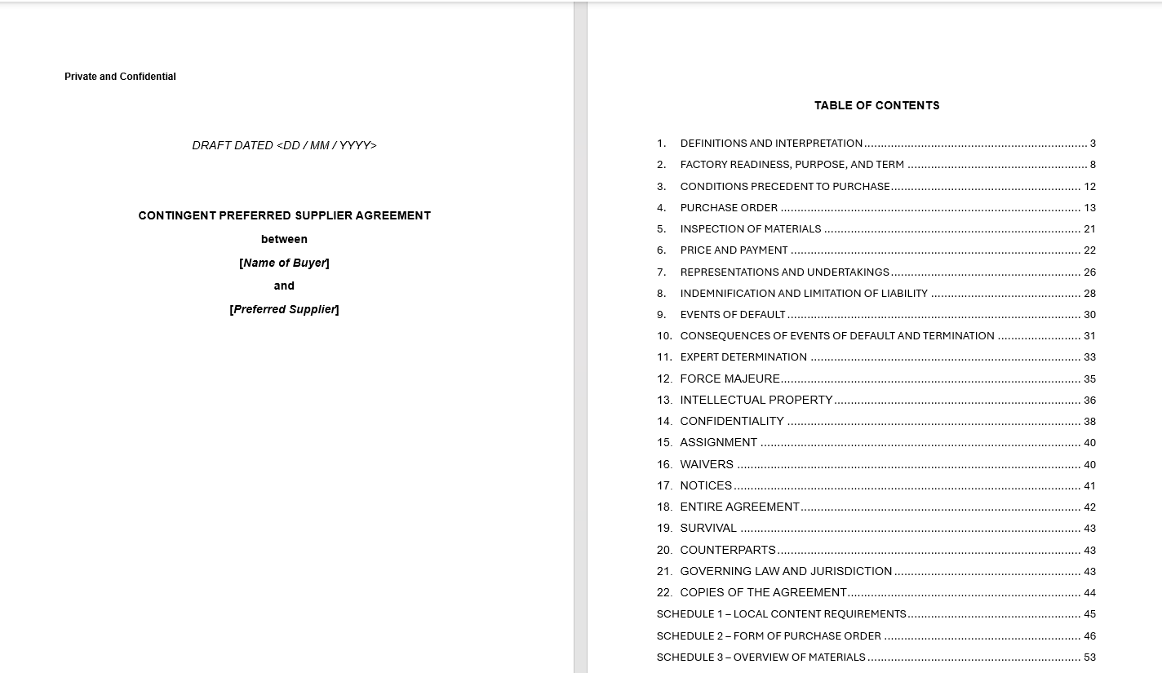
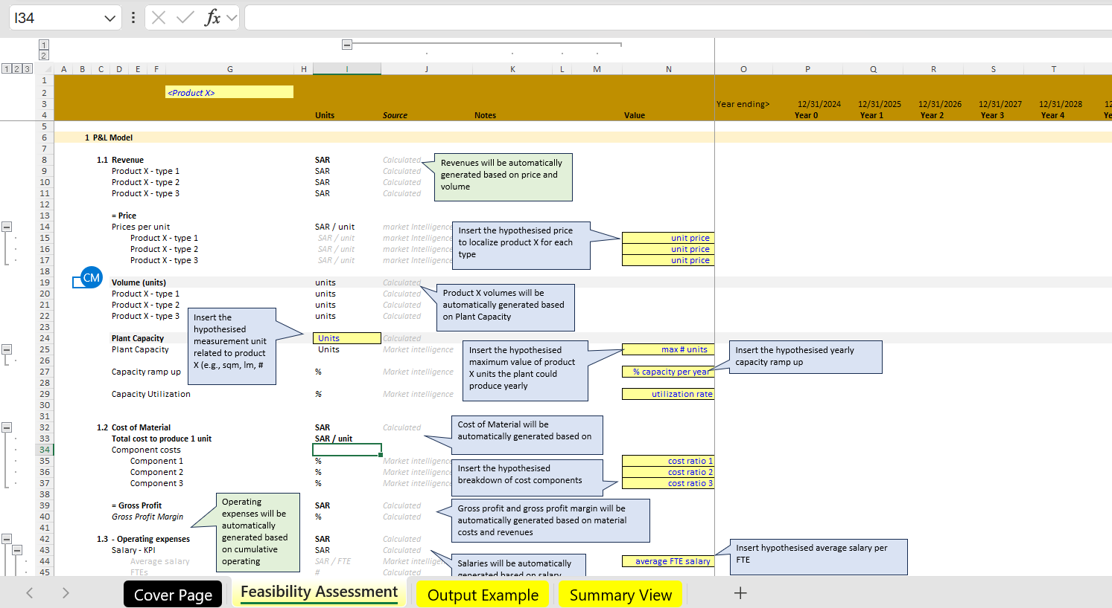
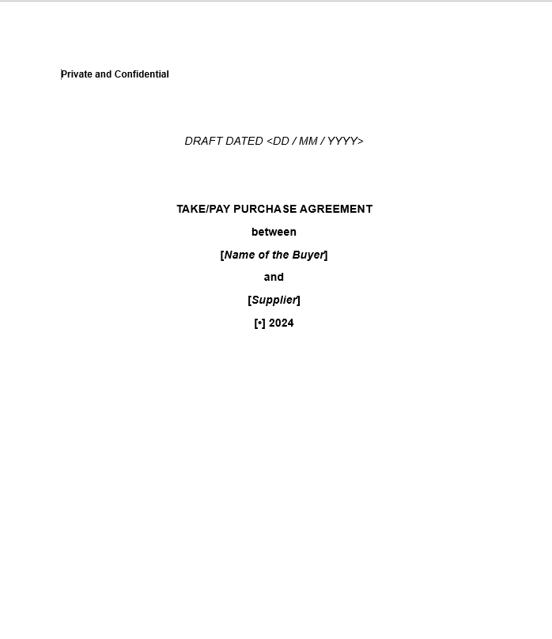
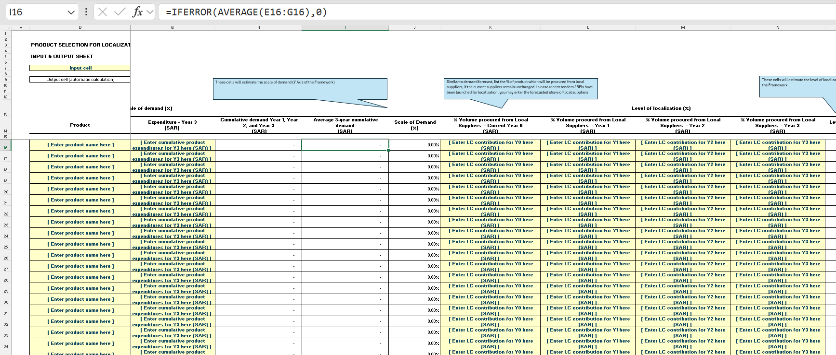
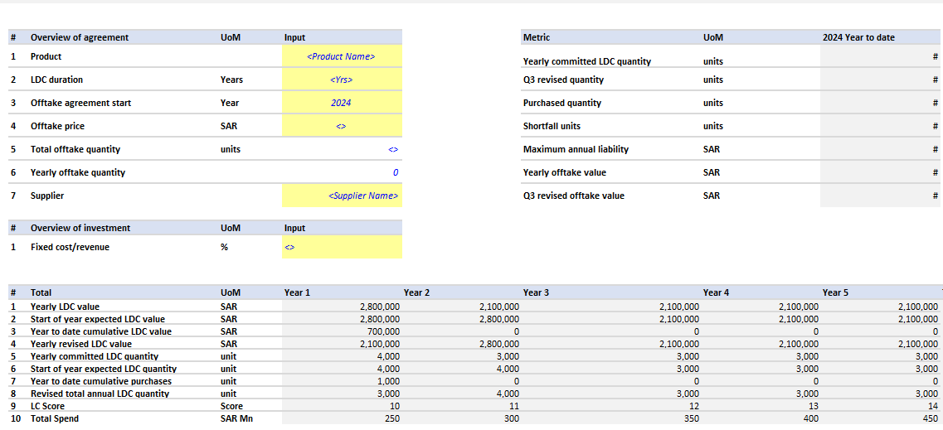
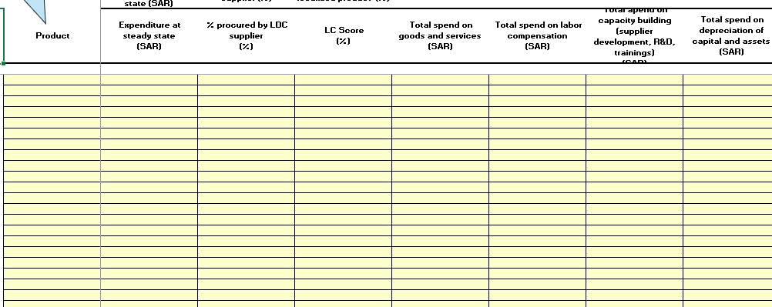
To support your LDC journey, this implementation guide includes a range of tools
Stages
1. Product selection
2. Feasibility and terms assessment
3. Tendering and LDC award
4. LDC agreement sign-off
5. LDC execution and monitoring
Methodologies, templates, and tools
A
Product selection framework
B
Feasibility assessment framework¹
D
RfP and RfI templates
E
PSA and take-or-pay agreement templates
F
Monitoring dashboard
C
Localization impact assessment dashboard
Consult PIF for support and queries (Contacts)
Implementation support
1. Given the nature and complexity of the template, this will be shared upon request. .Please reach out to PIF NDD contacts shared

Slide 9
Stage 1 − Product selection: Selecting eligible products for LDC requires assessment across three screening criteria
1. Product selection
2. Feasibility and terms assessment
3. Tendering and LDC award
4. LDC agreement sign-off
5. LDC execution and monitoring
To select a product, three questions need to be answered successively, with each question acting as a screening criterion
Criticality of the product for localization in terms of company spend size and the company-level procurement from foreign over local suppliers
Should the product be localized?
1
Yes
Rapid qualitative evaluation if there are any technical localization roadblocks (e.g., availability of critical raw material, access to specialized workforce)
Is localization of the product technically feasible?
2
Yes
Is demand commitment required?
High-level evaluation of the investor risk based on the KSA demand concentration and KSA supply concentration
3

Slide 10
LDC feasibility provides an in-depth assessment of the opportunity by answering four questions
1. Product selection
2. Feasibility and terms assessment
3. Tendering and LDC award
4. LDC agreement sign-off
5. LDC execution and monitoring
Objective
Evaluate whether demand is sufficient to localize the opportunity, based on:
KSA demand / supply gap
Regional export potential
Develop detailed business case to:
Select optimal type of LDC agreement (PSA or take-or-pay agreement) based on the financial risk of the investor
Assess the potential liability risks based on required LDC demand commitments and durations
Estimate of company-level LC impact as a result of the product localization
Ultimately, the LDC feasibility assessment aims to develop a thorough understanding of the opportunity and acts as the basis to obtain approval to commence the LDC journey
Questions covered under the LDC feasibility assessment
What is the localization opportunity and its expected impact?
Is the addressable demand sufficient for localization?
Is a preferred supplier agreement sufficient or is a take-or-pay required?
Are the associated risks manageable?
1
2
3
4

Slide 11
LDC localization opportunities should be articulated across the following parameters
1. Product selection
2. Feasibility and terms assessment
3. Tendering and LDC award
4. LDC agreement sign-off
5. LDC execution and monitoring
1
What is localization opportunity?
The following template should be filled in for the selected LDC product, articulating the localization opportunity and the expected company-level LC impact
What is the opportunity?
Sources
Expected LC impact
Sources
Product specifications
<Description of the procured product and its specifications>
Previous purchase orders
Business / operations teams
LC contribution (SAR)
<Expected contribution to local content in SAR Mn, through localization of the opportunity>
Calculation methodology in the detailed section
Depth of localization
<Expected value chain coverage of the opportunity (e.g., assembly, component manufacturing)>
Supplier sensing
Benchmark investments
PIF NDD (Contacts)
LC uplift (% Change)
<Expected increase of the LC score on a company level>
Calculation methodology in the detailed section
Plant capacity
<High-level capacity (units) and expected capex of the localization opportunity>
Supplier sensing
Benchmark investments
PIF NDD (Contacts)
Consult PIF for support and queries (Contacts)

Slide 12
To prove localization viability, total addressable demand needs to be assessed against the plant capacity
1. Product selection
2. Feasibility and terms assessment
3. Tendering and LDC award
4. LDC agreement sign-off
5. LDC execution and monitoring
2
Is the demand sufficient?
Annual volume (e.g., units, tons)
Sources
KSA demand
#
Company own demand
Market intelligence (through estimations, supplier sensing, expert interviews)
KSA supply
NIIC factory database
Supplier sensing
#
KSA demand / supply gap
#
Regional export potential
#
Regional reported imports (HS codes)
Market intelligence (through estimations, supplier sensing, expert interviews)
Total addressable demand
KSA
Export
#
Minimum viable plant capacity of the LDC product
#
If total addressable demand is smaller than expected plant capacity, the viability of the opportunity needs to be reviewed
Supplier sensing
Benchmark investments
% of total addressable demand
Consult PIF for support to estimate supply and demand (Contacts)

Slide 13
Stage 2 − Feasibility and terms assessment: There are two types of LDC agreements
1. Product selection
2. Feasibility and terms assessment
3. Tendering and LDC award
4. LDC agreement sign-off
5. LDC execution and monitoring
3
Is preferred supplier agreement sufficient?
Offered only as a last-resort
Type of agreement
Preferred supplier agreement
Take-or-pay agreement
1
2
How does it work?
Buyer has to procure from supplier only if business need arises, i.e., if there is demand and the buyer procures from a foreign entity, legal implications arise. However, if the buyer does not procure, no legal obligations arise
Purchase quantity, duration, and price contractually agreed upon
Supplier must commit to invest in a local facility
Demand commitment with purchase obligations: if such an agreement has been concluded, the buyer is legally obliged to procure from the supplier even if no business need arises
Product quantity, duration, and price contractually agreed upon
Supplier must commit to invest in a local facility
Liability risk exposure?
No (procurement only if business need arises)
Yes (in the form of take-or-pay)
When to apply?
Low financial risk for the investor
Low to medium capex
Medium to high Internal Rate of Return (IRR)
Low to medium product complexity (based on PCI¹)
High financial risk for the investor
High capex
Low IRR
High product complexity (based on PCI¹)
1. Product Complexity Index

Slide 14
Stage 2 − Feasibility and terms assessment: The type of demand commitment is assessed via three parameters
1. Product selection
2. Feasibility and terms assessment
3. Tendering and LDC award
4. LDC agreement sign-off
5. LDC execution and monitoring
3
Is preferred supplier agreement sufficient?
The following three parameters are crucial to deciding whether a PSA will suffice, or if a take-or-pay is needed. They are outputs from a product-specific business model
Implications for demand commitment
Parameters
Definition
How to calculate
Capex
Funds that a company spends on acquiring or maintaining physical assets such as property, buildings, machinery, or equipment. These are long-term investments
Consider and estimate all direct and indirect costs that will be incurred to operationalize a manufacturing facility
Higher capex will increase investor risk and may require take-or-pay
1
Outputs from the business case
Returns (IRR¹)
IRR is the rate of return at which the present value of a project's cash inflows equals the present value of its cash outflows, or the project breaks even in terms of net value
Estimate yearly net cash flows of the project
Lower IRR (typically less than 10%²) increases investor risk and may require take-or-pay
2
Product complexity
Measure of a product’s complexity and requirement of technical know-how
Provided by “The Atlas of Economic Activity”
Higher product complexity will increase investor risk and may require take-or pay
3
1. Internal Rate of Return. 2. Thresholds are typically product / industry / capital structure specific and should be nuanced as per the context

Slide 15
Stage 2 − Feasibility and terms assessment: two parameters needed to understand the level of risks
1. Product selection
2. Feasibility and terms assessment
3. Tendering and LDC award
4. LDC agreement sign-off
5. LDC execution and monitoring
4
Are the associated risks manageable?
The following two parameters are crucial to help investors understand the potential risks. They are outputs from a product-specific business model
Risk assessment dimension
Business model output
Description
How to calculate
Implications for risk
Ratio of total yearly fixed costs (in SAR) and per-unit contribution margin (in SAR)¹, in steady state
As the break-even value increases, the demand commitment needs to increase, leading to a higher buyer risk
LDC volume
Procurement volume for which demand commitment is given
Break-even volume
1
Ratio of initial investment and annual cash inflow²
The longer the payback period, the longer will the time for which demand commitment is needed, increasing buyer risk
LDC duration
Time period over which LDC is planned or obligated to be fulfilled
Payback period
2

Slide 16

Example business case output – telecom product
1. Product selection
2. Feasibility and terms assessment
3. Tendering and LDC award
4. LDC agreement sign-off
5. LDC execution and monitoring
KPIs to inform the type of LDC agreement (output of the business case)
SAR Mn
1,000
Revenue
Cost of materials
Cumulative free cash flow
Capex
Fixed and variable overheads
Capex (SAR Mn) | 175-200
IRR | 13-15%
Revenues
0
Costs
Net present value (NPV) (SAR Mn)¹ | 50+
KPIs to inform the level of the associated LDC risk (output of the business case)
-800
Year 0
Year 1
Year 2
Year 3
Year 4
Year 5
Year 6
Year 7
Year 8
Year 9
Plant capacity ramp-up
Break-even volume (yearly) | ~1 Mn units
Payback period | 6 - 8 yrs.
-
50%
100%
100%
100%
100%
100%
100%
100%
100%
Plant capacity utilization
-
33%
67%
70%
74%
77%
81%
85%
89%
94%
Sales (Mn units)
-
1.0
2.0
2.1
2.2
2.3
2.4
2.6
2.7
2.8
1. If NPV is negative, the investment is likely non-viable in its current form
Ready-to-plug business model template shared separately
Consult PIF for support and queries (Contacts)

Slide 17
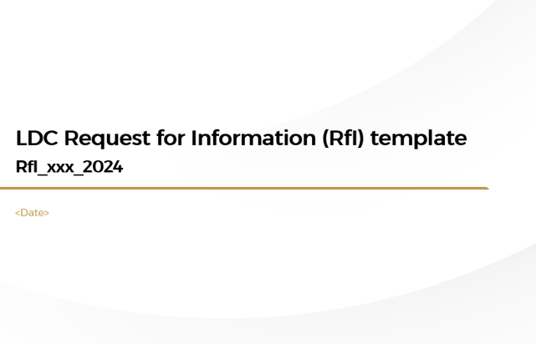

Stage 3 – Tendering and LDC award: two types of LDC agreements and related terms need to be defined
1. Product selection
2. Feasibility and terms assessment
3. Tendering and LDC award
4. LDC agreement sign-off
5. LDC execution and monitoring
A
B
Request for information (RfI)
Request for proposal (RfP)
Objectives
Formally validate supplier interest to locally supply the product
Shortlist suppliers for RfP participation
Validate the need to provide demand guarantees
Understand supplier needs
Identify and select the optimal supplier to minimize risk effectively
Ensure the best cost while ensuring best product quality with required specifications including localization needs
Ensure that the supplier delivers the product on schedule
Tools provided in the toolkit
RfI template provided as separate document as part of this implementation guide
RfP template provided as separate document as part of this implementation guide

Slide 18
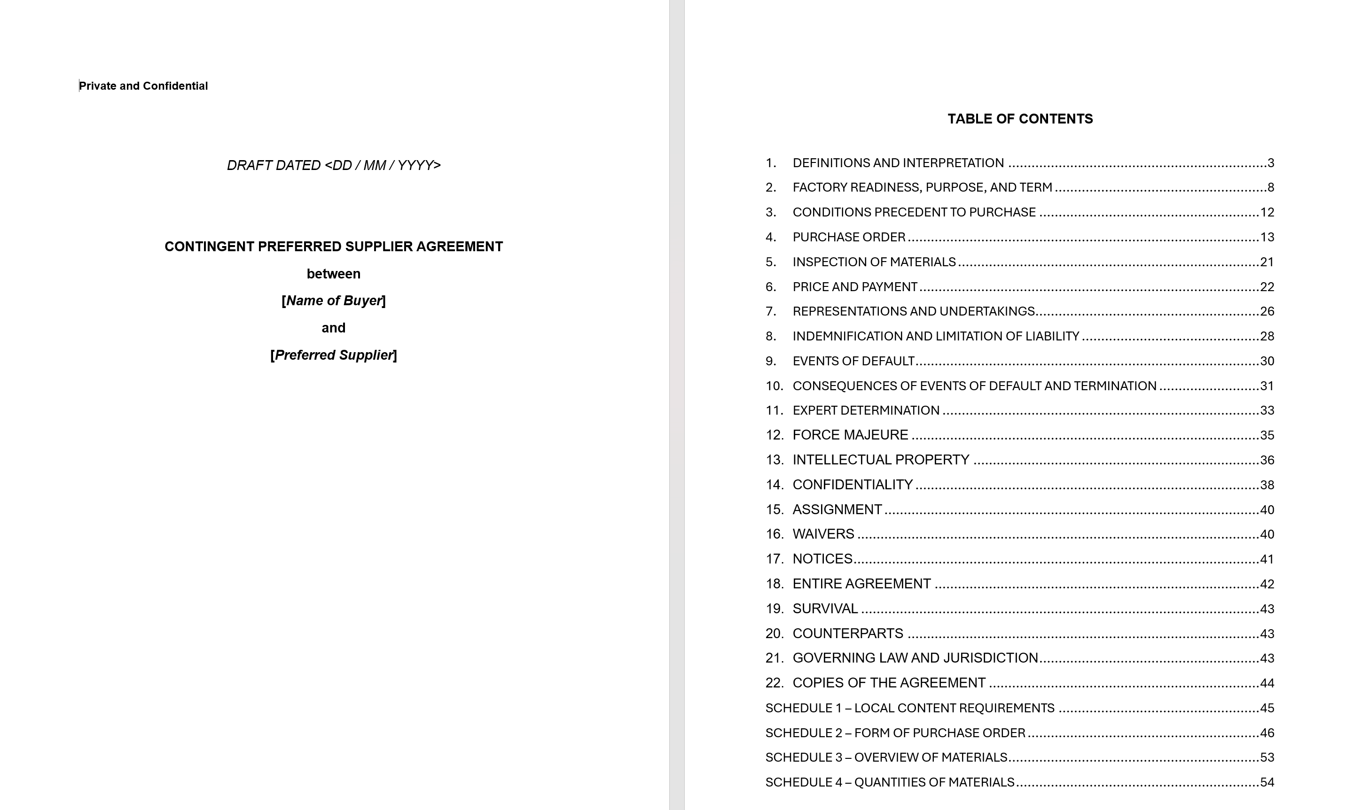
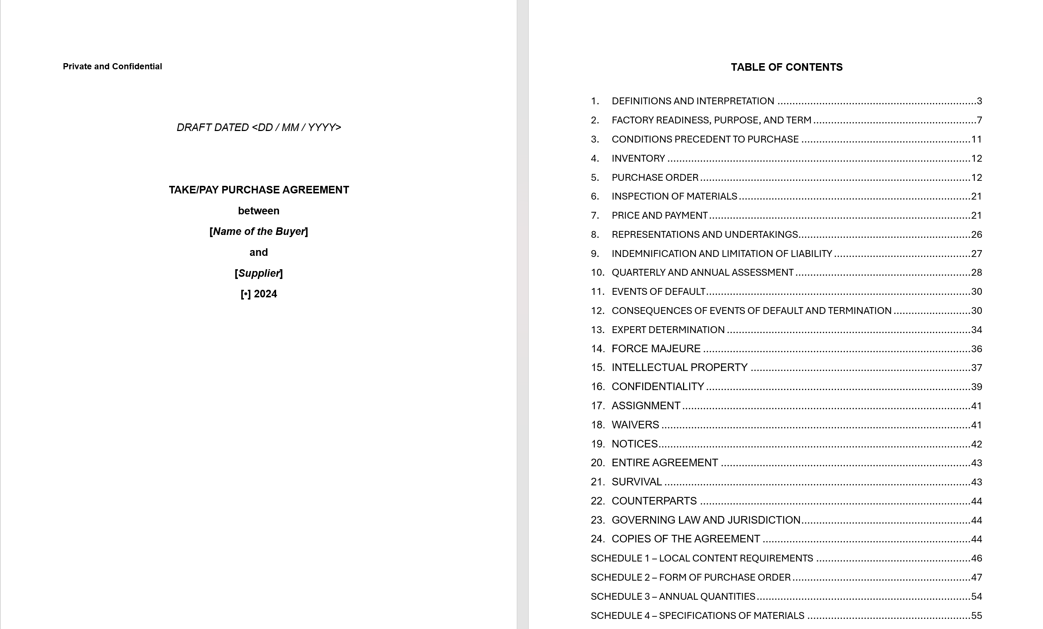
Stage 4 – Tendering and LDC award: two types of LDC agreements and related terms need to be defined
1. Product selection
2. Feasibility and terms assessment
3. Tendering and LDC award
4. LDC agreement sign-off
5. LDC execution and monitoring
A
B
Preferred supplier agreement (PSA)
Take-or-pay Agreement
Description
Prioritization of a preferred local supplier up to a certain annual quantity at an agreed-upon price
Demand commitments with purchase obligations set at a minimum annual quantity at an agreed-upon price
Demand commitment
Only if business needs arise
Yes
Risks to the buyer (agreements to have equivalent clauses to mitigate them)
Supply risk
Price risk
Technology risk
Liability risk
Supply risk
Price risk
Technology risk
Ready-to-plug template
PSA template provided as separate document as part of this implementation guide
Take-or-pay template provided as separate document as part of this implementation guide

Slide 19
Stage 5 – LDC execution and monitoring: Recommended governance to monitor LDC
1. Product selection
2. Feasibility and terms assessment
3. Tendering and LDC award
4. LDC agreement sign-off
5. LDC execution and monitoring
Illustrative – Should be customized according to each company’s context
LDC governance
Roles and responsibilities
Approve high-liability LDC agreements
Set localization vision / targets at a company level
Board of directors
Direction and approvals
Executive management
Approve all LDC agreements
Approve supplier selection based on the RfP responses
Direction and approvals
[Product selection] Endorse recommendations of the LC unit
[Feasibility assessment] Provide inputs to the LC unit to build the business case
[Tender and award] Coordinate the RfI / RfP process across various stakeholders and provide inputs to the LC unit
[Terms and conditions] Provide inputs as needed
[Monitoring] Oversee day-to-day issue resolution / manage and own tracking
Legal
LDC taskforce
….
Ops / supply chain
Procurement team
Finance
Business teams
Monitoring and support
Own of all localization initiatives including LDC mechanism
Manage and drive the LDC process, across the 5 stages
LC unit
Consult PIF for learnings on LC unit (Contacts)

Slide 20
Executive Summary
LDC implementation guide – How to…
…Select products for LDC
…Assess feasibility of LDC products
…Tender and award LDC supplier agreements
…Define LDC terms and conditions
…Monitor LDC progression and impact
…Set up and operate an LDC governance
Appendix (additional data and information)
1
2
Contents
3

Slide 21
Stage 1 of 5 − Product selection: Section preface
Product Selection
What is covered in the section
Framework and methodology to select and appropriate product which can be localized and needs demand commitment, from a longer-list of products
Tools to create the output to inform the analysis
By the end of the section, you will have an understanding of
Key questions to inform the choice of product
The product selection framework and how to use it
Templates / tools provided in the section
A
Product selection framework
Stakeholders involved
LC unit¹ [owner of the process]
Business team [provide suggestions on product choices]
Procurement / finance team / LDC taskforce [data to inform the framework]
1. Localization Unit

Slide 22
Selecting eligible products for LDC requires assessment based on three screening criteria
Methodology
Product Selection
In order to select a product, three questions need to answered. Each question is a screening criterion – only those products that pass the criterion for question 1 should be evaluated for question 2, and so on
Criticality of the product for localization in terms of company spend size and the company-level procurement from foreign over local suppliers
Should the product be localized?
1
Yes
Rapid qualitative evaluation if there are any technical roadblocks that would hinder localization of the product (e.g., availability of critical raw material, access to specialized workforce capabilities)
Is localization of the product technically feasible?
2
Yes
Is demand commitment required?
High-level evaluation of the investor risk based on the KSA demand concentration and KSA supply concentration (in line with market requirements)
3

Slide 23
LDC product selection – screening criteria
Methodology
1
Should the product be localized?
Criticality of the product for localization in terms of spend size and the overall level of procurement from foreign over local suppliers
Should the product be localized?
1
Yes
Rapid qualitative evaluation if there are any technical roadblocks that would hinder localization of the product (E.g., availability of critical raw material, access to labor)
Is localization of the product technically feasible?
2
Yes
Is demand commitment required?
High-level evaluation of the investor risk based on the demand concentration and availability of existing supply capacity (in line with market requirements)
3

Slide 24
Scale of demand and level of local procurement indicate a potential for localization
Methodology and tool
1
Should the product be localized?
Map each product procured by your company along the following two dimensions:
# | Dimension | Metric | Calculation methodology | Data sources
1 | Scale of demand | Annual product spend (average future forecast¹) as % of the total annual procurement spend across products | List all current and expected product procurement categories (opex and capex) Remove product categories without recurring long-term (10+ years) demand outlook Compile current (base year) procurement demand in SAR Compile demand forecast (at-least three years) and calculate average annual demand | LC sheets Internal financial reporting Annual business plans
2 | Level of imports | % Share of product demand volume procured from foreign suppliers | Compile current (base year) procurement volumes from local suppliers for product procurement categories with recurring demand In case the product is not procured in the base year, but will be going forward, estimate share of foreign procurement based on supplier relationships Calculate share of foreign procurement as % of the average demand for each product category | Procurement team Internal financial reporting
1 – Future forecast should be based on best available data. Although a 10-year forecast is ideal, a minimum of a three-year forecast should be considered
Note: The average annual demand should be tailored to align with the projected timeline for high-certainty demand outlook
Ready-to-plug template shared separately

Slide 25
Output example of estimating the 2 dimensions
Output example
1
Should the product be localized?
Illustrative example
Add data for more years as available (ideally, up to year 10)
# | Product | Is the spend recurring? (Yes / No) | Company Spend |  |  |  |  |  |  | Procurement from foreign suppliers
 |  |  | Year 0 (SAR Mn) | Year 1 (SAR Mn) | Year 2 (SAR Mn) | Year 3 (SAR Mn) | .... | Average annual Spend | Scale of demand | Year 0 (%) | Year 1 (%) | Year 2 (%) | Year 3 (%) | .... | Level of imports
1 | Product 1 | Yes | 500 | 550 | 600 | 650 |  | 575 | 49% | 25% | 35% | 45% | 50% |  | 39%
2 | Product 2 | Yes | 350 | 350 | 300 | 200 |  | 300 | 26% | 100% | 100% | 100% | 100% |  | 100%
3 | Product 3 | Yes | 275 | 500 | 100 | 325 |  | 300 | 26% | 0% | 0% | 25% | 50% |  | 19%
4 | Product 4 | No | 2,000 | - | - | - | - | - | 0 | 0% | 0% | 0% | 0% |  | 0%
 | ….
 | Total |  | 1,125 | 1,400 | 1,000 | 1,175 |  | 1,175 | -
Given one-time spend, do not consider for estimating scale
Exclude one-time spends (e.g., Product 4)
Estimated as ratio of average spend on one product to total average company spend. E.g., for Product 1, the ratio is (575/1,175 = 49%)
Estimated as ratio of avg. of foreign procurement %. E.g., For Product 1, the ratio is (avg. of 25%, 35%, 45%, 50% = 39%)
Consult PIF for support and queries (Contacts)

Slide 26
Visualization template to select products for localization
Template
1
Should the product be localized?
Post mapping every product along the two dimensions, plot them on an XY chart – Y-axis being the scale of demand and X-axis being the level of imports. Select for further evaluation only those products that are at the top right (high scale and high imports)
1
Scale of demand¹ (average annual product spend as % of the total annual average company procurement spend)
Prioritized products: Medium-high scale and high reliance on imports
High
(20%)
Medium
(5%)
Deprioritized products: Low-to-medium scale and medium-to-high localization
Low
(1%)
Low (0%)
Medium (50%)
High (100%)
Level of imports¹
(% Share of product demand volume procured from foreign suppliers)
2
1. Only refers to company level procurement spend, not across the country
Notes: The thresholds / categories will vary by category / company – overall, prioritize categories in the top right quadrant (high spend and high imports)

Slide 27
Output example for selecting products for localization
Output example
1
Should the product be localized?
Illustrative example
In this example, four products (electronics, telecom maintenance equipment, network infrastructure, tooling equipment) should be prioritized for further evaluation, given medium-high scale and high imports
1
Scale of demand (Annual product spend as % of the total annual company procurement spend)
High
(20%)
High spend, medium localization
High spend, low localization
Electronics
Telecom maintenance equipment
Medium spend, low localizaiton
Network infrastructure
Medium
(8%)
Wires
Tooling equipment
Gas and fuel
Chemicals
Paint and coating
Office furniture
IT hardware and software
Low
(1%)
Low (0%)
Medium (50%)
High (100%)
Level of imports (% Share of product demand volume procured from foreign suppliers)
2

Slide 28
Products for LDC are selected along three dimensions
Methodology
2
Can the product be localized?
Criticality of the product for localization in terms of spend size and the overall level of procurement from foreign over local suppliers
Should the product be localized?
1
Yes
Rapid qualitative evaluation if there are any technical roadblocks that would hinder localization of the product (e.g., availability of critical raw material, access to labor)
Is localization of the product technically feasible?
2
Yes
Is demand commitment required?
High-level evaluation of the investor risk based on the demand concentration and availability of existing supply capacity (in line with market requirements)
3

Slide 29
Technical localization feasibility can be assessed along a range of qualitative dimensions
Methodology
2
Can the product be localized?
Products shortlisted from question 1 should be evaluated as per the following dimensions. These are guidelines to help eliminate products, where localization is not immediately feasible due to technical challenges. PIF’s NDD team can be consulted for support / inputs.
Technical challenge dimension (non-exhaustive)
Data sources
Material availability
Are critical raw materials/input components available locally?
Supplier/ investor feedback
PIF NDD (Contacts)
Workforce
Requirement for specialized local workforce, which is not available in the short term
Supply characteristics
Long and challenging process to obtain certification requirements
Consolidated global supply chains with limited number of production facilities/suppliers
Product in scope typically produced by contract manufacturers, not the direct supplier
Regulations
Local regulations (e.g., standards) that need to be resolved prior to evaluating LDC feasibility
…
…
Consult PIF for support to resolve technical challenges (Contacts)

Slide 30
Products for LDC are selected along three dimensions
Methodology
3
Is demand commitment required?
Criticality of the product for localization in terms of spend size and the overall level of procurement from foreign over local suppliers
Should the product be localized?
1
Yes
Rapid qualitative evaluation if there are any technical roadblocks that would hinder localization of the product (E.g., availability of critical raw material, access to labor)
Is localization of the product technically feasible?
2
Yes
Is demand commitment required?
High-level evaluation of the investor risk based on the demand concentration and availability of existing supply capacity (in line with market requirements)
3

Slide 31
Requirement of demand commitment can be evaluated across two key dimensions
Methodology
3
Is demand commitment required?
Product shortlisted from question two should be evaluated as per the following dimensions
Requirement of demand commitment
Dimension |  | Metric | Rationale | No | Maybe¹ | Yes | Input sources
 | Buyer concentration | # of KSA companies acting as buyer (that have demand certainty) | Higher # of buyers reduces investor / supplier risk and may not require demand commitment | 4+ | 2-3 | 1 | Supplier sensing NIIC factory database Business teams PIF NDD (Contacts)
 | Existence and market fit of local supply capacity | # of KSA suppliers² that are able to provide the product with the required specifications | Existence of local suppliers indicates potential to supply through current capacity and/or a manageable risk for new investors | 3+ | 1-2 | 0
1
2
1. Based on subjective assessment
2. Only manufacturers / OEMs should be considered as suppliers, not distributors / other channel partners
Products that are rated as a “Yes” in at least one of these two dimensions should be selected for LDC and for further deep dive. The following page illustrates an example of one product that satisfies the three criteria and hence should be selected for LDC
Consult PIF for support and queries (Contacts)

Slide 32
Output example of product selection – telecom product
Output example
Product selection
 |  |  | Rationale
 | No | Yes | Sizable procurement spend (average annual demand 2024-2027 SAR +1 Mn) with recurring long-term opex demand outlook 75%+ procurement spend on foreign suppliers
 | No | Yes | No critical localization challenge identified
 | No | Yes | Single KSA buyer accounts for 80%+ of the demand Only one local supplier
Should the product be localized?
1
Is localization of the product technically feasible?
2
Is demand commitment required?
3
In this illustrative example, the telecom product should be selected for feasibility analysis

Slide 33
Executive Summary
LDC implementation guide – How to…
…Select products for LDC
…Assess feasibility of LDC products
…Tender and award LDC supplier agreements
…Define LDC terms and conditions
…Monitor LDC progression and impact
…Set up and operate an LDC governance
Appendix (additional data and information)
1
2
Contents
3

Slide 34
Stage 2 of 5 – Feasibility assessment: Section preface
Feasibility of products
What is covered in the section
Framework and methodology to do an in-depth feasibility assessment of the selected product(s)
Investor-view and buyer-view of the localization investment and implications on the investment
By the end of the section, you will have an understanding of
Various parameters and methodology to prepare a business case to inform the feasibility assessment
Types of LDC agreement and the approach to inform the choice
Templates / tools provided in the section
Feasibility assessment framework¹
Localization impact assessment dashboard
B
C
Stakeholders involved
LC unit [owner of the process]
LDC taskforce [provide inputs for the business case]
Management [approval and sign-off]
1. Given the nature and complexity of the template, this will be shared upon request. Please reach out to PIF NDD contacts shared

Slide 35
LDC feasibility provides an in-depth assessment of the opportunity by answering four questions
Feasibility of products
Objective
Evaluate whether demand is sufficient to localize the opportunity, based on:
KSA demand / supply gap
Regional export potential
Develop detailed business case to:
Select optimal type of LDC agreement (PSA or take-or-pay agreement) based on the financial risk of the investor
Assess the potential liability risks based on required LDC demand commitments and durations
Estimate of company-level LC impact as a result of the product localization
Ultimately, the LDC feasibility assessment aims to develop a thorough understanding of the opportunity and acts as the basis to obtain approval to commence the LDC journey
Questions covered under the LDC feasibility assessment
What is the localization opportunity and its expected impact?
Is the addressable demand sufficient for localization?
Is a preferred supplier agreement sufficient or is a take-or-pay required?
Are the associated risks manageable?
1
2
3
4

Slide 36
LDC localization opportunities should be articulated across the following parameters
Methodology
1
Localization opportunity and impact
The following template should be filled in for the selected LDC product, articulating the localization opportunity and the expected company-level LC impact
What is the opportunity?
Sources
Expected LC impact
Sources
Product specifications
<Description of the procured product and its specifications>
Previous purchase orders
Business/ operations teams
LC contribution (SAR)
<Expected contribution to local content in SAR Mn, through localization of the opportunity>
Calculation methodology on the following slide
Depth of localization
<Expected value chain coverage of the opportunity (e.g., assembly, component manufacturing)>
Supplier sensing
Benchmark investments
PIF NDD (Contacts)
LC uplift (% change)
<Expected increase of the LC score on a company level>
Calculation methodology on the following slide
Plant capacity
<High-level capacity (units) and expected capex of the localization opportunity>
Supplier sensing
Benchmark investments
PIF NDD (Contacts)
Consult PIF for support and queries (Contacts)

Slide 37
Methodology to calculate local content impact
Methodology and tool
Localization opportunity and impact
1
1
Company total yearly demand in steady state (SAR)
X
2
% procured from LDC supplier in steady state (can be higher than the LDC commitment given)
X
3
LC score of the localized product (based on Local Content Government and Procurement Authority (LCGPA) average sector scores)
4
Total cost of operations of the company (in line with LCGPA LC score baseline template)
# | Metric | Definition | Calculation methodology | Data sources
1 | Company total yearly demand in steady state | Company’s projected annual demand for the procured product in a selected year, assuming demand remains constant | Compile demand forecast (at least three years) Select the demand value from the year in which demand stabilizes | Internal financial reporting Annual business plans
2 | % procured from LDC supplier in steady state (can be higher than the LDC commitment given) | Ratio of procured volume from LDC supplier out of total product demand at steady state | Complete calculation methodology in Metric #1 Calculate share of procurement volume from LDC supplier as a % of the total yearly volume demand in steady state | Annual business plans
3 | LC score of the localized product (based on LCGPA average sector scores) | % local content attributed to the product sector by LCGPA | Insert the sector score attributed by LCGPA | Company LC reporting templates
4 | Total Cost of Operations (in line with LCGPA LC score baseline template) | Sum of costs associated to spend on goods and services, labor compensation, capacity building, and depreciation of capital and assets | Compile forecast of cost of operations (at least 3 years) Calculate the average cost of operations | Company LC reporting templates
1
2
3
4
Ready-to-plug template shared separately
Consult PIF for support and queries (Contacts)

Slide 38
LDC feasibility provides an in-depth assessment of the opportunity by answering four questions
2
Addressable demand
Objective
Evaluate whether demand is sufficient to localize the opportunity, based on:
KSA demand / supply gap
Regional export potential
Develop detailed business case to:
Select optimal type of LDC agreement (PSA or take-or-pay agreement) based on the financial risk of the investor
Assess the potential liability risks based on required LDC demand commitments and durations
Estimate of company-level LC impact as a result of the product localization
Ultimately, the LDC feasibility assessment aims to develop a thorough understanding of the opportunity and acts as the basis to obtain approval to commence the LDC journey
Questions covered under the LDC feasibility assessment
What is the localization opportunity and its expected impact?
Is the addressable demand sufficient for localization?
Is a preferred supplier agreement sufficient or is a take-or-pay required?
Are the associated risks manageable?
1
2
3
4

Slide 39
To prove localization viability, total addressable demand needs to be assessed against the plant capacity
Methodology
2
Addressable demand
Annual volume (e.g., units, tons)
Sources
KSA demand
#
Company’s own demand
Market intelligence (through estimations, supplier sensing, expert interviews)
KSA supply
NIIC factory database
Supplier sensing
#
KSA demand / supply gap
#
Regional export potential
#
Regional reported imports (HS codes)
Market intelligence (through estimations, supplier sensing, expert interviews)
Total addressable demand
KSA
Export
#
Minimum viable plant capacity of the LDC product
#
If total addressable demand is smaller than expected plant capacity, the viability of the opportunity needs to be reviewed
Supplier sensing
Benchmark investments
% of total addressable demand
Consult PIF for support to estimate supply and demand (Contacts)

Slide 40
Output example for a telecom product subject to localization
Output example
2
Addressable demand
Illustrative
Annual volume (# units)
Comments
KSA demand
2 Mn
KSA demand is 2 Mn units with a 3-5% YoY growth
KSA supply
All units are currently sourced through imports
0
KSA demand / supply gap
2 Mn
Regional export potential
1 Mn
Potential 1 Mn in exports to GCC neighboring countries
Total addressable demand
KSA
Export
3 Mn
Minimum viable plant capacity of the LDC product
2.1 Mn
For 1 small-medium sized plant
In this illustrative example, addressable demand is more than min. viable plant capacity and hence the addressable demand is sufficient
Consult PIF for support to estimate supply and demand (Contacts)

Slide 41
LDC feasibility provides an in-depth assessment of the opportunity by answering four questions
3
Is preferred supplier agreement sufficient?
Objective
Evaluate whether demand is sufficient to localize the opportunity, based on:
KSA demand / supply gap
Regional export potential
Develop detailed business case to:
Select optimal type of LDC agreement (PSA or take-or-pay agreement) based on the financial risk of the investor
Assess the potential liability risks based on required LDC demand commitments and durations
Estimate of company-level LC impact as a result of the product localization
Ultimately, the LDC feasibility assessment aims to develop a thorough understanding of the opportunity and acts as the basis to obtain approval to commence the LDC journey
Questions covered under the LDC feasibility assessment
What is the localization opportunity and its expected impact?
Is the addressable demand sufficient for localization?
Is a preferred supplier agreement sufficient or is a take-or-pay required?
Are the associated risks manageable?
1
2
3
4

Slide 42
There are two types of demand commitments that can be offered
Methodology
3
Is preferred supplier agreement sufficient?
Offered only as a last-resort
Type of agreement
Preferred supplier agreement
Take-or-pay agreement
1
2
How does it work?
The buyer has to procure from supplier only if business need arises, i.e., if there is demand and the buyer procures from a foreign entity, legal implications arise. However, if the buyer does not procure, no legal obligations arise
Purchase quantity, duration, and price contractually agreed upon
Supplier must commit to invest in a local facility
Demand commitment with purchase obligations: if such an agreement has been concluded, the buyer is legally obliged to procure from the supplier even if no business need arises
Product quantity, duration, and price contractually agreed upon
Supplier must commit to invest in a local facility
Liability risk exposure?
No (procurement only if business need arises)
Yes (in the form of take-or-pay)
When to apply?
Low financial risk for the investor
Low to medium capex
Medium to high Internal Rate of Return (IRR)
Low to medium product complexity (based on PCI¹)
High financial risk for the investor
High capex
Low IRR
High product complexity (based on PCI¹)
1. Product Complexity Index

Slide 43
A business model needs to be created to assess the type of demand commitment
Methodology
3
Is preferred supplier agreement sufficient?
The following three parameters are crucial to deciding whether a PSA will suffice, or if a take-or-pay is needed. The investment parameters are calculated after creating a business model (template shared separately), which estimates the yearly cash flows, net of cash outflow (capex, operating costs, etc.) and cash inflow (profits)
Implications for demand commitment
Parameters
Definition
How to calculate
Capex
Funds that a company spends on acquiring or maintaining physical assets such as property, buildings, machinery, or equipment. These are long-term investments
Consider and estimate all direct and indirect costs that will be incurred to operationalize a manufacturing facility¹
Higher capex will increase investor risk and may require take-or-pay
1
Outputs from the business case
Returns (IRR²)
IRR is the rate of return at which the present value of a project's cash inflows equals the present value of its cash outflows, or the project breaks even in terms of net value
Estimate yearly net cash flows of the project³
Lower IRR (typically less than 10%⁴) increases investor risk and may require take-or-pay
2
Product complexity index
Measure of a product’s complexity and requirement of technical know-how
Provided by “The Atlas of Economic Activity”
Higher product complexity will increase investor risk and may require take-or pay
3
1. More details can be found here (Link) 2. Internal Rate of Return 3. More details can be found here (Link) 4. Thresholds are typically product / industry / capital structure specific and should be nuanced as per the context

Slide 44
Example output of a business case – telecom product
Output example
3
Is preferred supplier agreement sufficient?
KPIs to inform the type of LDC agreement (output of the business case)
SAR Mn
1,000
Revenue
Cost of materials
Cumulative free cash flow
Capex
Fixed and variable overheads
Capex (SAR Mn) | 175-200
IRR | 13-15%
Revenues
0
Costs
NPV (SAR Mn)¹ | 50+
Break-even volume (yearly) | ~1M units
Payback period | 6 - 8 yrs.
-800
Year 0
Year 1
Year 2
Year 3
Year 4
Year 5
Year 6
Year 7
Year 8
Year 9
Plant capacity ramp-up
-
50%
100%
100%
100%
100%
100%
100%
100%
100%
Plant capacity utilization
-
33%
67%
70%
74%
77%
81%
85%
89%
94%
Sales (Mn units)
-
1.0
2.0
2.1
2.2
2.3
2.4
2.6
2.7
2.8
1. If NPV is negative, the investment is likely non-viable in its current form
Ready-to-plug business model template can be shared upon request
Consult PIF for support and queries (Contacts)

Slide 45
The type of demand commitment is informed by three parameters
Methodology
3
Is preferred supplier agreement sufficient?
Once the business model is created, use the following framework to assess whether a PSA is sufficient
Thresholds for each parameter are indicative and can vary by product category
Assessment dimension
Metric
Sources
Take-or- pay | * | PSA
> 200 Mn | 100-200 Mn | < 100 Mn
< 9% | 9-15% | > 15%
> 1.0 | 0.0-1.0 | < 0.0
Is a PSA sufficient?
Capex
Cumulative capex (in SAR) to set-up manufacturing facility and related infrastructure
Business model, informed by:
Business teams
Supplier feedback
External benchmarks
PIF NDD
1
Returns (IRR)
10-year IRR for the investment
2
Product complexity
Measure of a product’s complexity and requirement of technical know-how
The Atlas of Economic Activity
3
* Depends on subjective assessment of the buyer, based on industry context and / or supplier inputs

Slide 46
LDC feasibility provides an in-depth assessment of the opportunity by answering four questions
4
Are the risks manageable?
Objective
Evaluate whether demand is sufficient to localize the opportunity, based on:
KSA demand / supply gap
Regional export potential
Develop detailed business case to:
Select optimal type of LDC agreement (PSA or take-or-pay agreement) based on the financial risk of the investor
Assess the potential liability risks based on required LDC demand commitments and durations
Estimate of company-level LC impact as a result of the product localization
Ultimately, the LDC feasibility assessment aims to develop a thorough understanding of the opportunity and acts as the basis to obtain approval to commence the LDC journey
Questions covered under the LDC feasibility assessment
What is the localization opportunity and its expected impact?
Is the addressable demand sufficient for localization?
Is a preferred supplier agreement sufficient or is a take-or-pay required?
Are the associated risks manageable?
1
2
3
4

Slide 47
Two parameters (estimated as part of the business model) can inform investors whether the risks are manageable
Methodology
4
Are the risks manageable?
Risk assessment dimension
Business model output
Description
How to calculate
Implications for risk
Ratio of total yearly fixed costs (in SAR) and per-unit contribution margin (in SAR)¹, in steady state
As the break-even value increases, the demand commitment needs to increase, leading to a higher buyer risk
LDC volume
Procurement volume for which demand commitment is given
Break-even volume
1
Ratio of initial investment and annual cash inflow²
The longer the payback period, the longer will the time for which demand commitment is needed, increasing buyer risk
LDC duration
Time period over which LDC is planned or obligated to be fulfilled
Payback period
2

Slide 48
Example output of a business case to inform level of risk – telecom product
Output example
4
Are the risks manageable?
SAR Mn
1,000
Revenue
Cost of materials
Cumulative free cash flow
Capex
Fixed and variable overheads
Capex (SAR Mn) | 175-200
IRR | 13-15%
Revenues
0
NPV (SAR Mn) | 50+
Break-even volume (yearly) | ~1 Mn units
Payback period | 6 - 8 yrs.
Costs
-800
Year 0
Year 1
Year 2
Year 3
Year 4
Year 5
Year 6
Year 7
Year 8
Year 9
Plant capacity ramp-up
-
50%
100%
100%
100%
100%
100%
100%
100%
100%
Plant capacity utilization
-
33%
67%
70%
74%
77%
81%
85%
89%
94%
Sales (Mn units)
-
1.0
2.0
2.1
2.2
2.3
2.4
2.6
2.7
2.8
KPIs to inform whether the risks are manageable (framework on the next page)

Slide 49
The associated risks can be analyzed using two parameters
Methodology
4
Are the risks manageable?
Demand commitment can imply risks for the buyer, and it is important to estimate the extent of the risk. This can be assessed across two dimensions (which are primarily informed by the business model as well as supplier feedback, as available)
Thresholds for each parameter are indicative and can vary by product category
Are the associated risks manageable?
Risk assessment dimension
Business model output
No |  | Yes
> 40% | 30-40% | < 30%
8+ | 5-8 | Up to 4
Metric
Sources
Business teams
Supplier feedback
External benchmarks
PIF NDD
LDC volume
Break-even volume
% of LDC volume over total average annual buyer demand
1
LDC duration
Payback period
Minimum between # years for payback and # years with buyer demand at high confidence
2

Slide 50
Once all four questions are answered, the product’s LDC feasibility is known – output example
Output example
Feasibility assessment
Illustrative
Feasibility assessment
Outcome
Rationale
No impact
Limited impact
Large impact
What is the localization opportunity and its impact
No
Opportunity to localize <telecom product> by setting up assembly and testing facility
Currently, 100% reliance on imports with large procurement spend (SAR +500 Mn)
Localizing the assembly and testing can increase the localization score by up to 2%
1
No
Yes
Is addressable demand sufficient for localization?
No
Local demand and regional exports are 150-200% of the minimum viable plant capacity
2
No. Take-or-pay is needed
Yes
Is a PSA Sufficient?
No
Low risk for investors, given
IRR: 13+%
PCI: While high (1.2), the product is commoditized internationally, and foreign players will not face challenges in setting up new plants
3
No
Are the associated risks manageable?
No
Yes
Demand commitment is required for 4-5 years and 25% of the yearly demand, to de-risk the investment
4
In this illustrative example, the telecom product passes the LDC feasibility assessment and should be selected for localization. The framework (e.g., thresholds) should be tailored for specific needs / context

Slide 51
Executive Summary
LDC implementation guide – How to…
…Select products for LDC
…Assess feasibility of LDC products
…Tender and award LDC supplier agreements
…Define LDC terms and conditions
…Monitor LDC progression and impact
…Set up and operate an LDC governance
Appendix (additional data and information)
1
2
Contents
3

Slide 52
Stage 3 of 5 − Tendering and LDC award: Section preface
Tender and award
What is covered in the section
Steps to identify and award LDC agreement to the most appropriate supplier to localize the proposed product
By the end of the section, you will have an understanding of
How to launch an RfI and RfP to solicit supplier responses
How to evaluate supplier’s responses to RfI and RfP
Templates / tools provided in the section
D
D
RfP template
RfI template
Stakeholders involved
Legal team [owner of the process]
Procurement team [supplier evaluation and liaison]
Business teams / LC unit / LDC taskforce [recommendations and feedback]
1. Given the nature and complexity of the template, this will be shared upon request. Please reach out to PIF NDD contacts shared

Slide 53
An RfI and RfP process helps select suppliers competitively and lower risks as much as possible
Tender and award
A
B
Request for information (RfI)
Request for proposal (RfP)
Objectives
Formally validate supplier interest to locally supply the product
Shortlist suppliers for RfP participation
Validate the need to provide demand guarantees
Understand supplier needs
Identify and select the optimal supplier to minimize risk effectively
Ensure the best cost while ensuring best product quality with required specifications including localization needs
Ensure that the supplier delivers the product on schedule
Questions addressed in this document
What is the structure and outline of the document?
What is the information requested from suppliers?
How are the responses evaluated?
1
2
3

Slide 54
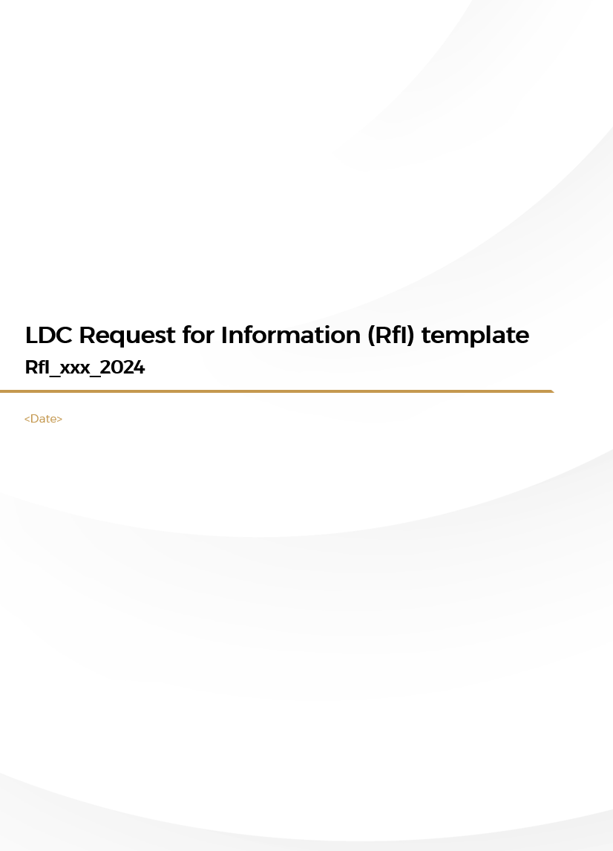
RfI typically includes three sections
Methodology and template
RfI
RfP
1
What is the structure of the document?
Section
What is included
Background and scope of the RfI
High-level KSA and buyer annual demand outlook
Current local supply capacity
Localization opportunity and product category description (including preliminary / secondary specifications)
1
Information required from the suppliers
Interest of the supplier in participating in the tendering
Supplier qualifications – minimum requirements for being shortlisted
Proposed high-level manufacturing plan
Main challenges and potential support
2
Details on the following page
Submission deadline and information
RfI process
Submission timeline
Details about the points-of-contacts
RfI template provided as separate document as part of this implementation guide
3
Consult PIF for support and queries (Contacts)

Slide 55
Information from suppliers is typically requested under four objectives
Methodology and template
RfI
RfP
2
What is the information requested?
RfI objective
Key information required to address the objectives
Formally validate supplier interest | Do you confirm your interest in participating in a future tendering process (through RfP)?
Shortlist suppliers for participating in RfP | What are your current manufacturing capabilities? E.g., current manufacturing capacity, products portfolio and specification, value chain integration What products can you produce in addition to the current ones? E.g., different specs, different technology What technologies and intellectual property (IP) (incl. technical certifications) do you have access to (both in-house and via technical partners)? What is your current geographical footprint? What is your KSA and regional experience? E.g., team, key projects, client portfolio Who are your key partners along the value chain? E.g., main suppliers, manufacturing technology partner
Validate current outside-in feasibility assessment and tailor RfP evaluation criteria | What is the proposed production capacity to localize? What is the required minimum viable plant size? What is the estimated timeline to build the manufacturing facility? What is the proposed level of integration across the value chain? E.g., assembly, component manufacturing What is the proposed production technology? E.g., semi-automated vs. automated line What is the expected capex requirement to build the manufacturing facility? What is the estimated selling price of the localized product? (nice to have)
Understand supplier needs | What potential challenges do you envisage to implement the project? E.g., technical, financial, commercial challenges What type of support do you require? E.g., financial, fiscal, operational incentives, access to infrastructure, regulatory enablement
1
2
3
4
Consult PIF for support and queries (Contacts)

Slide 56
RfI responses should be evaluated and shortlisted based on supplier interest and qualifications
Methodology
RfI
RfP
3
How to evaluate responses?
Dimension
Shortlisting criteria
Evaluation failed if
Evaluation passed if
Supplier interest | Has the supplier provided us with the right information by the submission deadline? |  | No | Yes
Supplier qualifications | Manufacturing capabilities | Are the supplier’s current manufacturing capabilities in line with customer requirements? E.g., in terms of product portfolio, expertise, plant capacity | No | Yes
 | Products | Can the supplier manufacture the required specifications? | No | Yes
 | Technologies and IP | Does the supplier (or its technological partner) have the required technologies and IP (including certifications)? | No | Yes
1
2
Consult PIF for support and queries (Contacts)

Slide 57
RfP typically includes eight sections
Methodology and template
RfI
RfP
1
What is the structure of the document?
Section
1
Background and high-level scope of the RfP
2
Mandatory document
3
Project scope and technical requirements
4
Agreement terms and conditions (T&Cs)
5
Technical proposal
6
Commercial proposal
7
Evaluation criteria
RfP template provided as separate document as part of this implementation guide
8
Submission deadline and information
Details on the next page
Consult PIF for support and queries (Contacts)

Slide 58
RfP typically includes eight sections
Methodology and template
RfI
RfP
2
What is the information requested?
Section
What is included
Background and high-level scope of the RfP | High-level KSA and PIF average annual demand Buyers’ current projects Current supply capacity Localization opportunity and product category description
Mandatory document | Mandatory documents, certifications, and standards (e.g., labor certificates, sustainability certificates, construction licenses)
Project scope and technical requirements | Project scope (e.g., product quality and specifications, manufacturing plant characteristics¹, manufacturing plant timeline) Technical requirements (e.g., technical certifications) Local content requirements (e.g., LC target, Saudi Made certificate)
Agreement T&Cs | Anticipation of key T&C of the agreement (e.g., conditions precedents, exclusive agreement, contract duration)
Technical proposal | Details in the next slides
Commercial proposal | Details in the next slides
Evaluation criteria | Minimum technical requirements Technical proposal evaluation criteria Commercial proposal evaluation criteria
Submission deadline and information | RfP process Submission timeline Details about the points of contacts
1
2
3
4
5
6
7
8
1. e.g., Maximum plant capacity (based on RfI responses), production technology, location
Consult PIF for support and queries (Contacts)

Slide 59
Responses to RfP need to be evaluated against technical and commercial parameters
Methodology and template
RfI
RfP
3
How to evaluate responses?
Section
What must be included
1
Background and high-level scope of the RfP | High-level KSA and PIF average annual demand….
Mandatory document | Mandatory documents, certifications and standards (e.g., labour certificates…..
Project scope and technical requirements | Project scope (e.g., product quality and specifications, manufacturing plant….
Agreement T&Cs | Anticipation of key T&C of the agreement (e.g., conditions precedents, exclusive….
Technical proposal | Minimum technical requirements (Technical pass) Proposed manufacturing plant capacity (up to a certain threshold) Product specifications Manufacturing plant technology (level of automation) Manufacturing plant setup timeline Manufacturing experience Proposed manufacturing plan Proposed manufacturing plant capacity Proposed depth of localization (i.e., level of integration across the value chain) Proposed local content strategy (e.g., local sourcing, Saudization, local R&D spend) Estimated capex requirements to build the manufacturing facility Estimated plant financials (e.g., revenues, margins) Estimated breakdown of fixed and variable costs (e.g., cost of components, salary costs) Funding sources
Commercial proposal | Proposed commercial terms Selling price of the localized product Required number of years for demand commitment Level of demand commitment
Evaluation criteria | Minimum technical requirements….
Submission deadline and information | RfP process…..
2
3
4
5
6
7
8
Consult PIF for support and queries (Contacts)

Slide 60
RfP evaluation process – technical and commercial scoring
Methodology
RfI
RfP
3
How to evaluate responses?
Technical evaluation
Commercial evaluation
A
Technical Screening:
Shortlist only those suppliers that meet the minimum requirements of product and supply
B
C
Technical Scoring:
Score each shortlisted supplier against three technical dimensions
Commercial Scoring:
Score each shortlisted supplier against three technical dimensions
Best supplier identified through a weighted average of technical and commercial scores
Note: Buyers can tailor the process (e.g., the weights of technical and commercial scores) based on existing procurement practices

Slide 61
RfP responses should be evaluated against a minimum technical criteria
Methodology
RfI
RfP
3
How to evaluate responses?
A
Technical screening
Evaluation failed if
Evaluation passed if
Dimension
Shortlisting criteria
Preference given if
Proposed manufacturing plant capacity | Is the proposed manufacturing plant capacity above the minimum required capacity? | No | Yes
Product specifications | Is the supplier committing to the production of the required specifications? | No | Yes
Manufacturing plant technology | Does the supplier have an automated factory? | No | Yes
Manufacturing plant setup timeline | Is the proposed manufacturing plant setup timeline aligned with the required demand timeline? | No | Yes
Manufacturing experience | Does the supplier have previous manufacturing experience? | No | Yes | Supplier has previous experience in Gulf countries, and / or, Working on localization
1
2
3
4
5
Consult PIF for support and queries (Contacts)

Slide 62
Suppliers that pass technical screening should be scored against three dimensions
Methodology
RfI
RfP
3
How to evaluate responses?
B
Technical scoring
Weightages are indicative and can vary across companies / industries
Dimension
Evaluation criteria
Weight
L3 (25%)
L2 (75%)
L1 (100%)
Proposed manufacturing plant capacity | Is the proposed manufacturing plant capacity above the minimum required capacity? | 50% | Dependent on opportunity | Dependent on opportunity | Dependent on opportunity
Product specifications | Is the supplier committing to the production of the required specifications? | 25% | Dependent on opportunity | Dependent on opportunity | Dependent on opportunity
Manufacturing plant technology | Is the technology used for manufacturing (e.g., tooling, automation, processes, etc.), world-class? | 25% | Dependent on opportunity | Dependent on opportunity | Dependent on opportunity
1
2
3
Each supplier to be evaluated (scored) and ranked (L1, L2, or L3) against technical parameters. Supplier with the highest score to be selected for further steps – evaluation of commercial proposal
Consult PIF for support and queries (Contacts)

Slide 63
Commercial evaluation is done across four dimensions
Methodology
RfI
RfP
3
How to evaluate responses?
C
Commercial scoring
Dimensions
Evaluation criteria
Weight
Scoring (continuous scoring, normalized on the best result)
Estimated price | What is the price of a unit of the product? | 40%
Number of years of annual demand commitment needed | How many years does the supplier want the demand commitment for? | 25%
Absolute annual demand commitment needed | What is the absolute annual demand commitment required by the supplier? | 25%
Committed share of capacity | What is the share of capacity the supplier is willing to commit to? | 10%
1
0 %
100 %
Highest Price
2
0 %
100 %
Highest number of years
3
0 %
100 %
Largest volume
0 %
100 %
4
Largest share over total capacity
Contract should be awarded to the supplier with the highest overall techno-commercial scores
Consult PIF for support and queries (Contacts)

Slide 64
Executive Summary
LDC implementation guide – How to…
…Select products for LDC
…Assess feasibility of LDC products
…Tender and award LDC supplier agreements
…Define LDC terms and conditions
…Monitor LDC progression and impact
…Set up and operate an LDC governance
Appendix (additional data and information)
1
2
Contents
3

Slide 65
Stage 4 of 5 – Terms and conditions: Section preface
Terms and conditions
What is covered in the section
Considerations to appropriately structure an LDC agreement to safeguard a buyer against investment risks
By the end of the section, you will have an understanding of
How to structure an LDC agreement
Templates / tools provided in the section
E
Preferred supplier agreement
E
Take-or-pay agreement
Stakeholders involved
Legal team [owner of the process]
Business teams / LC unit [recommendations and feedback]
BoD [take-or-pay sign-off]; Management [liability agreements sign-off]
1. Given the nature and complexity of the template, this will be shared upon request. Please reach out to PIF NDD contacts shared

Slide 66
Optimal terms and conditions of an LDC agreement to be defined for appropriate risk mitigation
Objective
Understand the buyer risks across four categories:
Liability risk
Supply risk
Price risk
Technology risk
Make an informed choice on the optimal type of LDC agreement – Preferred supplier agreement or take-or-pay
Minimize buyer risk based on the type of the LDC agreement
Questions covered under the LDC feasibility assessment
1
What are the various risks associated with an LDC agreement?
How to define optimal terms and conditions to mitigate these risks?
2

Slide 67
Defining terms and conditions helps structure the optimal agreement
Methodology and template
Terms and conditions
A
B
Preferred supplier agreement (PSA)
Take-or-pay Agreement
Description
Prioritization of a preferred local supplier up to a certain annual quantity at an agreed price
Demand commitments with purchase obligations set at a minimum annual quantity at an agreed price
Demand commitment
Only if business needs arise
Yes
Risks to the buyer (agreements to have equivalent clauses to mitigate them)
Supply risk
Price risk
Technology risk
Liability risk
Supply risk
Price risk
Technology risk
Ready-to-plug template
PSA template provided as separate document as part of this implementation guide
Take-or-pay template provided as separate document as part of this implementation guide

Slide 68
A preferred supplier agreement is structured with 11 sections
Methodology
A
Preferred supplier agreement
Section
What is included (non-exhaustive)
Definitions and interpretation | Definition of key terminologies used throughout the contract and rules of interpretation
Factory readiness, purpose, and term | General section on agreement commencement and its purpose (e.g., supplier/buyer obligations)
Conditions precedents | Description of conditions that must be met before any obligation gets triggered (e.g., factory setup)
Purchase order (PO) | Provisions detailing products’ PO (e.g., quantity, quality, specs) and consequence of non-payment
Inspection of materials | Provisions detailing products’ quality check mechanism of buyers
Price and payments | Provisions on price calculation, price review mechanisms and change requests, and payment terms
Representations and undertakings | Provisions detailing the party representative and undertakings
Indemnification and limitation of liability | Provisions such as conditions triggering guarantee payments, maximum liability)
Events of default (EoD) | Provisions describing the supplier’s and buyer’s failure to fulfil obligations
Consequences of EoD and termination | Provisions on the compensation mechanisms (i.e., remedies) and the termination of the agreement
Other boilerplate provisions | E.g., expert determination, force majeure, intellectual property, confidentiality, assignment, waivers
1
2
3
4
5
6
7
8
9
10
11
…………….

Slide 69
Supply risk mitigation mechanisms
Methodology
A
Preferred supplier agreement
1
Supply risk
Risk
Key questions
Mitigation mechanism
Section(s)
Clause(s)
Supply risk | How to minimize supply risk for the buyer? i.e., delivery, quantity, quality | LDC agreement to trigger only post-start of conditions precedents covering pre-production conditions¹ (e.g., timeline, production capacity, production technology) and production conditions (e.g., specifications, localization, Saudi Made certificate, other certificates²) | CONDITIONS PRECEDENTS | 3.1
 |  | Notification mechanisms in place to prevent any supply shortfall for each purchase order (i.e., time, quantity, specs) | FACTORY READINESS, REPRESENTATIONS AND UNDERTAKINGS | 2.1.4 7.2.1 (h)
 |  | Changes and amendment can be requested for every purchase order (i.e., price, quantity, specs), and at the beginning of each contractual year | PURCHASE ORDER | 4.8, 4.9
 | How to ensure the buyer is compensated in an adequate way? | Performance bond issued every PO (5% of the PO value, provided by a reputable bank in KSA) | PURCHASE ORDER | 4.10
 |  | Remedies to claim for compensation (i.e., liquidated damages, claw-back mechanism, invoke performance bond, termination contract) | CONSEQUENCES OF EVENTS OF DEFAULT AND TERMINATION | 10.1, 12.3 schedule 2 (6.1)
a
1
b
1. In line with what the supplier has committed to during the contracting phase; 2. E.g., certificate of registration, certificate of payment of Zakat, registration in GOSI

Slide 70
Supply risk mitigation mechanisms – buyer and supplier compensation
Methodology
A
Preferred supplier agreement
1
Supply risk
Buyer
Issue a PO
Contractor obtains the material from a suitable substitute third party at the expense of the manufacturer
Contractor and manufacturer mutually agree on the delay of the material
Get compensated
Supplier
Is entitled to liquidated damages (in case of delay)
Calls upon PB
Receive the PO and issue the PB
Manufacturer event of default
Has the manufacturer mitigated the risks?
N
Is there a risk of default¹?
Start manufacturing
Y
N
Y
No event of default
Notes: PB = Performance Bond, PO = Purchase Order; 1. I.e., a risk for the manufacturer of not being able to deliver the materials on time with the right quantity or the right specs
Consult PIF for support and queries (Contacts)

Slide 71
Price and technology risks mitigation mechanisms
Methodology
A
Preferred supplier agreement
2
Price and tech risk
3
Risk
Key questions
Mitigation mechanism
Section(s)
Clause(s)
Price risk | How to ensure the buyer is not paying prices higher than market prices? | Price defined in line with market conditions | PURCHASE ORDER, PRICE AND PAYMENTS | 4.3 (g) 6.2.1 (c), (d)
 | When does price review get triggered? | Prices to be reviewed on a continual basis (at the beginning of every contractual year) and potentially for each PO (based on separate contractor-supplier negotiation) | PURCHASE ORDER, PRICE AND PAYMENTS | 4.8.1, 4.8.5 6.2
Technology risk | How to ensure that the buyer is able to procure products in line with its requirements? | Technology change requests to be incorporated by the manufacturer if technologically and commercially feasible | PURCHASE ORDER, INSPECTION OF MATERIALS | 4.8.1 (c), 5.1.3
a
2
b
3
a
Back

Slide 72
Defining terms and conditions helps structure the optimal agreement
Terms and conditions
A
B
Preferred supplier agreement (PSA)
Take-or-pay Agreement
Description
Prioritization of a preferred local supplier up to a certain annual quantity at an agreed-upon price
Demand commitments with purchase obligations set at a minimum annual quantity at an agreed-upon price
Demand commitment
Only if business needs arise
Yes
Risks to the buyer (agreements to have equivalent clauses to mitigate them)
Supply risk
Price risk
Technology risk
Liability risk
Supply risk
Price risk
Technology risk
Ready-to-plug template
PSA template provided as separate document as part of this implementation guide
Take-or-pay template provided as separate document as part of this implementation guide

Slide 73
Take-or-pay draft agreement structured around 13+ sections
Methodology
B
Take-or-pay agreement
Section
What is included (non-exhaustive)
Definitions and interpretation | Definition of key terminologies used throughout the contract and rules of interpretation
Factory readiness | A general section setting out the commencement of the agreement and its purpose (e.g., supplier / buyer obligations)
Conditions precedents | Descriptions of conditions that must be met before the contractors’ purchase obligation begins (e.g., factory setup)
Inventory | Provisions on supplier to maintain certain level of inventory (e.g., per months or per year requirements)¹
Purchase order (PO) | Provisions detailing products’ PO (e.g., quantity, quality, specs) and consequence of non-payment by contractor
Inspection of materials | Provisions detailing products’ quality check mechanism of buyer²
Price and payments | Provisions detailing price calculation, price review mechanisms and change requests, and payment terms
Representations and undertakings | Provisions detailing the party representative and undertakings
Indemnification and limitation of liability | Provisions on indemnification and limitation of liability (e.g., conditions triggering guarantee payments, maximum liability)
Quarterly and annual assessment | Provisions describing the risk assessment process and the related mitigation measures
Events of default (EoD) | Provisions describing the supplier and buyers’ failure to fulfil obligations
Consequences of EoD and termination | Provisions detailing the compensation mechanisms (i.e., remedies) and the termination of the agreement
Other boilerplate provisions | E.g., expert determination, force majeure, intellectual property, confidentiality, assignment, waivers
1
2
3
4
5
6
7
8
9
10
11
12+
13+
…………….
1. To include optionality based on the product type (e.g., short supply vs. large supply), 2. In case the buyer wants to have the right to inspect the materials

Slide 74
Liability risk mitigation mechanisms
Methodology
B
Take-or-pay agreement
1
Liability risk
Risk
Key questions
Mitigation mechanism
Section(s)
Clause(s)
Liability risk | When does the liability get triggered? | Liability to get triggered when the buyer fails to meet their purchase obligations, and manufacturer has not committed any event of default | EVENTS OF DEFAULTS | 11.1, 11.2
 | How to ensure the liability is the “last-resort”? | Guarantee payment to be activated only if the buyer fails to meet his purchase obligations, and no mitigation actions (e.g., Commitment to another period, purchase by another contractor or buyer, sale on the market) have been implemented – details in next slide | EVENTS OF DEFAULTS | 11.2 (a) (and 5.1.2, 10)
 | How is the maximum liability calculated? | Maximum annual liability to cover only for fixed costs of shortfall units Termination payment to be capped and minimized (among different options) | CONSEQUENCES OF EVENTS OF DEFAULT AND TERMINATION | 12.2, 12.4.1 (and 9.2.3)
a
1
b
c

Slide 75
Portfolio company event of default – quarterly and annual assessment (section 10)
Methodology
B
Take-or-pay agreement
1
Liability risk
Change request
Risk assessment
Mitigation mechanisms check
Event of default assessment
Q4 (year 1)
Every quarter
Every quarter
End of year
The buyer commits to:
Purchase the shortfall quantity over an alternative period of time² not more than xx after end of year
Procure another buyer to purchase the materials within xx days after end of year
Supplier sells such materials to other purchasers in the market through commercially reasonable efforts
No event of default
Has the buyer purchased the minimum annual quantity? i.e., no shortfall happened
Y
Parties agree on change requests e.g., quantity, price, specs
Is there a risk of default¹?
N
Y
Buyer event of default
N
Maximum liability = shortfall units³ x product price x fixed cost (as a percentage of price)
1. I.e., a risk for the buyer of not being able to purchase the minimum annual quantity; 2. To be mutually agreed upon between the parties; 3. Minimum annual LDC quantity – purchased quantity – quantity for which a PO has been raised

Slide 76
Termination payment – output example
Output example
B
Take-or-pay agreement
1
Liability risk
Contract length: 5 years
Demand commitment: 70,000 units/year
Price: 700 SAR/unit
Capex: SAR 56 Mn
Plant capacity: 100,000 units/year
Calculation methodology
Illustrative example (<building material>)
Termination after 1 year
Termination after 4 year
Remaining LDC value at the time of termination (product price¹ x shortfall units)
SAR 196 Mn
700 SAR/unit x (70k units x 4 years)
SAR 49 Mn
700 SAR/unit x (70k units x 1 year)
a
Termination payment
Lesser of
By pro quota² reimbursement of investment by the supplier (i.e., initial capex, fixed costs³)
SAR 104 Mn
70% x (SAR 56 Mn + 33%⁴ x 100k units x 700 SAR/unit x 4 years)
SAR 55 Mn
70% x (SAR 56 Mn + 33%⁴ x 100k unit x 700 SAR/unit x 1 year)
b
70% (i.e., 70k units out of 100k units)
In the illustration above, the termination payment after year 4 should be SAR 49 Mn
1. Price as per the contract defined at the time of termination; 2. Up to the year of termination; 3. Excluding depreciation; 4) Ratio of unitary fixed costs over unitary price

Slide 77
Supply risk mitigation mechanisms
Methodology
B
Take-or-pay agreement
2
Supply risk
Risk
Key questions
Mitigation mechanism
Section(s)
Clause(s)
Supply risk | How to minimize supply risk for buyer? i.e., delivery, quantity, quality | LDC agreement to trigger only post-start of conditions precedents covering pre-production conditions¹ (e.g., timeline, production capacity, production technology) and production conditions (e.g., specifications, localization, Saudi Made certificate, other certificates²) | CONDITIONS PRECEDENTS | 3.1
 |  | Notification mechanisms in place to prevent any supply shortfall for each purchase order (i.e., time, quantity, specs) | FACTORY READINESS, REPRESENTATIONS AND UNDERTAKINGS | 2.1.4 8.2.1 (h)
 |  | Changes and amendments can be requested for every purchase order (i.e., price, quantity, specs), and at the beginning of each contractual year | PURCHASE ORDER | 5.9, 5.10
 | How to ensure the buyer is compensated in an adequate way? | Performance bond issued every PO (5% of the PO value, provided by a reputable bank in KSA) | PURCHASE ORDER | 5.11
 |  | Buyer to claim for compensation (i.e., liquidated damages, claw-back mechanism, invoke performance bond, termination contract) | CONSEQUENCES OF EVENTS OF DEFAULT AND TERMINATION | 12.1, 12.3.3, schedule 2 (6.1)
a
2
b
1. In line with what the manufacturer has committed to during the contracting phase; 2. E.g., certificate of registration, certificate of payment of Zakat, registration in GOSI

Slide 78
Supply risk mitigation mechanisms – Contractor and buyer’s compensation
Methodology
B
Take-or-pay agreement
2
Supply risk
Buyer
Issue a PO
Contractor obtains the material from a suitable substitute third party at the expense of the manufacturer
Contractor and manufacturer mutually agree on the delay of the material
Get compensated
Supplier
Is entitled to liquidated damages (in case of delay)
Calls upon PB
Receive the PO and issue the PB
Manufacturer event of default
Has the manufacturer mitigated the risks?
N
Is there a risk of default¹?
Start manufacturing
Y
N
Y
No event of default
Notes: PB = Performance Bond, PO = Purchase Order; 1. I.e., a risk for the manufacturer of not being able to delivery the materials on time with the right quantity or the right specs
Consult PIF for support and queries (Contacts)

Slide 79
Price and technology risks mitigation mechanisms
Methodology
B
Take-or-pay agreement
3
4
Price and tech risk
Risk
Key questions
Mitigation mechanism
Section(s)
Clause(s)
Price risk | How to ensure the buyer is not paying prices higher than market ones? | Price defined in line with market conditions | PURCHASE ORDER, PRICE AND PAYMENTS | 5.4 (g) 7.2.1 (c), (d)
 | When does price review get triggered? | Prices to be reviewed on a continuous basis (at the beginning of every contractual year) and potentially for each Purchase Order (based on separate contractor-supplier negotiation) | PURCHASE ORDER, PRICE AND PAYMENTS | 5.9.1, 5.9.5 7.2
Technology risk | How to ensure that the buyer purchases products in line with its requirements? | Technology change requests to be incorporated by the Manufacturer if technologically and commercially feasible | PURCHASE ORDER, INSPECTION OF MATERIALS | 5.9.1 (c), 6.1.3
a
3
b
4
a
1. In line with what the Manufacturer has committed to during the contracting phase; 2. e.g., certificate of registration, certificate of payment of Zakat, registration in GOSI
Back

Slide 80
Executive Summary
LDC implementation guide – How to…
…Select products for LDC
…Assess feasibility of LDC products
…Tender and award LDC supplier agreements
…Define LDC terms and conditions
…Monitor LDC progression and impact
…Set up and operate an LDC governance
Appendix (additional data and information)
1
2
Contents
3

Slide 81
Stage 5 of 5 – LDC monitoring: Section preface
LDC monitoring
What is covered in the section
KPIs to monitor LDC progress against the objectives set out in the LDC agreement
By the end of the section, you will have an understanding of
How to calculate and track them the relevant KPIs?
Templates / tools provided in the section
F
Monitoring dashboard
Stakeholders involved
LDC taskforce [owner of the process]
LC unit [recommendations / inputs]

Slide 82
Three types of KPIs are defined for monitoring LDC progress
LDC monitoring
After signing the LDC agreement, progress should be measured by tracking against three sets of KPIs:
1
2
3
Internal liability KPIs
Supplier performance KPIs
Localization KPIs
KPIs to track progress against the committed demand from the buyer. Indicative KPIs are:
KPIs to track supplier’s operational performance. Given each company will have its own KPIs to track suppliers’ performance, these are indicative:
KPIs to track the intended localization impact to be achieved through LDC. These are:
Historical / remaining LDC volume
Remaining LDC duration
Remaining termination payment
OTIF %¹
Defect rate
Price
…..
LC score of LDC supplier
LC contribution of purchases
Questions addressed in this section
How to calculate the KPIs
How to track the KPIs
Ready-to-plug template shared separately
1. On time and in full

Slide 83
Three KPIs to measure LDC liability for the buyer
1
Internal liability KPIs
KPI
KPI description
Calculation methodology
Data sources
Review frequency
Historical / remaining LDC volume | Product procurement tracking, highlighting achieved volumes and outstanding targets | Ratios of procured / remaining LDC volume and the demand commitment agreed upon in the LDC agreement | Procurement team | Once-a-year
Remaining LDC duration | For how many months the procurement needs to be undertaken exclusively from the chosen supplier | Ratio of time elapsed since contract signing and LDC duration agreed upon in the LDC agreement | Procurement team | Once-a-year
Remaining termination payment | Penalty incurred by the buyer for early termination of the remainder of the contract | Lesser of remaining LDC value and pro-quota reimbursement of investment by the supplier (i.e., initial capex, fixed costs) [Explained in the previous section] | Finance team | Once-a-year
1
2
3

Slide 84
Multiple KPIs to measure supplier performance
2
Supplier performance KPIs
KPI
KPI description
Calculation methodology
Data sources
Review frequency
OTIF % | KPI to measure how regularly were the products supplied on time and in full (OTIF) | OTIF deliveries as a % of all deliveries | Procurement team | Every month
Defect rate | Indicates how often were the products rejected by the buyer, due to defects | # of defective or returned products as a % of all products procured | Procurement and quality teams | Every month
Price | Refers to measure of price, relative to other suppliers | Ratio of price to other suppliers in the region, or global benchmarks as available | Procurement team | Every PO and every quarter
…….
1
2
3
…

Slide 85
Two KPIs to measure localization impact
3
Localization KPIs
KPI
KPI description
Calculation methodology
Data sources
Review frequency
LC score of LDC supplier | Measures the improvement of local content score of the supplier | Difference between LC scores in the current year and the baseline year | Supplier master data PIF NDD | Once-a-year
LC contribution of purchases | Measures the LC impact of the purchases from the LDC supplier | Total spend with the supplier multiplied by supplier’s LC score | Procurement team LC team | Once-a-year
1
2
Consult PIF for support and queries (Contacts)

Slide 86
Executive Summary
LDC implementation guide – How to…
…Select products for LDC
…Assess feasibility of LDC products
…Tender and award LDC supplier agreements
…Define LDC terms and conditions
…Monitor LDC progression and impact
…Set up and operate an LDC governance
Appendix (additional data and information)
1
2
Contents
3

Slide 87
Stage 5 of 5 – LDC governance: Section preface
LDC governance
What is covered in the section
How to run an efficient governance to manage an LDC agreement
By the end of the section, you will have an understanding of
Recommended operating model
Roles and responsibilities of the key stakeholders
Templates / tools provided in the section
N/A
Stakeholders involved
LC unit [owner of driving the governance]

Slide 88
LDC governance cuts across the LDC value chain with various decision makers
LDC governance
LDC stages
1. Product selection
2. Feasibility and terms assessment
3. Tendering and LDC award
4. LDC agreement sign-off
5. LDC execution and monitoring
Activities
Rapid LDC assessment (feasibility and necessity)
Buyer engagement (annual demand, specifications, LDC commitment)
Supplier sensing
Feasibility assessment and guarantee requirements
RfI issuance
RfP development
Contractual frameworks development
RfP issuance
Bids review in alignment with objectives
Signing of guarantee
Establishment of monitoring and reporting processes
LDC execution progress monitoring
Implementation of risk mitigation measures
Decisions
Product(s) selected to conduct feasibility studies
LDC mechanism and RfP issuance
Contractual terms for LDC
Approval for issuance of commitment (if required) in line with the selected bidder
Change and dispute management decisions
Stakeholders involved
Localization unit (LC unit)
LDC taskforce (endorsement)
Executive management (for approval)
LDC taskforce (endorsement)
Executive management (approval for PSA)
Board of directors (approval for take-or-pay)
Procurement team
LDC taskforce
LDC taskforce

Slide 89
Recommended roles of key stakeholders
LDC governance
Illustrative – Should be customized with each company’s context
LDC governance
Roles and responsibilities
Approve of high-liability LDC agreements
Set localization vision / targets at a company level
Board of directors
Direction and approvals
Executive management
Approve of all LDC agreements
Approve supplier selection based on the RfP responses
Direction and approvals
[Product selection] Endorse recommendations of the LC unit
[Feasibility assessment] Provide inputs to the LC unit to build the business case
[Tender and award] Coordinate the RfI / RfP process across various stakeholders and provide inputs to the LC unit
[Terms and conditions] Provide inputs as needed
[Monitoring] Oversee day-to-day issue resolution / manage and own tracking
Legal
LDC taskforce
….
Ops / supply chain
Procurement team
Finance
Business teams
Monitoring and support
Own all localization initiatives including LDC mechanism
Manage and drive the LDC process, across the 5 steps
LC unit
Consult PIF for learnings on LC unit (Contacts)

Slide 90
Roles and responsibilities of the LDC taskforce
LDC governance
LDC taskforce stakeholders
Roles and responsibilities
Legal team |  | Contract management (LDC agreements, RfI, RfP) Managing buyer’s liability / risk
Ops / supply chain team |  | Provide inputs for feasibility assessment, e.g., through supplier sensing Track and manage supplier’s performance
Finance team |  | Own the business case model and provide inputs across the process (E.g., IRR calculation)
Business team |  | Provide inputs across the process (e.g., pricing for feasibility assessment) Highlight issues if any related extent of liability
Procurement team |  | Provide inputs across the process (e.g., other suppliers for feasibility assessment) Own supplier evaluation and supplier liaison
1
2
3
4
5
Roles of stakeholder’s and cadence is orchestrated by the LC unit

Slide 91
Executive Summary
LDC implementation guide – How to…
…Select products for LDC
…Assess feasibility of LDC products
…Tender and award LDC supplier agreements
…Define LDC terms and conditions
…Monitor LDC progression and impact
…Set up and operate an LDC governance
Appendix (additional data and information)
1
2
Contents
3

Slide 92
In case of questions / request for support, reach out to PIF’s NDD team
For queries on LDC concept or the implementation guide
Financial Institutions team from NDD (E: NDD_FI@pif.gov.sa )
For sector-specific queries
Sector | Primary team contact | To be copied on emails
Energy and utilities | NDD_Energy@pif.gov.sa | NDD_FI@pif.gov.sa
Industrials and mining | NDD_Industrials@pif.gov.sa | NDD_FI@pif.gov.sa
Automotive and mobility | NDD_Automotive@pif.gov.sa | NDD_FI@pif.gov.sa
Aerospace and defense | NDD_Aerospace@pif.gov.sa | NDD_FI@pif.gov.sa
Aviation and security | NDD_Aviation@pif.gov.sa | NDD_FI@pif.gov.sa
Financial institutions (FI) | NDD_FI@pif.gov.sa | NDD_FI@pif.gov.sa
Transport and logistics (T&L) | NDD_TL@pif.gov.sa | NDD_FI@pif.gov.sa
Telecom, media, and technology (TMT) | NDD_TMT@pif.gov.sa | NDD_FI@pif.gov.sa
Healthcare (HC) | NDD_HC@pif.gov.sa | NDD_FI@pif.gov.sa
Consumer goods and retail (CG&S) Food and agriculture (F&A) | NDD_CGS@pif.gov.sa | NDD_FI@pif.gov.sa
Entertainment, leisure, education and sports (ELES) | NDD_ELES@pif.gov.sa | NDD_FI@pif.gov.sa
Real estate and infrastructure | NDD_REI@pif.gov.sa | NDD_FI@pif.gov.sa
Construction and building materials | NDD_CBM@pif.gov.sa | NDD_FI@pif.gov.sa

Slide 93
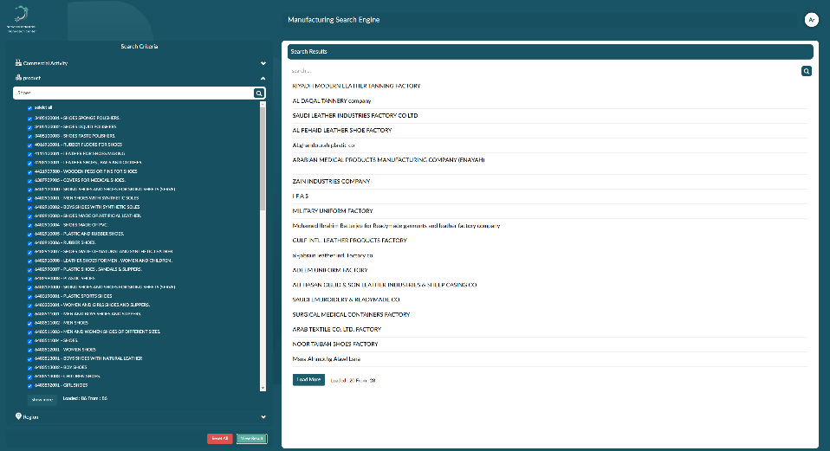
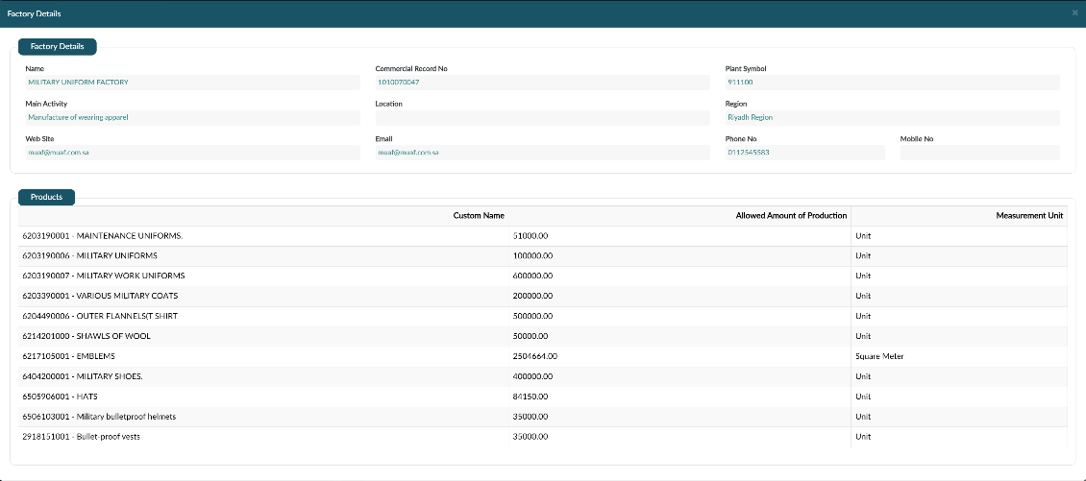
Factory database to understand presence of suppliers and / or other buyers for a product
Access the Saudi factories database, with 11,000+ local suppliers across 12,000+ products
Available company information
Name
List of supplied products
Allowed amount of production
Main activity
Region
Website
Email
Phone no.

Slide 94




Typical sources for local data to inform the business model
Source
Entity
Source description
Applicability
Link
Land prices
Land rental rates in special economic zones (SEZs)
Business model – for estimating cost of land to set up a facility
Land rental rates in industrial cities
Utilities and energy costs
Cost of utilities for industrial use (electricity, potable water, gas 1.27 USD/Mn BTU)
Business model – for estimating cost utilities
Saudization exemption (SEZ)
Requirements for SEZ residents
Business model – for estimating relevant locations for the facility
Mandatory list
Requirement to procure products listed in the mandatory list from local companies
To estimate investor risk
Last accessed: October 2024

Slide 95
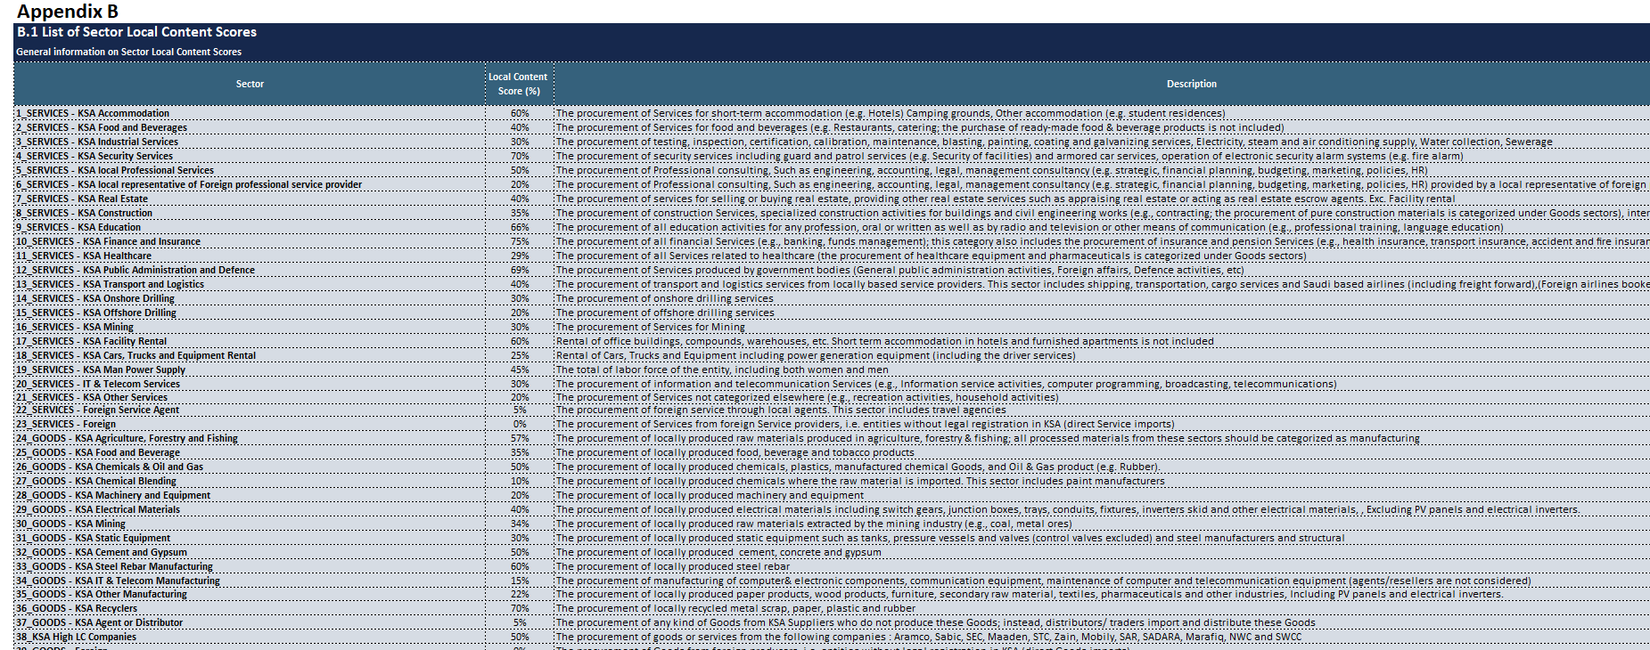
LCGPA LC score sheet
Sample LC score sheet which is shared by the supplier with LCGPA, every year

Slide 96
Components used to measure total cost of operations
Total procurement of goods and services
Total spend on labor compensation
Total spend on capacity building
Depreciation of capital and assets
+
+
+
Spend on goods and services
Salaries in KSA
Spend on supplier development
+
Spend on R&D in KSA
+
Spend on training of employees
Depreciation in KSA (100% of purchased or built assets)

