Slide 1
Cyclistic Bike-Share Analysis Project
Analysis of Casual Riders vs Annual Members
Prepared by: [Bahaa Elkady]

Slide 2
Agenda
1. Business Task
2. Data Preparation
3. Data Processing & Analysis
4. Visualizations
5. Recommendations
6. Conclusion

Slide 3
Business Task
Objective: Understand how annual members and casual riders use Cyclistic bikes differently.
Key Question: How can Cyclistic convert casual riders into annual members?

Slide 4
Data Preparation
• Data was collected from Cyclistic bike-share system, spanning over two quarters.
• Cleaning process included:
- Removing invalid data
- Calculating ride duration
- Adding 'Day of the Week' feature
- Filtering out zero or negative durations.

Slide 5
Data Processing & Analysis
• Data was processed using R programming for exploratory data analysis.
• Key metrics calculated:
- Ride duration for both casual and member riders
- Ride distribution across different weekdays
- Popular start stations and trends over time.

Slide 6
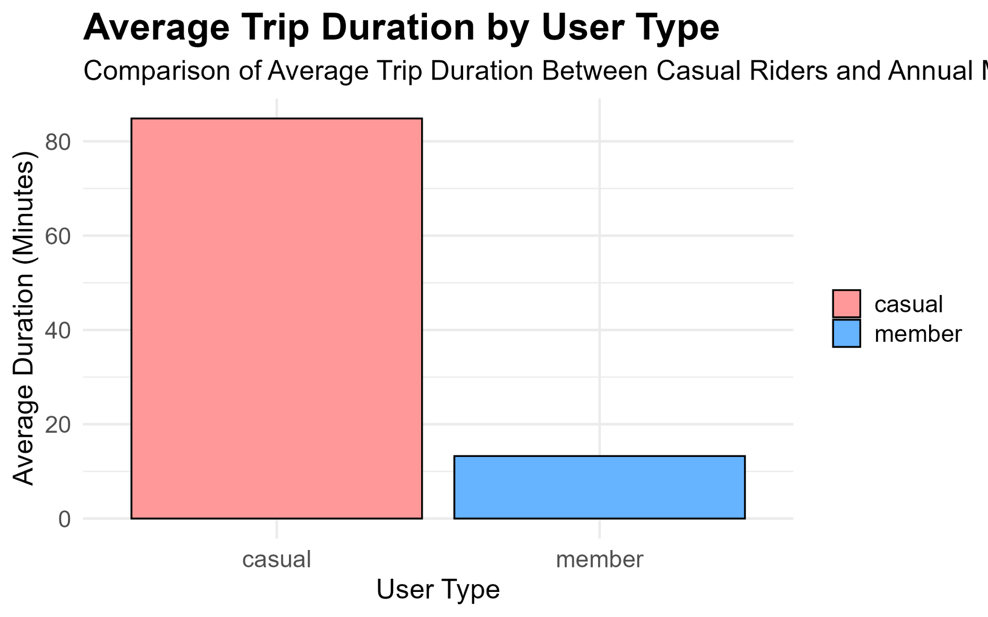
Average Trip Duration by User Type

Slide 7
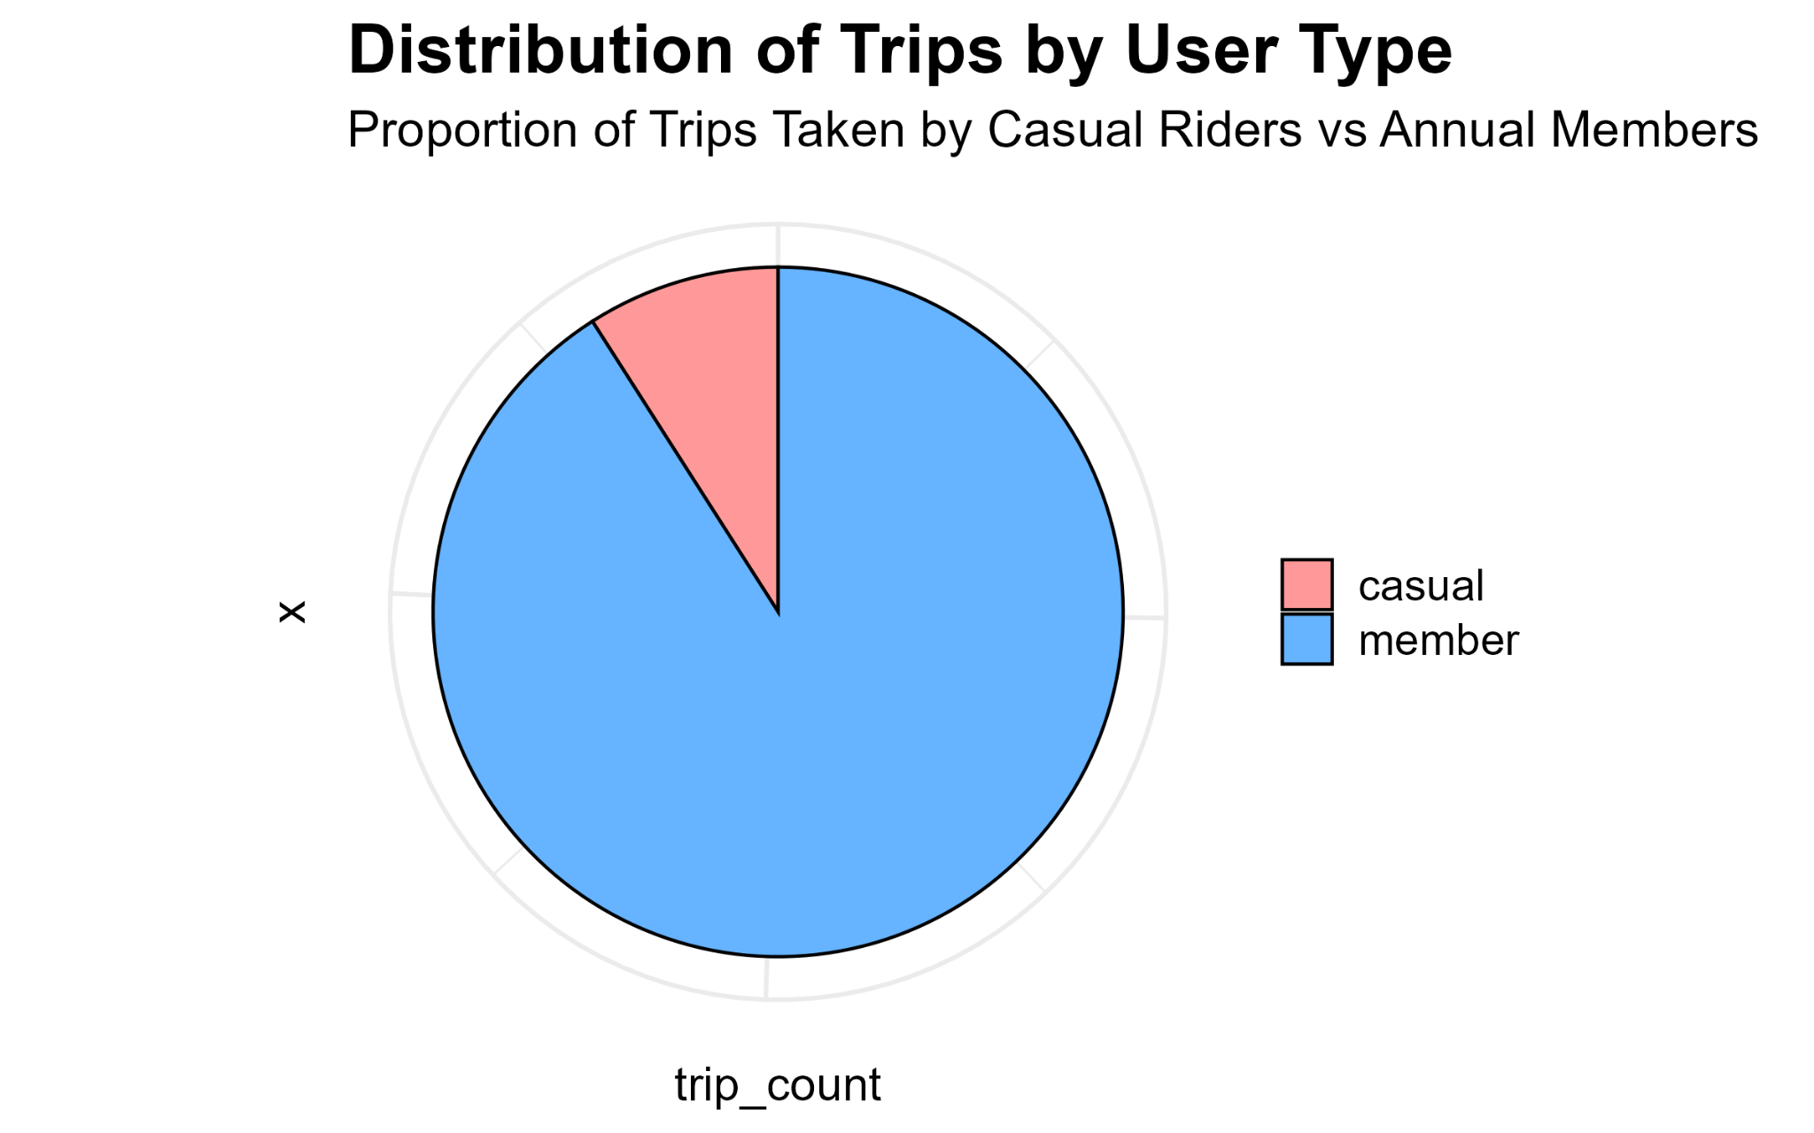
Distribution of Trips by User Type

Slide 8
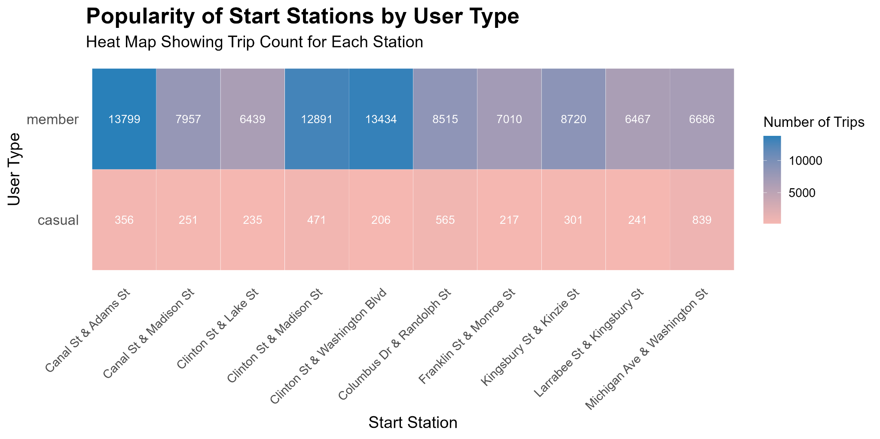
Enhanced Popularity of Start Stations by User Type

Slide 9
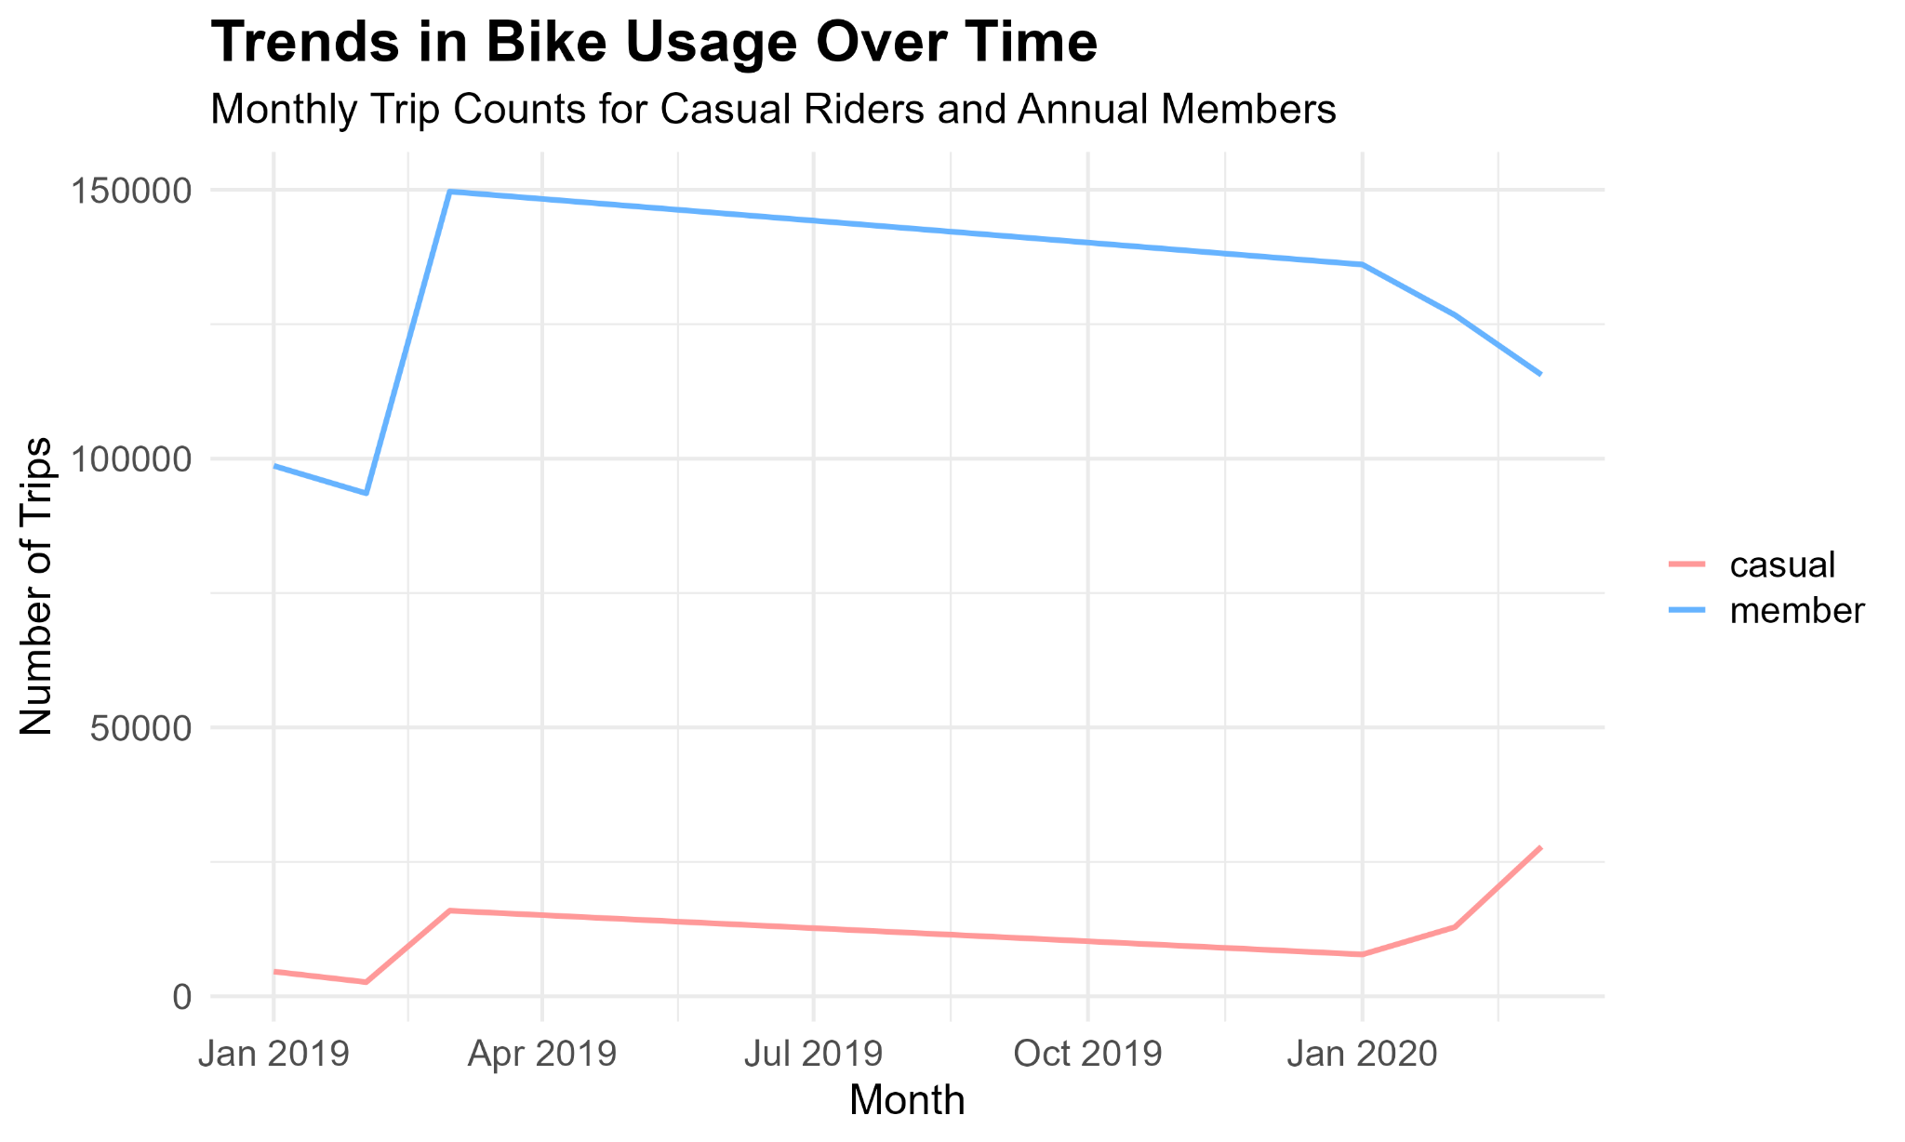
Trends in Bike Usage Over Time

Slide 10
Recommendations
• Focus marketing efforts on converting casual riders who frequently use the service.
• Offer discounts on annual memberships during peak casual rider usage periods.
• Target popular start stations with promotional offers for converting casual riders.

Slide 11
Conclusion
• The analysis reveals clear differences in behavior between casual riders and annual members.
• Recommendations focus on maximizing member conversion through targeted marketing strategies.

