Slide 1
🏥
HCAHPS Patient Survey
National Quality of Care Analysis
United States · 51 States · 10 Measures · 2015 – 2023
9 Years
51 States
43K+
10
of data
covered
facilities
measures
Prepared by Dr. Bahaa · Bahaa Pharmacy, Dirout, Egypt · 2026

Slide 2
Agenda
01
Dataset Overview
06
COVID-19 Impact
Tables, scope, and key variables
Pre / During / Post pandemic
02
Exploratory Analysis
07
Geographic Analysis
Score distributions & baseline
Regional & state performance
03
National Trend
08
Response Rate Trends
Are hospitals improving overall?
Data reliability over time
04
Measure-by-Measure
09
Measure Type Analysis
Where did hospitals progress most?
Composite vs Individual vs Global
05
Opportunity Areas
10
Recommendations
Persistent low-performance zones
Data-driven priorities for action

Slide 3
01 | Dataset Overview
What is HCAHPS?
7 Data Tables
A national standardized survey measuring patients' perspectives on hospital care.
Published quarterly by CMS.
Coverage: Oct 2013 – Sep 2022
(Released: July 2015 – July 2023)
reports.csv
9
Release periods & dates
measures.csv
10
10 HCAHPS measures
questions.csv
19
Survey questions
national_results.csv
90
National scores
state_results.csv
4,580
State-level scores
10 HCAHPS Measures
responses.csv
43,219
Facility response rates
C
C
C
C
C
C
I
I
G
G
Communication
with Nurses
Communication
with Doctors
Responsiveness
of Staff
Communication
about Medicines
Discharge
Information
states.csv
51
States & Census regions
Care
Transition
Cleanliness
of Environment
Quietness
of Environment
Overall Hospital
Rating
Willingness
to Recommend

Slide 4
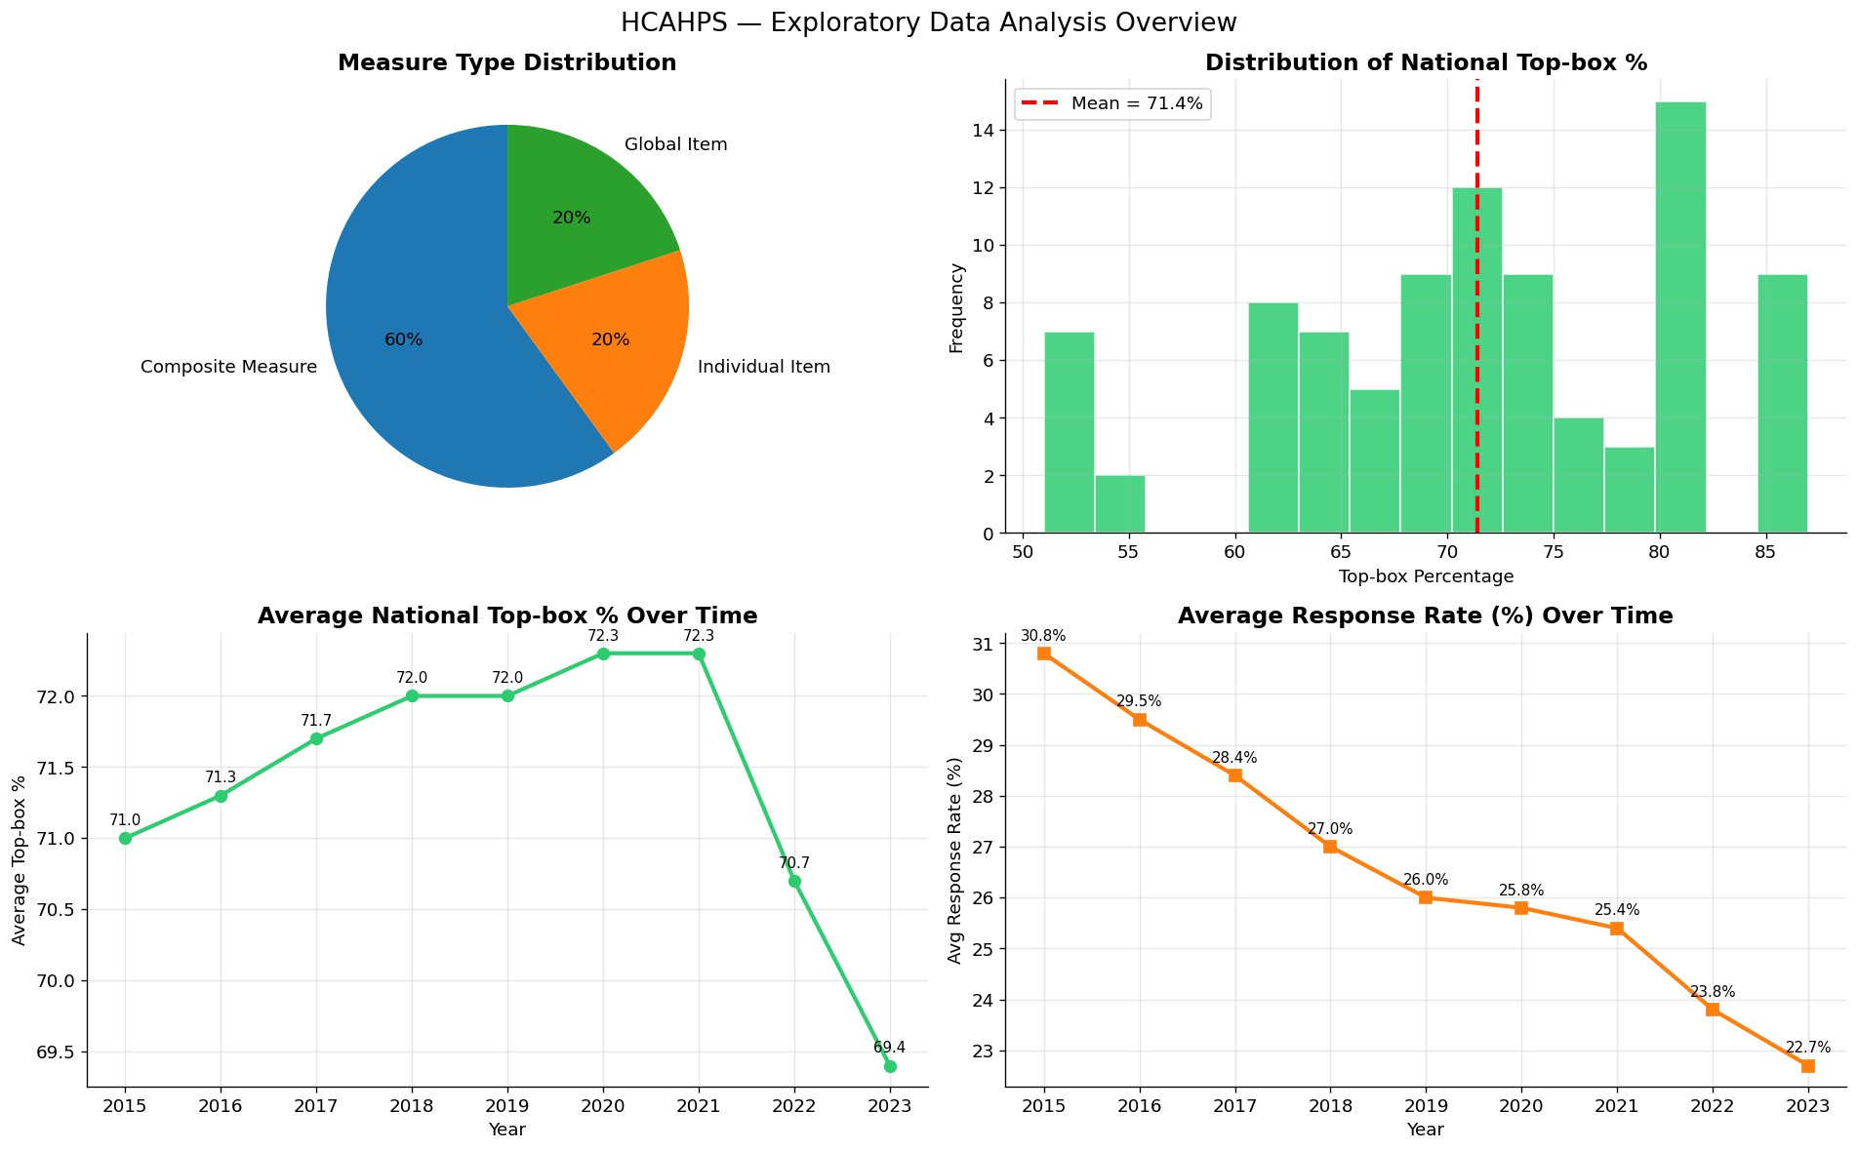
02 | Exploratory Data Analysis
71.4%
10
30.8%
22.7%
Mean Top-box %
Measures tracked
Response rate 2015
Response rate 2023

Slide 5
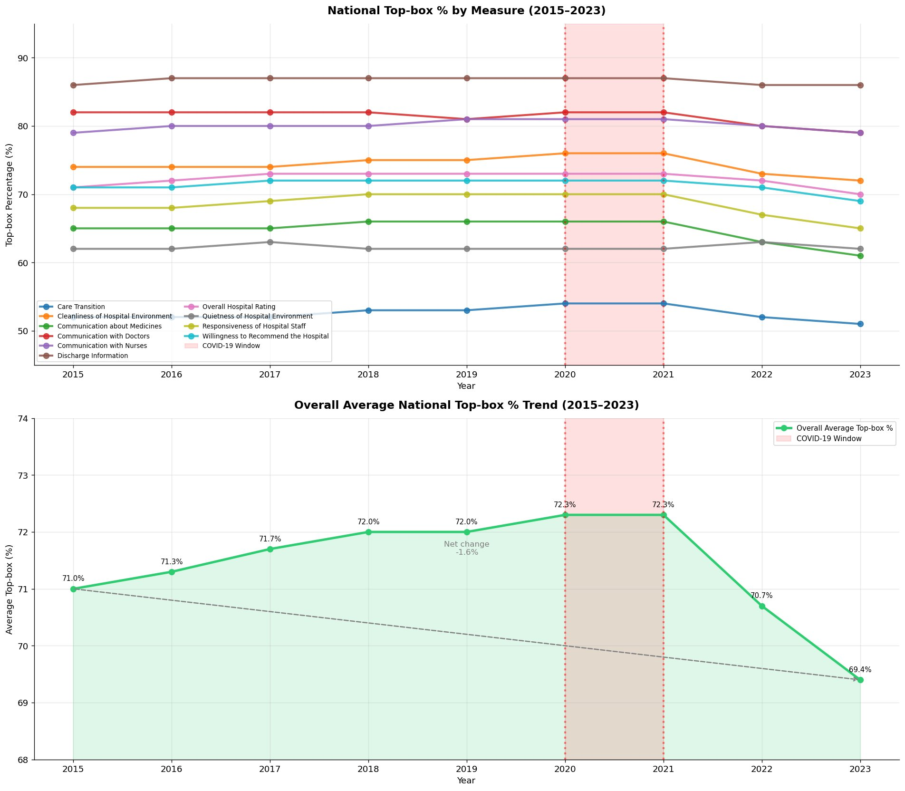
03 | National Trend — Are Hospitals Improving?
71.0%
72.3%
69.4%
-1.6pp
Score in 2015
Peak 2020–2021
Score in 2023
Net Change
💡 Overall average declined from 71.0% (2015) → 69.4% (2023). Scores peaked during COVID then collapsed sharply post-pandemic.

Slide 6
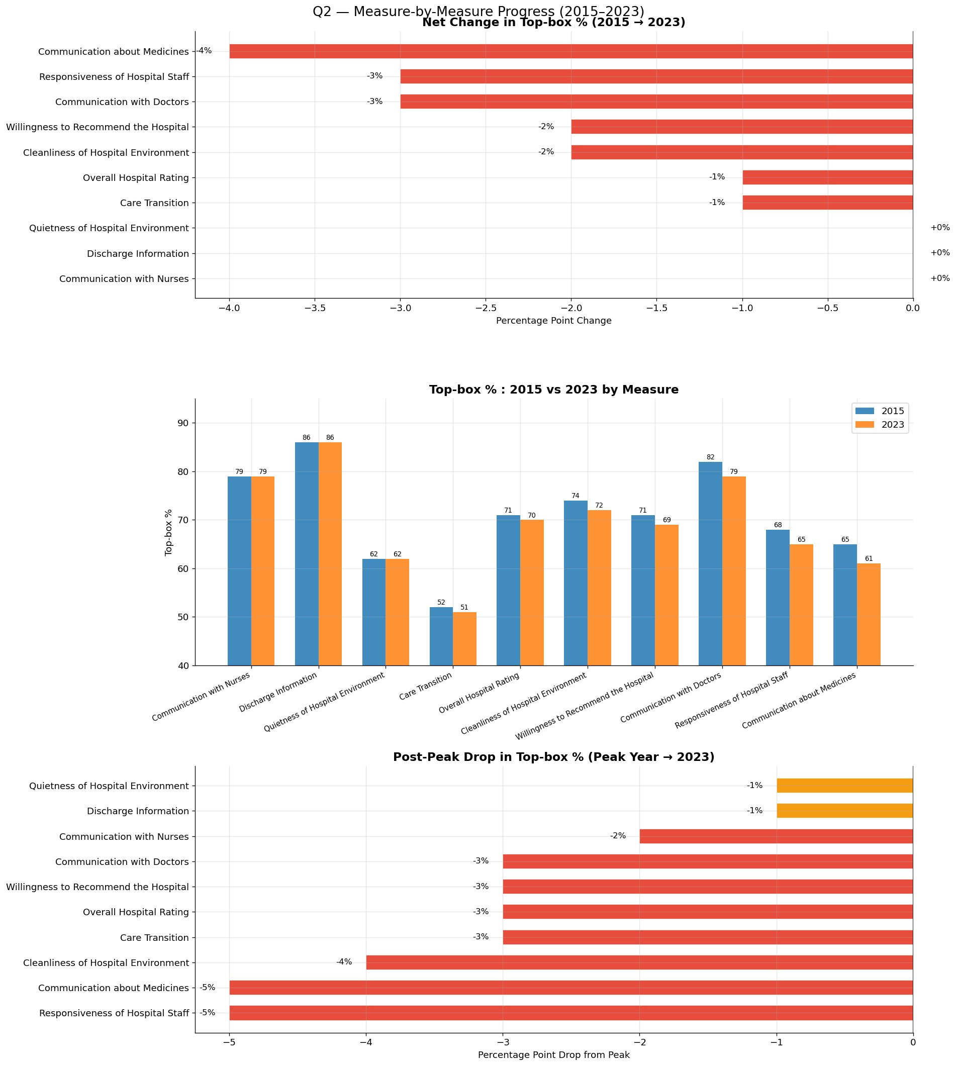
04 | Measure-by-Measure Progress (2015 → 2023)
0
-4%
-5%
3
Measures improved
Worst decline (Meds)
Worst post-peak drop
Measures held flat
⚠️ Zero measures showed net improvement — Communication about Medicines fell the most (-4pp) while Nurses, Discharge Info & Quietness held flat.

Slide 7
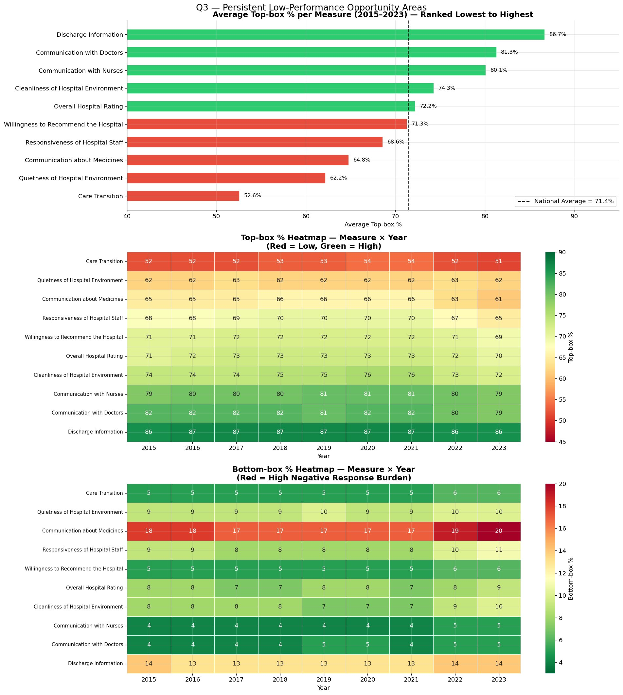
05 | Persistent Opportunity Areas
52.6%
64.8%
20%
-18.8pp
Care Transition avg
Medicine Comm. avg
Bottom-box burden (Meds)
Care Transition gap
🚨 Care Transition has been stuck at 51–54% for 9 consecutive years — a structural failure, not a COVID effect. Medicine Communication carries the highest negative response burden (20% in 2023).

Slide 8
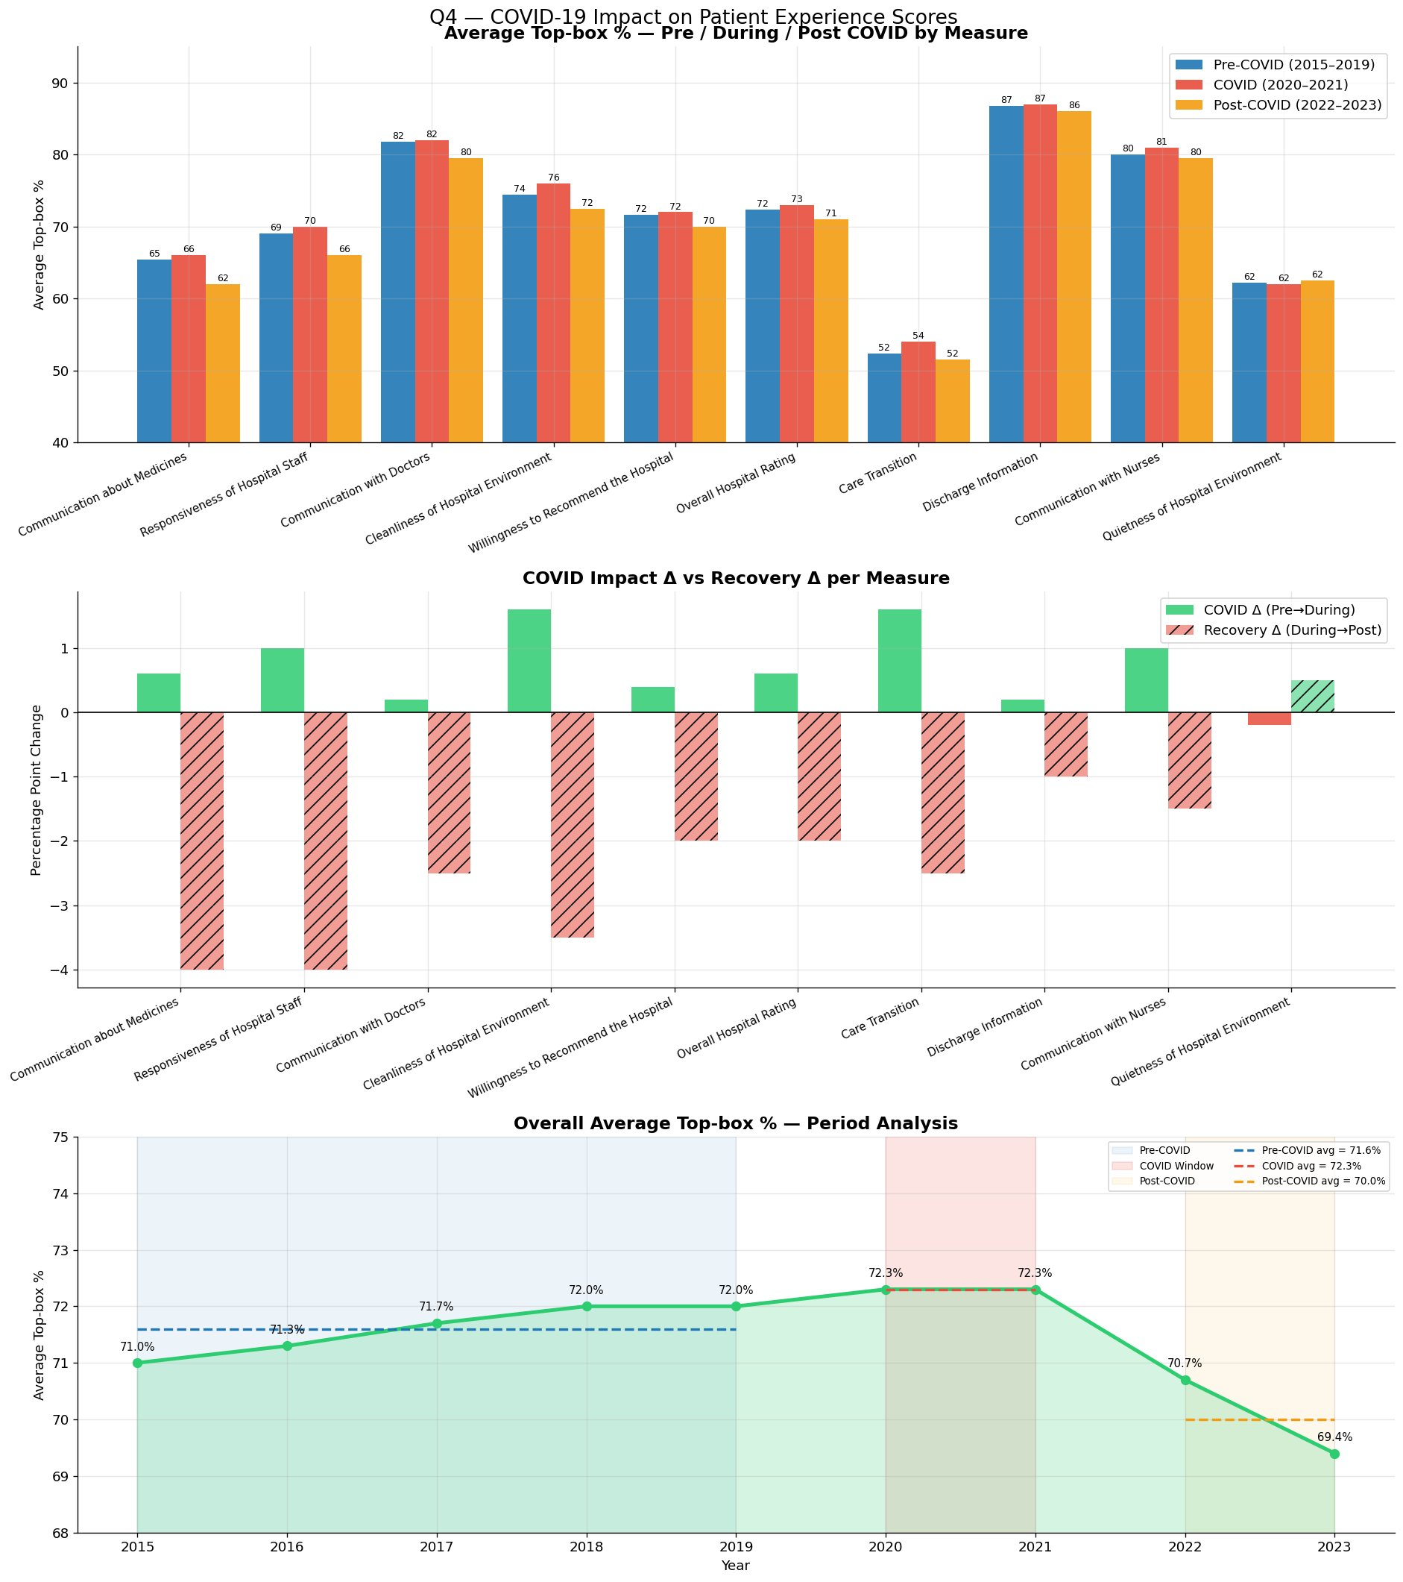
06 | COVID-19 Impact on Patient Experience
71.6%
72.3%
70.0%
-2.3%
Pre-COVID avg (2015–19)
During COVID (2020–21)
Post-COVID avg (2022–23)
Post-COVID collapse
💡 Scores paradoxically ROSE +0.7% during COVID — patients were more grateful. The real damage came post-COVID: -2.3% drop, erasing 6 years of gains due to staff burnout.

Slide 9
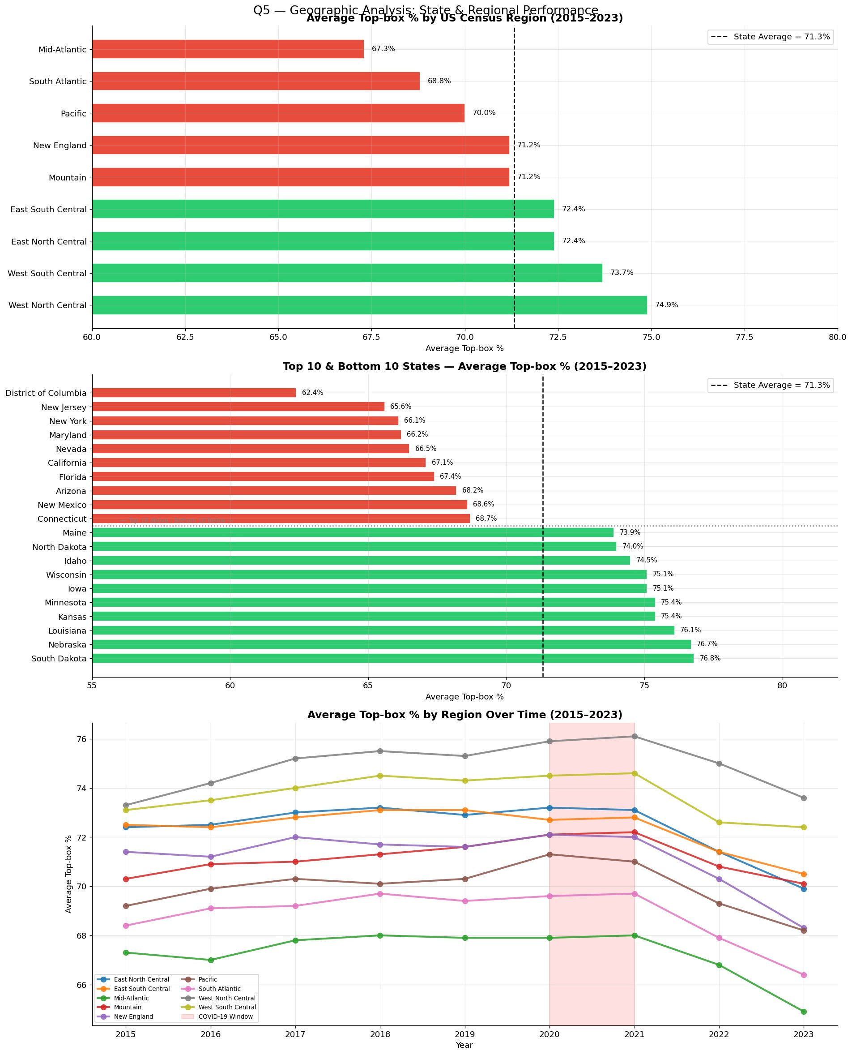
07 | Geographic Analysis — State & Regional Performance
74.9%
67.3%
76.8%
62.4%
Best region (W.N. Central)
Worst region (Mid-Atlantic)
Best state (S. Dakota)
Worst state (DC)
🗺️ West North Central leads at 74.9% while Mid-Atlantic lags at 67.3%. South Dakota (76.8%) is the best state; DC (62.4%) the worst. A 14.4pp gap separates best from worst state.

Slide 10
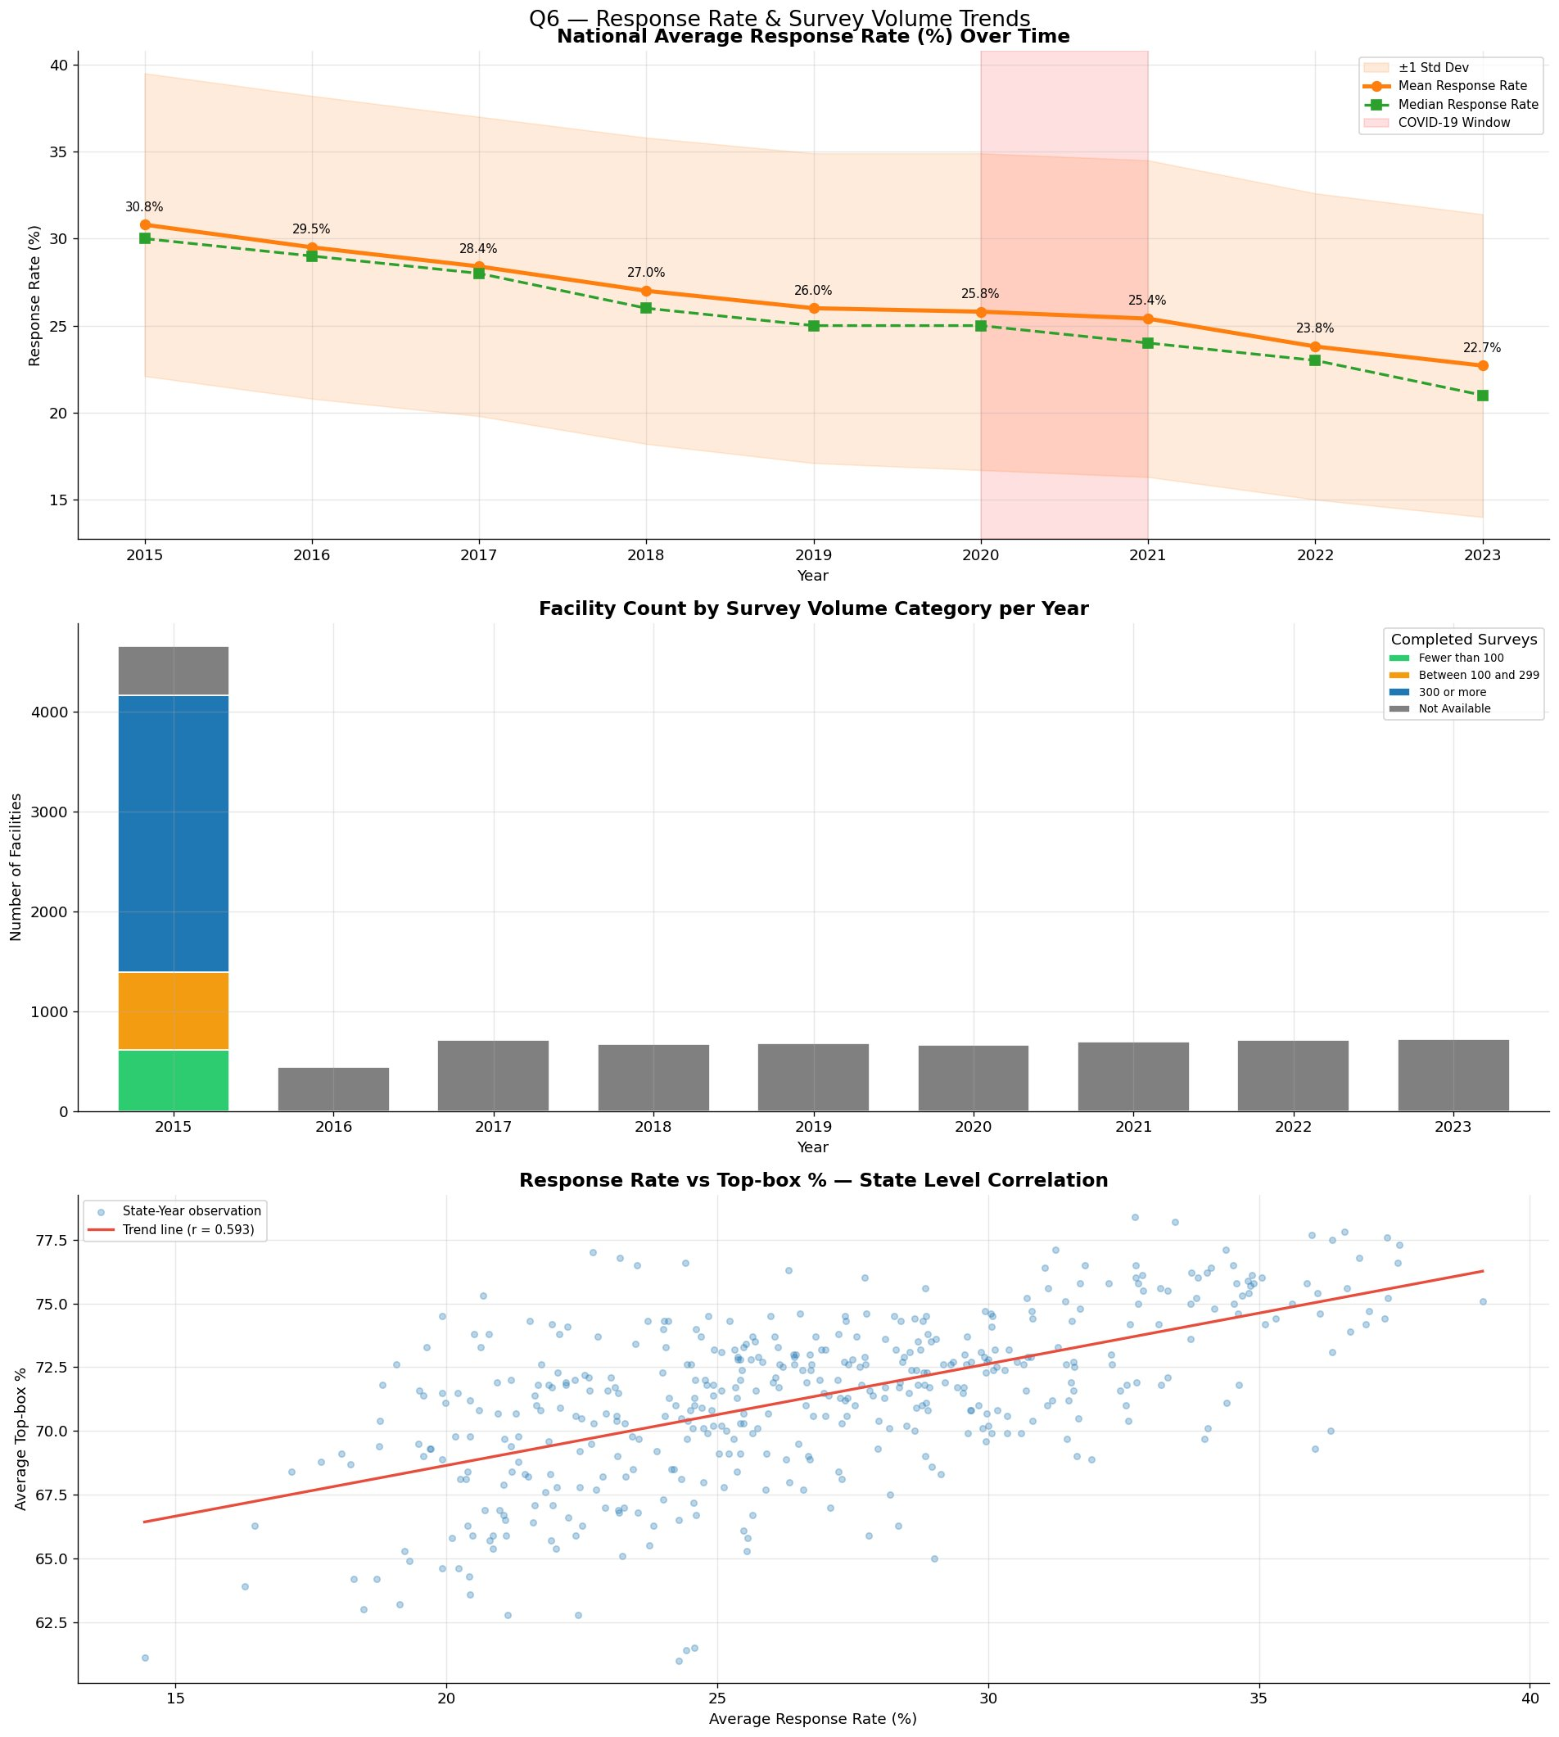
08 | Response Rate Trends — Data Reliability
30.8%
22.7%
-8.1pp
0.593
Response rate 2015
Response rate 2023
Total decline
Correlation r (score)
📉 Response rates fell from 30.8% → 22.7% over 9 years. A correlation of r=0.593 shows states with higher participation tend to score better — declining engagement is itself a quality warning sign.

Slide 11
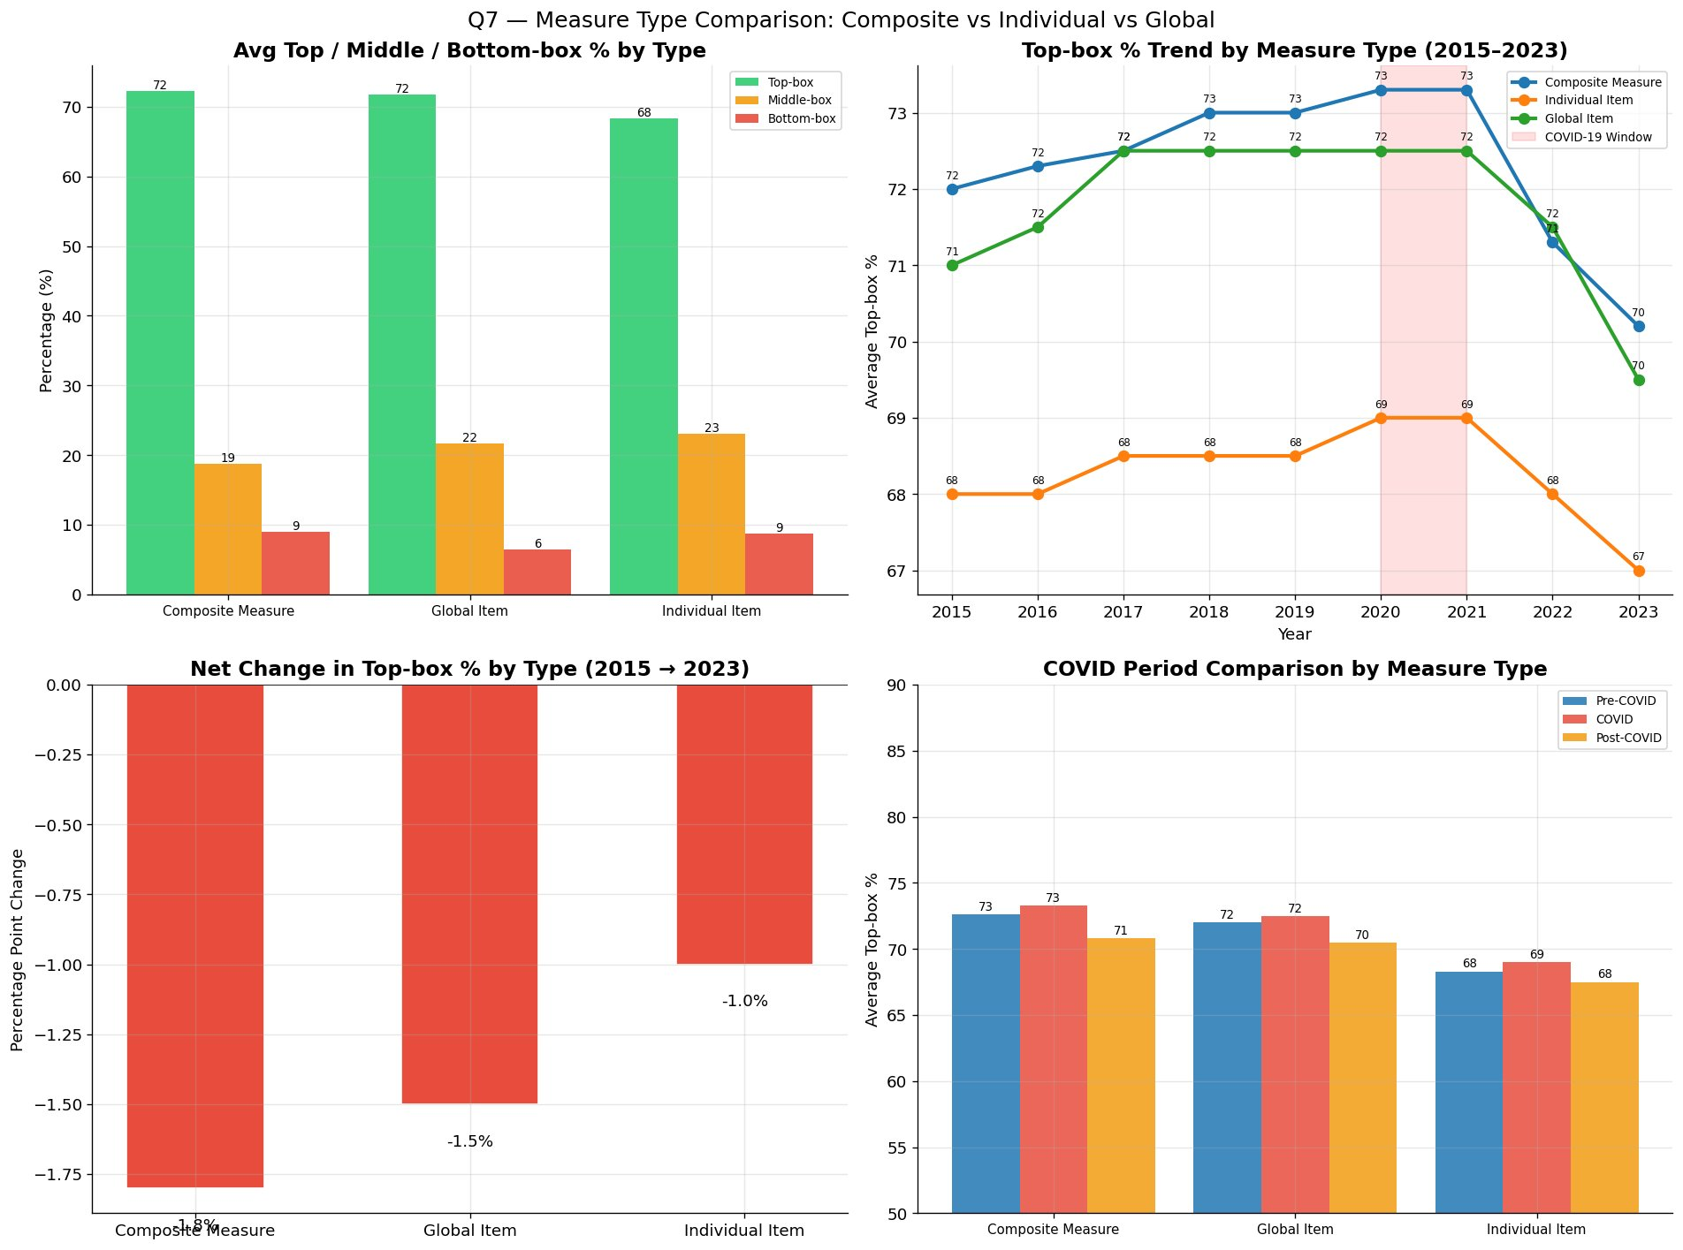
09 | Measure Type Comparison — Composite vs Individual vs Global
-1.8pp
-1.5pp
-1.0pp
2021
Composite decline
Global decline
Individual decline
Peak year (all)
📊 Composite measures (staff behavior) declined the most (-1.8pp). All three types peaked in 2020–21 then dropped. Individual Items showed most resilience (-1.0pp).

Slide 12
10 | Data-Driven Recommendations
01
Redesign Care Transition Processes
02
Improve Medicine Communication
Dedicated discharge planning teams, medication reconciliation, and 48-hr post-discharge follow-up calls. Stuck at 51–54% for 9 years.
Mandate bedside pharmacist consultations and plain-language medication cards. 1 in 5 patients report worst possible medicine communication experience.
CRITICAL
CRITICAL
03
Address Post-COVID Staff Burnout
04
Target Responsiveness Protocols
Invest in staff mental health programs, safe staffing ratios, and communication skills training to restore pre-COVID service levels.
Audit call-light response benchmarks and accountability systems. Responsiveness dropped from 68% → 65% with a -5pp post-peak decline.
HIGH
HIGH
05
Learn from High-Performing States
06
Invest in Survey Participation
Commission best-practice studies in South Dakota, Nebraska & Kansas (76–77%). These Midwest states outperform by 4–5pp consistently.
Implement SMS/multilingual post-discharge outreach. Response rates at 22.7% with r=0.593 correlation — engagement is itself a quality metric.
MEDIUM
OPPORTUNITY

Slide 13
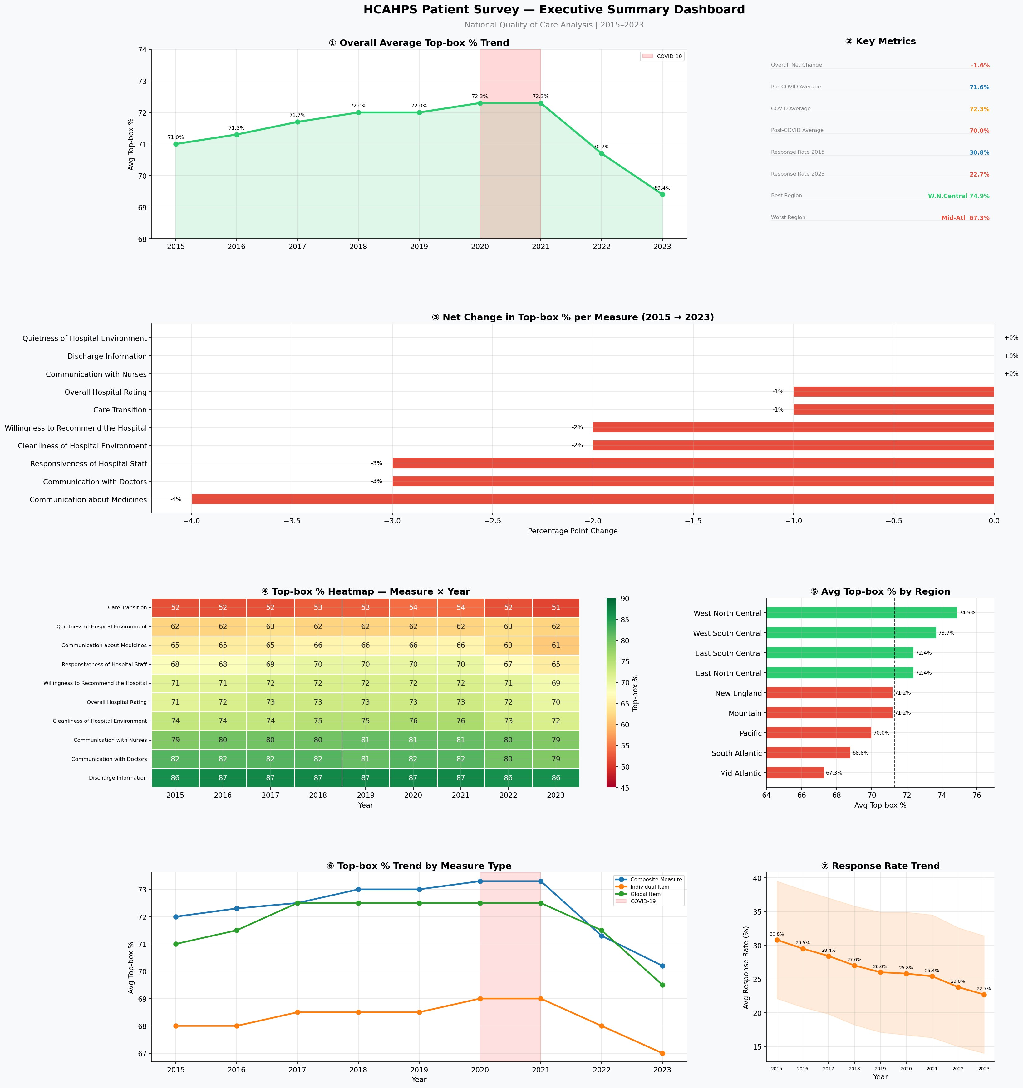
— | Executive Summary Dashboard

Slide 14
K e y T a k e a w a y
American hospitals are not improving
patient experience — they are losing ground.
📉 Overall Top-box % declined 71.0% → 69.4% — all 10 measures fell or held flat over 9 years
🚨 Care Transition (52.6%) & Medicine Communication (64.8%) are chronic crisis zones requiring urgent action
🦠 COVID scores paradoxically rose; the post-COVID collapse (-2.3%) erased 6 years of incremental gains
🗺️ Midwest states outperform coastal regions by 5–7pp — South Dakota, Nebraska & Kansas are proven benchmarks
📋 Response rates fell to 22.7% — declining engagement amplifies bias and undermines data reliability
Dr. Bahaa · Bahaa Pharmacy, Dirout, Egypt · 2026 · Data: CMS HCAHPS 2015–2023

