Slide 1
🏥
Massachusetts General Hospital
Patient Records Analysis | 2011 – 2022
Analyst: Dr. Bahaa | Organization: Bahaa Pharmacy — Data Analytics Division | Date: May 2026
Data Source: Synthea Synthetic Patient Generator | ~974 Patients | 27,891 Encounters

Slide 2
Agenda
01
Dataset Overview
04
Cost & Coverage Insights
Files, records, and data structure
Claim costs, payer coverage, top procedures
02
Key Performance Indicators
05
Patient Behavior Analysis
High-level metrics snapshot
Admissions, 30-day readmissions, top patients
03
Encounters Overview
06
Conclusions & Recommendations
Volume trends, class breakdown, length of stay
Key findings and next steps

Slide 3
Dataset Overview
👥
🏨
🔬
🛡️
🏥
patients.csv
encounters.csv
procedures.csv
payers.csv
organizations.csv
974
27,891
47,701
10
1
rows
rows
rows
rows
rows
Patient demographics
& medical history
Hospital visits,
costs & payer info
Medical procedures
per encounter
Insurance
companies
Hospital
info
📅 Coverage Period: 2011 – 2022 | Source: Synthea Synthetic Patient Generator | Hospital: Massachusetts General Hospital

Slide 4
Key Performance Indicators
👥 Total Unique Patients
🏨 Total Encounters
📊 Avg Encounters / Patient
🛏️ Avg Length of Stay
974
27,891
28.6
1.5 days
💰 Avg Total Claim Cost
🛡️ Insurance Coverage Rate
💸 Avg Out-of-Pocket Cost
🔄 30-Day Readmission Rate
$3,640
51.3%
$2,525
60.2%

Slide 5
Objective 1 — Encounters Overview
💡 Key Insight: Activity peaked in 2014 (3,885 encounters) with a COVID dip in 2019–2020 and strong recovery in 2021. 99.7% of all encounters were under 24 hours — the hospital is primarily outpatient.

Slide 6
Objective 2 — Cost & Coverage Insights
48.7%
Encounters with Zero Coverage
13,586
Uninsured Encounters
$206,260
Avg Cost — ICU Admission
4,596
Most Frequent Procedure Count
⚠️ Key Insight: Nearly half of all encounters (48.7%) had zero insurance coverage, leaving patients with an avg out-of-pocket cost of $2,525 per visit.

Slide 7
Objective 3 — Patient Behavior Analysis
87.7%
Overall Readmission Rate
60.2%
30-Day Readmission Rate
16,786
Total 30-Day Readmit Encounters
1,375
Max Readmissions — Single Patient
⚠️ Key Insight: 60.2% of all encounters were 30-day readmissions, strongly suggesting a patient population dominated by chronic conditions such as renal failure, heart disease, and end-of-life care.

Slide 8
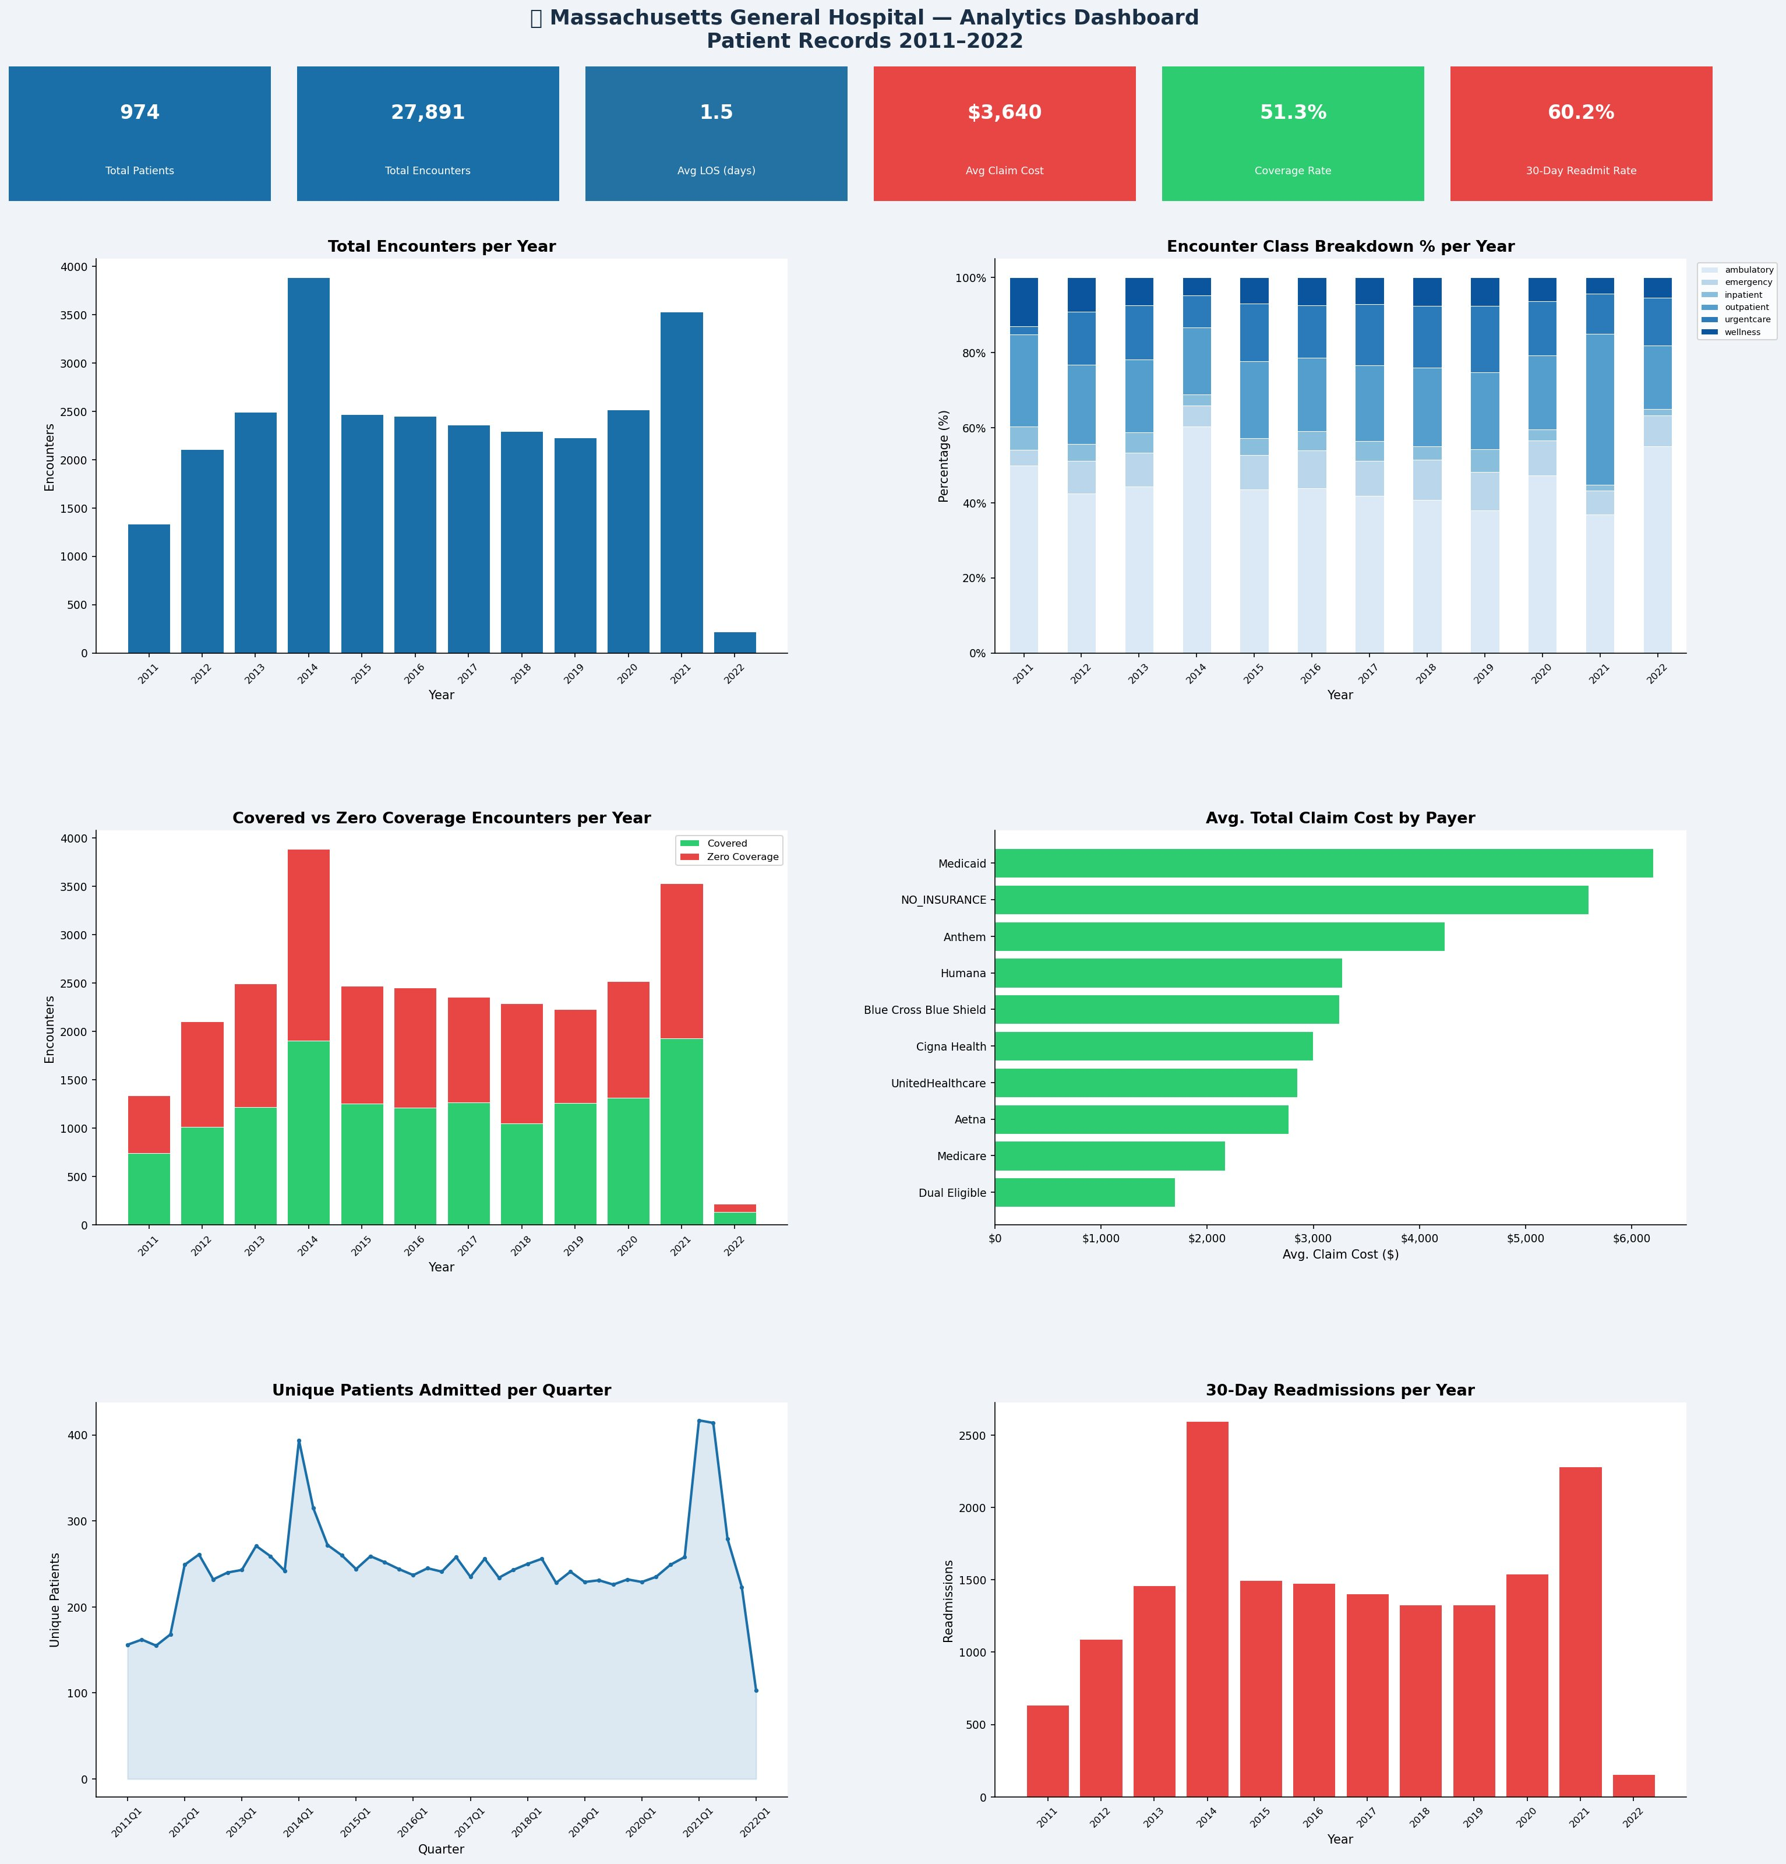
Analytics Dashboard — Full Overview

Slide 9
Conclusions & Recommendations
📋 Key Findings
🎯 Recommendations
2014 was peak year with 3,885 encounters
01
Address Insurance Coverage Gap
Ambulatory visits dominate every year at 50%+
Explore financial assistance programs, Medicaid enrollment support, and patient payment plans to reduce uninsured burden.
99.7% of encounters were under 24 hours
48.7% of encounters had zero insurance coverage
02
Chronic Care Management Program
Avg out-of-pocket cost: $2,525 per visit
Target the top 15 high-readmission patients with a dedicated program to reduce unnecessary 30-day readmissions.
ICU admission avg cost: $206,260
60.2% of encounters were 30-day readmissions
03
Monitor Post-COVID Recovery
One patient had 1,375 readmissions alone
The 2021 rebound is promising. Conduct a full 2022–2023 analysis to confirm the recovery trend is sustained.

Slide 10
Thank You
Massachusetts General Hospital — Patient Records Analysis
Dr. Bahaa | Bahaa Pharmacy, Data Analytics Division | Dirout, Assiut, Egypt | May 2026
974
27,891
47,701
11 yrs
Patients
Encounters
Procedures
Coverage

