Slide 1
CENG 336 INT. TO EMBEDDED SYSTEMS DEVELOPMENT 2023-2024 Spring Recitation-3

Slide 2
Today’s Outline
Serial Communication
ADC
Example Codes

Slide 3
Serial Communication
There is a EUSART module in PIC18F8722, capable of asynchronous/synchronous communication.
We will focus on asynchronous mode today.

Slide 4
Serial Communication
Important Registers:
RCSTA1 for reception
TXSTA1 for transmission
SPBRGH:SPBRG, BAUDCON for setting the baudrate.
IPR1, PIE1, PIR1 for interrupt enable, priority and flag bits.
INTCON for enabling global, peripheral interrupts.
Lastly TRISC registers because RC6 is TX and RC7 is the RX pin.

Slide 5
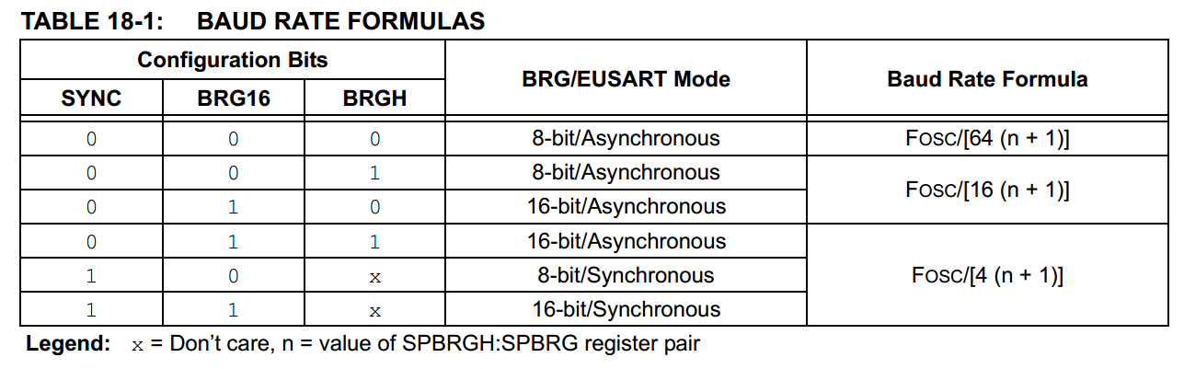
Initial Configurations
We will configure EUSART1 for asynchronous, 9600 bps (for demo) 8-bit baudrate generator (high-speed mode), for a 40MHz crystal.
Asynchronous, TXSTA.SYNC = 0;
8-bit generator, BAUDCON.BRG16 = 0; (SPBRGH ignored)
High-speed mode, TXSTA.BRGH = 1;
For SPBRG, we would normally use the formula here:

Slide 6
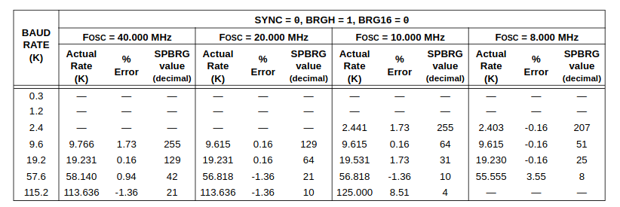
Initial Configurations
...but it is already on the table as it is a common baudrate!
SPBRG = 255;

Slide 7
Initial Configurations
RCSTA.SPEN = 1; to set RC6/7 as serial comm. pins.
PIE1.TXIE = 1; PIE1.RCIE = 1; to enable interrupts for transmission/reception.
TRISC.RC6 = 0; TRISC.RC7 = 1; for pin I/O.
INTCON.GIE = 1; INTCON.PEIE = 1; for enabling interrupts in general and also peripheral interrupts.

Slide 8
Transmission
Whenever you want to send a character, set TXSTA.TXEN = 1;
This will trigger the interrupt (as TXREG is initially empty). Load your character to TXREG, in ISR.
For any regular interrupt, you want to clear it after everything is done. But PIR1.TXIF cannot be cleared in software. There are two ways of keeping it from triggering a meaningless interrupt again (done inside ISR):
Loading a value to TXREG, which we did.
setting TXSTA.TXEN = 0; i.e. terminating the transmission.
After the char is sent, the interrupt will trigger again. If this was the last char you wanted to send, do 3b in ISR. Otherwise load the next character to TXREG (3a - in ISR).

Slide 9
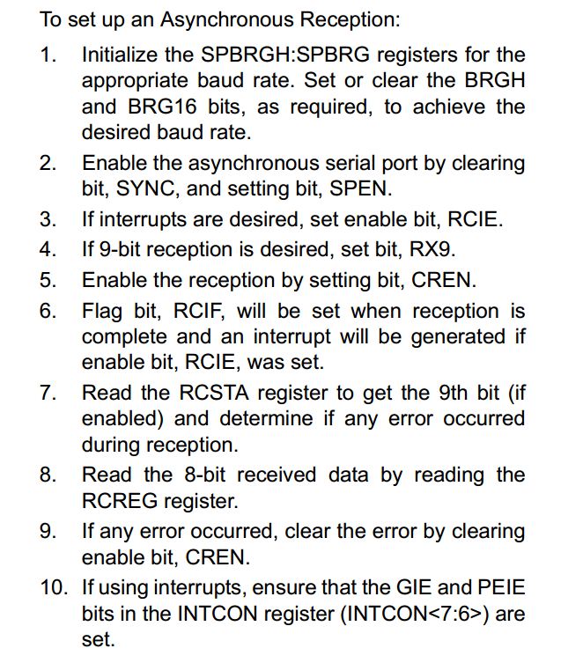
Reception
Set RCSTA.CREN = 1; to start receiving.
RCIF will fire as soon as you receive a byte.
The contents will be on RCREG. Copy them somewhere and use them.
Sometimes errors might happen (RCSTA.OERR, RCSTA.FERR)
Unset and then set RCSTA.CREN to keep receiving.
Do not forget to clear the interrupt flag.

Slide 10
Demo

