Slide 1
CENG 336 INT. TO EMBEDDED SYSTEMS DEVELOPMENT Spring 2017 Recitation-3

Slide 2
Today’s Outline
Interrupts overview
External interrupt
PORTB on change interrupts
Timer interrupts
Sample program

Slide 3
INTERRUPTS
Programmed I/O: The status of the I/O device is repeatedly checked by the program (Inefficiency in terms of time usage because you have to wait inside the loop without doing anything else).
Interrupts I/O: The I/O device requests the interrupt and an interrupt handling routine or interrupt service routine is needed.
An interrupt is a signal that stops the microcontroller from what is doing, so that something else can happen (a temporary break). After ISR is completed then the CPU carries on where it was left off.

Slide 4
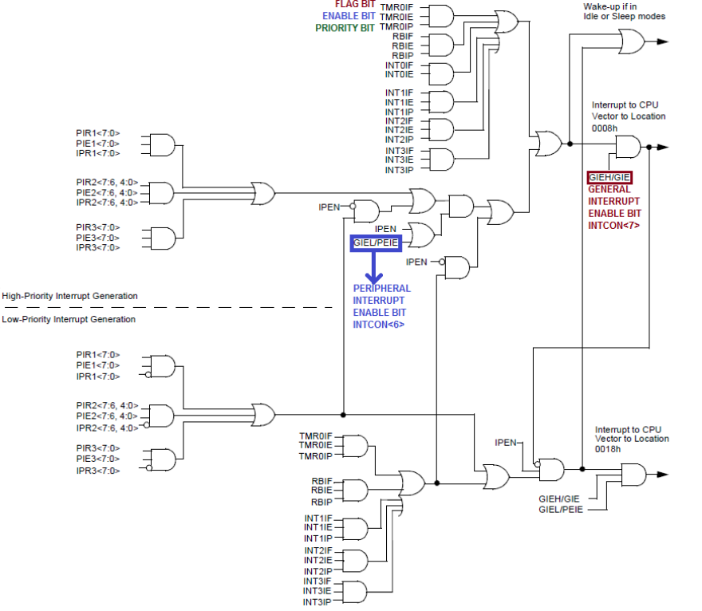
INTERRUPT LOGIC

Slide 5
INTERRUPT LOGIC
IMPORTANT! FLAG BITS are set regardless of PEIE, GIE or enable bit
according to the working conditions of peripheral.
Do not forget to clear proper interrupt flag in your interrupt service routine!
When writing your own code, it may be useful to disable all interrupts and then initialize your other parameters/ports/etc. After completing initialization part you can enable the interrupts and continue with main routine.
Refer to the datasheet for the details.

Slide 6
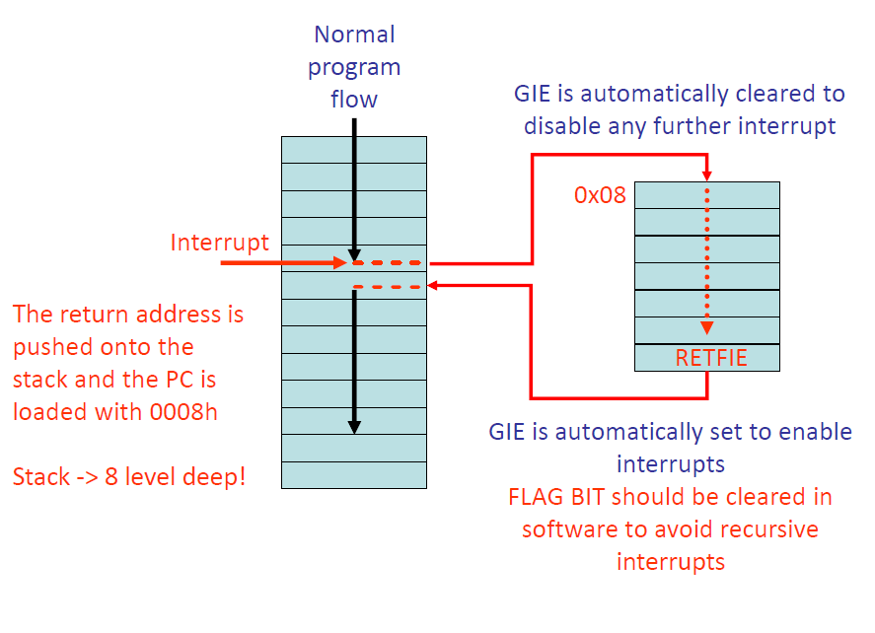
EFFECTS & HANDLING

Slide 7
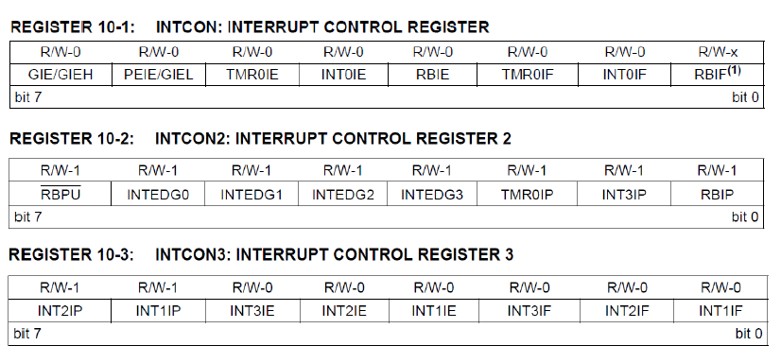
INTERRUPT CONTROL REGISTERS
(RCON Register can be used to enable/disable interrupt priorities)

Slide 8
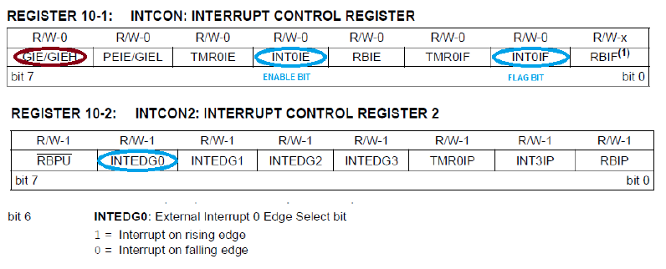
EXTERNAL (INT) INTERRUPT
External interrupt from RB0/INT0, RB1/INT1 and RB2/INT2 pins:

Slide 9
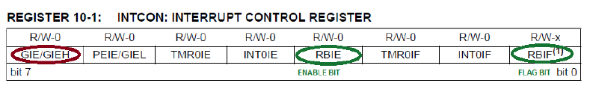
PORTB ON CHANGE INTERRUPT
An input change on PORTB<4:7> sets flag bit RBIF (placed at INTCON<0>). Only the pins configured as input can cause this interrupt to occur.
How to clear RBIF? Make a read and then a write operation of PORTB to end the mismatch condition. Clear flag bit RBIF. You can not clear RBIF without making read/write operation of PORTB.

Slide 10
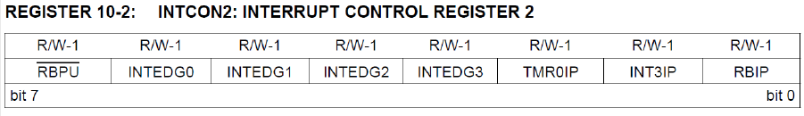
PORTB ON CHANGE INTERRUPT
RBPU bit enables the internal pull-up resistors for PORTB when it is set to zero. This is a useful feature since it eliminates the need for external pull-up resistors. The application hardware turns out to a simpler one.

Slide 11
TIMER INTERRUPTS
There are 3 timer modules:
TIMER0 Module
TIMER1 Module
TIMER2 Module

Slide 12
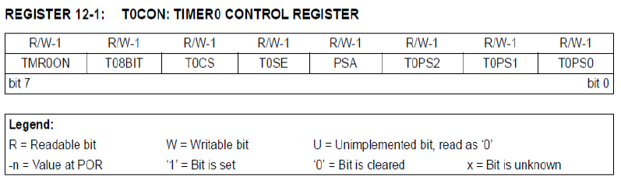
TIMER INTERRUPTS – TIMER0
To use Timer0, we use T0CON register:
-TMR0ON : Timer0 ON/OFF control bit
-T08BIT : 0 : 8-bit timer/counter, 1 : 16-bit timer/counter
-T0CS : 1 : Counter Mode, 0 : Timer Mode
-T0SE : 1 : Increment on High-To-Low, 0 : Increment on Low-To-High

Slide 13
TIMER INTERRUPTS – TIMER0
-PSA : 0 : Prescaler is not assigned, 1 : Prescaler is assigned
-T0PS<2:0> :
- 111 = 1:256 prescale value
- 110 = 1:128 prescale value
- 101 = 1:64 prescale value
- 100 = 1:32 prescale value
- 011 = 1:16 prescale value
- 010 = 1:8 prescale value
- 001 = 1:4 prescale value
- 000 = 1:2 prescale value

Slide 14
TIMER INTERRUPTS – TIMER0
Timer Mode (T0CS = 0) : The module increments on every clock cycle by default unless a different prescaler value is selected.
Counter Mode (T0CS = 1) : Timer0 increments either on every rising or falling edge of pin RA4/T0CKI.
2 data registers:
- TMR0L
- TMR0H
Selected by T08BIT.

Slide 15
TIMER INTERRUPTS – TIMER0
The TMR0 interrupt is generated when the TMR0 register overflows from FFh to 00h in 8-bit mode, or from FFFFh to 0000h in 16-bit mode.
This overflow sets the TMR0IF flag bit.
To enable/disable the interrupt TMR0IE bit is set/cleared.
The TMR0IF bit must be cleared in software by the Interrupt Service Routine to prevent infinite interrupt loop.

Slide 16
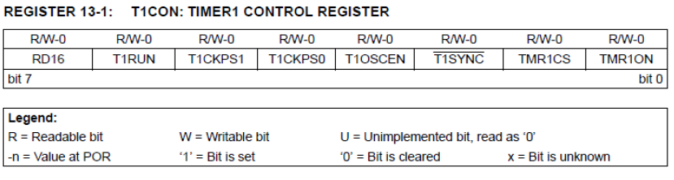
TIMER INTERRUPTS – TIMER1
To use Timer1, we use T1CON register:
-RD16 : 0 : 8-bit timer 1 : 16-bit timer
-TMR1ON : Timer1 ON/OFF bit
-TMR1CS : 0 : Internal clock
1 : External clock from RC0/T1OSO/T13CKI (on the rising edge)

Slide 17
TIMER INTERRUPTS – TIMER1
-T1SYNC : Timer1 external clock input synchronization select bit
[When TMR1CS = 1]:
1 : Do not synchronize external clock input.
0 : Synchronize external clock input
[When TMR1CS = 0]:
This bit is ignored. Timer1 uses the internal clock.
- T1CKPS<1:0> : Timer1 input clock prescale select bits:
- 11 = 1:8 prescale value
- 10 = 1:4 prescale value
- 01 = 1:2 prescale value
- 00 = 1:1 prescale value

Slide 18
TIMER INTERRUPTS – TIMER1
The operating mode is determined by the clock select bit, TMR1CS (T1CON<1>). When TMR1CS is cleared, Timer1 increments on every internal instruction cycle (Fosc / 4). When the bit is set, Timer1 increments on every rising edge of the Timer1 external clock input or the Timer1 oscillator, if enabled.
When Timer1 is enabled, the RC1/T1OSI and RC0/T1OSO/T13CKI pins become inputs. This means the values of TRISC<1:0> are ignored and the pins are read as '0'.

Slide 19
TIMER INTERRUPTS – TIMER1
-T1OSCEN : Enable/Disable Timer1 Oscillator
By setting the clock select bits, SCS<1:0> (OSCCON<1:0>) to '01', the device switches to SEC_RUN mode; both the CPU and peripherals are clocked from the Timer1 oscillator.
-T1RUN : Timer1 System Clock Status bit
1 : Device clock is derived from Timer1 oscillator
0 : Device clock is derived from another source

Slide 20
TIMER INTERRUPTS – TIMER1
Interrupt occurs on overflow (from FFFFh to 0000h).
Interrupt flag bit is TMR1IF (PIR1<0>).
This interrupt can be enabled or disabled by setting or clearing the Timer1 Interrupt Enable bit which is TMR1IE (PIE1<0>).

Slide 21
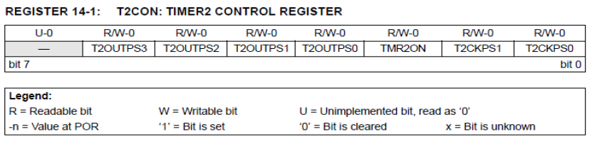
TIMER INTERRUPTS – TIMER2
To use Timer2, we use T2CON register:
- 8 bit Timer and period registers (TMR1 and PR2, respectively),
- Readable and writable (both registers),
- Interrupt on TMR2 to PR2 match.
- TMR2ON : Timer2 ON/OFF bit

Slide 22
TIMER INTERRUPTS – TIMER2
-T2OUTPS<3:0> : Timer2 Output Postscale Select bits
-0000 = 1:1 postscale
-0001 = 1:2 postscale
- …….
-1111 = 1:16 postscale
-T2OUTPS<3:0> : Timer2 Clock Prescale Select bits
- 00 = Prescaler is 1
- 01 = Prescaler is 4
- 1x = Prescaler is 16

Slide 23
TIMER INTERRUPTS – TIMER2
In normal operation, TMR2 is incremented from 00h on each clock (Fosc / 4).
The value of TMR2 is compared to that of the period register, PR2, on each clock cycle. When two values match, the comparator generates a match signal as the timer output. This signal also resets the value of TMR2 to 00h on the next cycle and drives the output counter/postscaler. This counter generates the TMR2 match interrupt flag which is latched in TMR2IF (PIR1<1>).
The interrupt is enabled by setting the TMR2 Match Interrupt Enable bit, TMR2IE(PIE1<1>).

