Slide 1
An Introduction to PyFluxPro
Peter Isaac, James Cleverly, Ian McHugh and Cacilia Ewenz

Slide 2

Overview
Description of PyFluxPro
Processing levels
Quality control checks
Post-processing corrections
Gap filling strategies
Partitioning strategies
Plotting routines
File conversion abilities

Slide 3
PYfluxPRO overview

Slide 4
Why PyFluxPro?
The global flux tower community needs a QC and post-processing system;
Make individual wisdom available to many.
Standardise procedures across the network.
Allow users to interact with data.
Make repeat processing easy.
Self-documenting.
Easy to maintain.
Free.

Slide 5
Description
PyFluxPro began as OzFluxQC in 2011.
Suite of Python routines consisting of >10,000 lines of code integrated into a single GUI.
GUI provides access to QC and post-processing routines, gap filling, partitioning and plotting.
Not a program for processing turbulence data.
Code is open source.
Data formats are netCDF, Excel and CSV.

Slide 6
Philosophy
Minimise the time spent processing data.
Make it easy to repeat the processing.
Encourage interaction with the data.
Use best features of computers and humans;
Humans are excellent at pattern recognition but bad at doing boring tasks.
Computers are excellent at boring tasks but difficult to program for pattern recognition.

Slide 7
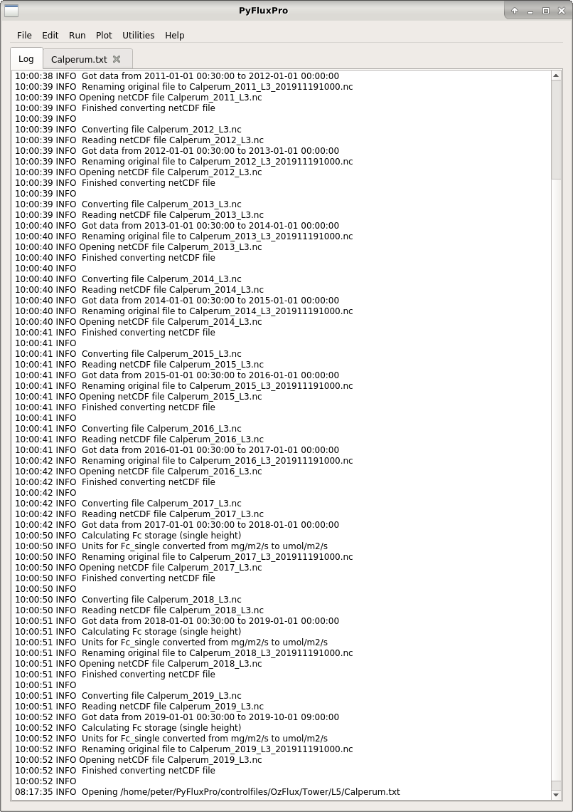
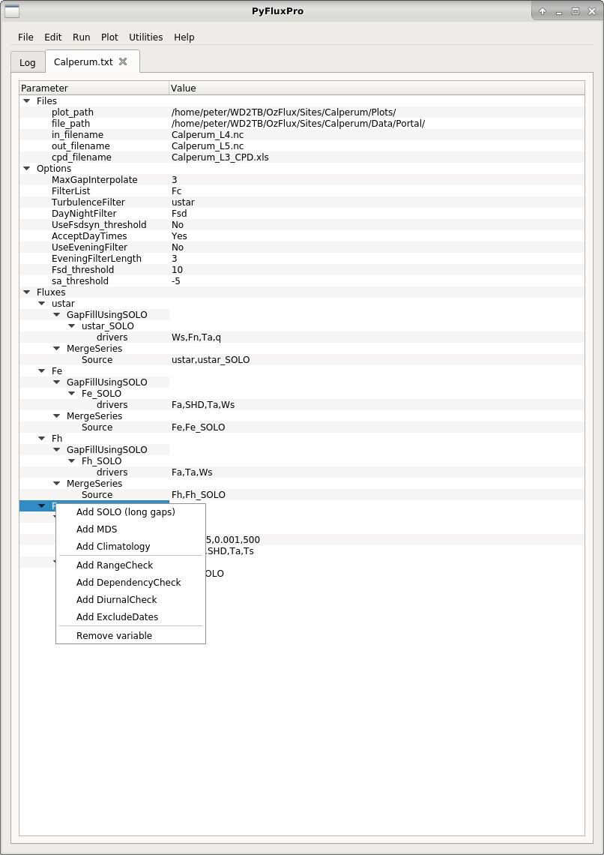
PyFluxPro GUI
Log window
Gap filling L5

Slide 8
Installation
Python 3
Miniconda or Anaconda Python distribution recommended.
Create a virtual environment using the supplied environment.yml file.
PyFluxPro
Scripts available from GitHub.
https://github.com/OzFlux/PyFluxPro.git
“git” recommended for initial cloning and subsequent updates.
Released under BSD 3-clause license.

Slide 9
Input Data
Meteorological and soil data from towers.
Fluxes from 2 sources;
Covariances output by logger;
Fluxes calculated from covariances.
Less work than processing turbulence data.
Less control over some QC steps.
Fluxes output by EddyPro or similar
The purist’s approach.
More work but more control over processing.
Able to test for stationarity in nocturnal fluxes.

Slide 10
Processing Levels
L1 – convert from XLS or CSV to netCDF
L2 – Quality control
L3 – Post-processing
L4 – Gap filling of meteorology
L5 – Gap filling of fluxes
L6 – Partitioning NEE into GPP and ER

Slide 11
PyFluxPro Data Flow
Slow data
TOA5
Yearly files
Multiple year files
L1
control file
L2
control file
L3
control file
L4 control file
L5 control file
L6 control file
L1 Excel spreadsheet
L1
L2
L3
L4
L5
L6
L1
netCDF
L2
netCDF
L3
netCDF
L4
netCDF
L5
netCDF
L6
netCDF
_fulloutput
CSV file
Fast data
TOB3
EddyPro

Slide 12
netCDF Files
Platform independent binary file.
Widely used by modelling communities.
Metadata packaged with data.
PyFluxPro netCDF files;
Compliant with CF Metadata Conventions;
Controlled vocabulary for metadata.
Standardised set of global and variable attributes (metadata).
Standardised variable names.

Slide 13
pyfluxpro processing levels

Slide 14
L1 Details
Conversion of input files to PyFluxPro netCDF files;
Standardising the input format to PyFluxPro.
Addition of metadata to the data stream;
Global attributes to describe data set;
Site, contact, canopy, vegetation, soil …
Variable attributes to describe data;
standard_name, long_name, height, instrument …

Slide 15
L2 Details
Quality control checks;
Plausible limits on data.
Rejection of outlying points.
Rejection of specific date periods.
Rejection of specific times.
Linear correction of calibration drifts.
Rejection of data based on CSAT and IRGA diagnostics.
QC checks written to variable attributes.

Slide 16
Behind the Scenes
Quality Control flags;
Every observation for every variable is assigned an integer QC flag.
Each integer QC flag value has a unique meaning.
QC flag value based on QC checks, processing options, gap filling etc.
Metadata;
Metadata travels with the data.
Metadata updated whenever something is done to the data.
Resulting file should be self-documenting.

Slide 17
L3 Details
Post-processing and corrections;
Merge redundant measurements.
Calculate meteorological quantities.
2D coordinate rotation (if required).
Massman frequency corrections.
Calculation of fluxes from covariances.
Application of WPL corrections (if required).
Calculation of net radiation, available energy, ground heat flux.

Slide 18
PyFluxPro Data Flow
Slow data
TOA5
Yearly files
Multiple year files
L1
control file
L2
control file
L3
control file
L4 control file
L5 control file
L6 control file
L1 Excel spreadsheet
L1
L2
L3
L4
L5
L6
L1
netCDF
L2
netCDF
L3
netCDF
L4
netCDF
L5
netCDF
L6
netCDF
_fulloutput
CSV file
Fast data
TOB3
EddyPro
See next slide for details

Slide 19
PyFluxPro L3 to L5 Data Flow
Yearly files
Multiple year files
L3
Control file
Concatenation
Control file
Climatology
Control file
L4 control file
L3
Concatenate
L4
To L5
Climatology
Climatology Excel spreadsheet
L3
netCDF
L3
netCDF
L4
netCDF
u* threshold
Control file
u* threshold
detection
u* results Excel spreadsheet
User supplied control file
Standard control file

Slide 20
Concatenate, climatology and u*
Concatenate;
L1 to L3 typically use year or part-year files.
Single, multiple year file for L4 to L6.
Climatology;
Used as last resort in gap filling at L4.
Monthly and 2D interpolated.
u* threshold;
Reject biased Fc data prior to partitioning at L6.
Change point detection only.

Slide 21
Gap Filling Data
Do not need to gap fill data for process studies or model validation and parameterisation.
Do need to gap fill data when daily, monthly or annual sums are needed.
PyFluxPro uses a neural network or Marginal Distribution Sampling to gap fill fluxes using meteorological data as drivers (L5).
PyFluxPro uses data from alternate sources to gap fill meteorology (L4).

Slide 22
L4 Details
Gap filling meteorological quantities;
Need to gap fill meteorological drivers used to predict Fe, Fc and ER.
Radiation, temperature, humidity, wind speed, precipitation and soil moisture.
PyFluxPro uses 3 sources of alternate data;
Automated Weather Station (AWS) network e.g. the NOAA ISD archive.
The ECMWF Re-analysis (ERA5) archive.
Local numerical weather prediction models.

Slide 23
L4 Details: NOAA ISD
Available from 1901 to present.
Basic meteorology available;
Ta, RH, WS, WD, Precip.
30 minute time step.
Provision to the community;
Python scripts available in PyFluxPro to download ISD stations near flux tower site, process these and reformat as netCDF files.
Pluses and minuses;
AWS data often fits tower data better than models
No radiation or soil data

Slide 24
L4 Details: ERA5
Available from 1979 to present.
ERA5 available at ~30 km resolution globally.
Use analysis fields (00, 12 UTC) plus forecast fields (03, 09, 15, 18 UTC).
Interpolation from 1 hour time step to time step of flux tower.
Radiation, meteorology and soil data;
Fsd, Fsu, Fld, Flu, Ta, RH, WS, WD, Precip, Sws, Ts, Fg.
Provision to the community;
Python scripts available in PyFluxPro to download ERA5 data for the flux tower site, process this and reformat as netCDF files..

Slide 25
L5 Details
Gap filling of fluxes;
Need to gap fill Fe and Fc to get sums
PyFluxPro also gap fills Fh and u*
PyFluxPro uses a neural network to gap fill fluxes;
SOFM/SOLO neural network (Hsu et al 2002)
User specified drivers
User specified network parameters

Slide 26
L6 Details
Partitioning of NEE into GPP and ER;
u*-filter approaches;
Use u*-filtered, nocturnal Fc to estimate ER.
Between 5% and 20% left after applying u* filter to nocturnal data.
Fit a function to u*-filtered, nocturnal Fc
Neural network (SOFM/SOLO)
Lloyd-Taylor (Arrhenius function)
Lasslop et al (2010) approach;
Avoids reliance on u*-filter approach
User specified conditions for fit.

Slide 27
pyFluxpro Plotting

Slide 28
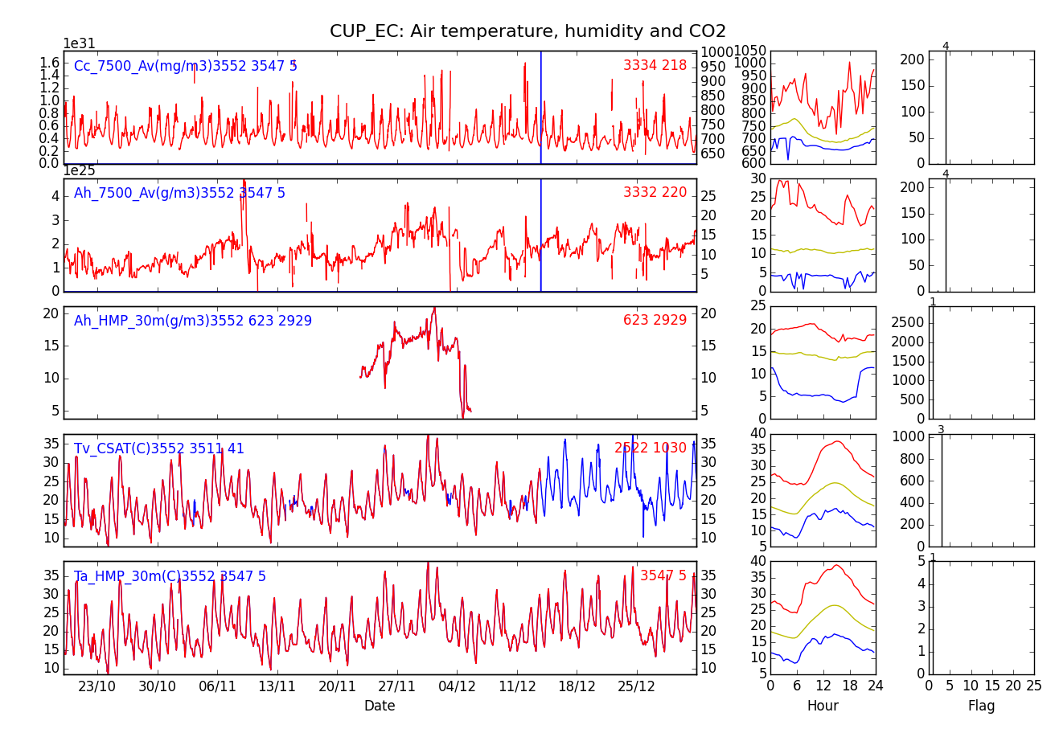
Plotting Data: L1 - L4 Time Series

Slide 29
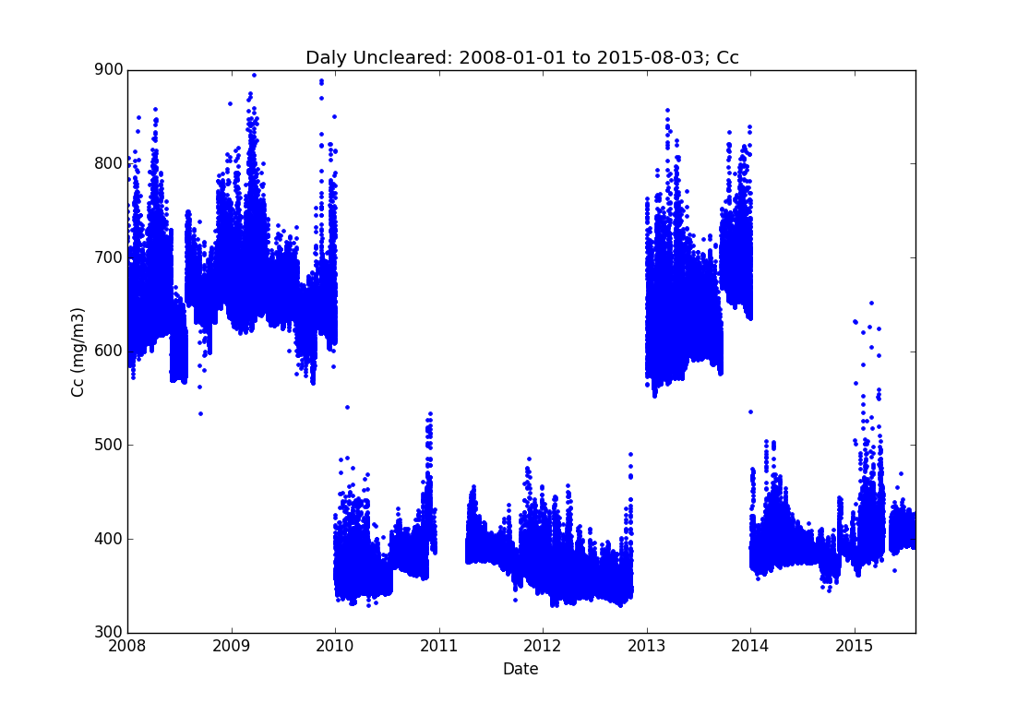
Plotting Data: 30 minute

Slide 30
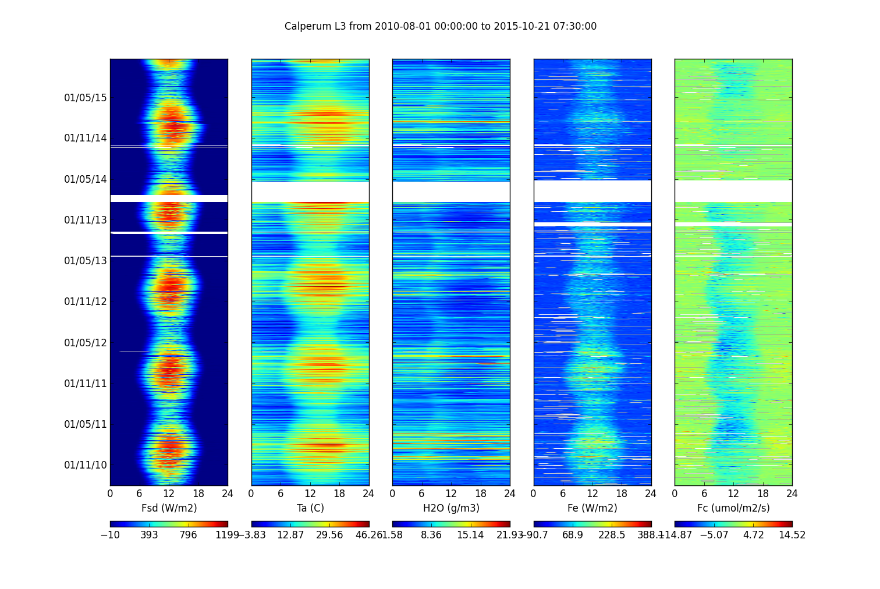
Plotting Data: Fingerprints

Slide 31
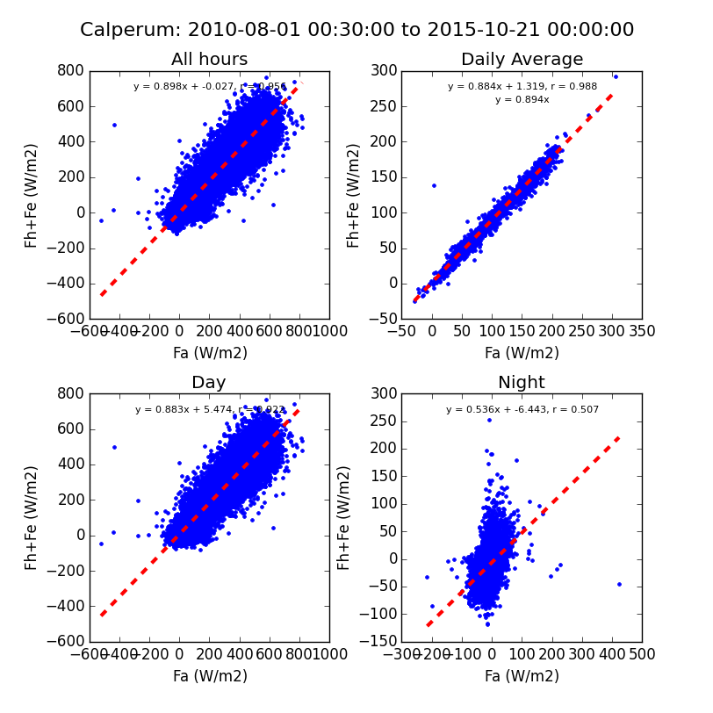
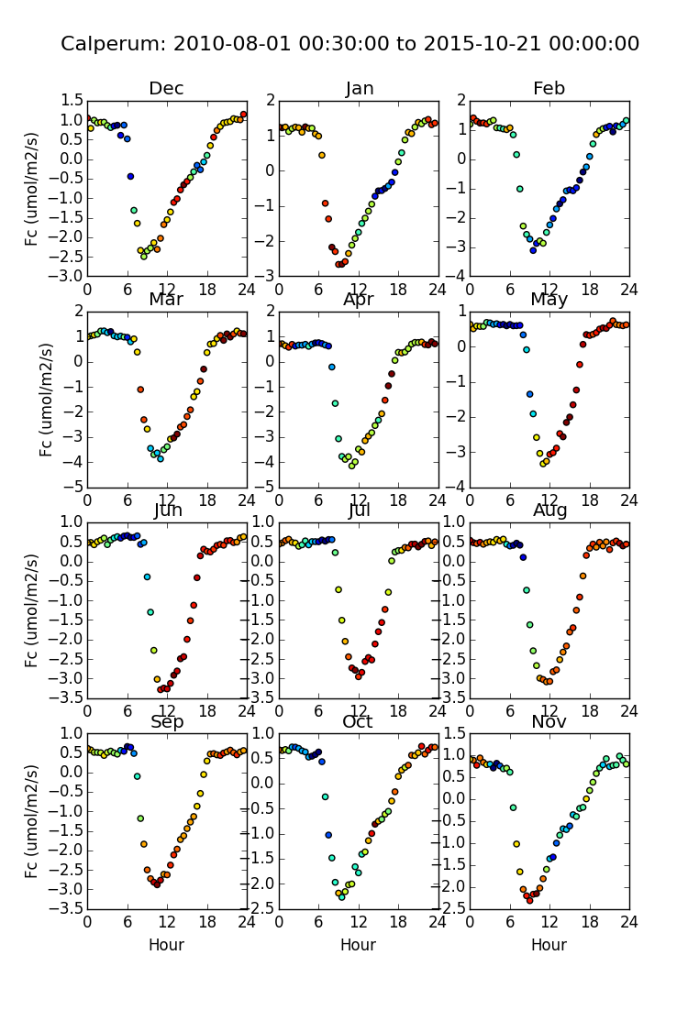
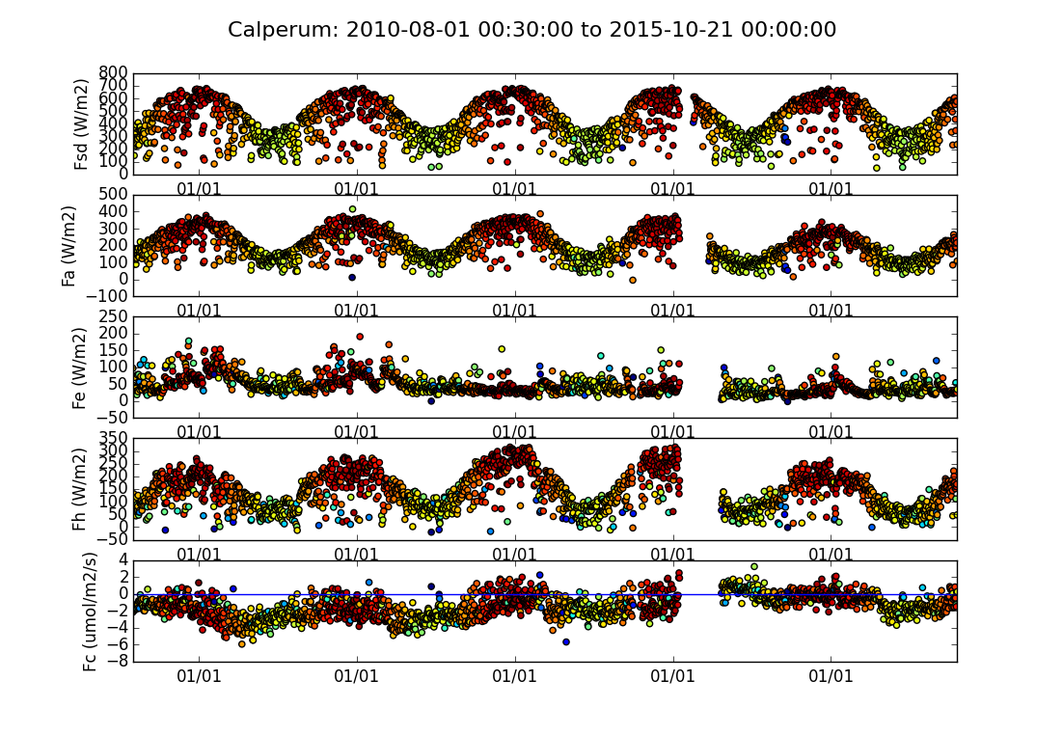
Plotting Data:
L3 Summary

Slide 32
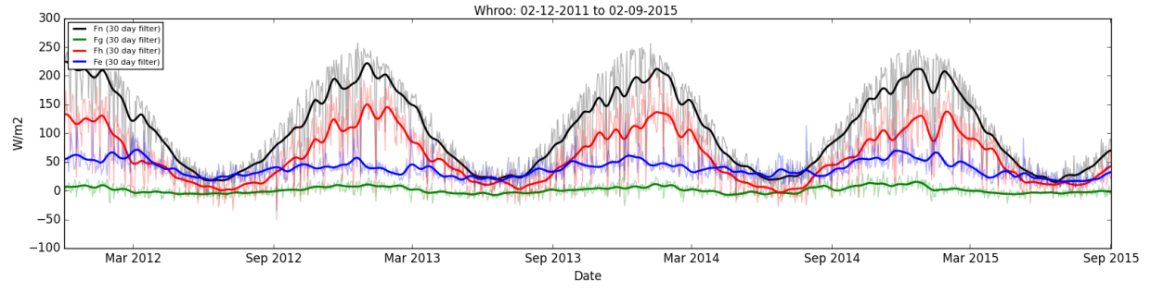
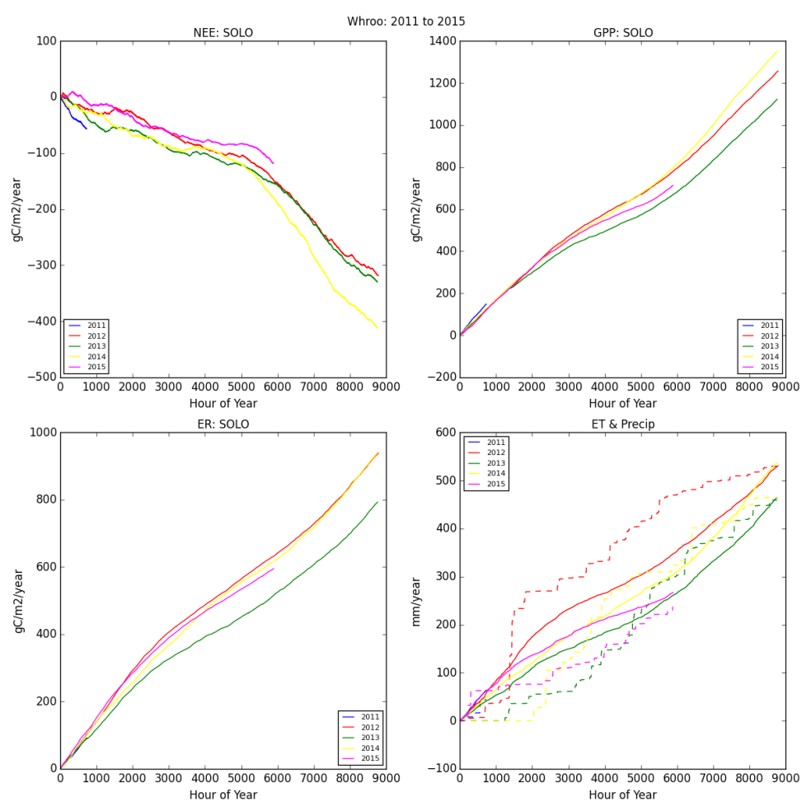
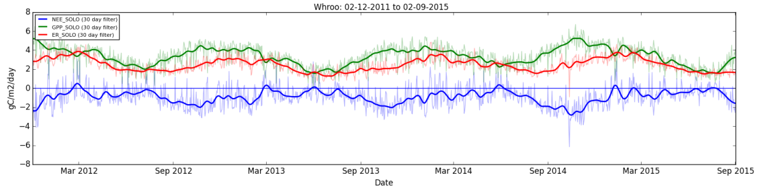
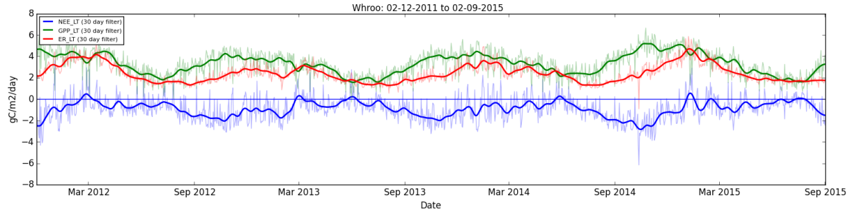
Plotting Data: L6 Summary

Slide 33
File conversion

Slide 34
Input Files
XLS or CSV files;
Used at L1 and converted to PyFluxPro netCDF.
PyFluxPro netCDF files;
Internal used at all levels.
Can be from external source at L4;
ISD, ERAI and local NWP.
Can be from external source at L4, L5 and L6;
Through the [Imports] key in control file.
EddyPro, REddyPro files once converted to PyFluxPro netCDF (utilities provided).

Slide 35
Output Files
PyFluxPro netCDF file.
Can be read in Python, MATLAB, R, IDL etc
Excel spreadsheet;
“File/Convert/nc to xls” menu option.
Saves attributes, data and QC flags.
Specialist formats;
FluxNet CSV file for submission to FluxNet.
REddyProc CSV file for use with REddyProc.
Re-format L3 data for use with on-line tool or R scripts.

