Slide 1
FRAUD DETECTION
Fraud Detection via Graph Theory
A Comparative Study of Classical, Spectral,
and Neural Graph Methods
Baha Kirbasoglu
Graduate Graph Theory — Term Project
May 2026

Slide 2
Why Graph Theory for Fraud Detection?
Traditional ML treats every transaction or provider as an isolated observation
Fraud is inherently relational: fraud rings, collusion networks, and coordinated billing are structural phenomena
Graph-theoretic methods encode these relationships explicitly as edges
Key question: do structural signals in transaction graphs improve fraud detection performance?
TABULAR VIEW
ID
Amount
Time
Card
1042
$ 84.20
09:12
•••2341
1043
$ 22.10
09:13
•••8821
1044
$417.00
09:14
•••0193
1045
$ 9.99
09:14
•••5547
GRAPH VIEW
fraud ring
2

Slide 3
Research Hypothesis
“
Fraudulent entities form structurally distinct communities in transaction graphs, and graph-theoretic methods — including centrality-based classification, spectral analysis, and graph neural networks — outperform tabular anomaly detection on relational fraud data, particularly for Medicare provider-level fraud.
Two datasets tested: Credit Card transactions (European cardholders) and Medicare provider prescribing records
Direct comparison against tabular ML baselines from a companion project (BLG607 Data Mining)
3

Slide 4
Datasets
Credit Card Fraud
Medicare Provider Fraud
Source: ULB Kaggle (European cardholders, Sept 2013)
284,807 transactions, 492 fraudulent (0.172%)
Features: 28 PCA components + Amount + Time
Graph subset: 50,000 nodes (stratified)
Source: CMS Part D 2017–2019 + OIG LEIE ground truth
7,701 unique providers, 137 fraudulent (1.78%)
Raw data: ~11.9 GB (6 million rows sampled)
Fraud label: OIG List of Excluded Individuals/Entities
4

Slide 5
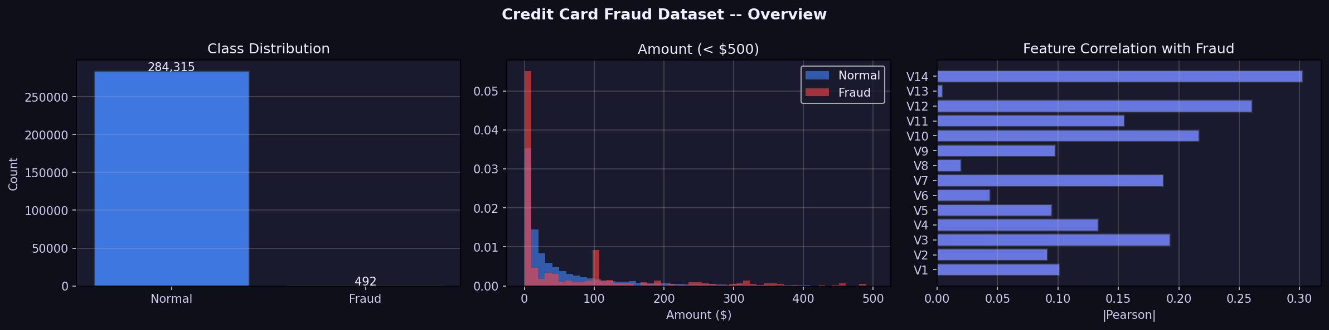
Datasets — Exploratory Overview
Credit Card class imbalance, amount distribution, and feature correlations
Credit Card Fraud Dataset — class distribution, transaction amounts, and feature correlations
5

Slide 6
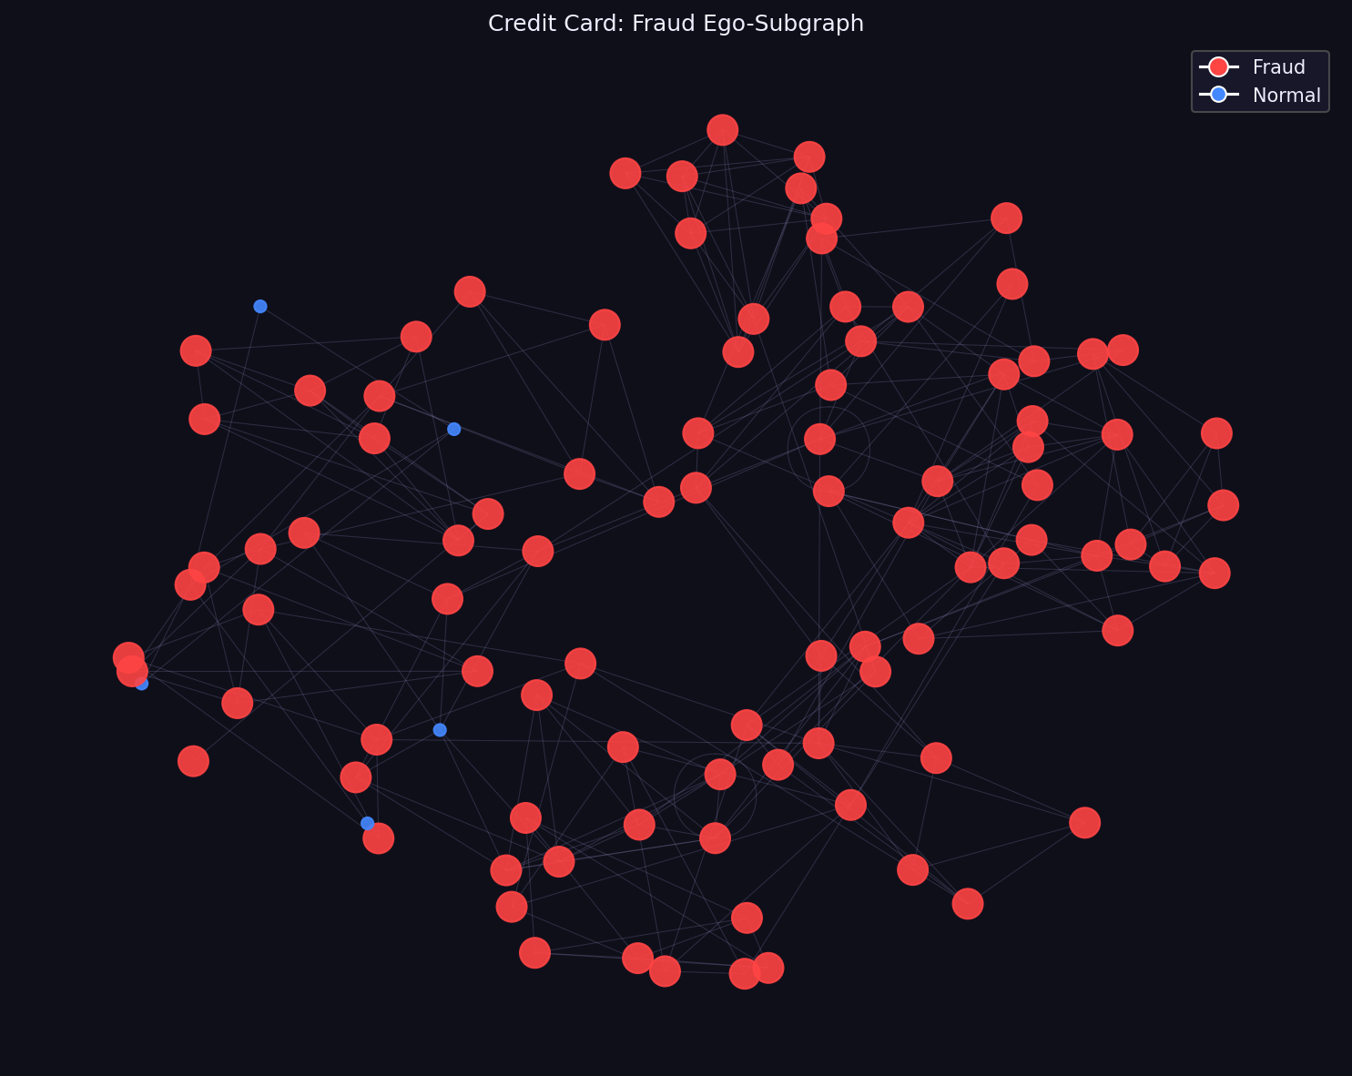
Graph Construction — Credit Card K-NN Similarity Graph
Each transaction is a node
Edges connect transactions that are cosine-similar in 28-dim PCA feature space (k = 10 nearest neighbors)
Resulting graph: 50,000 nodes, 347,127 edges
Rationale: fraudulent transactions cluster in feature space; K-NN graph makes this structure explicit
Aᵢⱼ = 1 iff j ∈ k-NN(i) or i ∈ k-NN(j)
Credit Card fraud ego-subgraph
6

Slide 7
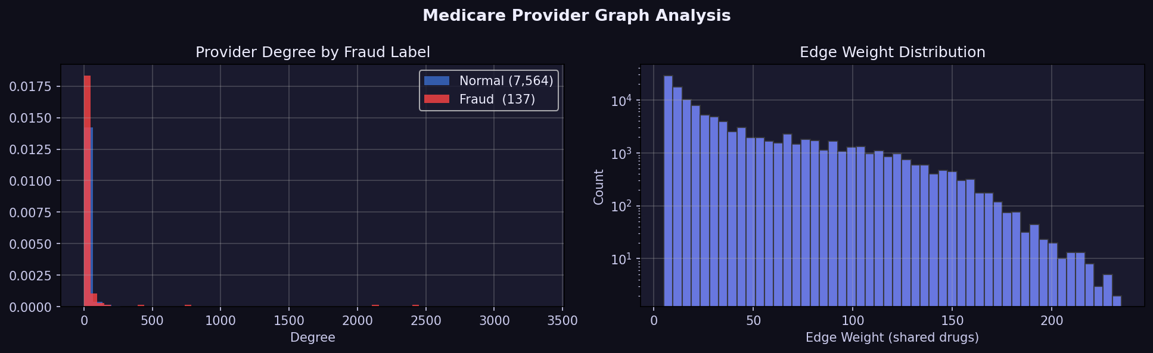
Graph Construction — Medicare Provider-Drug Bipartite Projection
Step 1: Build bipartite graph B — providers and drugs as two node sets; edge = prescription
Step 2: Project onto provider layer — edge between p₁ and p₂ if they share ≥ 5 drugs
Challenge: hub drugs (> 25% of providers) would create ~334M edges
Solution: remove hub drugs before projection; cap neighborhood at K = 25
Result: 7,701 nodes, 113,350 edges
Medicare provider graph analysis — degree distribution and edge weights
7

Slide 8
Methods Evaluated: Four Categories
Tabular-ML Baseline
OCSVM · GMM · Isolation Forest · LOF · Ensemble
Graph-Classical
Centrality features (PageRank, Betweenness, Clustering, …) + Random Forest
Graph-Spectral
Fiedler vector anomaly score · Spectral Clustering (k = 10)
Graph-GNN
GCN · GraphSAGE · GAT (supervised); DOMINANT (unsupervised)
Note: All methods evaluated on the same datasets with identical train/val/test splits (70/10/20, stratified).
8

Slide 9
Classical Graph Analysis: Centrality and Community Detection
Six centrality measures per node: degree, PageRank, betweenness, closeness, eigenvector, clustering coefficient
Centrality vector used as input to a balanced Random Forest classifier
Community detection via Louvain algorithm (modularity optimization)
Key finding — Credit Card
Community 0: 396 nodes, 383 fraudulent — 96.7% internal fraud rate
Strong evidence that fraud forms structurally cohesive subgraphs detectable without supervision.
9

Slide 10
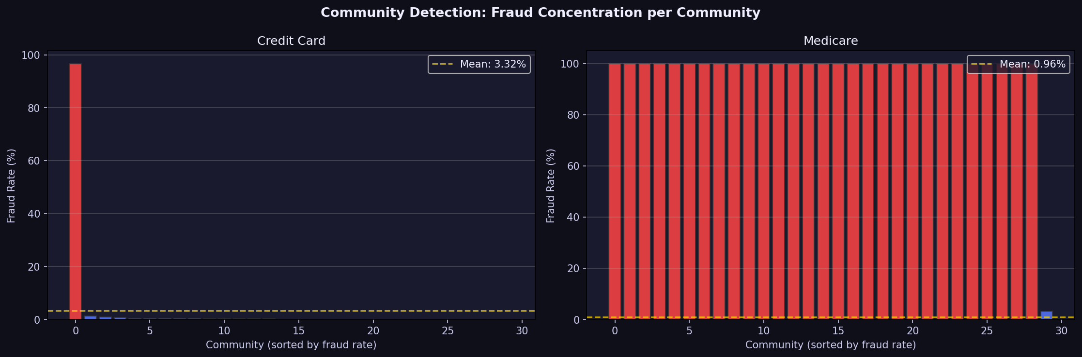
Community Detection — Fraud Concentration
Per-community fraud rate distribution (Credit Card vs Medicare)
Community Detection: Fraud Concentration per Community
10

Slide 11
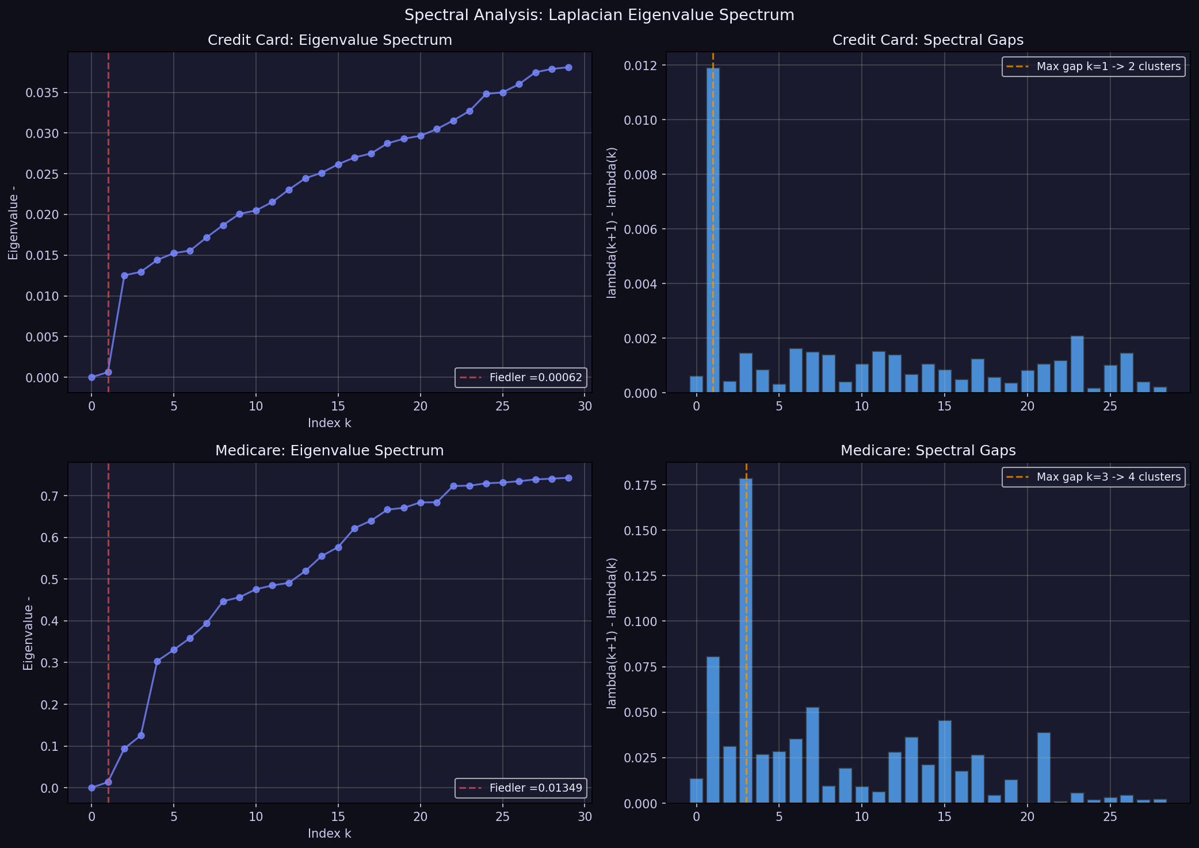
Spectral Methods: Laplacian Eigenanalysis
Normalized Laplacian: L = D⁻¹ᐟ²(D − A)D⁻¹ᐟ²
Eigenvalues: 0 = λ₁ ≤ λ₂ ≤ …
Fiedler value λ₂ (algebraic connectivity): how easily the graph splits
• Credit Card: λ₂ = 0.000619 (low — easily partitioned)
• Medicare: λ₂ = 0.013493
Fiedler vector (eigenvector of λ₂): optimal bisection; used as anomaly score
Spectral clustering: K-means on bottom-k eigenvectors
GCN connection: a GCN layer ≈ first-order Chebyshev spectral convolution.
11

Slide 12
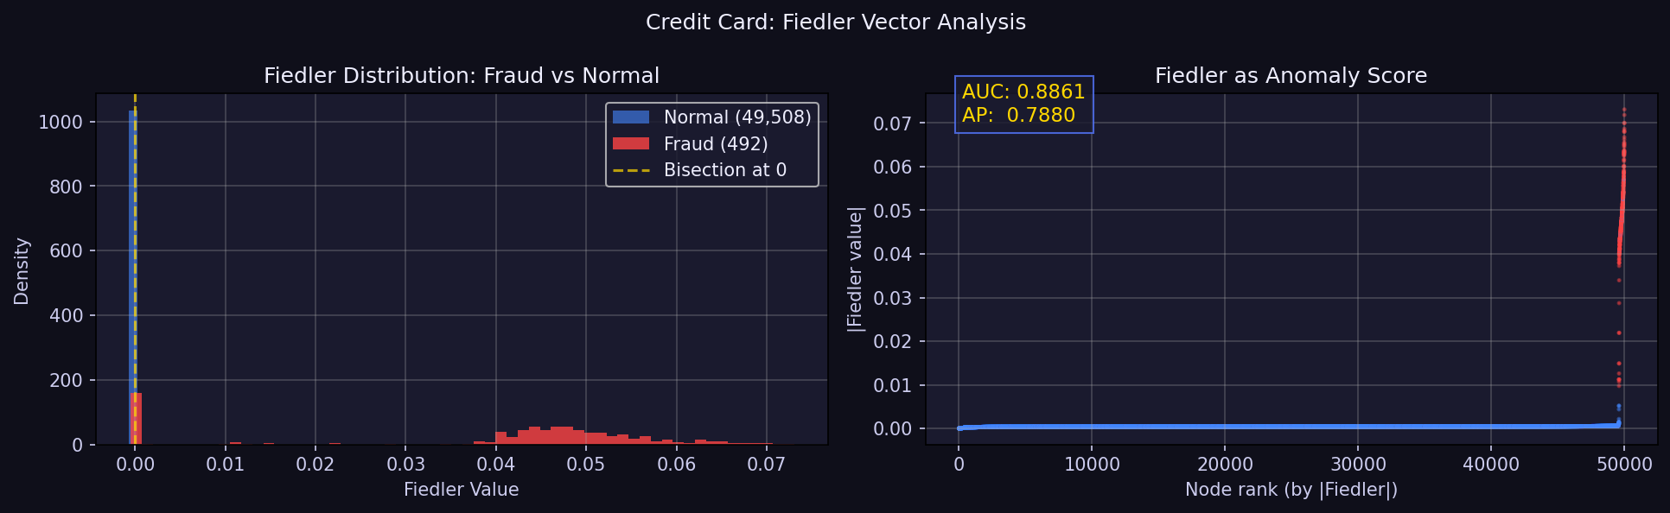
Spectral Results — Credit Card
Credit Card
Fiedler Anomaly
AUC-ROC = 0.8861 AUC-PRC = 0.7880
Spectral Clustering (k = 10)
AUC-ROC = 0.9221 AUC-PRC = 0.7489
Best graph method overall on this dataset.
Credit Card — Fiedler distribution and anomaly score
12

Slide 13
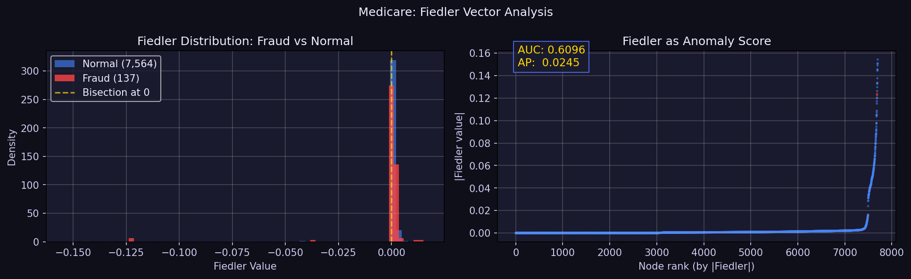
Spectral Results — Medicare
Medicare
Fiedler Anomaly
AUC-ROC = 0.6096
(exceeds tabular baseline)
Spectral Clustering (k = 10)
AUC-ROC = 0.5779
Fiedler score outperforms spectral clustering here.
Medicare — Fiedler distribution and anomaly score
13

Slide 14
Graph Neural Networks: Architectures
Model | Key Mechanism | Hidden | Epochs
GCN | Normalized adjacency aggregation | 64 → 32 | 200
GraphSAGE | Mean neighbor sampling | 64 → 32 | 200
GAT | Learned attention (4 heads) | 8×4 → 32 | 200
DOMINANT | Attribute + structure recon. (unsup.) | 64 | 100
All supervised models trained with BCELoss, class-weighted to address imbalance
Input features: 7 centrality measures (no raw transaction features)
Framework: PyTorch Geometric 2.7
14

Slide 15
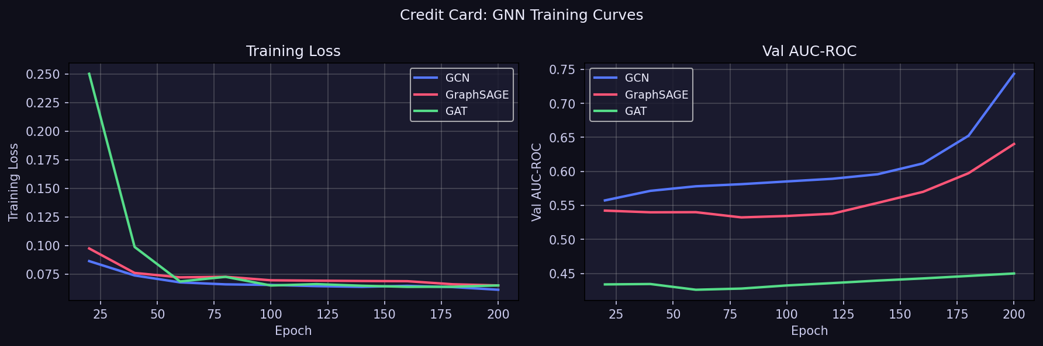
GNN Training Curves — Credit Card
Training loss and validation AUC-ROC across GCN, GraphSAGE, GAT
15

Slide 16
Graph Neural Networks: Results
Credit Card
Medicare
GCN
0.6144
GCN
0.6139
(highest overall)
GraphSAGE
0.5171
GAT
0.4361
GAT
0.3586
(worst)
GraphSAGE
0.4309
DOMINANT
0.5708
(21 min train)
DOMINANT
0.5509
Key observation: GNNs underperformed spectral methods on Credit Card despite greater architectural complexity.
16

Slide 17
Full Comparison — Credit Card Dataset
Categories
Tabular-ML
Graph-Spectral
Graph-Classical
Graph-GNN
Bottom line
Best graph: 0.9221
Best tabular: 0.9588
Gap: −3.8%
17

Slide 18
Full Comparison — Medicare Dataset
Winner
GCN
AUC-ROC 0.6139
Highest among all methods on Medicare.
Bottom line
Best graph: 0.6139
Best tabular: 0.6081
Gain: +0.95%
18

Slide 19
Was the Hypothesis Supported?
Credit Card — NOT SUPPORTED
Medicare — MARGINALLY SUPPORTED
Best graph (Spectral Clustering): 0.9221
Best tabular (GMM): 0.9588
Relative gap: −3.83%
Reason: PCA preprocessing removed relational structure; edges encode proximity in compressed feature space, not semantic transaction similarity.
Best graph (GCN): 0.6139
Best tabular (Isolation Forest): 0.6081
Absolute improvement: +0.0058 (+0.95%)
Reason: Bipartite projection encodes domain knowledge; shared prescribing patterns directly relate to provider-level fraud.
19

Slide 20
Why Did Spectral Methods Outperform GNNs?
Global vs. local view
Spectral clustering operates on global graph topology, capturing macro-level partitions across all 50,000 nodes simultaneously.
Weak local signal for GNNs
GNNs aggregate local neighborhoods; with centrality-only inputs, local neighborhoods in a PCA-derived graph carry limited discriminative signal.
Training instability
With 0.17% fraud rate (492 vs. 49,508), GNN optimization may converge to degenerate majority-class solutions despite class weighting.
Unsupervised wins
The 96.7% fraud-rate Louvain community was detected without supervision — spectral structure is stronger than the label signal available to GNNs.
20

Slide 21
Graph Construction Quality is Decisive
The most important design decision was how to build the graph from tabular data
Credit Card: K-NN in PCA space — weak prior; edges may not encode fraud-relevant relationships
Medicare: bipartite provider-drug projection — strong prior; edges encode shared prescribing behavior (the domain definition of collusion)
A graph that encodes domain knowledge provides far more useful structure than a generic similarity graph
Hub-drug removal was critical: without it, 334 million edges would have eliminated all structural signal
WEAK PRIOR
K-NN in PCA space
STRONG PRIOR
Bipartite domain projection
21

Slide 22
Limitations
Credit card features were PCA-transformed prior to public release, preventing construction of a semantically grounded similarity graph
Medicare analysis used a sampled subset (6M of ~60M rows) due to memory constraints; hub-drug removal and neighborhood capping may have discarded informative edges
GNN experiments were single runs with a fixed random seed; performance variance across seeds was not measured
Tabular ML baselines were carried over from the companion BLG607 project rather than re-evaluated here
The marginal Medicare improvement (+0.95%) is below the threshold typically considered practically significant in deployed fraud detection systems
22

Slide 23
Conclusions
Graph-theoretic methods provide competitive fraud detection performance but do not uniformly outperform tabular approaches
Spectral clustering (AUC-ROC = 0.9221) was the strongest graph method on the credit card dataset, though it did not exceed the tabular GMM baseline (0.9588)
On Medicare, GCN (0.6139) and the Fiedler anomaly score (0.6096) narrowly surpassed all tabular methods
GNNs underperformed classical and spectral methods in both settings — attributable to sparse feature inputs, severe class imbalance, and graph construction quality
Graph methods are most advantageous when graph construction encodes genuine domain knowledge about relational fraud behavior
23

Slide 24
Key Takeaways
01
Graph construction > model complexity. A semantically grounded edge definition (bipartite drug projection) outperforms a sophisticated GNN built on a generic K-NN graph.
02
Spectral methods are powerful baselines. The Fiedler vector and spectral clustering consistently exceeded GNNs while requiring no training and fewer hyperparameters.
03
Community structure is real, but hard to exploit. A 96.7% fraud-rate community was detected without any labels — yet supervised GNNs could not leverage this structure effectively.
04
Graph methods add value in the relational domain. For Medicare provider fraud, where relationships are semantically meaningful, a small but consistent improvement over tabular methods was observed.
24

Slide 25
Selected References
Kipf & Welling (2017). Semi-Supervised Classification with GCN. ICLR 2017
Hamilton, Ying & Leskovec (2017). Inductive Representation Learning on Large Graphs. NeurIPS 2017
Veličković et al. (2018). Graph Attention Networks. ICLR 2018
Ding et al. (2019). Deep Anomaly Detection on Attributed Networks. SDM 2019
Blondel et al. (2008). Fast Unfolding of Communities in Large Networks. J. Stat. Mech.
Fiedler (1973). Algebraic Connectivity of Graphs. Czech. Math. J.
CMS (2022). Medicare Part D Prescribers by Provider and Drug. CMS Open Data
OIG (2023). List of Excluded Individuals and Entities (LEIE).
25

Slide 26
THANK YOU
Questions & Discussion
Repository: Full results, source code, and notebooks available in the project repository
Datasets: Kaggle ULB Credit Card · CMS Medicare Part D · OIG LEIE
Methods: NetworkX · PyTorch Geometric · SciPy · Scikit-learn
Baha Kirbasoglu · BLG 549E · Graduate Graph Theory · May 2026

