Slide 1
IMPBA: Image Mask Prediction and Background-Aware Inpainting for Object Removal
Course: Image Processing
Instructor: İlkay Öksüz
Baha Kırbaşoğlu

Slide 2
Outline
-Introduction & Motivation
-Related Work
-Proposed Approach (IMPBA)
-Experimental Setup
-Results & Discussion
-Conclusion & Future Work
-References
Baha Kırbaşoğlu

Slide 3
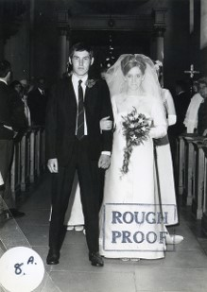


Introduction & Motivation
Image inpainting aims to reconstruct missing regions realistically
Object removal is more challenging due to semantic consistency
Large holes require global context understanding
Applications: photo editing, content creation, image forensics
Baha Kırbaşoğlu

Slide 4
Why Object Removal is Hard
Large missing regions
Loss of structural cues
Texture and semantic ambiguity
Need for long-range dependencies
Baha Kırbaşoğlu

Slide 5
Related Work
CNN-based inpainting: limited global context
Transformer-based approaches (e.g., MAT)
Adversarial and perceptual learning methods
Trade-off: performance vs computational cost
Baha Kırbaşoğlu

Slide 6
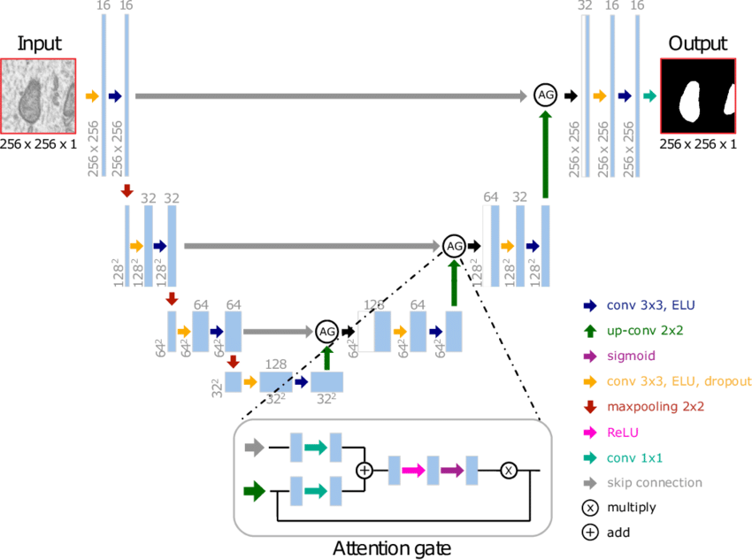
Proposed Approach: IMPBA
Autoencoder-based image inpainting framework
Two architectures:
  U-Net-like baseline
  Attention U-Net
Focus on object removal scenarios
Attention improves contextual reasoning
Baha Kırbaşoğlu

Slide 7

Dataset & Training Setup
Dataset: DeFacto Inpainting Dataset
~25,000 object removal samples
Resolution: 256 × 256
Loss functions:
  MSE
  Perceptual Loss (VGG19)
Training on NVIDIA A100 GPU
Baha Kırbaşoğlu

Slide 8
Evaluation Metrics
PSNR – pixel-level accuracy
SSIM – structural similarity
LPIPS – perceptual similarity
  Perceptual quality ≠ pixel accuracy
Baha Kırbaşoğlu

Slide 9
Experimental Results
Attention U-Net → higher SSIM
Perceptual loss → best LPIPS
Different metrics capture different qualities
Attention mechanisms improve perceptual consistency in large missing regions.
Baha Kırbaşoğlu

Slide 10
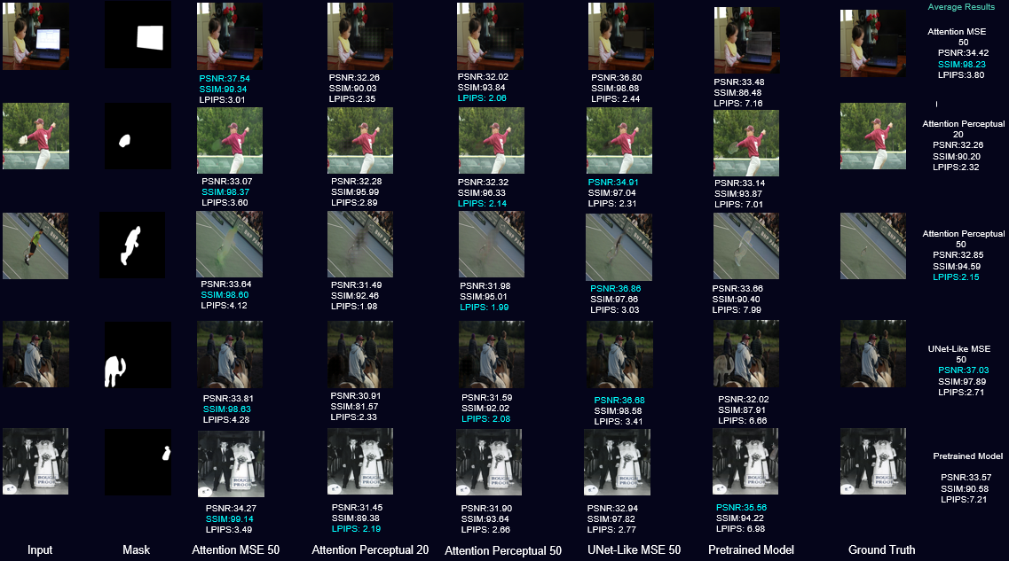

Slide 11
Discussion
Strengths:
  Improved perceptual realism
  Better structural consistency
Limitations:
  Resolution constrained to 256×256
  Performance drops in very complex textures
Baha Kırbaşoğlu

Slide 12
Conclusion
Attention improves object removal inpainting
Perceptual loss enhances visual realism
IMPBA is effective under limited resources
Suitable for real-world object removal tasks
Attention-based inpainting achieves more realistic object removal.
Baha Kırbaşoğlu

Slide 13
Future Work
Higher-resolution inpainting
Transformer-based hybrid architectures
Adversarial training
Larger and more diverse datasets
Baha Kırbaşoğlu

Slide 14
References
Li et al., MAT, CVPR 2022
Zuo et al., Generative Inpainting
DeFacto Dataset
Baha Kırbaşoğlu

Slide 15
Thank You for Your Attention
Questions?
Baha Kırbaşoğlu

