Slide 1
eduKemet
A Gamified learning Solution by Bahale.

Slide 2
“The youth remain vulnerable in the labour market...” ~Stats SA
According to Stats SA, by the start of 2024, the number of unemployed youths increased to 45.5%. This was following the increase of unemployed youth by 236 000.
In a research conducted by the labour market intelligence, it was found that graduate unemployment has sharply risen from 5.8% in 2008 to almost 12% 2023.
This is a pattern.

Slide 3
We have a problem
Tertiary graduates are struggling to enter the job market because of the great gap between the skills granted to them by their degrees and what the job market wants.

Slide 4

Don’t worry… I got us.
A gamified platform designed to prepare youths, starting from as early as high school, for their future careers by building skills that are essential in making them employable, while enhancing their current abilities.

Slide 5
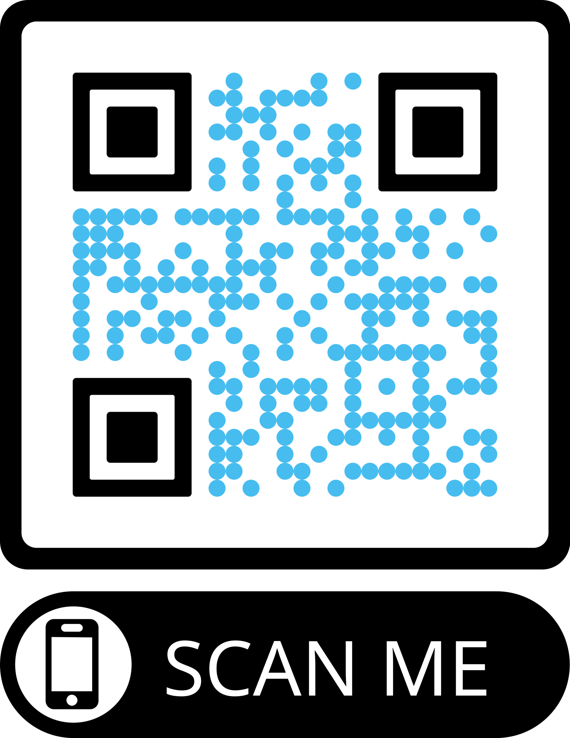
Eyes on me…
https://edu-kemet.vercel.app

Slide 6
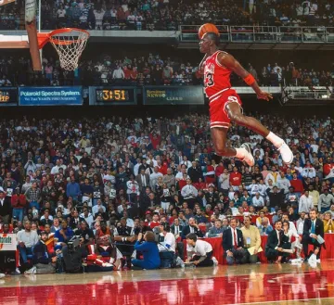
Thank you…

