Slide 1

Enhancing E-Commerce Excellence - Customer Segmentation and Intelligent Product Recommendation
Presented By:
Sujith Gollamudi
Bahalul Khan Pathan
Sai Krishna Aditya Gorthi

Slide 2
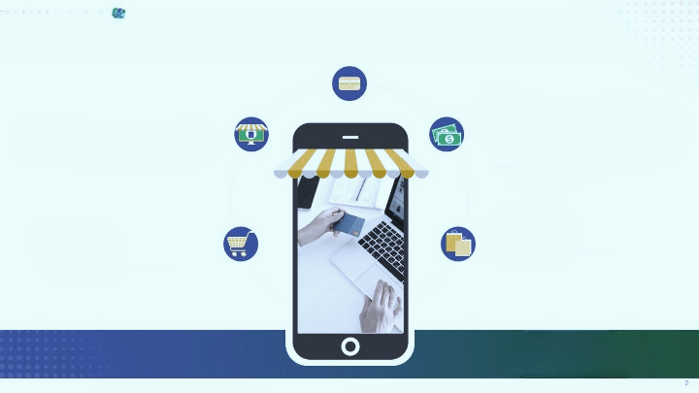

Introduction
Project Approach
Data Source
Project Execution
Project Outputs
Conclusion
Content

Slide 3
Section 1
Introduction

Slide 4
The Significance of Personalized Customer Experience
Personalized and seamless customer experience is crucial for e-commerce success
Project focus: customer segmentation and intelligent product recommendation

Slide 5
Project Scope
Utilizing
Utilizing clustering techniques for customer segmentation
Implementing
Implementing association rule mining for intelligent product recommendation

Slide 6
Section 2
Project Approach

Slide 7
Customer Segmentation Techniques
K-Means and Hierarchical Clustering for customer segmentation
Factors considered: purchase frequency, transaction value, and product categories

Slide 8

Association Rule Mining
Market Basket Analysis
Market basket analysis is a specific application of association rules that focuses on analyzing transactions in a retail environment with the objective of identifying products that are frequently bought together. This information can be used by retailers to boost their sales and profits. By analyzing transaction data, retailers can identify patterns of customer behavior and make data-driven decisions about product placement, promotions, and pricing.
The objective of the analysis is to identify which products are frequently purchased together in order to develop marketing strategies, optimize product placement, and improve customer satisfaction.

Slide 9
Section 3
Data Source

Slide 10
Utilized Dataset
"Online Retail Data Set" from the UCI Machine Learning Repository
Online retail is a transactional data set which contains all the transactions occurring between 01/12/2010 and 09/12/2011 for a UK-based and registered non-store online retail. The company mainly sells unique all-occasion gifts. Many customers of the company are wholesalers.

Slide 11

Dataset Link
Online Retail Data Set https://archive.ics.uci.edu/ml/datasets/online+retail

Slide 12
Section 4
Project Execution

Slide 13
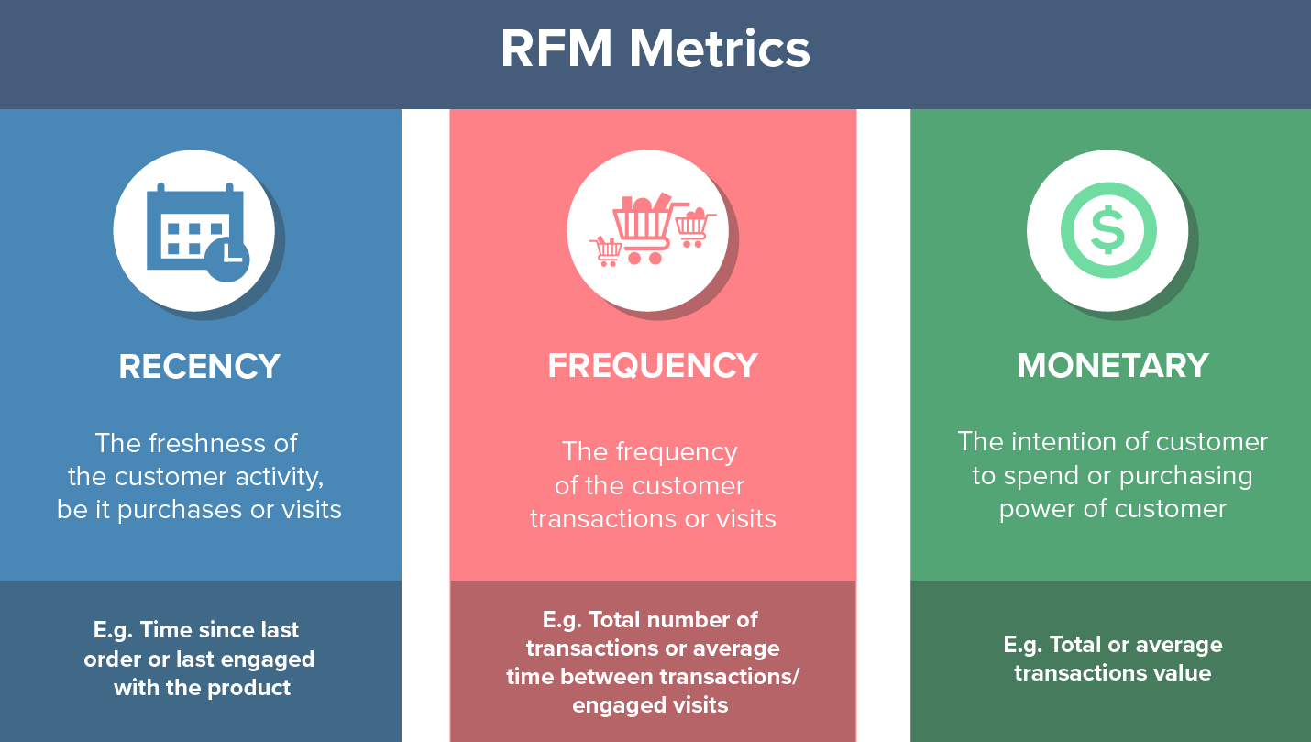
Segmentation
We aim to segment the Customers based on RFM(Recency, Frequency, Monetary) so that the company can target its customers efficiently.
Recency — How recently did the customer purchase? It means the number of days since a customer made the last purchase.
Frequency — How often do they purchase in a given period. So we can understand this value as for how often or how many a customer used the product of a company. The bigger the value is, the more engaged the customers are.
Monetary — How much do they spend? It is the total amount of money a customer spent in a given period. Therefore big spenders will be differentiated with other customers such as MVP or VIP.

Slide 14
Data Cleaning and Preprocessing
There are 135080 missing values and no null values in the dataset. But CustomerID is a key attribute in determining the RFM so we will omit the missing rows from our dataset.
In order to perform analysis, we need to split the InvoiceDate into Day, Month, Year and Hour. Hence, we will first convert it to character and split the InvoiceDate records into weekOfDay, hourOfDay, month and year.
To implement the RFM analysis, we need to further process the data set in by the following steps:
Find the most recent date for each ID , to get the Recency data
Calculate the quantity of transactions of a customer till present date, to get the Frequency data
Sum of Total Sales is the Monetary data.

Slide 15
Determining Optimal Cluster
We will use two most popular methods to find an optimal number of clusters:
Elbow Method
Silhouette Method

Slide 16
Association Rule Mining Process
Mining association rules to discover product relationships
Utilization of the Apriori algorithm for valuable insights

Slide 17
Section 5
Project Outputs

Slide 18
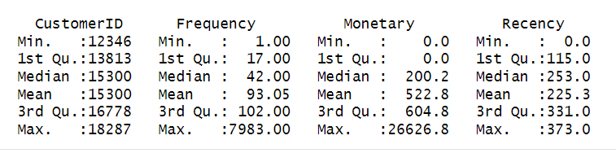
Calculating Recency, Frequency and Monetary

Slide 19
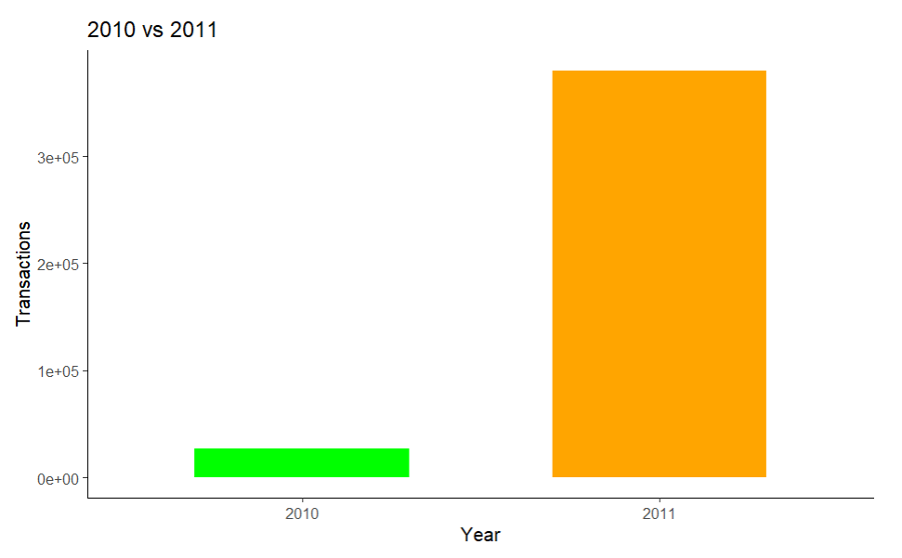
Transactions By Year Analysis
By comparing the total number of transactions in year 2010 and 2011, we find that people’s consumption habits changed a lot. People became interested in shopping online.

Slide 20
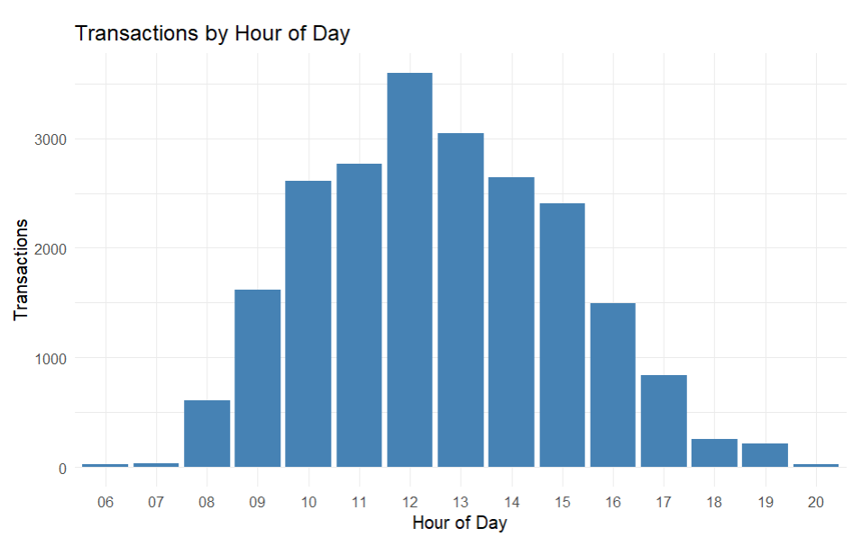
Transactions By hour of the Day Analysis
The graph explains that between 10am till 3pm most of the orders are placed online.

Slide 21
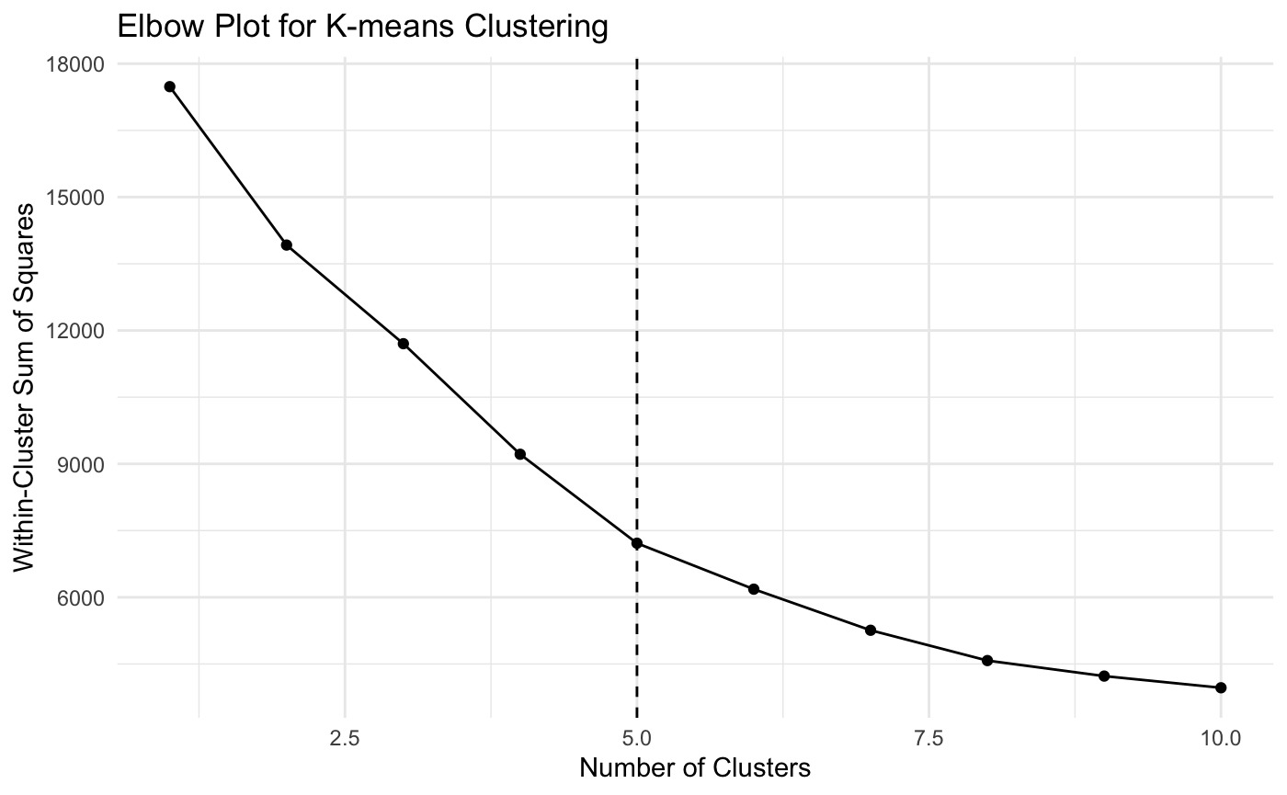
Elbow Method
The graph starts to bend at Cluster 5, hence we can determine that K=5 is the Optimal Cluster.

Slide 22
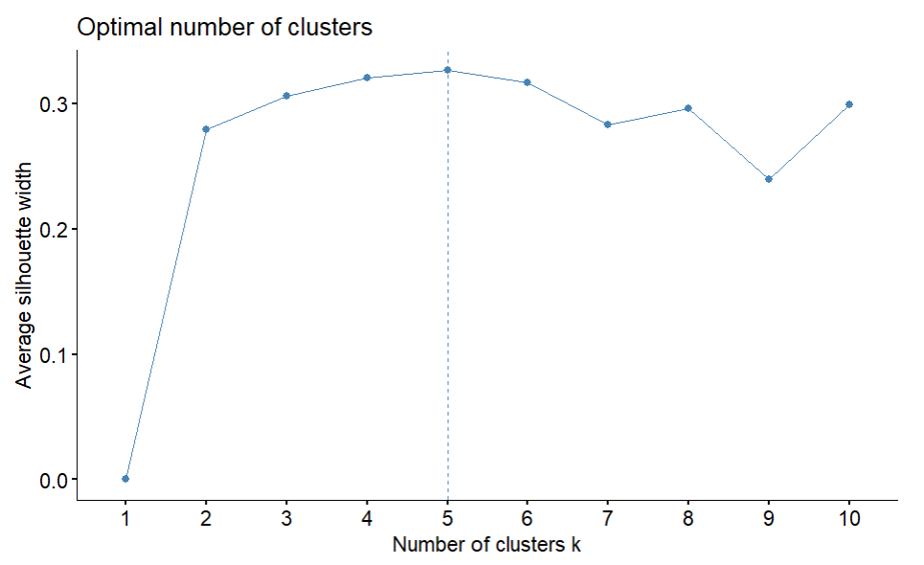
Average Silhoute Method
From above graph we can visualize that k=5 is the Optimal number of Cluster and k=8 is the next best.
We will visualize kmeans clusters using k=5 for better understanding.

Slide 23
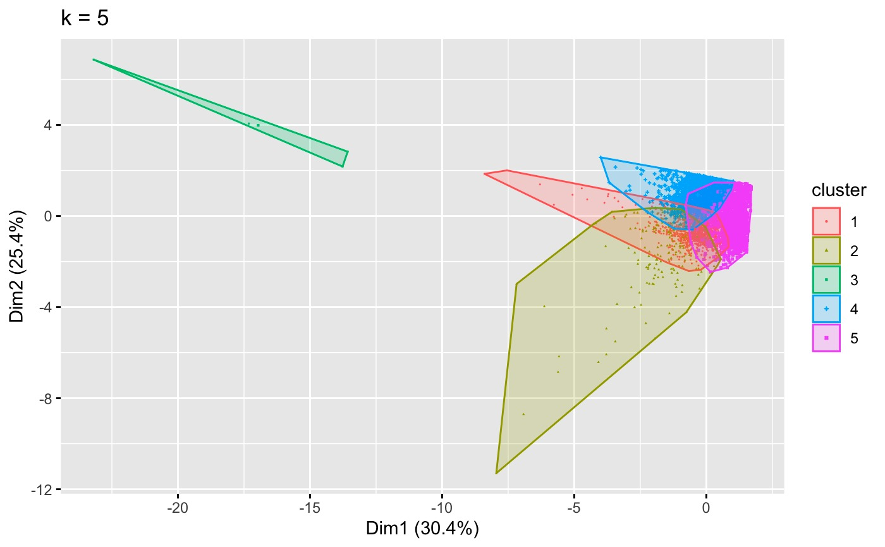
After observing the elbow graph results and Silhoute plot results we have concluded to take K = 5 as our preferred clusters

Slide 24
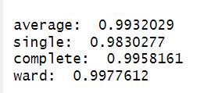
Agglomerative coefficients for different hierarchical clustering methods
The agnes$ac value gets the agglomerative coefficient, which measures the amount of clustering structure found (values closer to 1 suggest strong clustering structure). We see that all the four linkage methods are quite similar and close to 1, but Ward’s method gives the best result. Also, in general, Complete and Ward’s linkage are preferred over others.

Slide 25
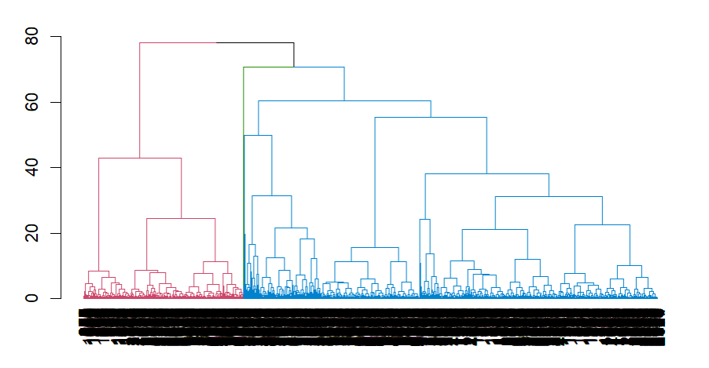
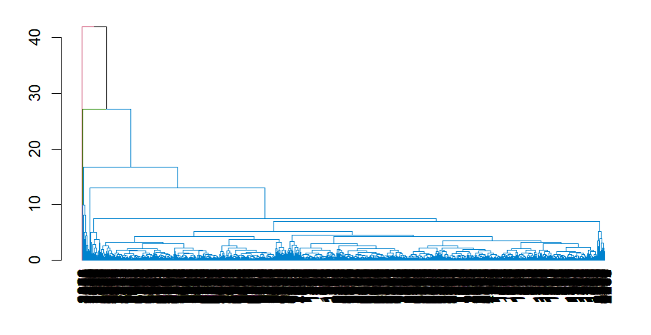
dendrograms - Complete and Ward’s.
Ward
Complete
We observe that the Complete linkage creates clusters for each outliers and thus creates 2 clusters each for 2 outlier which would not provide good result. We will go with Ward’s method.

Slide 26
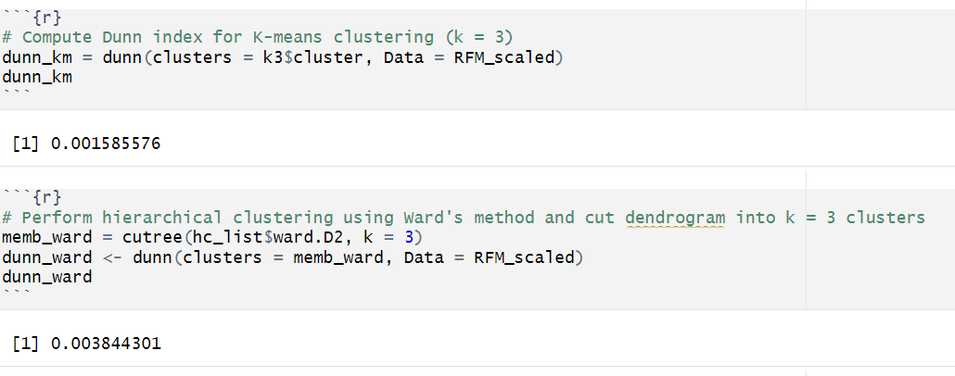
To confirm that hierarchical is better, we do Dunn’s Index test.
We see that the Dunn’s Index for hierarchical is higher than k-means clustering indicating hierarchical gives better Clustering results.

Slide 27
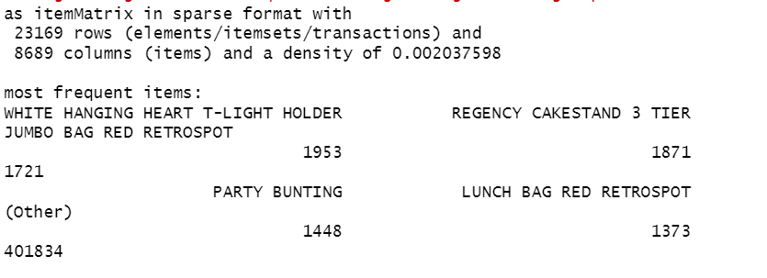
Association rules
The most frequent items in the dataset are WHITE HANGING HEART T-LIGHT HOLDER, which appears in 1953 transactions, followed by REGENCY CAKESTAND 3 TIER, JUMBO BAG RED RETROSPOT, PARTY BUNTING and LUNCH BAG RED RETROSPOT

Slide 28
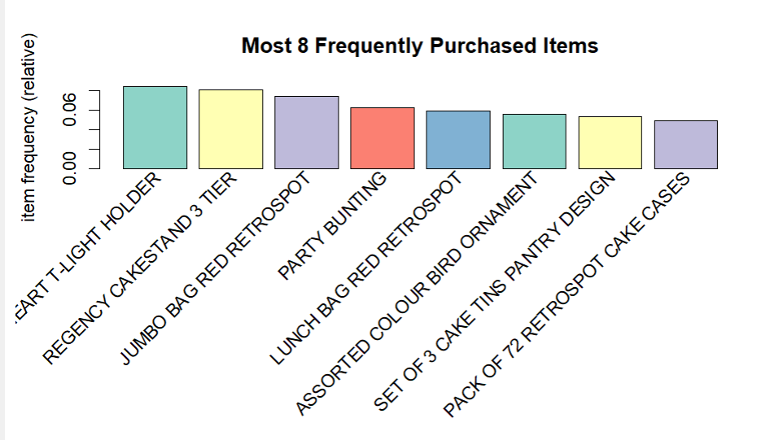
Most 8 Frequently Purchased Items
According to the plot, the items with the highest sales are ‘WHITE HANGING HEART T-LIGHT HOLDER’ and ‘REGENCY CAKESTAND 3 TIER’. To boost the sales of ‘SET OF 3 CAKE TINS PANTRY DESIGN’, the retailer could place it near the ‘REGENCY CAKESTAND 3 TIER’.

Slide 29
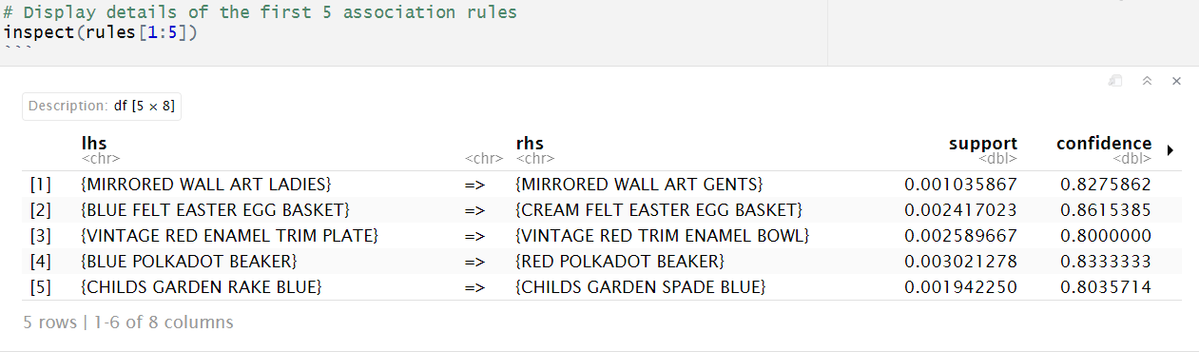
Apriori algorithm
According Apriori, if a customer buys BLUE FELT EASTER EGG BASKET, there is a high probability of 86% that they will also buy CREAM FELT EASTER EGG BASKET.

Slide 30
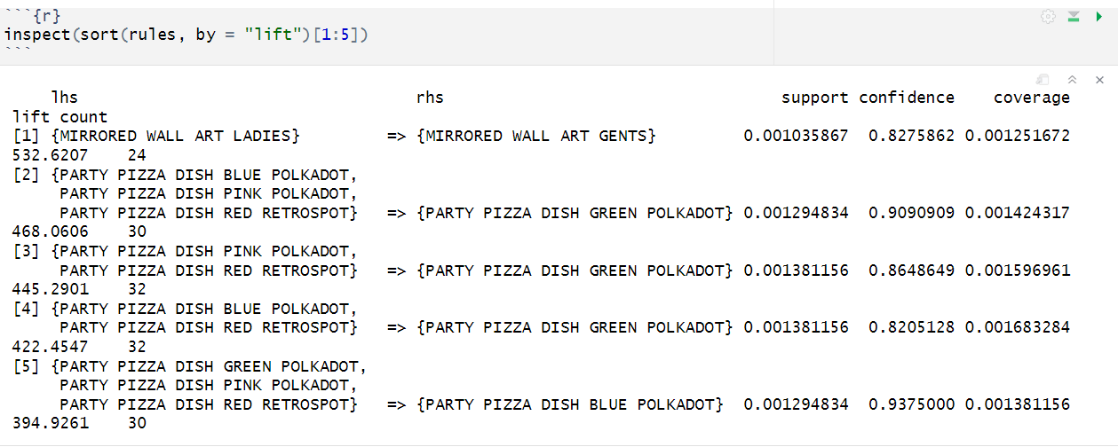
Apriori algorithm
According Apriori, if a customer buys PARTY PIZZA DISH BLUE POLKADOT, PARTY PIZZA DISH PINK POLKADOT, PARTY PIZZA DISH RED RETROSPOT, there is a high probability of 91% that they will also buy PARTY PIZZA DISH GREEN POLKADOT.

Slide 31
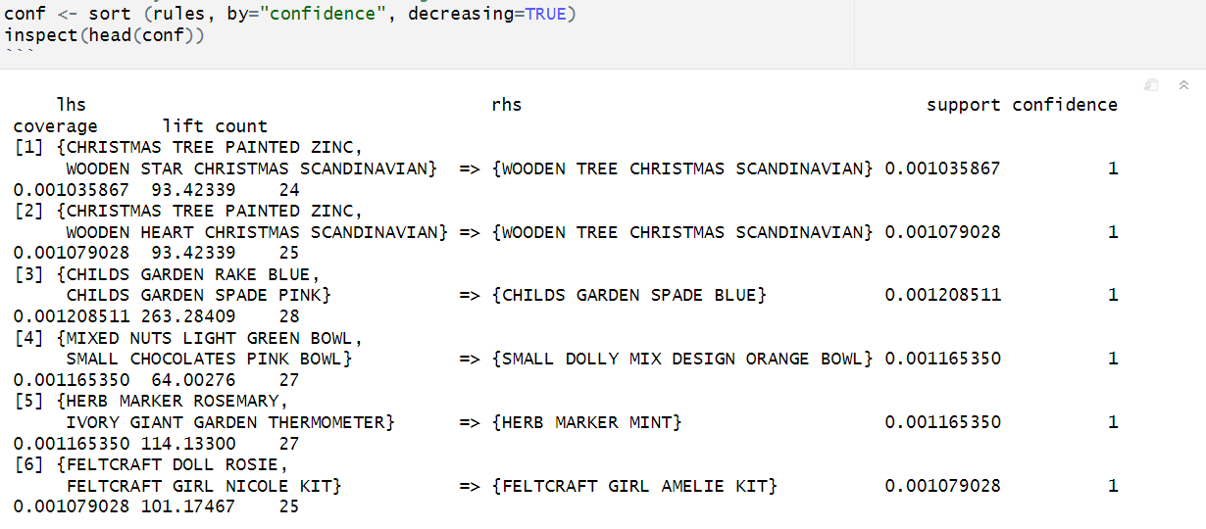
Confidence level
When the confidence is 1, it means that whenever the items on the left-hand side (LHS) are purchased, the items on the right-hand side (RHS) are also purchased 100% of the time. According to the infomration provided in the output, we can perform the following analyisis: All customers who purchased ‘CHRISTMAS TREE PAINTED ZINC’ and ‘WOODEN STAR CHRISTMAS SCANDINAVIAN’ also purchased also purchased ‘WOODEN TREE CHRISTMAS SCANDINAVIAN’ The lift value in the rule 1 is significantly high, indicating that the occurrence of the initial three items has a substantial influence on the confidence value.

Slide 32
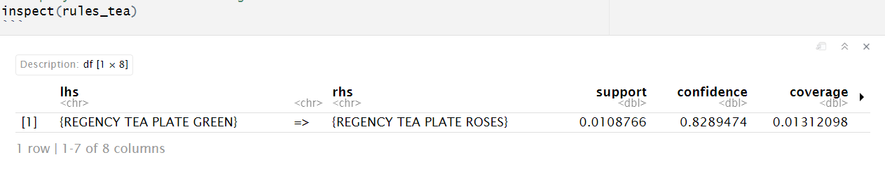
What were the other items purchased by customers who bought the green Regency tea plate?
82.9% of the time, customers who purchased REGENCY TEA PLATE GREEN also bought REGENCY TEA PLATE ROSES.

Slide 33
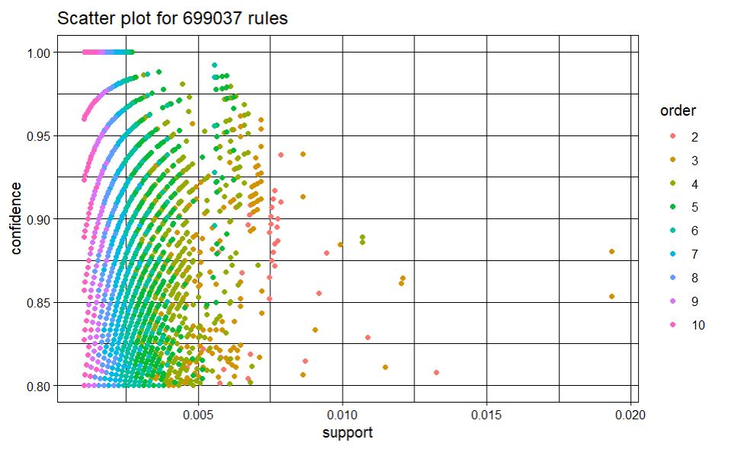
Two-key plot vizualization
The horizontal and vertical axes on the graph indicate support and confidence correspondingly, while the shading in this instance reflects the number of items in the rule.

Slide 34
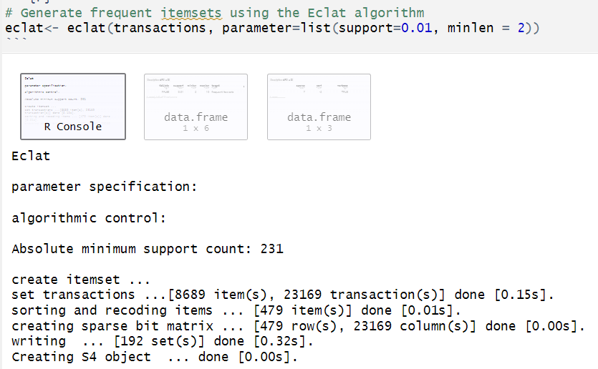
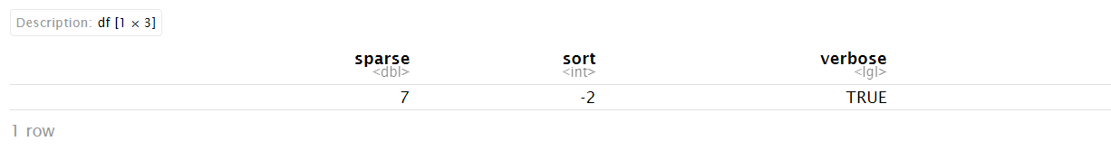
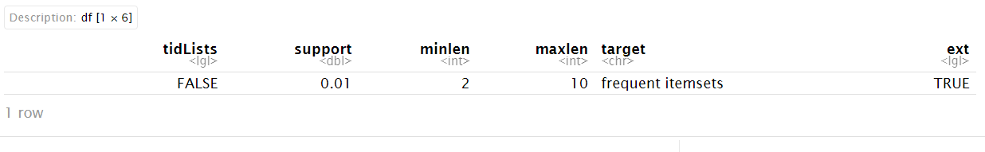
ECLAT algorithm

Slide 35
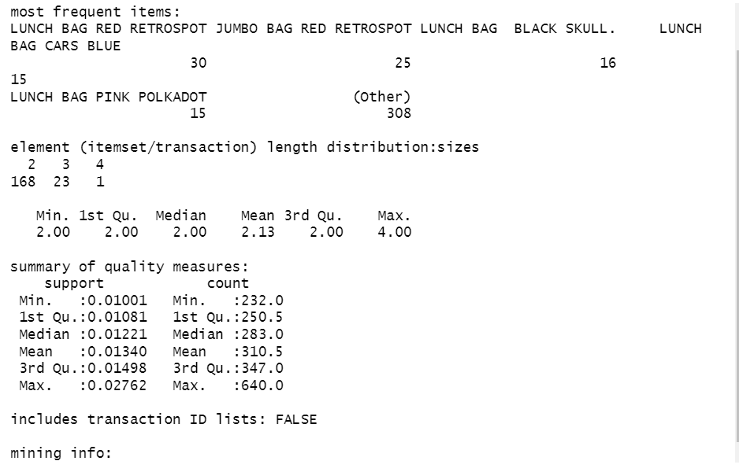
Summary of ECLAT Algorithm

Slide 36
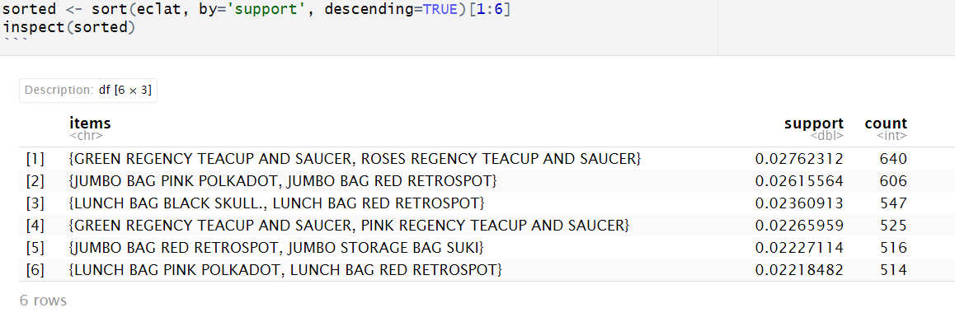
Top 6 frequent itemsets

Slide 37
Section 6
Conclusion

Slide 38

Actionable Insights for E-Commerce Platforms
Understanding customer behavior and product associations
Enhancing the shopping experience and increasing sales

Slide 39

Thank You

