Slide 1
{}
{1}
agg
1
agg
agg
inh
inh
inh
inh
inh
agg
{2}
agg
inh
inh
{2,3}
3
{2}
2
inh
inh
inh
inh
ass
2
2
{}
{2}
{2}

Slide 2
{}
{1}
agg
1
agg
inh
inh
inh
inh
{2}
inh
inh
{2,3}
2
3
{2}
inh
inh
inh
inh
2
2
{}
{2}
{2}

Slide 3
{}
{1}
agg
1
agg
inh
inh
inh
inh
{2}
inh
inh
{2,3}
2
3
{2}
inh
inh
inh
inh
2
2
{}
{2}
{2}
Diameter=2

Slide 4
{}
{1}
agg
1
agg
inh
inh
inh
inh
{2}
inh
inh
{2,3}
2
3
{2}
inh
inh
inh
inh
2
2
{}
{2}
{2}
Diameter=2

Slide 5
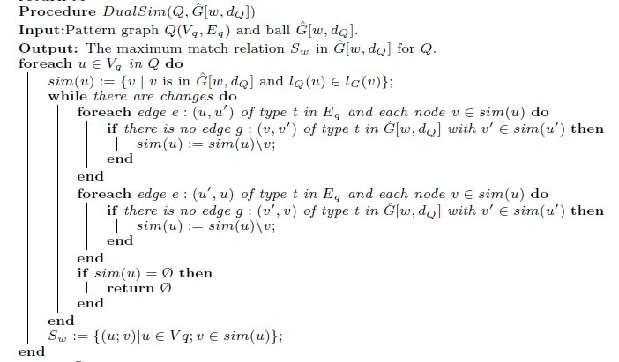
Sw := DualSim(Q; ^G[w; dQ]);
a=1
C=agg
A=inh
B=inh
b=2
c=3
t={1}
W=agg
D=inh
E=inh
T=inh
V=inh
Sim(a) = {t}
Sim(b) = {u, v, w, x}
Sim(c) = {v}
Sim(d) = {u, v, w, x}
Sim(e) = {u, v, w, x}
Sim(a) = {t}
Sim(b) = {u, v, w, x}
Sim(c) = {v}
Sim(d) = {w, x}
Sim(e) = {w, x}
Sw(a) = {(a,t)}
Sw(b) = {(b,u), (b,v), (b,w), (b,x)}
Sw(c) = {(c,v)}
Sw(d) = {(d,w), (d,x)}
Sw(e) = {(d,w), (d,x)}
d=2
e=2
U=inh
X=inh
v={2,3}
u={2}
out(a) = {}
in(a) = {A,B,C}
out(b) = {A}
in(b) = {}
out(c) = {B,C}
in(c) = {D,E}
out(d) = {D}
in(d) = {}
out(e) = {E}
in(e) = {}
out(t) = {}
in(t) = {T,U,X,V,W}
out(u) = {T}
in(u) = {}
out(v) = {V,W}
in(v) = {Y,Z}
out(w) = {U,Y}
in(w) = {}
out(x) = {X,Z}
in(x) = {}
Y=inh
Z=inh
w={2}
x={2}

Slide 6
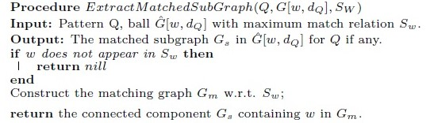
Gs :=ExtractMatchedSubGraph(Q; ^ G[w; dQ]; Sw);
a=1
C=agg
A=inh
B=inh
b=2
c=3
t={1}
Sw(a) = {(a,t)}
Sw(b) = {(b,u), (b,v), (b,w), (b,x)}
Sw(c) = {(c,v)}
Sw(d) = {(d,w), (d,x)}
Sw(e) = {(d,w), (d,x)}
W=agg
D=inh
E=inh
T=inh
V=inh
d=2
e=2
U=inh
X=inh
v={2,3}
u={2}
Y=inh
Z=inh
w={2}
x={2}

