Slide 1
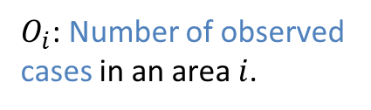

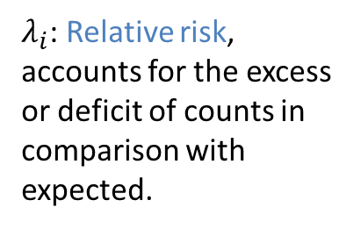
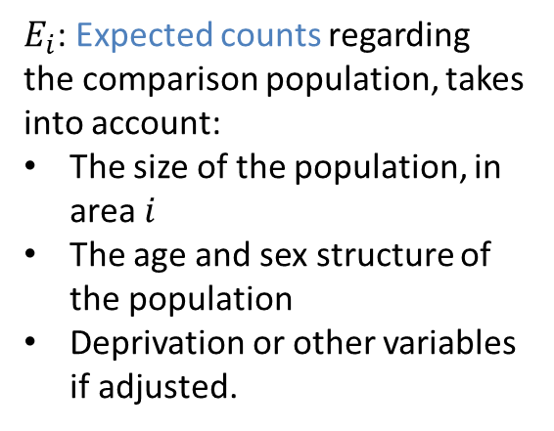
BYM Model Stage 1: Observation
$$O_{i}∼P(E_{i}λ_{i})$$
$O_{i}$: Number of observed cases in an area $i$.
$λ_{i}$: Relative risk, accounts for the excess or deficit of counts in comparison with expected.
$E_{i}$: Expected counts regarding the comparison population, takes into account:
The size of the population, in area $i$
The age and sex structure of the population
Deprivation or other variables if adjusted.

Slide 2
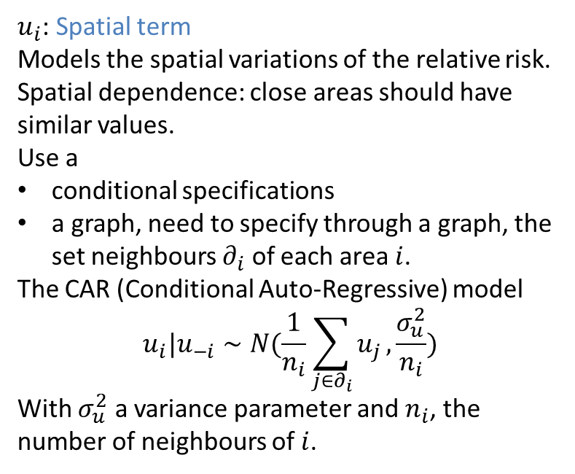

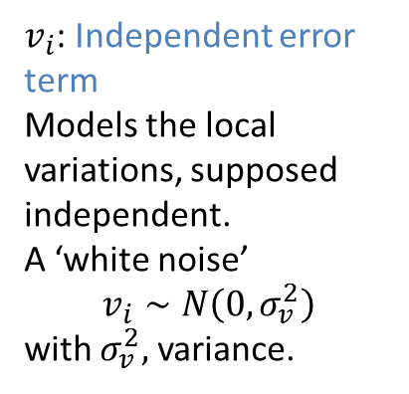
Stage 2: Decomposition of the relative risk
$$\log{λ_{i}=u_{i}+v_{i}}$$
$u_{i}$: Spatial term
Models the spatial variations of the relative risk.
Spatial dependence: close areas should have similar values.
Use a
conditional specifications
a graph, need to specify through a graph, the set neighbours $∂_{i}$ of each area $i$.
The CAR (Conditional Auto-Regressive) model
$$u_{i}|u_{−i}∼N(\frac{1}{n_{i}}\sum_{j∈∂_{i}}{u_{j}},\frac{σ_{u}^{2}}{n_{i}})$$
With $σ_{u}^{2}$ a variance parameter and $n_{i}$, the number of neighbours of $i$.
$v_{i}$: Independent error term
Models the local variations, supposed independent.
A ‘white noise’
$$v_{i}∼N\left(0, σ_{v}^{2}\right)$$
with $σ_{v}^{2},$ variance.

Slide 3
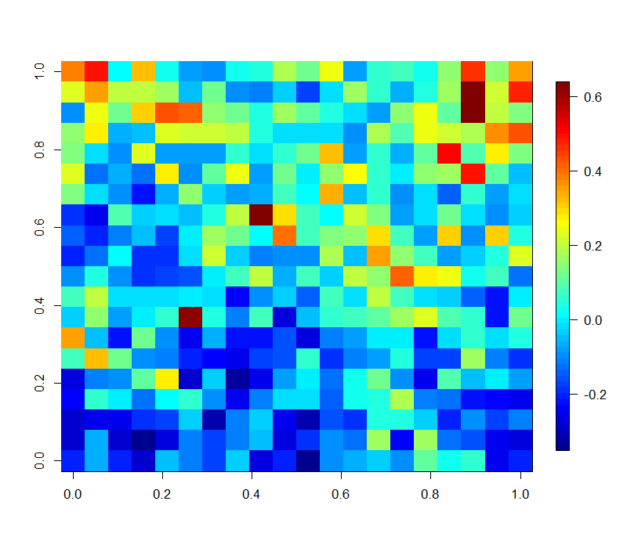
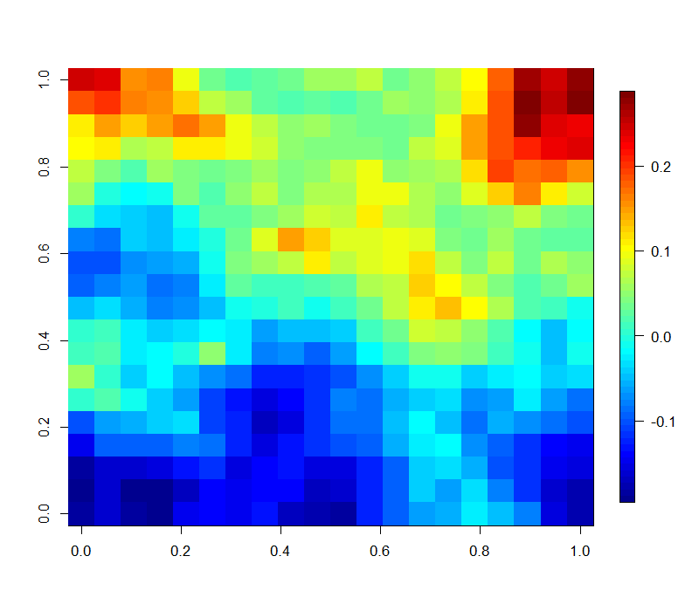
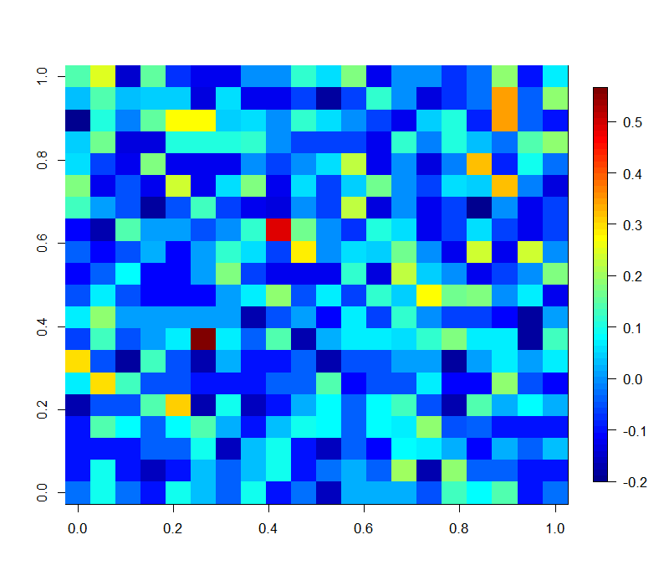
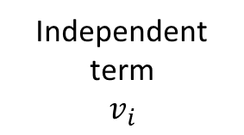
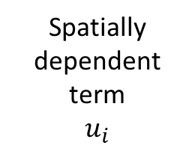
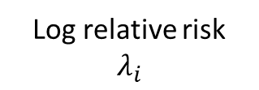
Log relative risk
$$λ_{i}$$
Spatially dependent term
$$u_{i}$$
Independent term
$$v_{i}$$
=
+

Slide 4

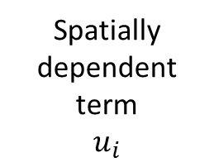
Spatially dependent term
$$u_{i}$$
Graph

Slide 5

Spatially smooth relative risk
$$\exp\left(u_{i}\right)$$
Smoothed for chance (with Poisson distribution) and very local variations (smaller than the geographical level considered).
Let to highlight regions with high or low risk
Be careful:
Conceptual model: the idea that we have of the reality
Important information can be in the independent term, check the smooth relative risk, or other estimates
Low counts : inaccurate maps
Priors

Slide 6


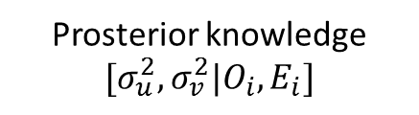
Bayesian Inference
DATA
$$O_{i}, E_{i}$$
Prior knowledge about the parameters
$${[σ}_{u}^{2}, σ_{v}^{2}]$$
Prosterior knowledge
$$[σ_{u}^{2},σ_{v}^{2}|O_{i},E_{i}]$$
Inference
In version 3: link to WinBUGS[2] => Monte Carlo Markov Chains [1]
In version 4: R code
Fast computation with INLA[3] : Integrated Nested Laplace Approximations
(later) MCMC Methods: two own written algorithms
[1]Lunn, D.J., Thomas, A., Best, N., and Spiegelhalter, D. (2000) WinBUGS -- a Bayesian modelling framework: concepts, structure, and extensibility. Statistics and Computing, 10:325--337.
[2]Brooks, S., et al., eds. Handbook of Markov Chain Monte Carlo. CRC Press, 2011.
[3] Rue, H., Martino, S., and Chopin, N. Approximate Bayesian inference for latent Gaussian models using integrated nested Laplace approximations. JRSSb, 71(2):319-392, 2009.

