Slide 1
Twitter
Front-end:
By Bahar - using HTML, CSS, JS, and ReactJS
Back-end:
By Yalda - using Java and Spring Framework
Database:
PostgreSQL
A summery of options are shown in the next slides.
This project has been done during one week only, so we focused on implementing as many options as possible instead of design and similar characteristics.

Slide 2
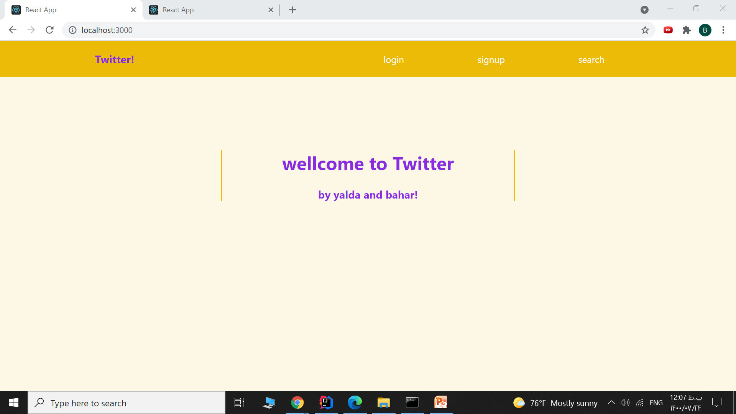
Welcome page:
User can signup, login, or search for a user, tweet or hashtag

Slide 3
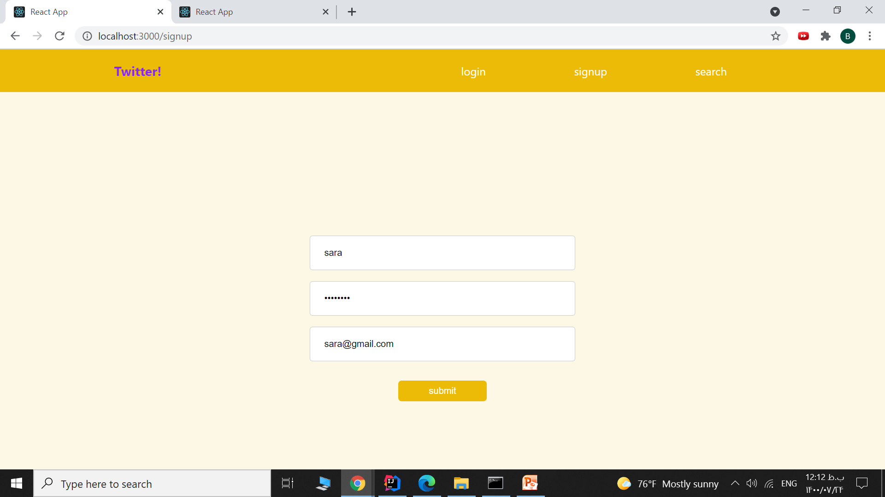
Sigunp:
User can signup with a username, password, and email

Slide 4
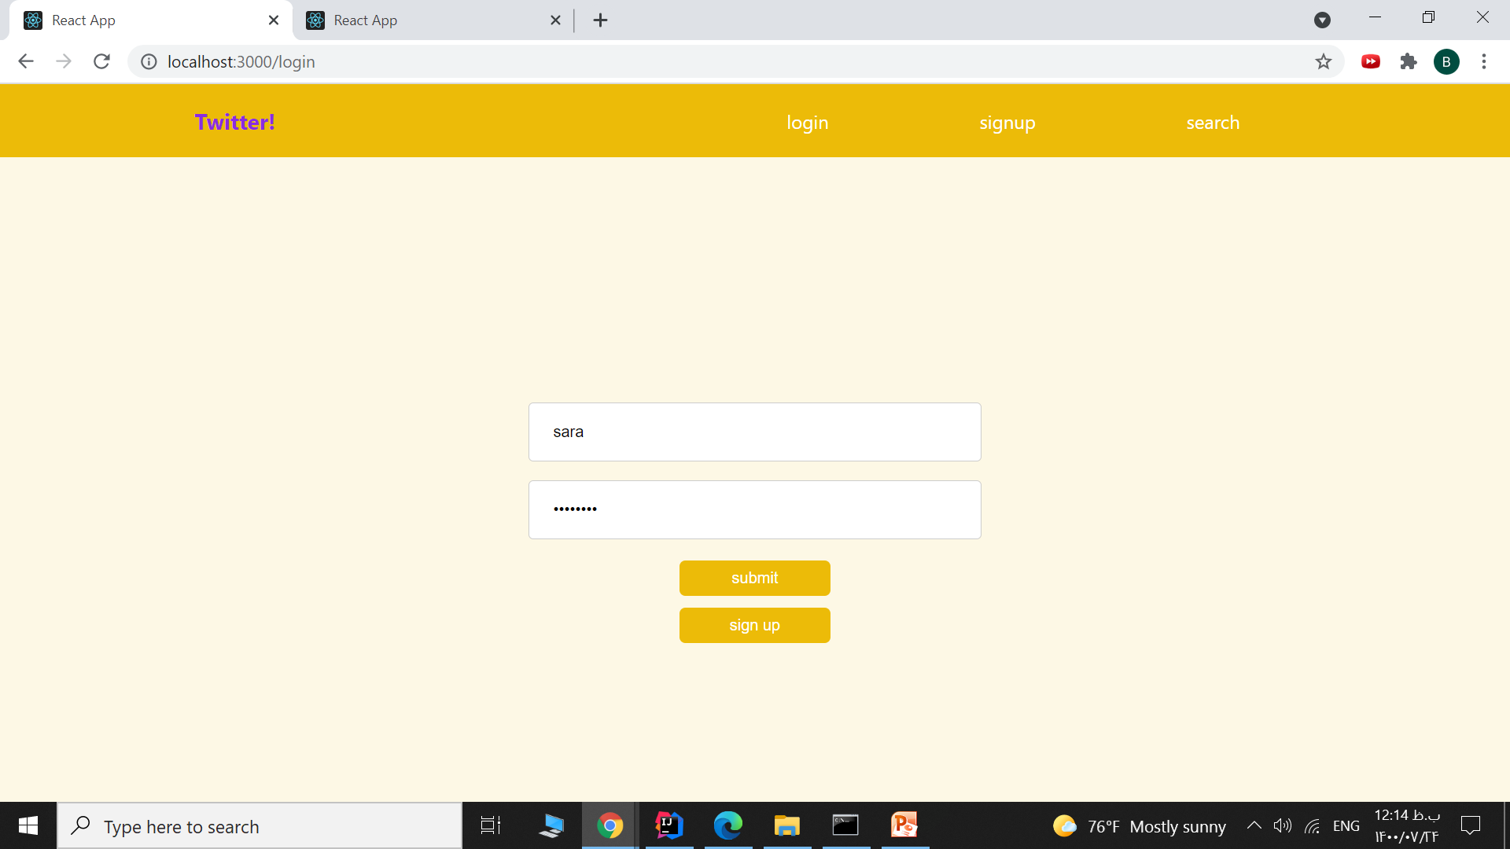
Login:
User can login after signing up

Slide 5
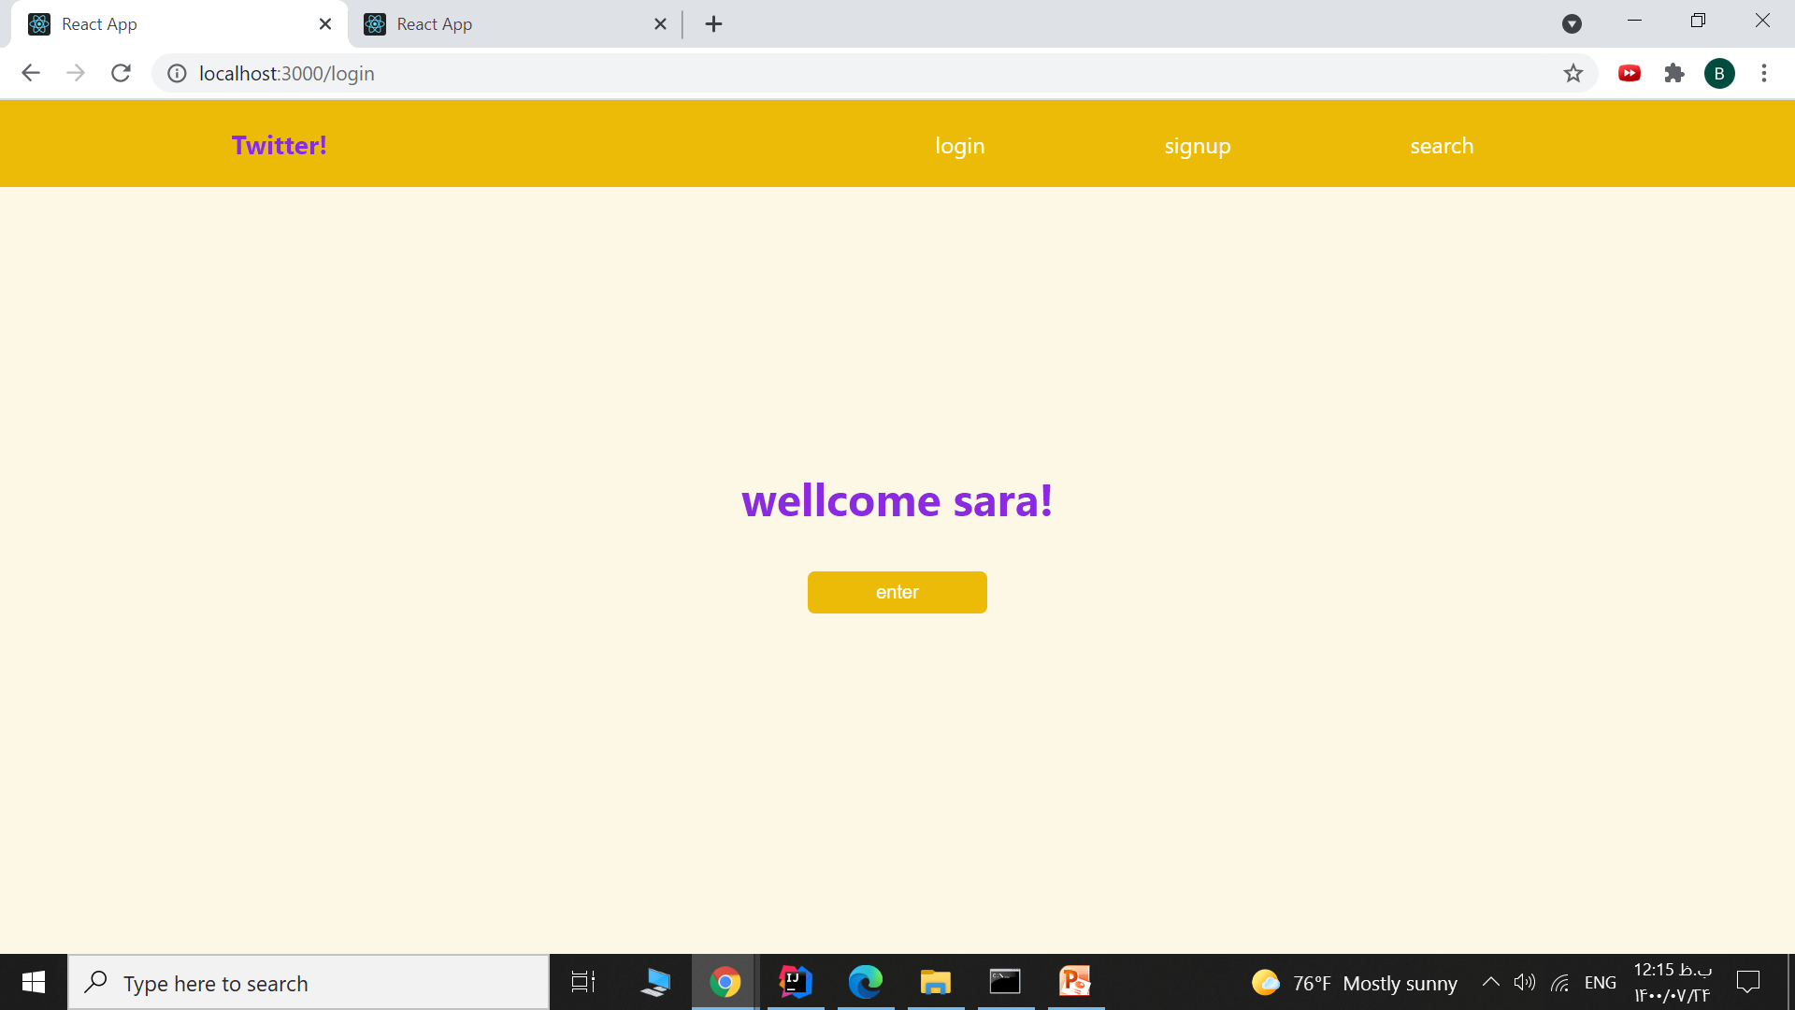
Login:
User can login after signing up

Slide 6
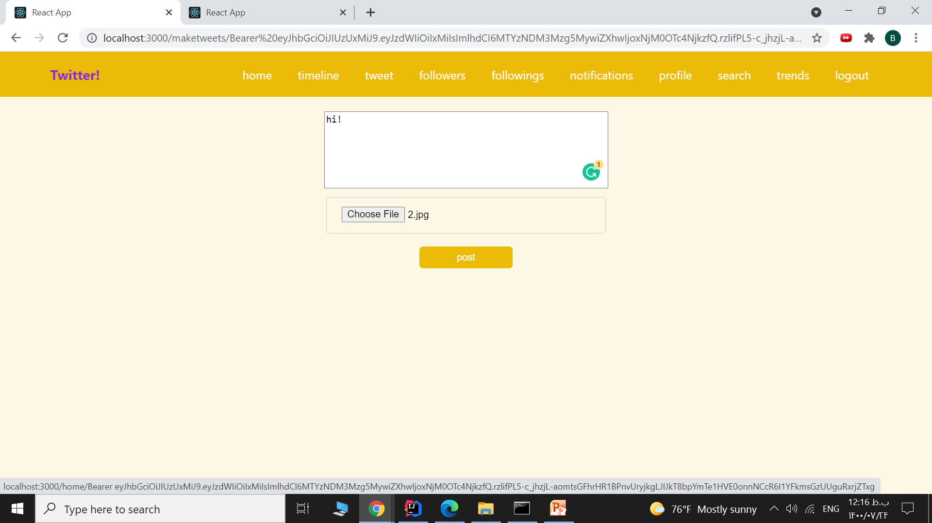
Tweet:
User can post a tweet containing text, image, and video

Slide 7
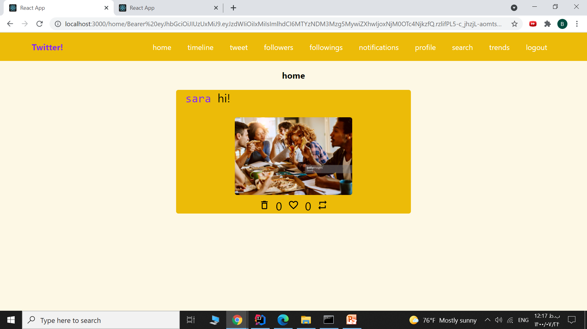
Home:
User can see a list of his own tweets and like, re-tweet or delete them

Slide 8
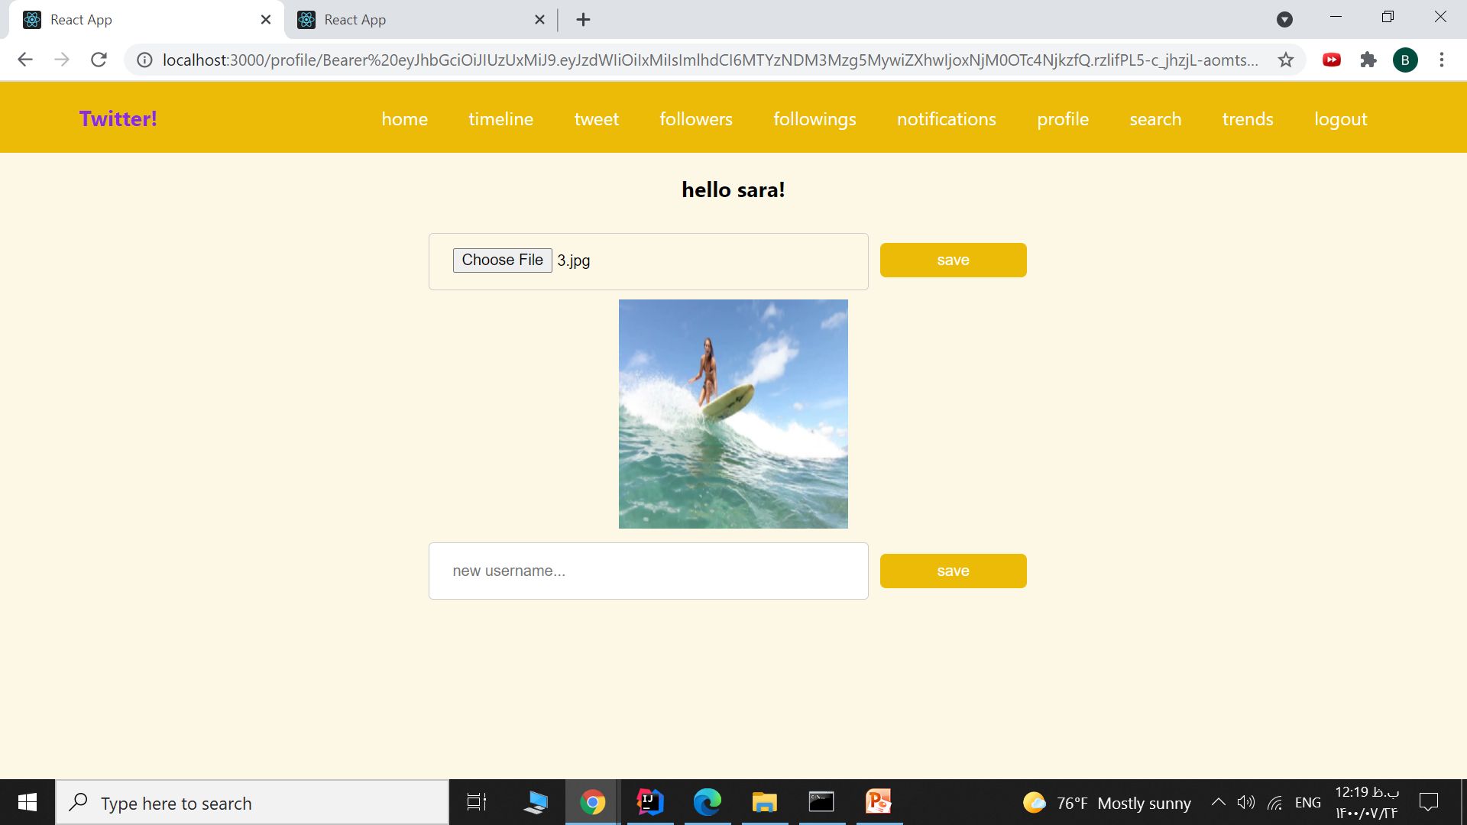
Profile:
User can change his profile picture or username

Slide 9
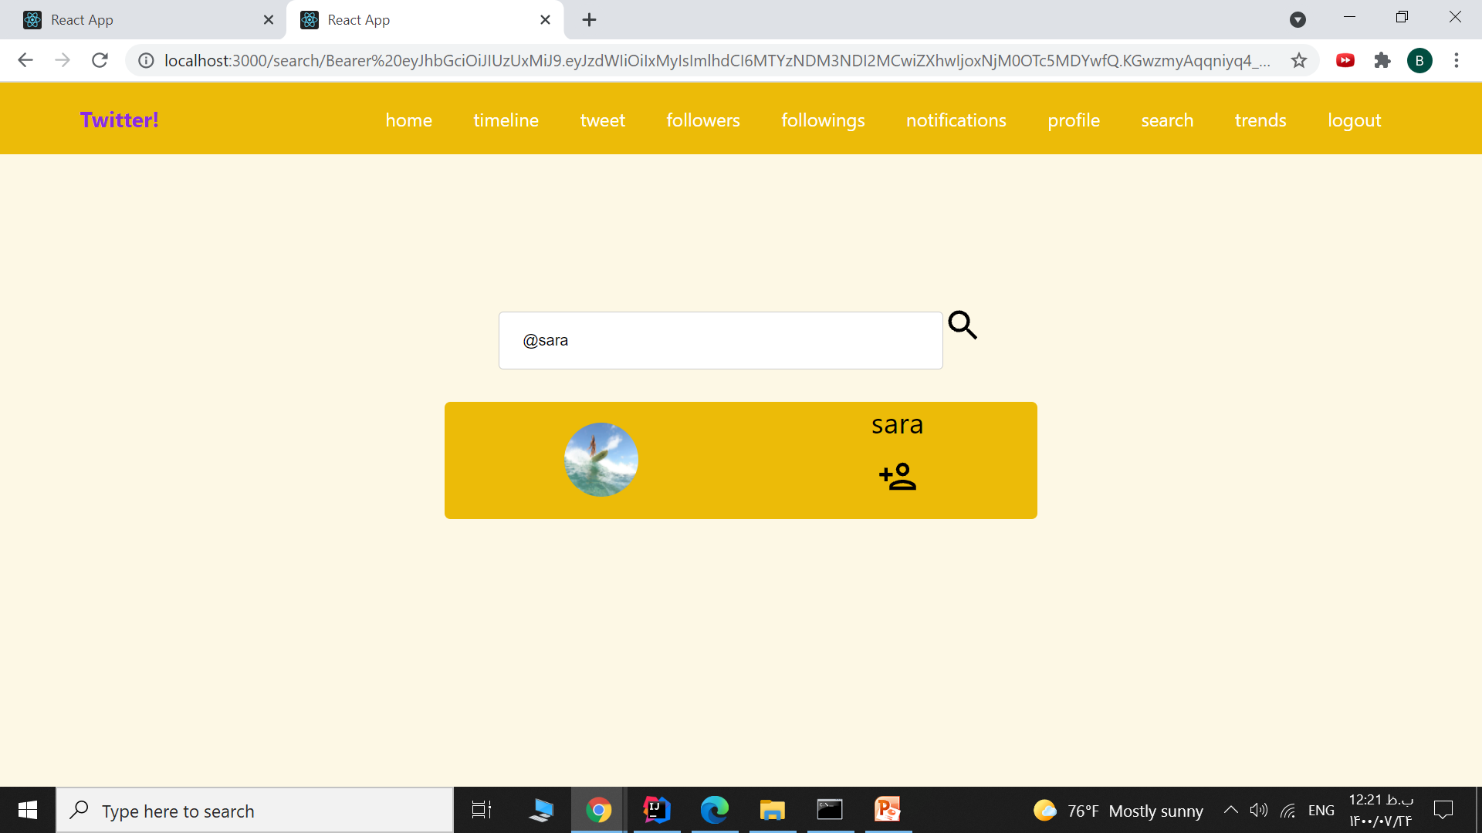
Search:
User can search for other users and follow or un-follow them

Slide 10
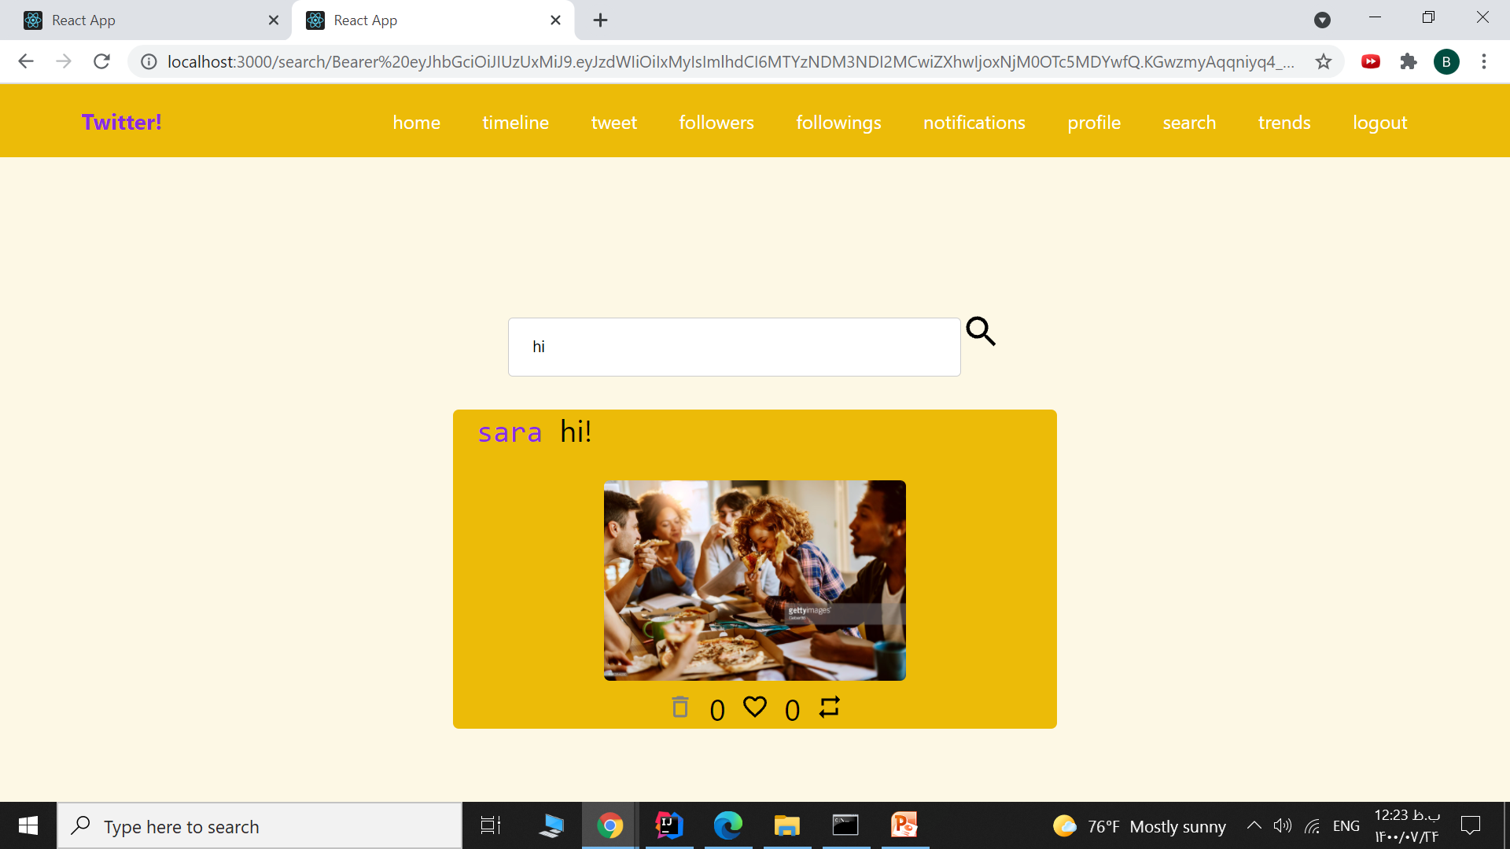
Search:
User can search for tweets and hashtags, and like or re-tweet them

Slide 11
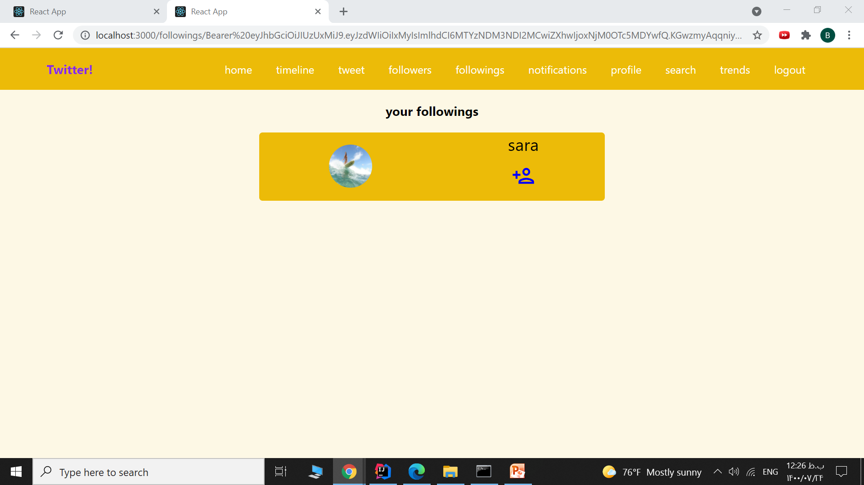
Following and Followers:
User can see a list of his following and followes,
and follow or un-follow them

Slide 12
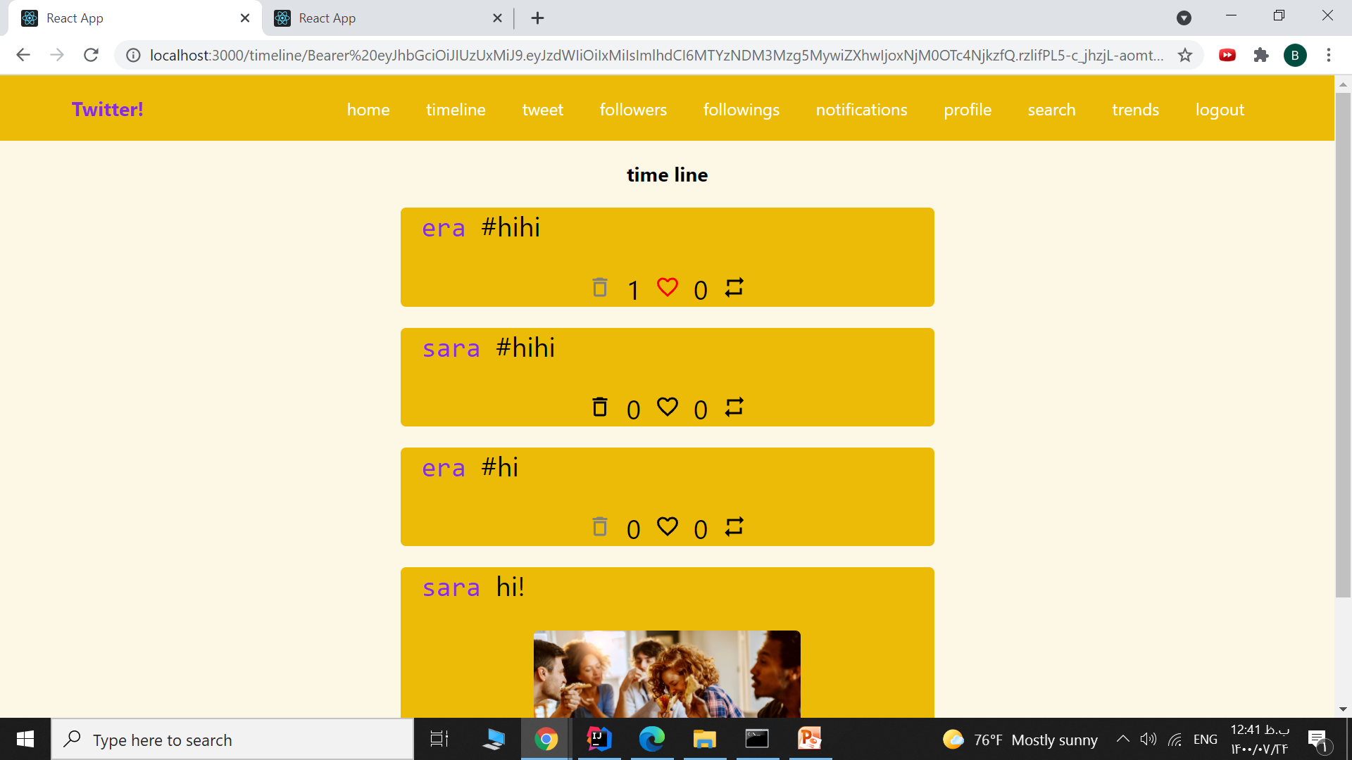
Timeline:
User can see a list of his own and his followings’ tweets
and like, re-tweet or delete them

Slide 13
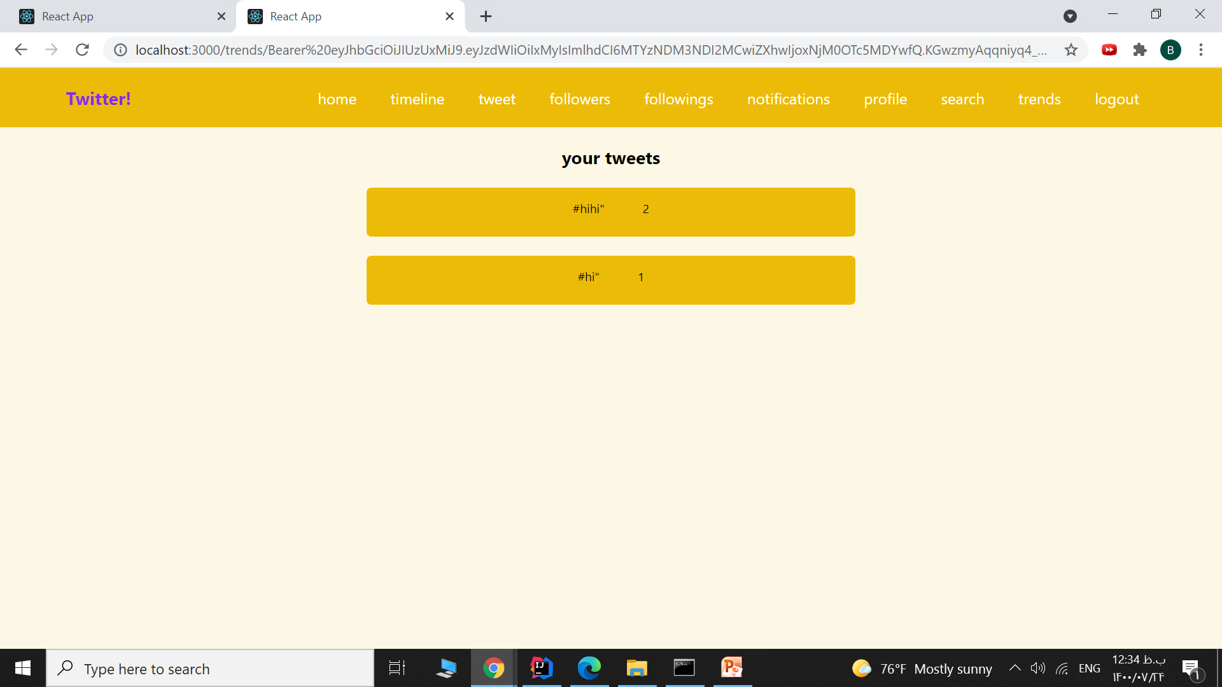
Trends:
User can see a list of trending hashtags in order

Slide 14
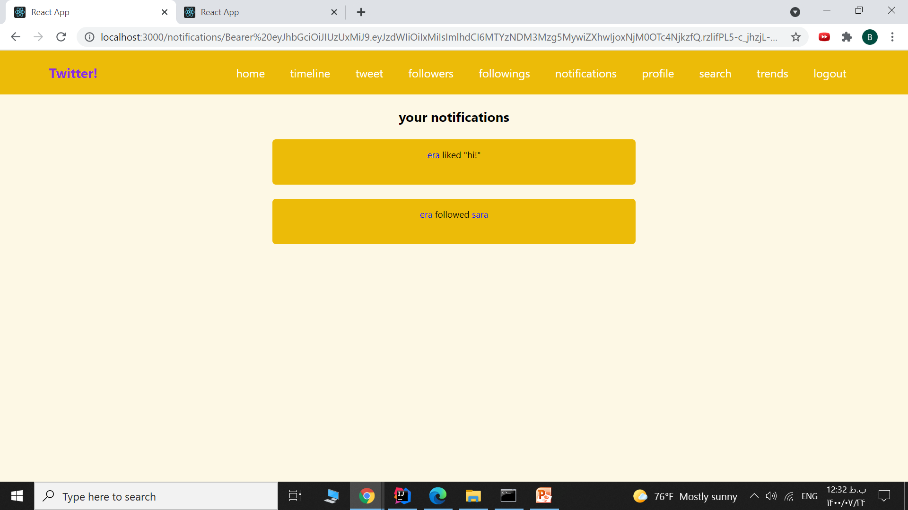
Notifications:
User can see a list of his followings’ activities

