Slide 1
Hpcc systems
An introduction

Slide 2
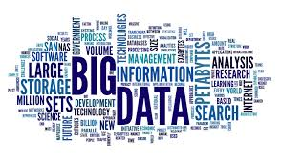
Big Data
Handling massive volume of both structured and unstructured.
Structured Data
Data that can be processed, stored, and retrieved in a fixed format.
Ex: dates, salary table
Unstructured Data
Data that lacks any specific form or structure whatsoever. This makes it very difficult and time-consuming to process and analyze unstructured data.
Ex: emails, videos.

Slide 3
Dipping into a Data Lake
Data Cleansing and Organization (ETL)
Machine Learning
Advanced Analytics
A central (logical) repository of data
Unlimited storage
Schema on read
Low cost of storage and compute
File metadata tracking
High performance processing
HPCC Systems DATA LAKE
On-premises Data Movement
Real-time Data Movement
Batch Data
Notes:
HPCC Systems is data lake technology that allows you to store all your structured and unstructured data at any scale. You can store your data as-is, without having to first structure the data, and run different types of analytics—from dashboards and visualizations to big data processing, real-time analytics, and machine learning to guide better decisions. Data can be ingested in real-time via streams or API and batch.

Slide 4

HPCC Systems (Small to Big Data) ETL
Integrate
Profile
Clean
Standardize
Aggregate
Machine Learning
Deliver
Decreasing Content Volume
Batch Services
Relate &
Big Data
Sources
Real-time Services
Profile & Clean
Standardize
Analyze
Visualization Integration
Increasing Content Quality
Unstructured and Structured Content
HPCC Systems Data Lake
Analysis Applications
Notes:
At LexisNexis we use HPCC Systems to collect data from 1000s of sources like public records (property, court records) and private (Driver Motor Vehicle, telematics). We ingest the data, clean it, link it and then analyze it. The goal of the LN services is to identify risky individuals or businesses for insurance (driving and life), financial services (loans, credit cards etc.) and government (track fraudsters, criminals like sex offenders, drug traffickers and money launderers).
HPCC System is capable of handling and processing batch data (processing data in massive amount). Real time services refers to ability real time data and processing it that same time. Driving information is great example, data is sent in real time and gets processed immediately. Visualization Integration refers to the ability of adding graphs, tables and visualization to big data processing.

Slide 5
Anatomy of a Big Data Processing System
Big Data
Smaller Data
Compute
Divide
Notes:
Big Data processing in traditional computing like relational systems is hard. HPCC Systems data lake technology uses a divide and conquer approach to solving Big Data problems by dividing data into smaller chunks and running compute on these chunks in parallel. This means faster processing and hence results.

Slide 6

The Challenge
Use Case: Smart Hat
4,000 workers die and millions are injured annually while working on the industrial floor
$
Very high cost for maintaining safety in industrial businesses
Notes:
Workers in industries such as oil rigs and manufacturing factories are always at a risk of injuries from accidents. Over 4000 workers die on the industrial floor every year. The time to react to an accident is very slow and expensive.

Slide 7

The Solution + Result
Use Case: Smart Hat
Sensor-Equipped Wi-Fi Hardhats Pushing floor information to a monitoring station, which uses a prediction engine to forecast emergency situations
Factory readings and real-time alerts
Prediction Engine sends back emergency updates
Monitoring station updates
Produced an industrial wearable that uses IoT and wireless communications systems to protect and empower industrial workers
Notes:
With the help of IoT and HPCC Systems, Guardhat was able to create a solution that, one, enabled proactive actions to potentially avoid accidents and, two, react quickly if there was an accident. The solution involved creating protective smart hats that are equipped with IoT sensors to detect atmospheric parameters like pressure, CO levels, O2 levels etc. In addition to enabling video and audio detection of events.
HPCC Systems provides the platform that is used to collect the sensor data and process it for analysis. HPCC Systems AI algorithms are used to predict potential events (like fires) before they can occur.

Slide 8
Mobile Strategy Games
The mobile games industry is worth billions of dollars, with companies spending vast amounts of money on the development and marketing of these games to an equally large market. This dataset includes fields such as Name, Release Date, Description, avg rating, etc.
Spotify Playlists Dataset
This dataset is based on the subset of users in the #nowplaying dataset who publish their #nowplaying tweets via Spotify. In principle, the dataset holds users, their playlists and the tracks contained in these playlists.

Slide 9

Cloud IDE
Register ECL Cloud IDE on Campus https://ide.hpccsystems.com/auth/login​​​​​​​

Slide 10
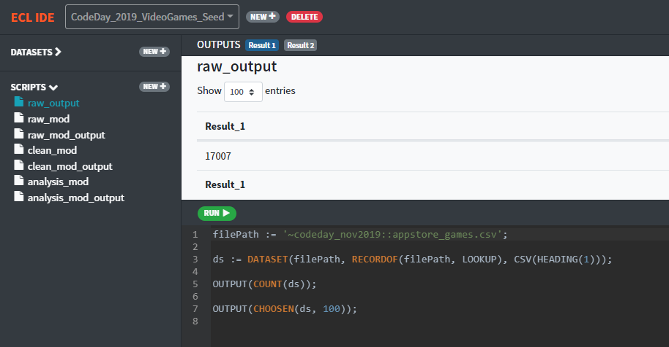
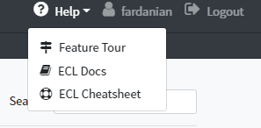
Cloud IDE
Please see following for more information:
https://github.com/BaharF/CodeDay_Feb2020/blob/master/CloudIDE-Setup.pdf

Slide 11
ECL
ECL is language design to query/manipulate huge data and is used for ETL (Extract, Transform, and Load) and data visualization.
ECL is not case-sensitive.
White space is ignored, allowing formatting for readability as needed.
Single-line comments must begin with //.
Block comments must be delimited with /* and */.
ECL uses the standard object.property syntax to qualify Definition scope and disambiguate field references within tables:
ModuleName.Definition //reference a definition from another module/folder
Dataset.Field //reference a field in a dataset or recordset

Slide 12
Record Structure
Defines the layout o fields in the dataset, order of the fields should be the same as the dataset.
Layout := RECORD
STRING pickup;
INTEGER fare;
END;
File Dataset
A physical data file on disk. It can be defined directly, or can be brought in.
memDs := DATASET([{'2015-01-01 01:08:56', 25.10},
{'2015-01-01 02:10:22', 40.15}], Layout);
fileDs := DATASET(
'~Sample::file::csv', Layout, CSV);

Slide 13
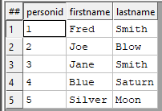

OUTPUT
Layout_Person := RECORD
UNSIGNED1 PersonID;
STRING15 FirstName;
STRING25 LastName;
END;
allPeople := DATASET([ {1,'Fred','Smith'},
{2,'Joe','Blow'},
{3,'Jane','Smith'},
{4, 'Blue', 'Saturn'},
{5, 'Silver', 'Moon'}]
,Layout_Person);
OUTPUT(allPeople, NAMED('allPeople')); // Same as allPeople;
OUTPUT((CHOOSEN(allPeople, 2)), NAMED('FirstTwoRecs'));

Slide 14


Filter
Layout_Person := RECORD
UNSIGNED1 PersonID;
STRING15 FirstName;
STRING25 LastName;
END;
allPeople := DATASET([ {1,'Fred','Smith'},
{2,'Joe','Blow'},
{3,'Jane','Smith'}],Layout_Person);
allPeople(LastName = 'Smith');
Sort
SortedPerson := SORT(Person, LastName, FirstName)

Slide 15
Aggregation
rec := RECORD
INTEGER Num1;
INTEGER Num2;
INTEGER Num3;
END;
DS := DATASET([{20,45,34}, {909,56,45}, {30,-1,90}], rec);
COUNT(DS); //Returns 3
MAX(DS, Num1); //Returns 909
MIN(DS, Num2); //Returns -1
AVE(DS, Num1) //Returns 319.6666666666667
TRUNCATE(AVE(DS, Num1)); //Returns 319
SUM(DS, Num1 + Num3); //Returns 1128

Slide 16
Module
The MODULE structure is a container that allows you to group related definitions. The parameters passed to the MODULE are shared by all the related members definitions.
Variable Scope:
Local definitions are visible only through the next EXPORT or SHARED definition (including members of the nested MODULE structure, if the next EXPORT or SHARED definition is a MODULE).
SHARED definitions are visible to all subsequent definitions in the structure (including members of any nested MODULE structures) but not outside of it.
EXPORT definitions are visible within the MODULE structure (including members of any subsequent nested MODULE structures) and outside of it .

Slide 17


MyMod := MODULE
SHARED x := 88; // local
SHARED y := 42; // local
EXPORT See := 'This is how a module works.’; // public
EXPORT res := Y * 2; // public
END;
OUTPUT(MyMod.See);
OUTPUT(MyMod.Res, Named('ViewResult'));

Slide 18
TRANSFORM
Specifies exactly how each field in the output record set is to receive its value.
It should include the result type.
Should contain name
Contains parameter list
SELF: refers to fields in result type.
PROJECT
Processes through all the records in the dataset performing TRANSFORM.
LEFT: refers to dataset getting passed to PROJECT.

Slide 19

NameRec := RECORD
STRING FirstName;
STRING LastName;
END;
NameDS := DATASET([{'Sun','Shine'}, {'Blue','Moon'}, {'Silver','Rose'}], NameRec);
NameOutRec := RECORD
STRING FirstName;
STRING LastName;
STRING CatValues;
INTEGER RecCount
END;
NameOutRec CatThem(NameRec L, INTEGER C) := TRANSFORM
SELF.CatValues := L.FirstName + ' ' + L.LastName;
SELF.RecCount := C;
SELF := L;
END;
CatRecs := PROJECT(NameDS, CatThem(LEFT,COUNTER));

Slide 20
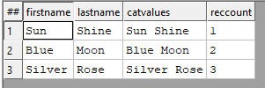
Inline TRANSFORM
Using the same dataset in the previous slide. The transform is build inside the PROJECT.
NameOutRec := RECORD
STRING FirstName;
STRING LastName;
STRING CatValues;
INTEGER RecCount
END;
CatRecs := PROJECT(NameDS, //Dataset name
TRANSFORM(NameOutRec, //layout to convert the dataset to
SELF.CatValues := LEFT.FirstName + ' ' + LEFT.LastName;
SELF.RecCount := COUNTER;
SELF := LEFT;
));
OUTPUT(CatRecs, NAMED('Inline_CatRecs'));

Slide 21

TABLE
Creates a temporary dataset in memory, GROUP option can be used.
Layout := RECORD
STRING10 pickup_date;
DECIMAL8_2 fare;
DECIMAL8_2 distance;
END;
Ds := DATASET([{'2015-01-01', 25.10, 5}, {'2015-01-01', 40.15, 8}, {'2015-01-02', 30.10, 6}, {'2015-01-02', 25.15, 4}], Layout);
crossTabLayout := RECORD
ds.pickup_date;
avgFare := AVE(GROUP, ds.fare);
totalFare := SUM(GROUP, ds.fare);
END;
crossTabDs := TABLE(ds, crossTabLayout, pickup_date);

Slide 22
JOIN
The JOIN function produces a result set based on the intersection of two or more datasets or indexes.
INNER: Only those records that exist in both datasets.
LEFT OUTER: At least one record for every record in the left.
RIGHT OUTER: At least one record for every record in the right.
LEFT ONLY: One record for each left record with no match in the left.
RIGHT ONLY: One record for each left record with no match in the right.
FULL ONLY: One record for each left and right record with no match in the opposite.

Slide 23
MyRec := RECORD
STRING1 Value1;
STRING1 Value2;
END;
LeftFile := DATASET([{'C','A'}, {'X','B'}, {'A','C'}], MyRec);
RightFile := DATASET([{'C','X'}, {'B','Y'}, {'A','Z'}], MyRec);
MyOutRec := RECORD
STRING1 Value1;
STRING1 LeftValue2;
STRING1 RightValue2;
END;
MyOutRec JoinThem(MyRec L, MyRec R) := TRANSFORM
SELF.Value1 := IF(L.Value1<>'', L.Value1, R.Value1);
SELF.LeftValue2 := L.Value2;
SELF.RightValue2 := R.Value2;
END;

Slide 24





Left Dataset Right Dataset
InnerJoinedRecs := JOIN(LeftFile,RightFile,
LEFT.Value1 = RIGHT.Value1,
JoinThem(LEFT,RIGHT));
LOutJoinedRecs := JOIN(LeftFile,RightFile,
LEFT.Value1 = RIGHT.Value1,
JoinThem(LEFT,RIGHT),
LEFT OUTER);
LOnlyJoinedRecs := JOIN(LeftFile,RightFile,
LEFT.Value1 = RIGHT.Value1,
JoinThem(LEFT,RIGHT),
LEFT ONLY);

Slide 25
Visualization
Methods include
Two-Dimensional
Multi-Dimensional Methods
Geospatial
General
A basic visualization typically requires the following steps:
1. Creation of a suitable dataset.
2. Output the dataset with a suitable name, so that visualization can locate the data.
3. Create (and output) the visualization, referencing the named output from step

Slide 26
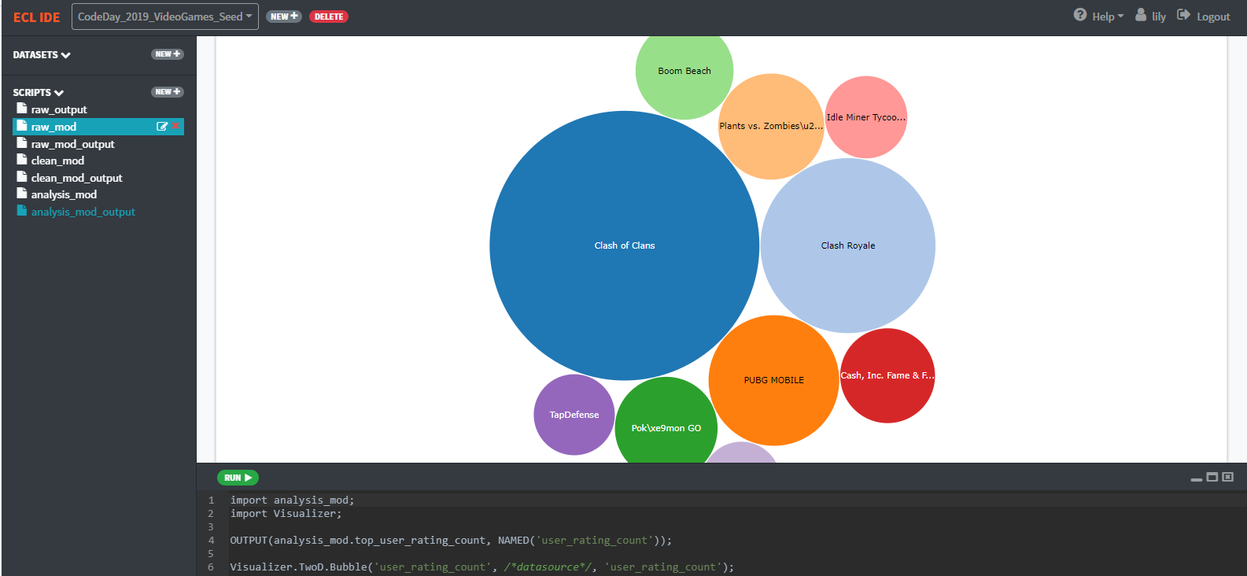
top_user_rating_count := TOPN( TABLE(clean_mod.games_ds, {name, user_rating_count}) , 10, -user_rating_count);
OUTPUT(analysis_mod.top_user_rating_count, NAMED('user_rating_count'));
Visualizer.TwoD.Bubble('user_rating_count', /*datasource*/, 'user_rating_count');

Slide 27
References
Github CodeDay:
https://github.com/BaharF/CodeDay_Feb2020
ECL training containing six short videos
https://www.youtube.com/watch?time_continue=192&v=Lk78BCCtM-0
ECL document
http://cdn.hpccsystems.com/releases/CE-Candidate-7.0.24/docs/EN_US/ECLLanguageReference_EN_US-7.0.24-1.pdf
Visualization document
https://d2wulyp08c6njk.cloudfront.net/releases/CE-Candidate-7.6.2/docs/EN_US/VisualizingECL_EN_US-7.6.2-1.pdf
ECL cheat sheet
https://github.com/BaharF/CodeDay_Nov2019/blob/master/ECL_Cheat_Sheet.pdf
VS Code
https://wiki.hpccsystems.com/display/hpcc/VS+Code+and+HPCC+Systems+Installation+Cheat+Sheet

Slide 28
Thank you!
learn more at hpccsystems.com

