Slide 1
DATA ANALYSIS and VISUALIZATION for E-commerce data
Bahar Rustamova

Slide 2
INFORMATION ABOUT PROJECT
In this project, the csv file data was analyzed in Python. Data visualization is in Power BI.
INFORMATION ABOUT DATA
Customer ID, Purchase Date, Product Price, Quantity, Total Purchase Amout, Payment Method, Customer Age, Returns, Customer Name, Total Price after returns, Gender , Churn

Slide 3
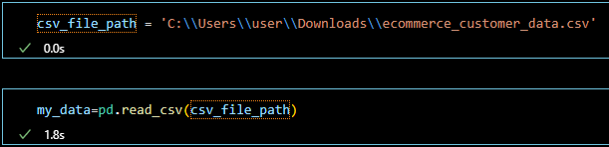
Csv file pass to Python

Slide 4
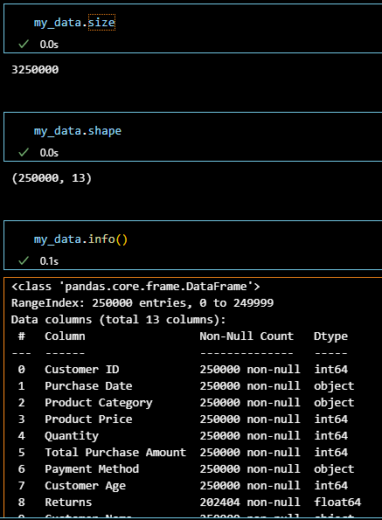
We are getting some basic information about our data. Example: Size, Shape, for the info(Column, type …)
Analyzing data with Python

Slide 5
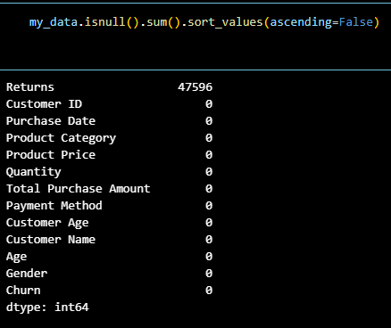
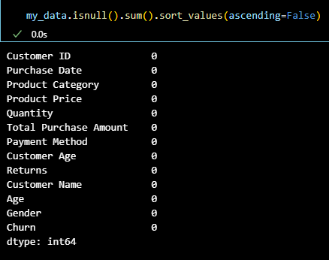
1) After that we are checking null values 2) We can see that we have empty cells , so we fill empty cells with 0.
Before
After

Slide 6
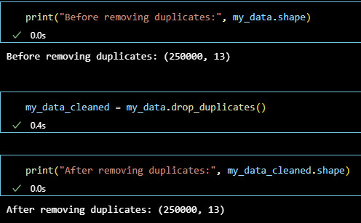
Checking dublicates

Slide 7
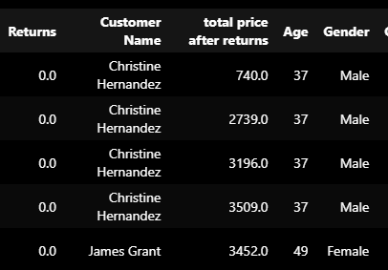

We can add a new column here to know the total price after returned items
We have 2 Age column, we dropped this one.

Slide 8
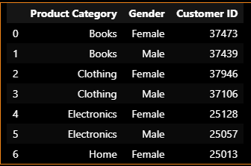
We group our datasets by "Product Category" and “Gender” with the “Group By” function.

Slide 9
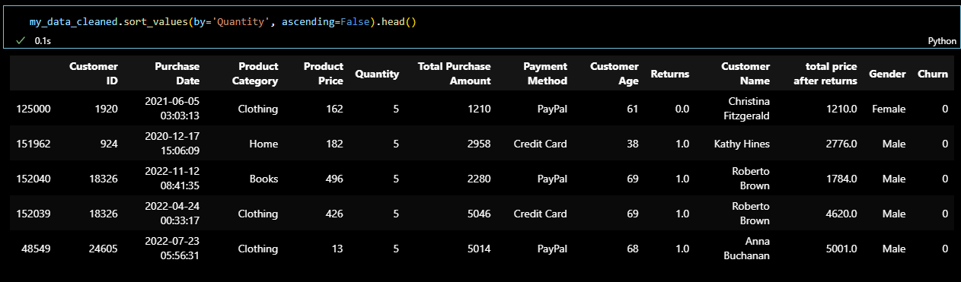
We are sorting our datasets according to “Quantity”.

Slide 10
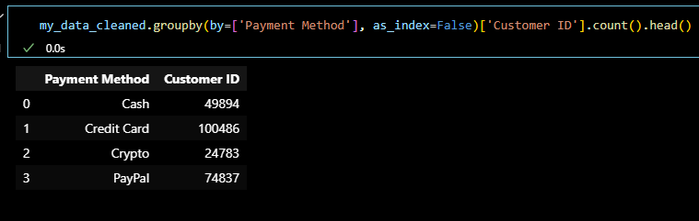
We grouped by Payment Method with count of Customer ID. We can see how many customers use each payment method.

Slide 11
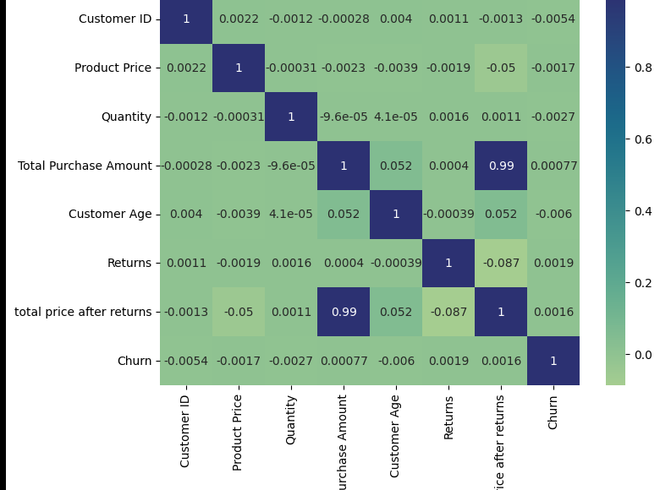
Calculates their correlation matrix and visualizes it as a heatmap using Seaborn.

Slide 12
Visualization in Power BI
Using DAX formulas, we define the following measures.
TotalReturns = SUM('ecommerce_customer_data1'[Returns])
TotalQuantity = SUM('ecommerce_customer_data1'[Quantity])
Percent Of Sold items = 100-(DIVIDE([TotalReturns],[TotalQuantity],0)*100)
%Percent of Sold Items = FORMAT([Percent Of Sold items], "0.00") & "%"

Slide 13
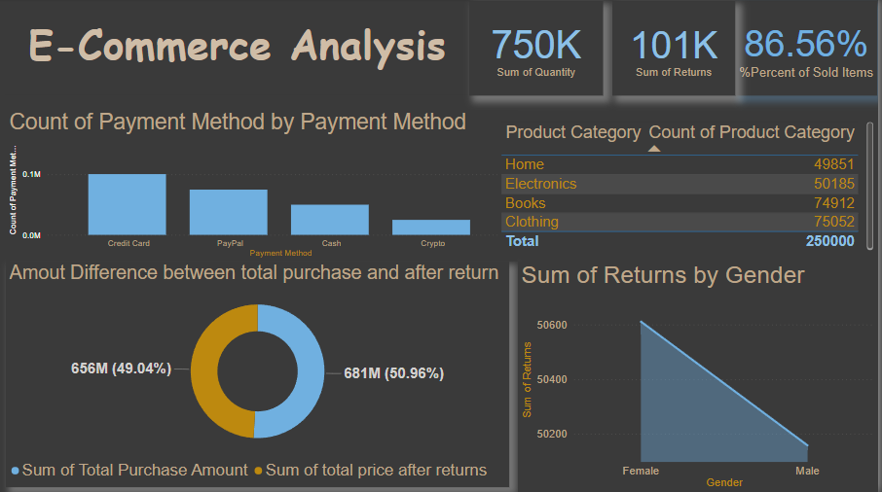

Slide 14

Sum of sold products
Percent of sold items after returns items
Sum of Returns product

Slide 15
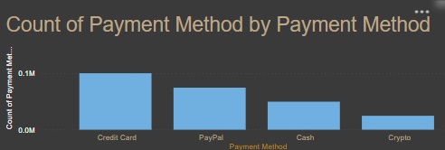
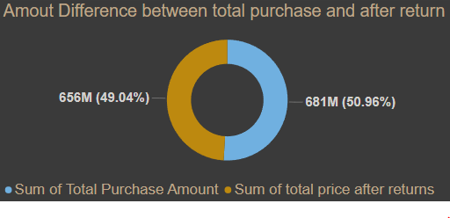
We can analyze that which kind of payment method customer used more.
Company earned 681M but after returns items company got 656M

Slide 16
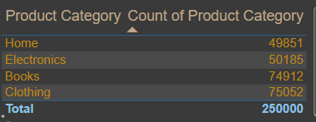
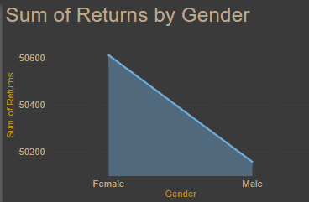
Here we can see the total number by product category.
As we can see, the percentage of returns in the items sold is higher in women.

Slide 17
Thanks for Your Attention
If you have any question,
please contact with me
baharrustemova08@gmail.com

