Slide 1

Job Analaysis Project in Power BI
Bahar Rustamova

Slide 2
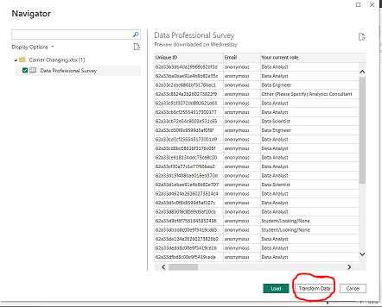
Gathering data
I import data from excel. After that, I select the necessary excel sheet and click transform data. Power BI Query opens.

Slide 3
01.
02.
03.
04.
05.
Modified columns
Your current role
Industry
Programming language
Country
Current salary

Slide 4
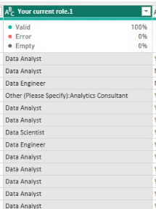
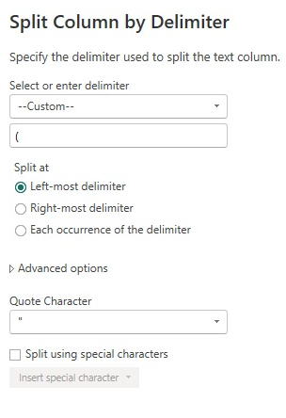
Your current role column
01.
As you can see in this column, there are different data starting with Other. We split them and store them as Other in the main column, and we put the related statements written after Other in the second column to be added.

Slide 5
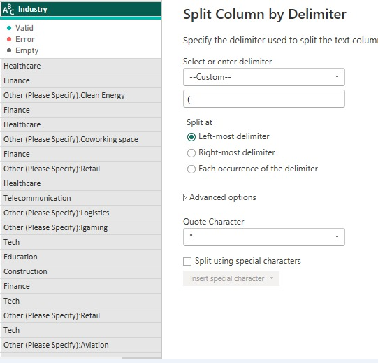
02.
Industry column
This column is also the same as the previous one

Slide 6
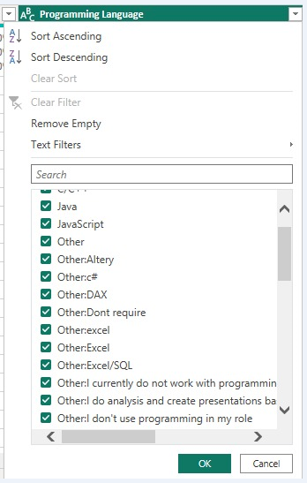
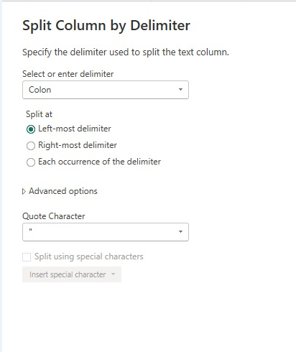
03.
Programming language column
This column is also the same as the previous one. There is only one difference that it is enough to choose colon instead of custom. Which will be split according to the colon.

Slide 7
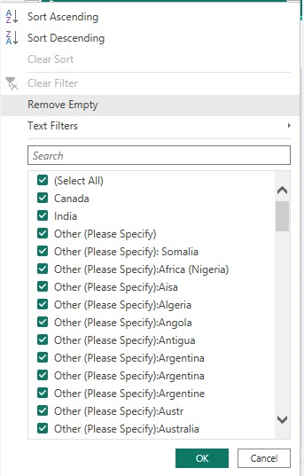
04.
Country column
This column is also the same as the previous one. There is only one difference that it is enough to choose colon instead of custom. Which will be split according to the colon.

Slide 8
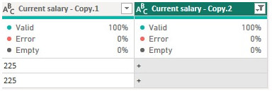
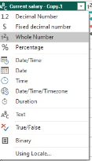
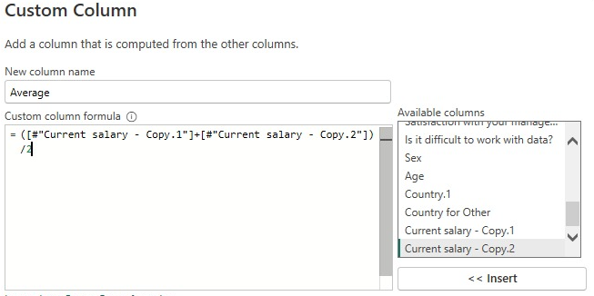
Current salary column
04.
Dublicate column
Split column according to digit, non-digit
Delete column which has K
Replace “K”, “-” values to nothing
“+” sign change to “225”, because it is max value
First column will be my Min column, second one Max column
Change them to whole number
Find average by using min and max column

Slide 9
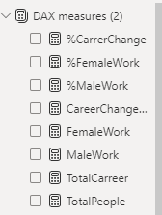

Using DAX formulas
Go to home page and use “Close and Apply”.
I have created some tables by using DAX formulas.
Here are some examples.

Slide 10
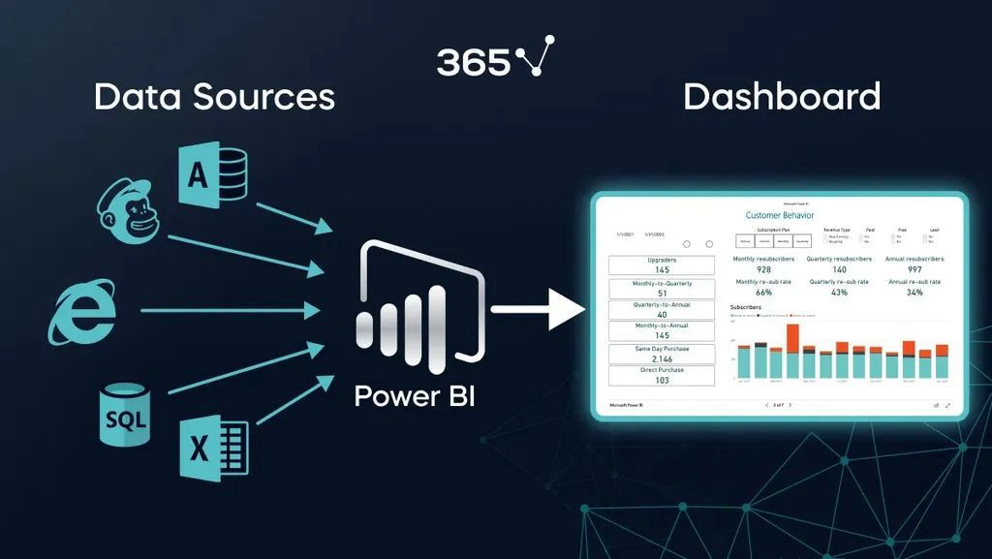
We have finished first part, let’s go to visualization part

Slide 11
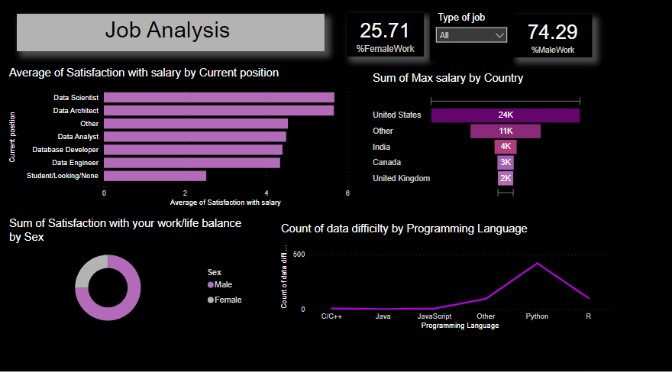

Slide 12
Thanks for your great interest

