Slide 1
DATABASE in Microsoft SQL Server
Created by Bahar rustamova

Slide 2
WHY DO I CREATE THIS DATABASE ?
Travel Database, my goal in creating this database related to travel is that someone who wants to travel can more easily find the information he needs based on where he wants to go. I wanted to create this idea more based on my favorite activities (travel). Because when I travel myself, I find this information on different websites and it is a bit of a waste of time. Which can be the most important set of information that a person who wants to travel will need. Since this is my mini database, I couldn't fit all the countries and cities. I created a database based on the more popular places I know.
I have prepared 2 types of EER Diagrams. Diagram 2 is easier to understand where I have created tables and shown how they are related to each other by foreign keys.

Slide 3


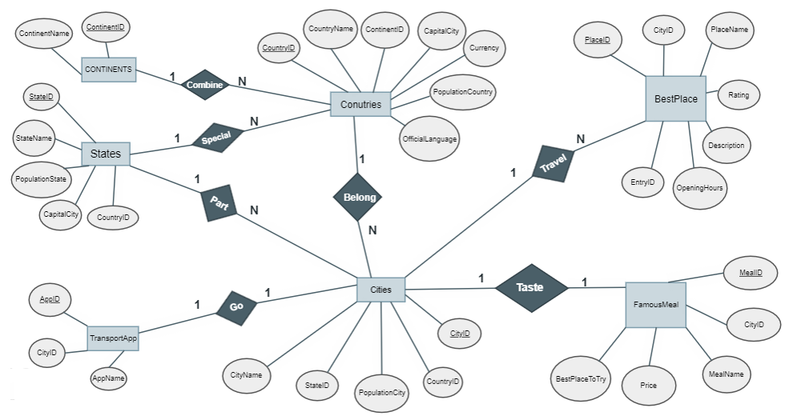
OUR EER DIAGRAMS

Slide 4
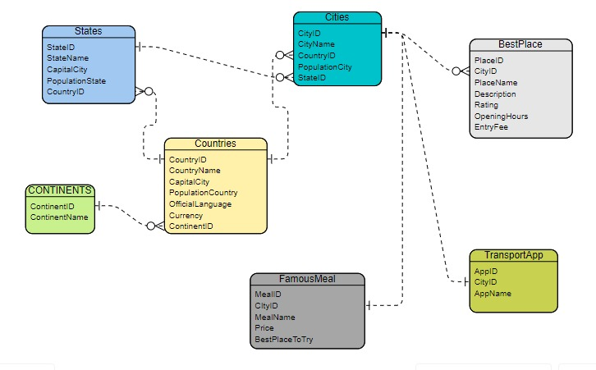

Slide 5

What is written inside this figure is the name of the tables
What is written inside this figure is the name of the columns
What is written inside this figure is the relationship between the tables
_
Inside the oval figure is the column name belonging to each table with underline. In which the Primary Key was added to that column name.
1-1
One-to-One relationship
1-N
One-to-Many relationship

Slide 6
About DataBase Creating
In this database, the countries belonging to each continent and several cities of some countries are given. Some countries, for example, the United Kingdom, the United States, have several parts within themselves, so they are additionally listed in the states table. Therefore, while creating the city table, both country and state tables were used. BestPlace, FamousMeal and TransportApp are based on Citites table. The information in the TransportApp table may contain not only applications, but also the name of the transport that can be used in that city, so that transport does not have its own application.

Slide 7
How do I create my database?
What are tables and columns included in tables?

Slide 8
Column Names
Information
Table Name
In the Continents table, the names of 7 continents and each of them is assigned a order number as the ContinentID column name.
CONTINENTS
ContinentID, ContinentName
In the Countries table, the names of the countries, the order number(CountryİD) assigned to them, the official language, the capital of country , currency and the ContinentID from the CONTINENTS table are foreign keyed. That is, which continent any country belongs to will be determined through the ContinentID in the Countries table
CountryID, CountryName, CapitalCity, PopulationCountry, OfficialLanguage,Currency, ContinentID
Countries
Combine is the connection between the CONTINENTS and Country tables. That is, the ContinentsID in the CONTINENTS table is added to the Countries table as a foreign key.
Combine
(relationship)
ContinentID, CountryID
The States table contains information about the order number(StateID), names, capital city, population and which country the state belongs to.
States
StateID,StateName,CapitalCity,PopulationCity,CountryID

Slide 9
Column Names
Information
Table Name
CityID,CityName,CountryID,PopulationCity,
StateID
The Cities table contains information about the order number(CityID), names, population, which country the city belongs to and which state the city belongs to.
Cities
Part
(relationship)
Part is the connection between the States and Cities tables. That is, the StateID in the States table is added to the Cities table as a foreign key.
StateID,CityID
Belong
(relationship)
Belong is the connection between the Countries and Cities tables. That is, the CountryID in the Countries table is added to the Cities table as a foreign key.
CountryID,CityID
The BestPlace table contains information about the order number(PlaceID), names, description about that place , rating, opening hours and which Place the Cities belongs to(CityID).
BestPlace
PlaceID,CityID,PlaceName,Description,Rating,OpeningHours,EntryFee
Travel
(relationship)
Travel is the connection between the Cities and Travel tables. That is, the CityID in the Cities table is added to the BestPlace table as a foreign key.
CityID,PlaceID

Slide 10
Column Names
Information
Table Name
TransportApp table contains information about the order number(AppID), names(table may contain not only applications, but also the name of the transport that can be used in that city, so that transport does not have its own application), which TransportApp the city belongs to(CityID).
TransportApp
AppID,CityID,AppName
Go
(relationship)
GO is the connection between the Cities and TransportApp tables. That is, the CityID in the Cities table is added to the TransportApp table as a foreign key.
CityID,AppID
The FamousMeal table contains information about the order number(MealID), names, price, where can they eat this meal and which city the place belongs to.
FamousMeal
MealID,CityID,MealName,Price,
BestPlaceToTry
Taste
(relationship)
Taste is the connection between the Cities and FamousMeal tables. That is, the CityID in the Cities table is added to the FamousMeal able as a foreign key.
CityID,MealID

Slide 11
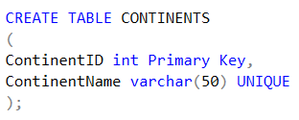
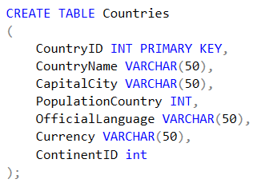

Database setup
First, I have created the CONTINENTS table:
Then the Countries table that is connected to it:
We add a Foreign Key that shows the relationship between these two tables:

Slide 12
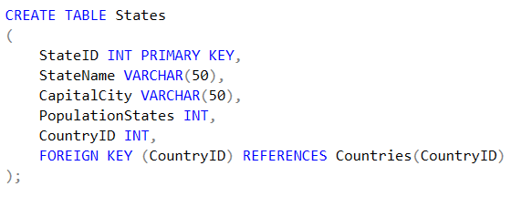
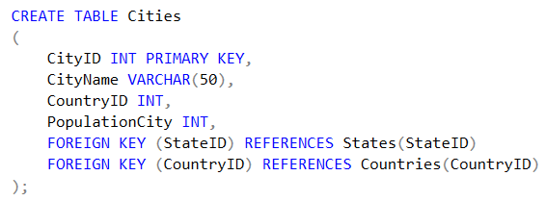
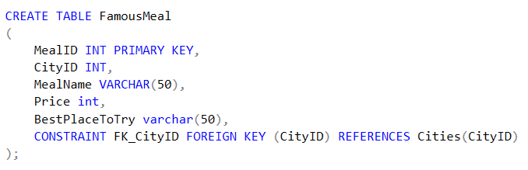
Let's create States table:
Let's create Cities table:
Then the FamousMeal table, which has a relationship with the Citites table, is created:

Slide 13
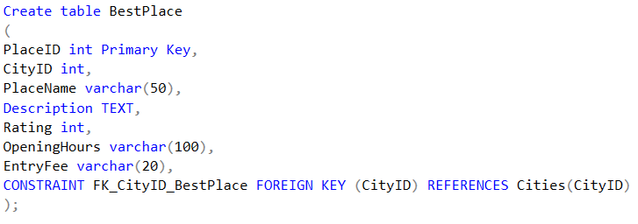
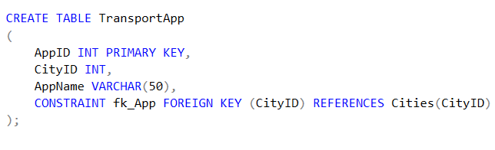
Then the BestPlace table, which has a relationship with the Citites table, is created:
Then the TransportApp table, which has a relationship with the Citites table, is created:

Slide 14
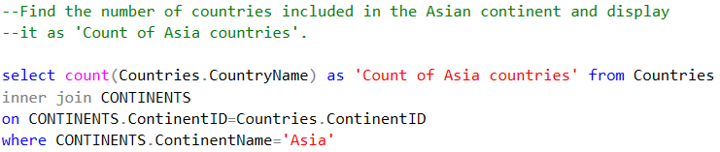
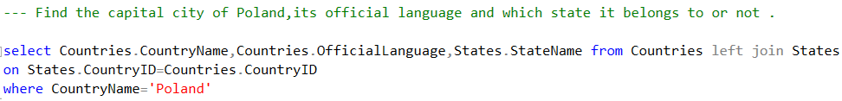
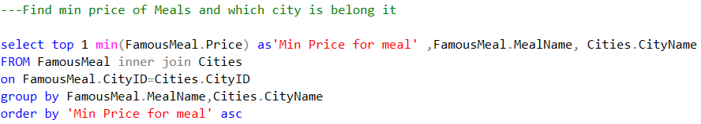
I have some codes

Slide 15
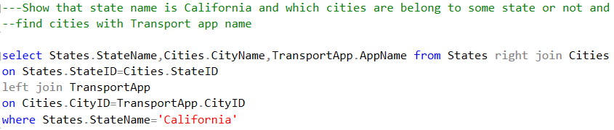
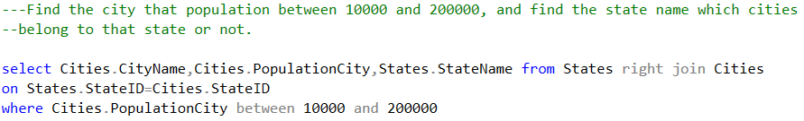
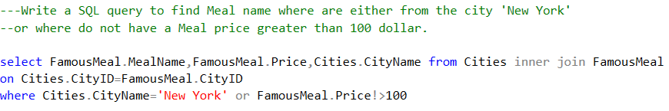

Slide 16
thanks for your attention

