Slide 1
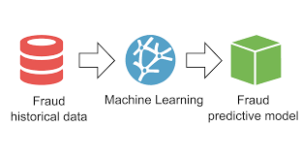
Fraud Detection Using Machine Learning Models
ZARA ZAHEDI

Slide 2
🧱 Workflow Overview:
Here's a typical workflow :
✅ Data cleaning / preprocessing
✅ Feature engineering
✅ Exploratory analysis (e.g. boxplots, correlation)
❗ Class imbalance handling
Class weighting → change how the model learns
🟡 Model building
This is where apply algorithms with class weighting
🟡 Model evaluation
Use metrics like precision, recall, F1-score, AUC, Confusion Matrix

Slide 3
Dataset Source and Feature Overview
Feature | Description
step | Time step — represents the hour of the transaction (e.g., 1 = first hour).
type | Type of transaction, e.g. PAYMENT, TRANSFER, CASH_OUT, etc.
amount | Amount of money transferred in the transaction.
nameOrig | Sender's account ID (usually starts with 'C' = customer).
oldbalanceOrg | Sender’s balance before the transaction.
newbalanceOrig | Sender’s balance after the transaction.
nameDest | Receiver’s account ID (starts with 'C' for customers, 'M' for merchants).
oldbalanceDest | Receiver’s balance before receiving money.
newbalanceDest | Receiver’s balance after the transaction.
isFraud | 1 if the transaction is fraudulent, 0 otherwise (target variable).
isFlaggedFraud | 1 if the transaction was automatically flagged (e.g., over a threshold), usually 0.
🗂️ Synthetic Financial Datasets For Fraud Detection (PaySim)
The dataset we use is a synthetic financial transaction dataset generated by Worldline and ULB, designed to mimic real-world mobile money operations. It includes over 6 million records and features transaction types, account balances, and fraud labels. The data is publicly available on Kaggle.

Slide 4
Dataset Overview
Feature | Count | Mean | Std Dev | Min | 25% | 50% | 75% | Max
step | 6,362,620 | 243.40 | 142.33 | 1.00 | 156.00 | 239.00 | 335.00 | 743.00
amount | 6,362,620 | 179,861.90 | 603,858.23 | 0.00 | 13,389.57 | 74,871.94 | 208,721.48 | 92,445,516.64
oldbalanceOrg | 6,362,620 | 833,883.10 | 2,888,242.67 | 0.00 | 0.00 | 14,208.00 | 107,315.18 | 59,585,040.37
newbalanceOrig | 6,362,620 | 855,113.67 | 2,924,048.50 | 0.00 | 0.00 | 0.00 | 144,258.41 | 49,585,040.37
oldbalanceDest | 6,362,620 | 1,100,702.00 | 3,399,180.00 | 0.00 | 0.00 | 132,705.70 | 943,036.70 | 356,015,900.00
newbalanceDest | 6,362,620 | 1,224,996.00 | 3,674,129.00 | 0.00 | 0.00 | 214,661.40 | 1,111,909.00 | 356,179,300.00
isFraud | 6,362,620 | 0.00 | 0.04 | 0.00 | 0.00 | 0.00 | 0.00 | 1.00
isFlaggedFraud | 6,362,620 | 0.00 | 0.00 | 0.00 | 0.00 | 0.00 | 0.00 | 1.00
Feature | Insight
step | Time steps (1–743); covers ~31 days of data
amount | Highly skewed; most transactions are small, max exceeds $92M
origin balances | Many senders start with 0 or drop to 0 after transactions
destination balances | Large variance; some accounts receive up to $356M
isFraud | Only 0.4% of transactions are fraudulent → high class imbalance
isFlaggedFraud | Rarely used; almost always 0

Slide 5
🔍 Typical Behaviours of Fraudsters
1. ✅ Number of Past Transactions (per sender)
Why it's powerful: Fraudsters often use new accounts with no history. A low or zero count strongly signals abnormal behaviour.
Priority: ★★★★☆ (Very useful, fairly easy to calculate)
2. ✅ Time Since Last Transaction (per sender)
Why it's useful: Sudden activity after a long period of silence can be suspicious.
Priority: ★★★★☆ (Very helpful, especially for behavioural models)
Zero or unchanged balance at the destination ‣ oldbalanceDest = 0 and newbalanceDest = 0 — may indicate a fake or mule account.
3. 🔄 Average Past Transaction Amount
Why it helps: Detects unusual behaviour — like a small spender suddenly sending huge money.
Priority: ★★★☆☆ (Helpful but slightly more complex to compute)
4. 💰 Total Past Amount Transferred
Why it helps: Shows overall account activity — fraudsters may try to move large sums quickly.
Priority: ★★☆☆☆ (Can be redundant with average + count)
5. 🔁 Incoming vs. Outgoing Transaction Ratio
Why it helps: Most users have both incoming and outgoing — fraud accounts may only do one.
Priority: ★★☆☆☆ (Good for advanced models)

Slide 6
Feature Engineering
build features!
✅ we should do this manually — the model does not automatically understand the past behaviour of an account over time. Machine learning models (like XGBoost, Random Forest, etc.) see each transaction as a separate row, with no memory of what came before.
So unless we create features that describe past behaviour, the model has no way of knowing:
How many transactions this account has made before
Whether it's a new account
How recently it last transacted
If its behaviour has suddenly changed

Slide 7
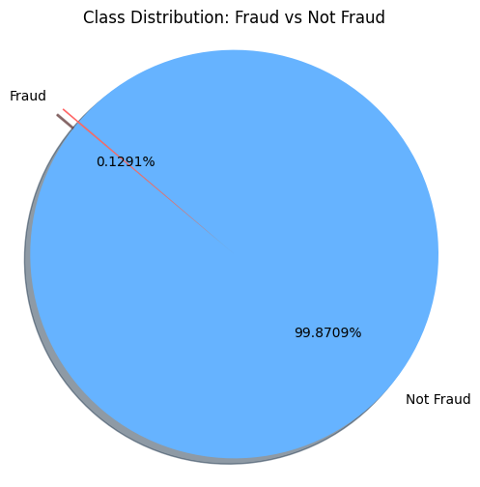
Class Imbalance
What can we do about it?
Resampling techniques:
Oversample the minority class (SMOTE, ADASYN).
Undersample the majority class.
Class weighting: Give more importance to fraud samples during training.
Anomaly detection models: Focus on rare patterns.
Better evaluation metrics: Use precision, recall, F1, or ROC-AUC.
Class Weighting
Assigns higher penalty to misclassifying minority class in loss function.
Built-in in many ML models like Logistic Regression, Random Forest, XGBoost.
✅ No data manipulation, keeps original distribution
⚠️ Might need tuning to find best weights
Not Fraud: 99.87% = 0.9987 ✅ Fraud: 0.13% = 0.0013

Slide 8
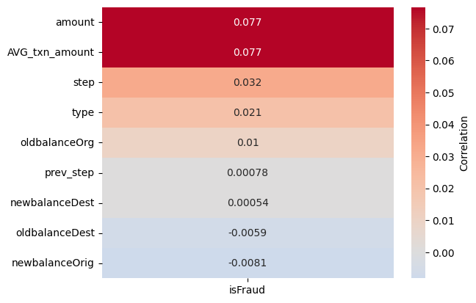
Which Model?
✅ Dataset Characteristics
Tabular, numerical + categorical features
Highly imbalanced target (isFraud ≈ 0.4%)
Non-linear relationships (e.g., balances, timing, behaviour)
Structured features (amounts, account IDs, etc.)
Many zero (e.g., 0 balances)
🏆 Recommended Models for Fraud Detection
Model | Why It's a Good Fit
💡 XGBoost / LightGBM | Handles class imbalance well, great with numeric & categorical data, robust to outliers
🌲 Random Forest | Simple, interpretable, and strong on structured data — handles non-linearity well
📊 Logistic Regression | Good baseline, fast to train, interpretable — but limited for complex patterns
🧠 Neural Networks | Possible for deep behaviour modelling (e.g. with embeddings), but needs tuning & more data

Slide 9
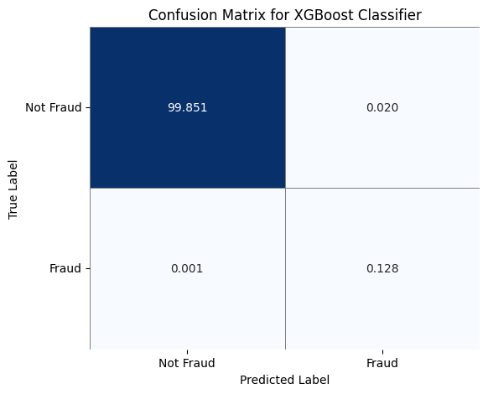
XGBoost Classifier
Label | Precision | Recall | F1-Score | Support
0 | 0.999991 | 0.999804 | 0.999897 | 1,906,322
1 | 0.867423 | 0.993101 | 0.926017 | 2,464
Accuracy | 0.999795 | 0.999795 | 0.999795 | 0.999795
Macro Avg | 0.933707 | 0.996452 | 0.962957 | 1,908,786
Weighted Avg | 0.999820 | 0.999795 | 0.999802 | 1,908,786
✅ This is an excellent result:
Very high recall for fraud (99.3%) → almost all frauds caught.
Very strong precision (86.7%) → relatively few false alarms.
Tiny number of false positives (374) and false negatives (17) across ~1.9M samples.
F1-score for fraud: 92.6% → shows good balance between precision & recall.
Almost perfect accuracy (99.98%).

Slide 10
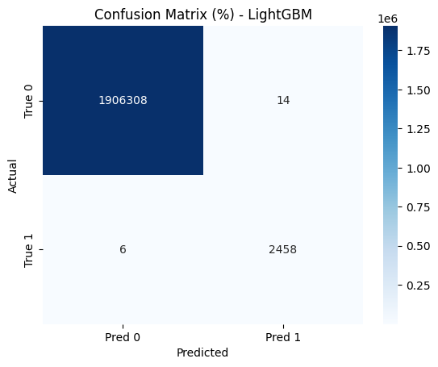
Performance Metrics – LightGBM
Label | Precision | Recall | F1-Score | Support
0 | 0.999997 | 0.999993 | 0.999995 | 1,906,322
1 | 0.994337 | 0.997565 | 0.995948 | 2,464
Accuracy | 0.999990 | 0.999990 | 0.999990 | 0.999990
Macro Avg | 0.997167 | 0.998779 | 0.997971 | 1,908,786
Weighted Avg | 0.999990 | 0.999990 | 0.999990 | 1,908,786
🌟 Performance Highlights:
Best fraud detection overall: very high precision (99.4%) and recall (99.76%) for fraud.
Only 14 false positives and 6 false negatives in ~1.9 million records — outstanding.
F1-score for fraud: 99.59% — extremely well balanced.
Accuracy: 99.999% — almost perfect.

Slide 11
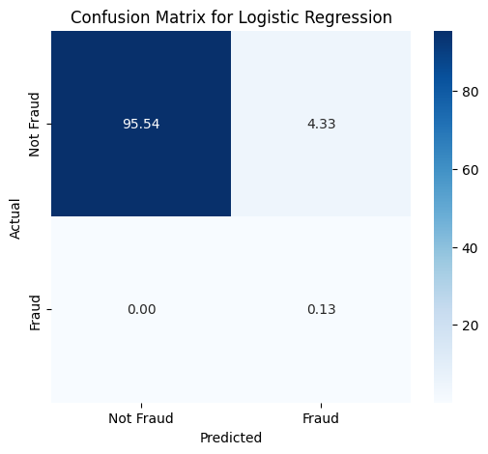
Performance Metrics – Logistic_Regression
Class | Precision | Recall | F1-Score | Support
0 (Non-Fraud) | 0.999997 | 0.956669 | 0.977853 | 1,906,322
1 (Fraud) | 0.028897 | 0.997565 | 0.056167 | 2,464
Accuracy | 0.956722 | 0.956722 | 0.956722 | 0.956722
Macro Avg | 0.514447 | 0.977117 | 0.517010 | 1,908,786
Weighted Avg | 0.998743 | 0.956722 | 0.976663 | 1,908,786
⚠️ Logistic Regression — Performance Highlights:
✅ Best at detecting all frauds: Extremely high recall for fraud class (99.76%) — it catches nearly every fraud case.
❌ Very low precision for fraud (2.89%) — most fraud predictions are false alarms (over 82,000 false positives).
⚖️ F1-score for fraud: Only 5.61% — unbalanced due to poor precision.
📉 Confusion matrix: ‣ False positives: 82,603 ‣ False negatives: 6
✅ Accuracy: 95.67% — looks good, but misleading due to class imbalance.
🚨 Conclusion: Not reliable for deployment without addressing class imbalance. Needs improvement in precision (e.g., better model or rebalancing techniques).

Slide 12
✅ Model Comparison Summary
Metric / Model | Logistic Regression | XGBoost | LightGBM
Accuracy | 95.67% | 99.98% | 99.999%
Precision (Fraud) | 2.89% | 86.74% | 99.43%
Recall (Fraud) | 99.76% | 99.31% | 99.76%
F1-score (Fraud) | 5.61% | 92.60% | 99.59%
False Positives | 82,603 | 374 | 14
False Negatives | 6 | 17 | 6
Training Time | 24.9s | 18.0s | 18.7s
✅ Conclusion: Among the three models tested, LightGBM delivers the highest performance, achieving near-perfect accuracy, extremely high fraud detection capability, and the lowest false positive rate. While Logistic Regression shows strong recall, its poor precision and very high false alarm rate make it unsuitable for deployment. XGBoost performs well but is slightly outpaced by LightGBM in overall balance.
👉 Recommendation: Proceed with LightGBM as the production model for fraud detection.

