Slide 1
نمايش اعداد

Slide 2
سيستم نمايش اعداد
مبنا (base):
مبناي r: ارقام محدود به [0, r-1]
دسيمال: (379)₁₀
باينري: (01011101)₂
اکتال: (372)₈
هگزادسيمال: (23D9F)₁₆
نيازها:
محاسبات در هر سيستم
تبديل از يک سيستم به سيستم ديگر

Slide 3
سيستم نمايش اعداد (دسيمال)
اعداد دسيمال:
دو بخش صحيح و اعشاري
A_{n-1} A_{n-2} … A₁ A₀ . A₋₁ A₋₂ … A_{-m+1} A_{-m}
که A_{i} عددي بين 0 تا 9 و با وزن 10^{i} است.

Slide 4
سيستم نمايش اعداد (دسيمال)
The value of
A_{n-1} A_{n-2} … A₁ A₀ . A₋₁ A₋₂ … A_{-m+1} A_{-m}
is calculated by
∑_{i=n-1..0} (A_{i} ∗ 10^{i} ) + ∑_{i=-m..-1} (A_{i} ∗ 10^{i} )
مثال:
(126.53)₁₀
= 1*10² + 2*10¹ + 6* 10⁰ +
5*10⁻¹ + 3*10⁻²

Slide 5
سيستم نمايش اعداد (حالت کلي)
“base” r (radix r)
N = A_{n-1} ∗r ^{n-1} + A_{n-2}∗r ^{n-2} +… + A₁∗r + A₀ +
A₋₁ ∗r ⁻¹ + A₋₂∗r ⁻² +… + A_{-m} ∗r ^{-m}
Most
Significant
Digit (MSD)
Least
Significant
Digit (LSD)

Slide 6
سيستم نمايش اعداد (حالت کلي)
مثال: r = 6
(312.4)₆ = 3∗6² + 1∗6¹ + 2∗6⁰ + 4∗6⁻¹
= (116.66)₁₀
تبديل از هر مبناي دلخواه r به مبناي 10 با رابطة بالا انجام مي شود.

Slide 7
اعداد باينري (مبناي 2)
کامپيوترها داده‌ها را به صورت رشته‌اي از “بيت‌ها” نمايش مي‌دهند.
بيت: 0 يا 1
مبناي 2: ارقام 0 يا 1
مثال:
(101101.10)₂ = 1∗2⁵ + 0∗2⁴ + 1∗2³ + 1∗2² + 0∗2¹ + 1∗2⁰ + 1∗2⁻¹ + 0∗2⁻²
(in decimal) = 32 + 0 + 8 + 4 + 0 + 1 + ½ + 0
= (45.5)₁₀

Slide 8
اعداد باينري (مبناي 2)
مثال:
(1001.011)₂ = 1∗2³ + 0∗2² + 0∗2¹ + 1∗2⁰ + 0∗2⁻¹ + 1∗2⁻² + 1∗2⁻³
(in decimal) = 8 + 1 + 0.25 + 0.125
= (9.375)₁₀

Slide 9
اعداد باينري
32 16 8 4 2 1 .5 .25 .125 .0625
( 1 1 0 1 0 1 . 1 0 1 1 )
= ( 53.6875 )
2
10

Slide 10
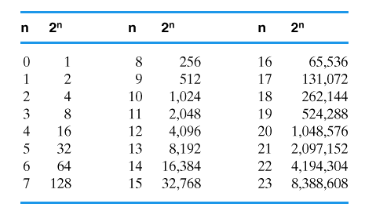
توان هاي 2
Memorize at least through 2¹²

Slide 11
اعداد اکتال (مبناي 8)
مبناي 8:
ارقام 0 تا 7
مثال:
(762)₈ = 7∗8² + 6∗8¹ + 2∗8⁰
(in decimal) = 448 + 48 + 2
= (498)₁₀

Slide 12
اعداد هگزادسيمال (مبناي 16)
مبناي 16:
ارقام 0, …, 9, A, B, C, D, E, F
A=10, B=11, … , F = 15
مثال:
(3FB)₁₆ = 3∗16² + 15∗16¹ + 11∗16⁰
(in decimal) = 768 + 240 + 11
= (1019)₁₀

Slide 13
تبديل مبناها
هر مبنا (r) ← دسيمال: آسان (گفته شده)
دسيمال ← هر مبناي r
دسيمال ← باينري
اکتال ← باينري و برعکس
هگزادسيمال ← باينري و برعکس

Slide 14
تبديل دسيمال به هر مبناي r
بخش صحيح:
تقسيم متوالي بر r
خواندن باقيمانده‌ها به بالا
34,761₁₀ = (?)₁₆
16 34,761
16 2,172 rem 9
16 135 rem 12 = C
16 8 rem 7
0 rem 8
Read up
34,761₁₀ = 87C9₁₆

Slide 15
تبديل دسيمال به هر مبناي r
بخش اعشاري:
ضرب متوالي در r
خواندن بخش‌های صحيح رو به پايين
0.78125₁₀ = (?)₁₆
0.78125 x 16 = 12.5 int = 12 = C
0.5 x 16 = 8.0 int = 8
Read
down
0.78125₁₀ = 0.C8₁₆

Slide 16
تبديل دسيمال به هر مبناي r
مثالي ديگر
0.1₁₀ = (?)₂
0.1 x 2 = 0.2 int = 0
0.2 x 2 = 0.4 int = 0
0.4 x 2 = 0.8 int = 0
0.8 x 2 = 1.6 int = 1
0.6 x 2 = 1.2 int = 1
0.2 x 2 = 0.4 int = 0
0.4 x 2 = 0.8 int = 0
Read
down
0.1₁₀ = 0.00011₂

Slide 17
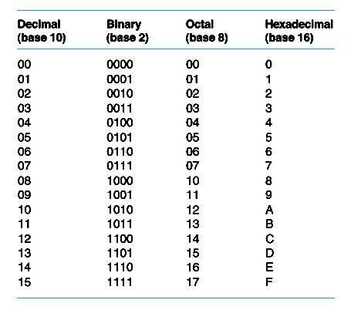
اعداد در مبناهاي مختلف
Memorize at least Binary and Hex

Slide 18
دسيمال ← باينري
فرض: N يک عدد دسيمال
بزرگترين عددي که توان 2 است و با تفريق آن عددي مثبت (N₁ )حاصل مي شود پيدا کن.
يک عدد 1 در MSB قرار بده.
مرحلة 1 را با عدد N₁ تکرار کن.
در بيت مربوط عدد 1 قرار بده.
وقتي اختلاف صفر شد توقف کن.

Slide 19
دسيمال ← باينري
مثال:
N = (717)₁₀
717 – 512 = 205 = N₁ 512 = 2⁹
205 –128 = 77 = N₂ 128 = 2⁷
77 – 64 = 13 = N₃ 64 = 2⁶
13 – 8 = 5 = N₄ 8 = 2³
5 – 4 = 1 = N₅ 4 = 2²
1 – 1 = 0 = N₆ 1 = 2⁰
→ (717)₁₀ = 2⁹ + 2⁷ + 2⁶ + 2³ + 2² + 2⁰
= ( 1 0 1 1 0 0 1 1 0 1)₂

Slide 20
باينري به اکتال باينري به هگزادسيمال
باينري به اکتال
8 = 2³
← هر 3 بيت باينري به يک رقم اکتال تبديل مي شود.
باينري به هگزادسيمال
16 = 2⁴
← هر 4 بيت باينري به يک رقم هگزادسيمال تبديل مي شود.

Slide 21
Binary ↔ Octal
(11010101000.1111010111)₂
(011 010 101 000 . 111 101 011 100)₂
( 3 2 5 0 . 7 5 3 4 )₈

Slide 22
Binary ↔ Hex
(110 1010 1000 . 1111 0101 11 )₂
( 0110 1010 1000 . 1111 0101 1100 )₂
( 6 A 8 . F 5 C )₁₆

Slide 23
Octal ↔ Hex
ازطريق باينري انجام دهيد:
Hex → Binary → Octal
Octal → Binary → Hex

Slide 24
تبديل ها (مثال)
جدول را پر کنيد:
Decimal | Binary | Octal | Hex
329.3935 | ? | ? | ?
? | 10101101.011 | ? | ?
? | ? | 336.5 | ?
? | ? | ? | F9C7.A

Slide 25
اعمال رياضي باينري: جمع
قوانين: مانند جمع دسيمال
با اين تفاوت که1+1 = 10 ← توليد نقلي
0+0 = 0(c0) (sum 0 with carry 0)
0+1 = 1+0 = 1(c0)
1+1 = 0(c1)
1+1+1 = 1(c1)
Carry | 1 | 1 | 1 | 1 | 1 | 0
Augend | 0 | 0 | 1 | 0 | 0 | 1
Addend | 0 | 1 | 1 | 1 | 1 | 1
Result | 1 | 0 | 1 | 0 | 0 | 0

Slide 26
سرريز (Overflow)
اگر تعداد بيت ها = n و حاصل جمع n+1 بيت نياز داشته باشد
← سرريز

Slide 27
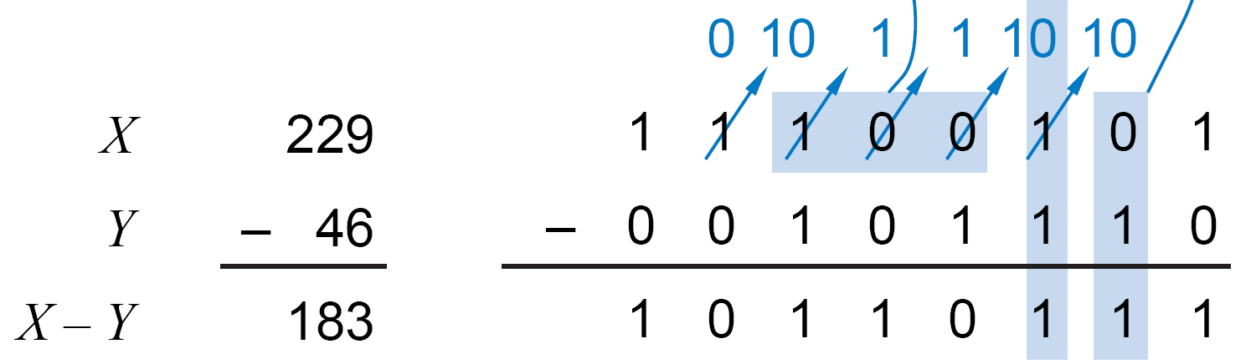
اعمال رياضي باينري: تفريق
قوانين:
0-0 = 1-1 = 0 (b0) (result 0 with borrow 0)
1-0 = 1 (b0)
0-1 = 1 (b1)
…
Borrow | 1 | 1 | 0 | 0
Minuend | 1 | 1 | 0 | 1 | 1
Subtrahend | 0 | 1 | 1 | 0 | 1
Result | 0 | 1 | 1 | 1 | 0

Slide 28
کليد موفقيت
الگوريتم هاي اعمال رياضي مبناي 10 را به خاطر آوريد.
آنها را براي مبناي مورد نظر تعميم دهيد.
قانون مبناي مورد نظر را به کار بريد.
براي باينري: 1+1=10

Slide 29
نمايش اعداد
نمايش اعداد مثبت:
در بيشتر سيستم‌ها يکسان است
نمايش اعداد منفي:
اندازه-علامت (Sign magnitude)
مکمل 1 (1’s complement)
مکمل 2 (2’s complement)
در بيشتر سيستم‌ها: مکمل 2
فرض در سلايدهای بعدی:
ماشين با کلمه‌هاي 4 بيتي:
← 16 مقدار مختلف قابل نمايش
تقريباً نيمي مثبت، نيمي منفي

Slide 30
نمايش اعداد
اندازه-علامت:
High order bit is sign: 0 = positive (or zero), 1 = negative
Three low order bits show the magnitude: 0 (000) thru 7 (111)
Number range for n bits = -(2 ^{n-1} - 1) to (2 ^{n-1} -1)
Two representations for 0
Cumbersome addition/subtraction
Must compare magnitudes to determine the sign of result

Slide 31
Addition and Subtraction Sign and Magnitude
4
+ 3
7
0100
0011
0111
-4
+ (-3)
-7
1100
1011
1111
result sign bit is the
same as the operands'
sign
when signs differ,
operation is subtract,
sign of result depends
on sign of number with
the larger magnitude
4
- 3
1
0100
1011
0001
-4
+ 3
-1
1100
0011
1001

Slide 32
نمايش اعداد
مکمل 1:
If N is a positive number, then its 1's complement, N, is defined as:
n
4
N = (2 - 1) - N
2 = 10000
-
1 = 00001
1111
-
7 = 0111
1000
Example: 1's complement of 7
Shortcut method:
Simply perform bit-wise complement
0111 -> 1000
= -7 in 1's comp.

Slide 33
نمايش اعداد
مکمل 1:
Subtraction implemented by addition & 1's complement
Still two representations of 0! This causes some problems
Some complexities in addition

Slide 34
Addition and Subtraction 1’s Complement
4
+ 3
7
0100
0011
0111
-4
+ (-3)
-7
1011
1100
10111
1
1000
End around carry
4
- 3
1
0100
1100
10000
1
0001
-4
+ 3
-1
1011
0011
1110
End around carry

Slide 35
Addition and Subtraction 1’s Complement
Why does end-around carry work?
Its equivalent to subtracting 2 and adding 1
n
n
n
M - N = M + N = M + (2 - 1 - N) = (M - N) + 2 - 1
(M > N)
n
n
-M + (-N) = M + N = (2 - M - 1) + (2 - N - 1)
= 2 + [2 - 1 - (M + N)] - 1
n-1
M + N < 2
n
n
after end around carry:
n
= 2 - 1 - (M + N)
this is the correct form for representing -(M + N) in 1's comp!

Slide 36
نمايش اعداد
If N is a positive number, then its 2's complement, N*, is defined as:
n
4
2 = 10000
7 = 0111
1001 = repr. of -7
مکمل 2:
N* = 2 - N
Example: 2’s complement of 7
sub
4
Example: 2’s complement of -7
2 = 10000
-7 = 1001
0111 = repr. of 7
sub
Shortcut method:
2’s complement = bit-wise complement + 1
0111 -> 1000 + 1 -> 1001 (representation of -7)
1001 -> 0110 + 1 -> 0111 (representation of 7)

Slide 37
نمايش اعداد
مکمل 2:
Like 1's comp
except shifted
one position
clockwise
Only one representation for 0
One more negative number than positive number (-8)
Number range for n bits = -(2 ^{n-1}) to (2 ^{n-1} -1)

Slide 38
مکمل 2
Here’s an easier way to compute the 2’s complement:
Leave all least significant 0’s and first 1 unchanged.
Replace 0 with 1 and 1 with 0 in all remaining more significant bits.
Examples:
N = 1010 N = 01011000 01 10 10101000
2’s complement 2’s complement
complement
unchanged
complement
unchanged

Slide 39
جمع و تفريق مکمل 2
4
+ 3
7
0100
0011
0111
-4
+ (-3)
-7
1100
1101
11001
Can the carry-outs be ignored?
Yes, reason explained in the next slide.
4
- 3
1
0100
1101
10001
-4
+ 3
-1
1100
0011
1111
Simpler addition scheme makes 2’s complement the most common
choice for integer number systems within digital systems

Slide 40
جمع و تفريق مکمل 2
Why can the carry-out be ignored?
-M + N when N > M > 0:
n
n
M* + N = (2 - M) + N = 2 + (N - M)
n
Ignoring carry-out is just like subtracting 2
-M + -N where N + M <= 2
n-1
n
n
-M + (-N) = M* + N* = (2 - M) + (2 - N)
= 2 - (M + N) + 2
= (M + N)* + 2
n
n
n
After ignoring the carry, this is just the right 2’s complement
representation for -(M + N)!

Slide 41
سرريز
Overflow Conditions:
1. Adding two positive numbers to get a negative number:
2. Adding two negative numbers to get a positive number:
-1
+0
-1
+0
-2
1111
0000
+1
-2
1111
0000
+1
-3
1110
0001
-3
1110
0001
1101
+2
1101
+2
-4
0010
-4
0010
1100
0011
+3
1100
0011
+3
-5
1011
-5
0100
+4
1011
0100
+4
-6
1010
-6
1010
0101
+5
0101
+5
1001
0110
1001
0110
-7
1000
+6
-7
+6
0111
1000
0111
-8
+7
-8
+7
5 + 3 = -8
-7 - 2 = +7

Slide 42
سرريز
Overflow Conditions:
0 1 1 1
0 1 0 1
0 0 1 1
1 0 0 0
1 0 0 0
1 0 0 1
1 1 1 0
1 0 1 1 1
5
3
-8
-7
-2
7
Overflow
Overflow
0 0 0 0
0 1 0 1
0 0 1 0
0 1 1 1
1 1 1 1
1 1 0 1
1 0 1 1
1 1 0 0 0
5
2
7
-3
-5
-8
No overflow
No overflow
Method 1: Overflow when the carry into sign ≠ carry out
Method 2: Overflow when sign(A) = sign(B) ≠ sign(result)

Slide 43
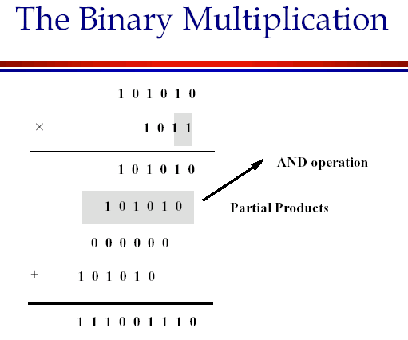

Slide 44
ضرب باينري
Shift-and-add algorithm, as in decimal
Check: 13 * 6 = 78
M’cand | 0 | 0 | 0 | 1 | 1 | 0 | 1
M’plier | 0 | 0 | 0 | 0 | 1 | 1 | 0
(1) |  |  | 0 | 0 | 0 | 0 | 0
(2) |  | 0 | 1 | 1 | 0 | 1
(3) | 0 | 1 | 1 | 0 | 1
Sum | 1 | 0 | 0 | 1 | 1 | 1 | 0

Slide 45
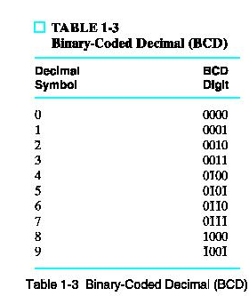
Binary-Coded Decimal (BCD)
A decimal code: Decimal numbers (0..9) are coded using 4-bit distinct binary words
Observe that the codes 1010 .. 1111 (decimal 10..15) are NOT represented (invalid BCD codes)

Slide 46
Binary-Coded Decimal
To code a number with n decimal digits, we need 4n bits in BCD
e.g. (365)₁₀ = (0011 0110 0101)_{BCD}
This is different from converting to binary, which is (365)₁₀ = (101101101)₂
Clearly, BCD requires more bits. BUT, it is easier to understand/interpret

Slide 47
BCD Addition
Case 1:
0001 1
0101 5
(0) 0110 (0) 6
Case 2:
0110 6
0101 5
(0) 1011 (1) 1
WRONG!
Case 3:
1000 8
1001 9
(1) 0001 (1) 7
Note that for cases 2 and 3, adding number 6 (0110) gives us the correct result.
How can we identify the wrong cases?

Slide 48
BCD Addition (cont.)
BCD addition is therefore performed as follows:
1) Add the two BCD digits together using normal binary addition
2) Check if correction is needed
4-bit sum is in range of 1010 to 1111
OR
b) carry out of MSB = 1
3) If correction is required, add 0110 to 4-bit sum to get the correct result
→ BCD carry out = 1

Slide 49
BCD Negative Number Representation
Similar to binary negative number representation except r = 10.
BCD sign-magnitude
MSD (sign digit options)
MSD = 0 (positive); not equal to 0 = negative
MSD range of 0-4 positive; 5-9 negative
BCD 9’s complement
invert each BCD digit (0→9, 1 → 8, 2 → 7,3 → 6, …7 → 2, 8 → 1, 9 → 0)
BCD 10’s complement
-N ≡ 10^{n} - N; 9’s complement + 1

Slide 50
BCD Addition (cont.)
Example: Add 448 and 489 in BCD.
0100 0100 1000 (448 in BCD)
0100 1000 1001 (489 in BCD)
10001 (carry out of MSB=1, add 6)
10111 (carry 1 into middle digit)
1101 (between 10 and 15, add 6)
10011 (carry 1 into leftmost digit)
1001 0011 0111 (BCD coding of 937₁₀)
0110
0110

Slide 51
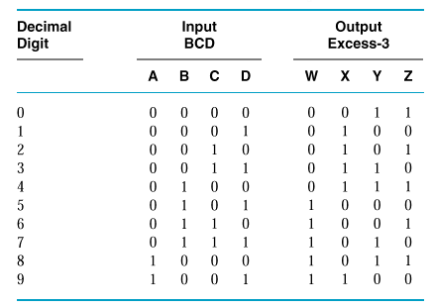
Excess-3
مانند BCD ولي هر رقم +3
جمع سرراست تر
self-comlpement code
(مکمل هر رقم = مکمل 9 آن)

Slide 52
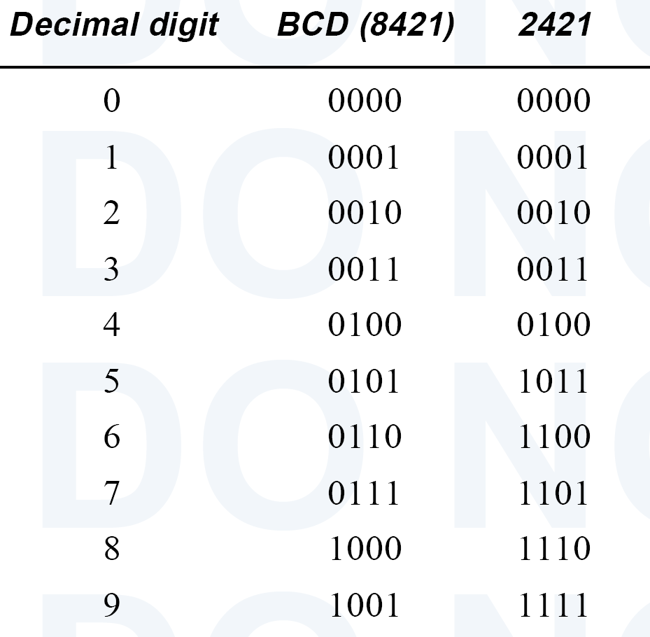
2421 Code
مانند BCD ولي وزن هر بيت 2421 است (به جاي 8421)
self-comlpement code
(مکمل هر رقم = مکمل 9 آن)

Slide 53
ASCII character code
We also need to represent letters and other symbols → alphanumeric codes
ASCII = American Standard Code for Information Interchange. Also known as Western European
It contains 128 characters:
94 printable (26 uppercase and 26 lowercase letters, 10 digits, 32 special symbols)
34 non-printable (for control functions)
Uses 7-bit binary codes to represent each of the 128 characters

Slide 54
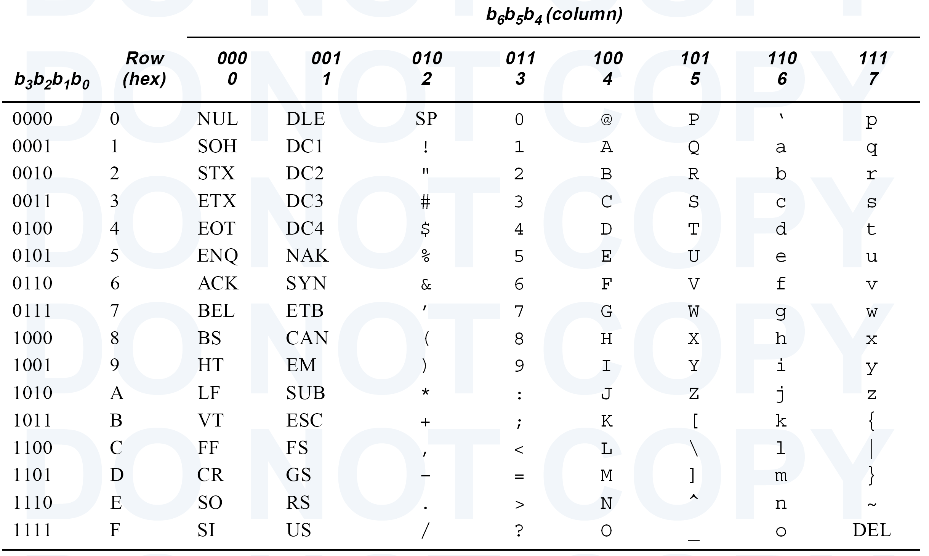
ASCII Table
Null
Space
Bell
BkSpc
Tab
Line Fd
Escape
Crg Ret

Slide 55
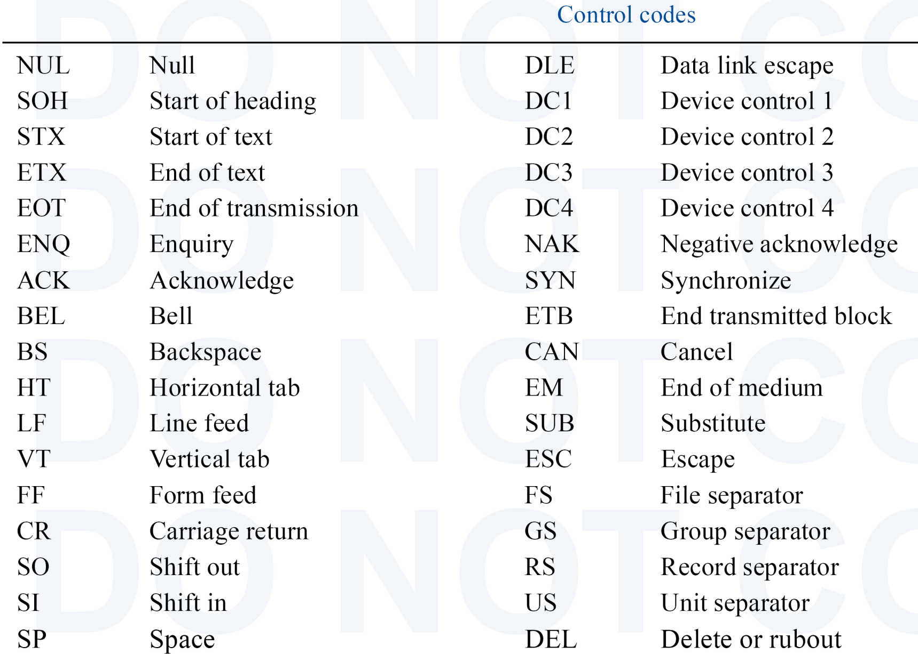
ASCII Control Codes

Slide 56
Unicode
Established standard (16-bit alphanumeric code) for international character sets
Since it is 16-bit, it has 65,536 codes
Represented by 4 Hex digits
ASCII is between 0000₁₆ .. 007B₁₆

Slide 57
Unicode Table (first 191 char.)
http://www.unicode.org/charts/

Slide 58
Unicode
062B 1579 | ث | 062C 1580 | ج | 062D 1581 | ح | 062E 1582 | خ
0633 1587 | س | 0634 1588 | ش | 0635 1589 | ص | 0636 1590 | ض
063B 1595 | ػ | 063C 1596 | ؼ | 063D 1597 | ؽ | 063E 1598 | ؾ
0643 1603 | ك | 0644 1604 | ل | 0645 1605 | م | 0646 1606 | ن
064B 1611 | ً | 064C 1612 | ٌ | 064D 1613 | ٍ | 064E 1614 | َ
0653 1619 | ٓ | 0654 1620 | ٔ | 0655 1621 | ٕ | 0656 1622 | ٖ
065B 1627 | ٛ | 065C 1628 | ٜ | 065D 1629 | ٝ | 065E 1630 | ٞ
0663 1635 | ٣ | 0664 1636 | ٤ | 0665 1637 | ٥ | 0666 1638 | ٦
066B 1643 | ٫ | 066C 1644 | ٬ | 066D 1645 | ٭ | 066E 1646 | ٮ
0673 1651 | ٳ | 0674 1652 | ٴ | 0675 1653 | ٵ | 0676 1654 | ٶ
067B 1659 | ٻ | 067C 1660 | ټ | 067D 1661 | ٽ | 067E 1662 | پ
0683 1667 | ڃ | 0684 1668 | ڄ | 0685 1669 | څ | 0686 1670 | چ
068B 1675 | ڋ | 068C 1676 | ڌ | 068D 1677 | ڍ | 068E 1678 | ڎ

Slide 59
ASCII Parity Bit
Parity coding is used to detect errors in data communication and processing
An 8th bit is added to the 7-bit ASCII code
Even (Odd) parity: set the parity bit so as to make the # of 1’s in the 8-bit code even (odd)

Slide 60
ASCII Parity Bit (cont.)
For example:
Make the 7-bit code 1011011 an 8-bit even parity code → 11011011
Make the 7-bit code 1011011 an 8-bit odd parity code → 01011011
Error Checking:
Both even and odd parity codes can detect an odd number of error.
An even number of errors goes undetected.

Slide 61
Gray Codes
Gray codes are minimum change codes
From one numeric representation to the next, only one bit changes
Applications:
Karnaugh map
Sequential circuits
Whenever we want one bit change at a time

Slide 62
Gray Codes (cont.)
Binary
00
01
10
11
Gray
00
01
11
10
Binary
000
001
010
011
100
101
110
111
Gray
000
001
011
010
110
111
101
100
Binary
0000
0001
0010
0011
0100
0101
0110
0111
1000
1001
1010
1011
1100
1101
1110
1111
Gray
0000
0001
0011
0010
0110
0111
0101
0100
1100
1101
1111
1110
1010
1011
1001
1000

