Slide 1
بهينه سازي با روش
Quine-McCluskey

Slide 2
Quine-McCluskey Method
  Tabular method to systematically find all prime implicants
  Provides basis for computer simplification (CAD tools).
Two Stages:
  Generate all the PIs, and make a PI table.
  Obtain the minimum cover of the PI table.

Slide 3
Stage 1
f(A,B,C,D) = Σm(0,4,5,6,7,8,9,10,13,15)
1: Column 1: ON-set minterm indices.
- Group by number of 1's.
Implication Table
Column I Column II
0000
0100
1000
0101
0110
1001
1010
0111
1101
1111
Column III
√
0-00
*
01--
2: Apply Uniting Theorem
- Compare elements of group:
(N 1's against those with N+1 1's)
- Eliminate variable and place in
next column.
E.g., 0000 vs. 0100 yields 0-00
0000 vs. 1000 yields -000
*
-000
*
-1-1
√
*
√
010-
√
01-0
√
√
100-
√
*
10-0
*
√
√
01-1
√
-101
√
√
011-
√
Check mark: when used in a combination,
Star: if cannot be combined. (These are the prime implicants).
√
1-01
*
-111
√
√
11-1
√

Slide 4
Stage 1 (continued)
AB
A
Prime Implicants:
CD
00
01
11
10
00
1
1
0
1
0-00 = A' C' D'
100- = A B' C'
1-01 = A C' D
-1-1 = B D
-000 = B' C' D'
10-0 = A B' D'
01-- = A' B
01
0
1
1
1
D
11
0
1
1
0
C
10
0
1
0
1
B
Stage 2: find smallest set of prime implicants that cover the ON-set

Slide 5
Stage 2
Stage 2:
  find smallest set of prime implicants that cover the ON-set
    recall that EPIs must be in all covers
  → Another tabular method: the prime implicant chart

Slide 6
Stage 2 (continued)
rows = prime implicants
columns = ON-set elements
place an "√" if ON-set element is
covered by the prime implicant
If column has a single √, then the
implicant associated with the row
is essential.
→ It must appear in minimum cover
Eliminate all columns covered by essential primes
Find minimum set of rows that cover the remaining columns
 | 0 | 4 | 5 | 6 | 7 | 8 | 9 | 10 | 13 | 15
0,4 (0-00) | √ | √
0,8 (-000) | √ |  |  |  |  | √
8,9 (100-) |  |  |  |  |  | √ | √
8,10 (10-0) |  |  |  |  |  | √ |  | √
9,13 (1-01) |  |  |  |  |  |  | √ |  | √
4,5,6,7 (01--) |  | √ | √ | √ | √
5,7,13,15 (-1-1) |  |  | √ |  | √ |  |  |  | √ | √
√
√
√
√
√
√
√
√
f = A C' D' + A B' C' + A B' D' + A' B + B D

Slide 7
Handle Don’t Cares: Stage 1
f(A,B,C,D) = Σm(4,5,6,8,9,10,13) + Σd(0,7,15)
1: Fill Column 1 with ON-set and
DC-set minterm indices. Group
by number of 1's.
Implication Table
Column I Column II
0000
0100
1000
0101
0110
1001
1010
0111
1101
1111
Column III
√
0-00
*
01--
2: …
*
-000
*
-1-1
√
*
√
010-
√
01-0
√
√
100-
√
*
10-0
*
√
√
01-1
√
-101
√
√
011-
√
√
1-01
*
-111
√
√
11-1
√

Slide 8
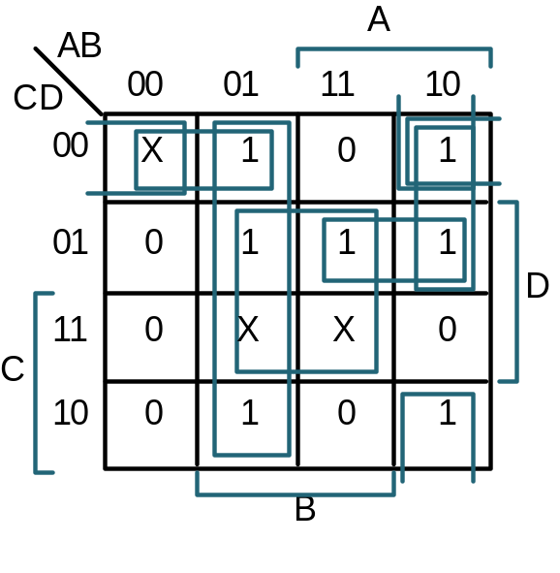
Stage 1 (continued)
Prime Implicants:
0-00 = A' C' D'
100- = A B' C'
1-01 = A C' D
-1-1 = B D
-000 = B' C' D'
10-0 = A B' D'
01-- = A' B
Stage 2: find smallest set of prime implicants that cover the ON-set

Slide 9
Stage 2
Stage 2:
  find smallest set of prime implicants that cover the ON-set
    Don’t care sets need not be covered

Slide 10
Stage 2 (continued)
 | 4 | 5 | 6 | 8 | 9 | 10 | 13
0,4 (0-00) | √
0,8 (-000) |  |  |  | √
8,9 (100-) |  |  |  | √ | √
8,10 (10-0) |  |  |  | √ |  | √
9,13 (1-01) |  |  |  |  | √ |  | √
4,5,6,7 (01--) | √ | √ | √
5,7,13,15 (-1-1) |  | √ |  |  |  |  | √
√
√
√
√
√
f = A B' D' + A C' D + A' B

