Slide 1


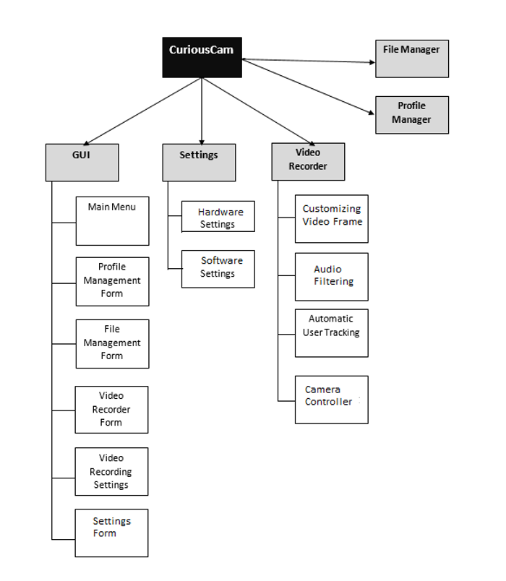
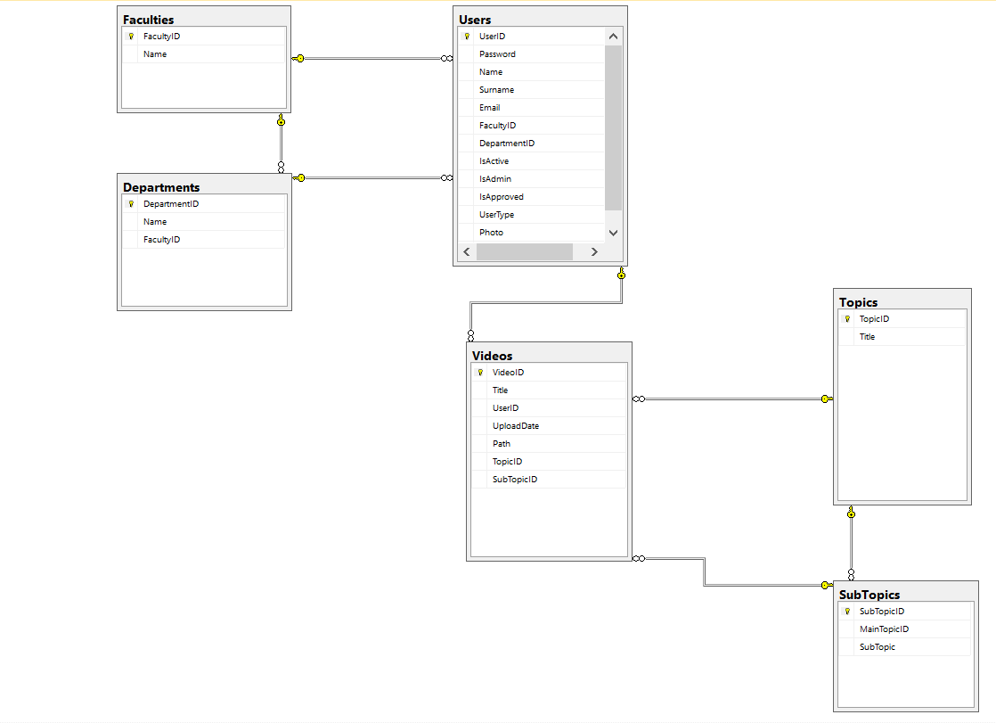
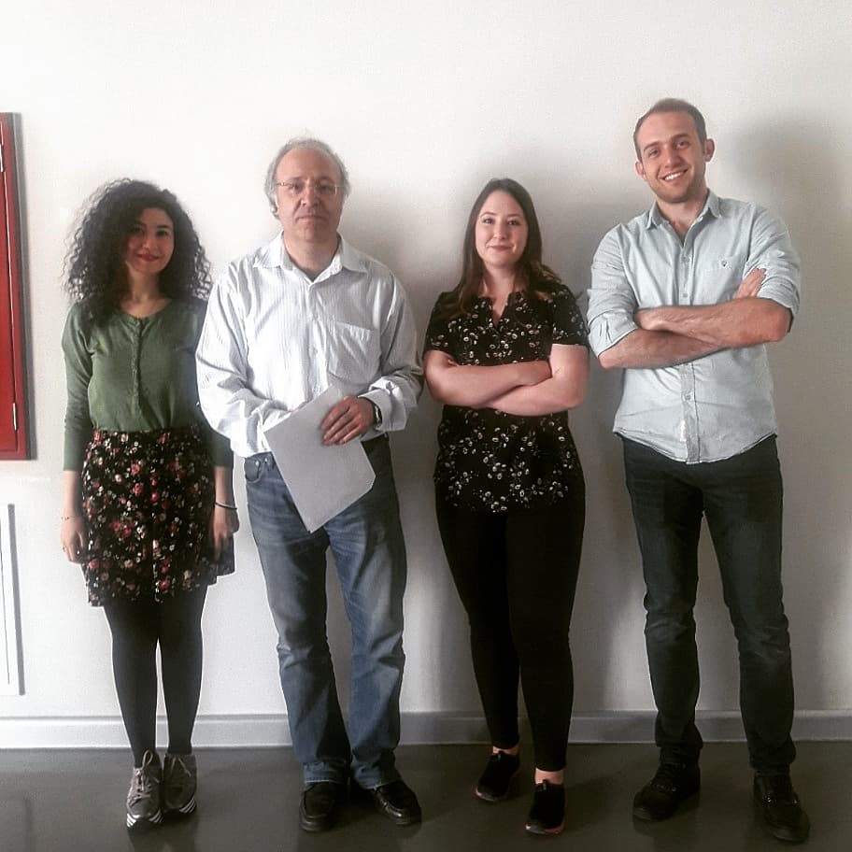
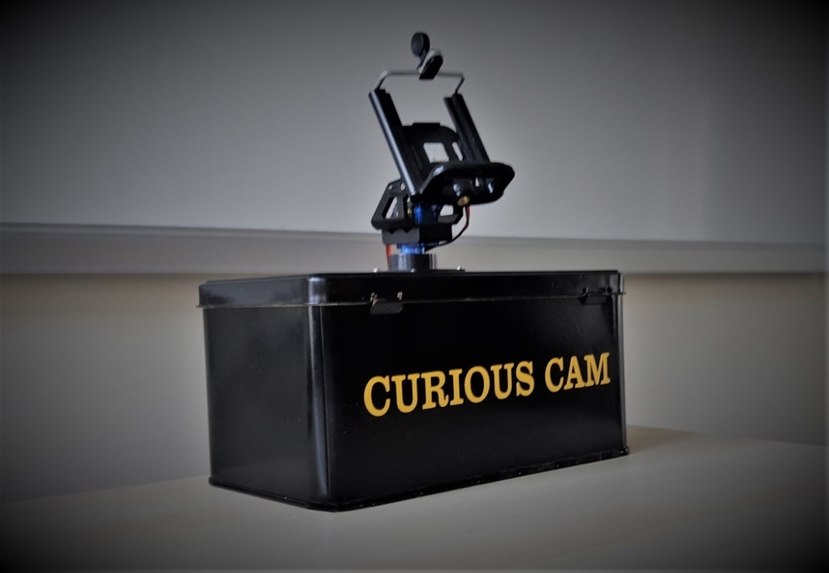
CURIOUS CAM For VIDEO LECTURE RECORDING
ENVIRONMENT
Bahar ŞENGEZ – Elifnur ALTUNTAŞ - Alihan Doğuş YALÇIN
Asst. Prof. Abdül Kadir GÖRÜR
Çankaya University Department of Computer Engineering
Abstract
Nowadays the use and importance of e-learning continue to increase, and it is well-known fact that one of the important components of e-learning is video lectures with video lectures students can view and study the instructor’s lectures. Therefore, preparation of video lecture became an important issue. In order to increase the quality of video and to bring the traditional classroom environment to the video course environment, cameraman who will follow the lecturer movements is required. For some people, the presence of the cameraman can lead to stress and may degrade their teaching performance. In this respect design and implementation of a camera platform that mimics cameraman shooting techniques such as following the instructor movements will provide a more comfortable environment for video lecture recording.
Keywords: Video Recording, Face Detection, Object Tracking, OpenCV.
Introduction
Seniour Project is CuriousCam for Video Lecture Recording Environment. This camera system, without the need for any cameraman, speaker's attention is conceived in order to distribute, creates a more comfortable environment by following the movements of the instructor.
Used Technology
In the project, we used different technologies to produce a complete system:
Java was used for creating the mobile application of the project.
OpenCV library was used in the mobile application for detecting the face on the camera frame.
Apache was used for creating a web server that executes a program written in PHP to send videos from the mobile application to the server.
ASP.NET was used for creating the website of the project.
Python was used for creating a Raspberry Pi based server that communicates with the mobile application to control two servo motors according to the data that comes from camera frame.
Results & Conclusion
Curious Cam for Video Lecture Recording Environment is a project where technically different technologies work in harmony with each other. The project is used to record a video of the classroom environment without the help of any cameraman. It keeps track of the movement of the professor using face detection algorithm. On the other hand, detecting a face from the frame and meanwhile record the frame needs high CPU power. For this reason, the mobile application needs to be used on a smartphone with high CPU power to record the video with high resolution.
Figure 1 –Function Diagram
Solution
CuriousCam system has two major hardware: an android smartphone to record video and track the user/lecturer; and a camera/phone platform to provide the camera with a stable stand and to automatically change its orientation.
In terms of software, a java program using OpenCV in smartphone records video, detects the user in space and send the user position data to the camera platform. Besides, a program in Raspberry Pi receives user position data and manages the camera platform. The algorithms of the software are as follow.
Acknowledgement
We would like to thank our advisor Asst. Prof. Dr. Abdül Kadir GÖRÜR for his contribution and support during the project.
Android
Raspberry Pi
Capture video frame
Noise reduction
User detection using Face Recognition
Preprocess video frame
Save frame
Send the user position data
Receive the user position
Calculate new camera orientation
Compare the new orientation with the current one
Move the camera platform, if necesaary
Figure 2 – Database
The camera platform is moved only if the new position is different enough. Small changes of the user is not directly applied. Otherwise, the camera moves too much and might cause undesirable effects on the video.
Figure 3 – Finished Product
Figure 4 – Team Member

