Slide 1

CuriousCam
Çankaya University
04.06.2018

Slide 2
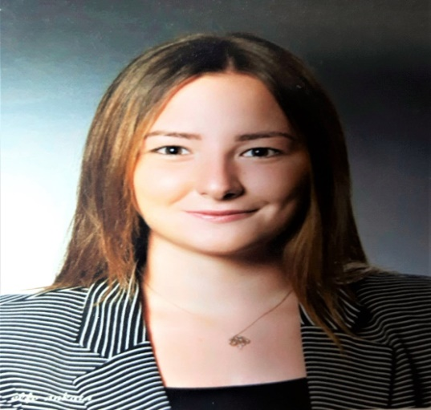
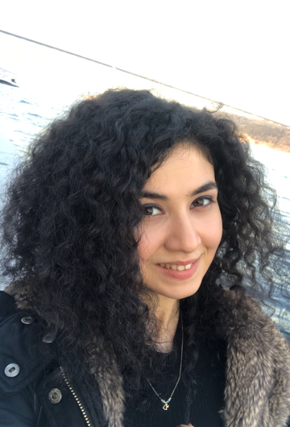
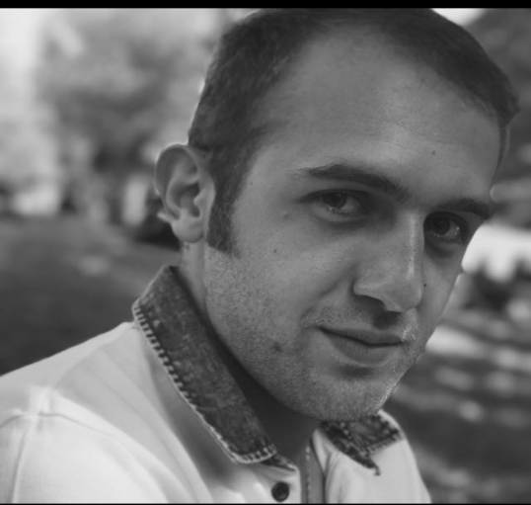
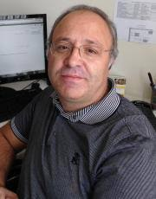
About Us
Bahar Şengez
201511407
Elif Nur Altuntaş
201311003
Alihan Doğuş Yalçın
201611411
Abdül Kadir Görür

Slide 3
CuriousCam
Curious Cam for Video Lecture Recording Environment

Slide 4



Curious Cam for Video Lecture Recording Environment
  Mobile Application
  Microcontroller
  Web Site

Slide 5



Android Application of Curious Cam
  Java
  OpenCV
  FFmpeg

Slide 6
Trade-Off
  CPU vs. Resolution
  Resolution vs. The correctness of detection a face

Slide 7
  Wi-Fi Server
  Database

Slide 8
Wi-Fi Server
Raspberry Pi 3 runs as a wireless access point to control servo motors, according to detected face's X and Y coordinates sent from our android application.

Slide 9
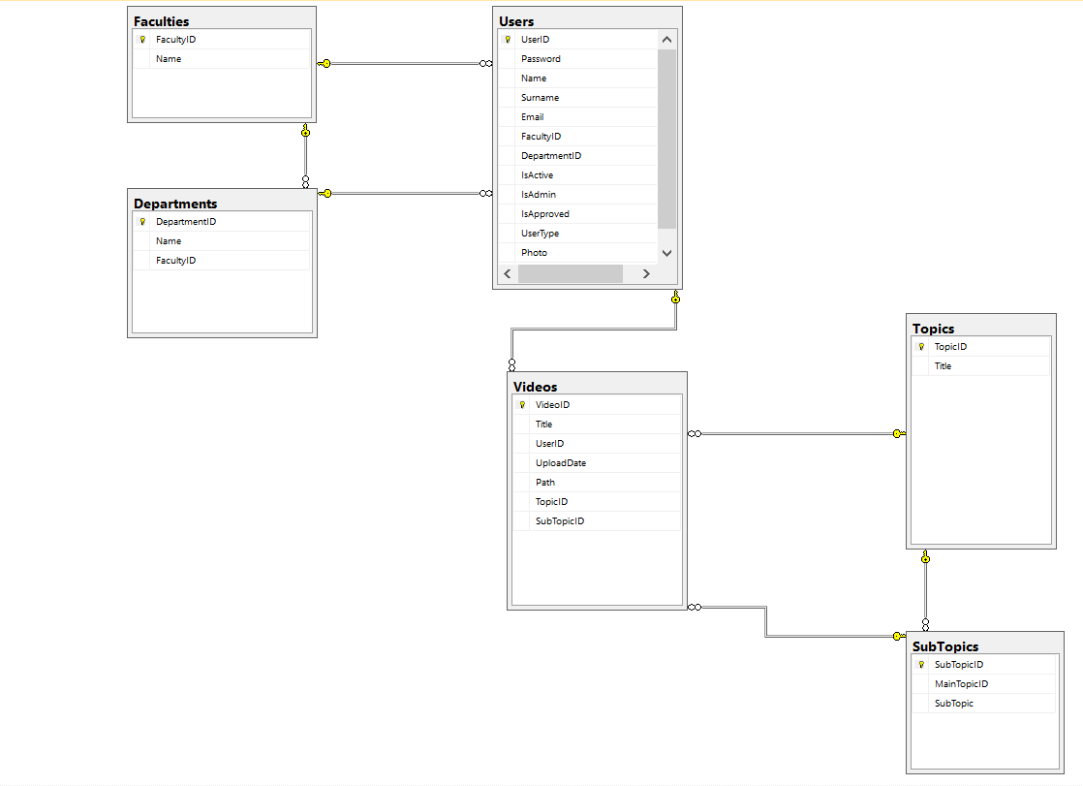
Project Database
Figure : Project Database

Slide 10
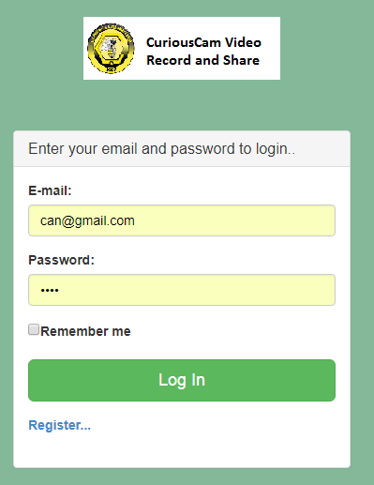
Web Site: Curiouscam.com
CuriousCam.com: A video sharing system for Curiouscam videos.
  Users: instructors, students, university staffs.
  Only instructors can share video.
  Students and university staff can search and watch videos.
  Any user can be assigned as admin of the website.
  Administrator has the full authority of managing the web site: users, videos, etc.
Figure : Login Page

Slide 11
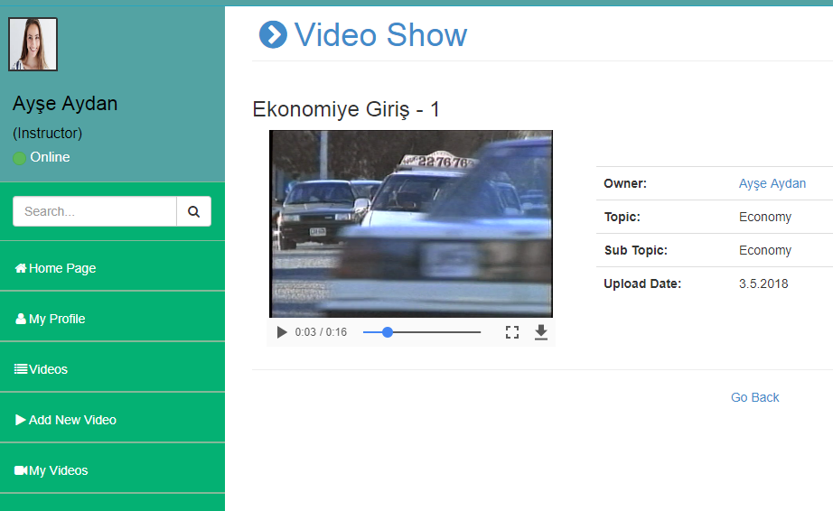
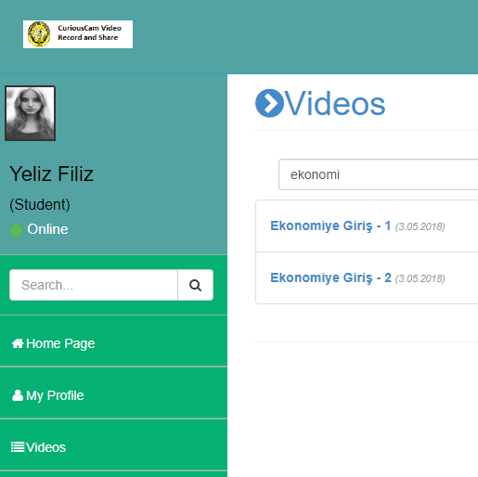
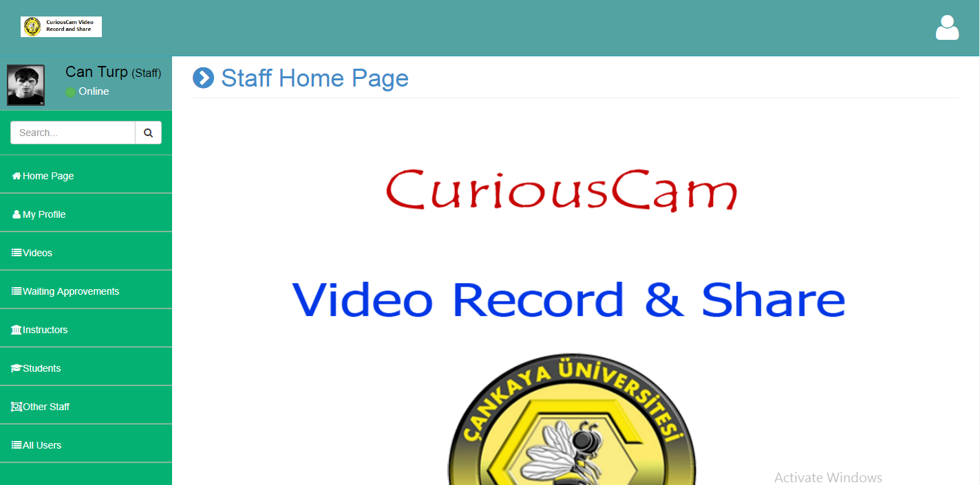
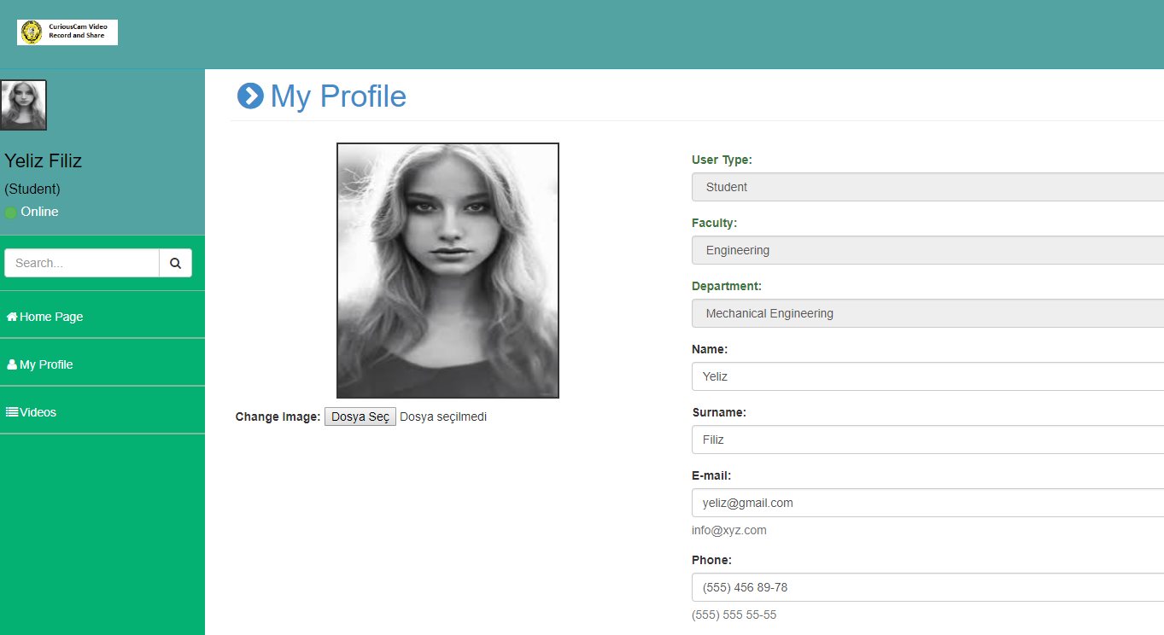
Curiouscam.com: Sample Screens

Slide 12
As a Conclusion …
Curious Cam is complex hardware and software system that integrate various technologies :
  Java, Python, Image Processing, Electronics, Mechanics, Raspberry Pi, Web (ASP.NET in C#, SQL, etc.) …
The project ended up with a rare system capable of recording video by tracking the user without an extra cameraman.
Also, the system has a website to share produced videos.

Slide 13
REFERENCES
[1] https://www.raspberrypi.org/documentation/
[2] https://www.asus.com/us/Single-Board-Computer/Tinker-Board/
[3] http://www.hardkernel.com/main/products/prdt_info.php
[4] http://www.orangepi.org/orangepiplus2/
[5] https://www.mathworks.com/products/matlab.html
[6] http://www.mvtec.com/products/halcon/
[7] http://openframeworks.cc/
[8] http://cimg.eu/
[9] https://fiji.sc/
[10] https://opencv.org/about.html

Slide 14
Thank You For Listening

Slide 15
Questions ?

