Slide 1
Solution
System Components
Class Diagram

Slide 2
Solution System Components
CuriousCam
Profile Manager
Device Manager
Video Recorder
Video Settings Manager
Camera Orientation Controller
User Tracker
File Manager
Video Player

Slide 3


Solution (Cont.) System Components…
Profile Manager
Responsible for managing user personal information: name, surname, instutition, photo, etc.
Device Manager
Enables the user to determine the basic settings of devices plugged to computer.
The user can select and test any camera or microphone installed on the system.

Slide 4


Solution (Cont.) System Components…
Video Recorder
Responsible of capturing and recording video.
The user can start, pause, continue and stop video recording.
Video Recording Settings Manager
Determines the basic properties of the video to be recorded.
Selects video file save location.
Sets video and audio quality.
Customizes video output, putting text or photo on video frame.

Slide 5
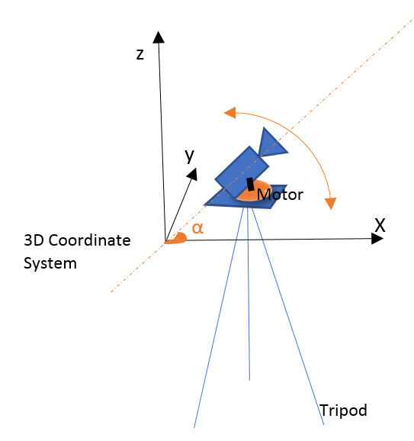
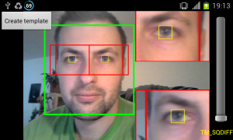
Solution (Cont.) System Components…
Camera Orientation Controller
Responsible of based on Raspberry Pi.
The user can manually change the camera orientation or reset it.
The mouse buttons are to be used to turn camera right and left.
User Tracker
Responsible of tracking user in space.
Provide camera controller with information.
Uses proper image processing methods such as face detection.

Slide 6


Solution (Cont.) System Components…
File Manager
Responsible of managing video files generated by the system.
It has operations of listing and removing video files existing in the “Save” directory.
The user can also see or change the basic information of a video file, including, owner, director, producer, etc.
Video Player
It is the component to display recorded videos.
It encompasses the basic video playing operations, including start, pause, continue, stop, fast forward, back forward.

Slide 7
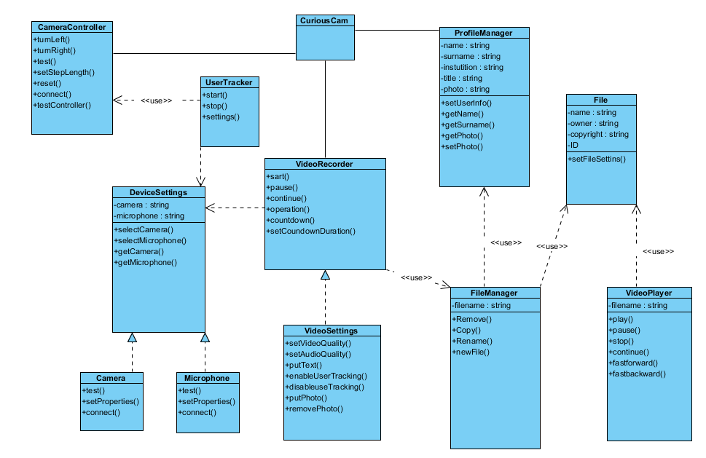
Solution (Cont.) Class Diagram
CuriousCam
ProfileManager
FileManager
File
VideoPlayer
CameraController
UserTracker
DeviceSettings
Camera
Microphone
VideoRecorder
VideoSettings

