Slide 1
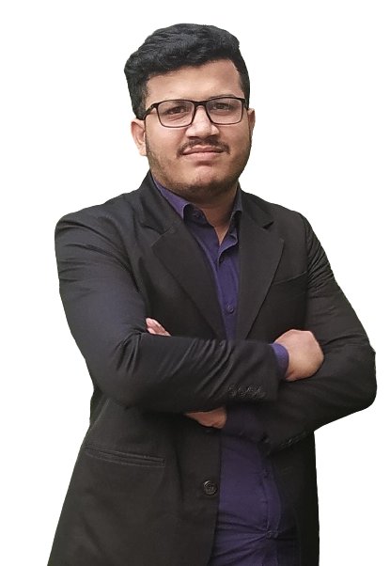
PROFILE
ABOUT
SKILL
PROJECTS
CONTACT
BAHARUL ISLAM
Flutter Developer

Slide 2
PROFILE
ABOUT
SKILL
PROJECTS
CONTACT
BAHARUL ISLAM
I AM A
WITH
FLUTTER & WORDPRESS
2 YEARS
DESIGNER
EXPERIENCE

Slide 3
PROFILE
ABOUT
SKILL
PROJECTS
CONTACT
TECHNICAL SKILL
FLUTTER
70%
WORDPRESS
90%
PREMIARE PRO
65%
POWERPOINT
96%
MS OFFICE
80%

Slide 4

PROFILE
ABOUT
SKILL
PROJECTS
CONTACT
POWERPOINT
FLUTTER
WORDPRESS
PREMIARE PRO
55
15
25
13
PROJECTS
PROJECTS
PROJECTS
PROJECTS

Slide 5





PROFILE
ABOUT
SKILL
PROJECTS
CONTACT
Baharul Reza
Baharul Islam
github.com/Baharul-Islam
+880 1720877114
+880 1630307081

