Slide 1
POT
Prediction markets for your group chat, powered by Panta
Telegram groups turn their arguments into Panta markets, back a side from their phones, and get a receipt when they settle.
Baheet Adeniji
@pantapotbot · pot-navy.vercel.app · github.com/Baheet18/pot
Panta API Sidetrack · Colosseum Crypto World's Fair

Slide 2
POT · powered by Panta
Every group chat says "bet?" Then nothing happens.
Meanwhile, on Panta
"Man U will lose on Saturday."
Real markets on Solana, fair payouts, a creator's cut, and a clean API.
But a market is only fun when your friends are on the other side, and most Panta markets have very little money in them today.
The arguments live in group chats. The markets live on a website.
"BTC hits 150k by December."
"Obi joins ADC before 2027."
Nobody writes it down. Nobody agrees what counts. Nobody holds the money.
Panta API Sidetrack · Colosseum Crypto World's Fair
2

Slide 3
POT · powered by Panta
Four taps from argument to receipt
1
2
3
4
Make it
Create it
Join it
Settle it
Admin types /new and the question. AI writes the YES/NO rule, sources and times (Lagos time).
Admin taps Create and signs in Phantom. They become the Panta creator and earn the creator's cut.
Members tap Buy YES or Buy NO on their phone, or buy from a Blink shared on X.
When the result is in, the bot posts a receipt: who backed which side, stake and payout.
Pot never holds keys or money. Every payment, buy and claim is signed by the user in their own wallet.
Panta API Sidetrack · Colosseum Crypto World's Fair
3

Slide 4
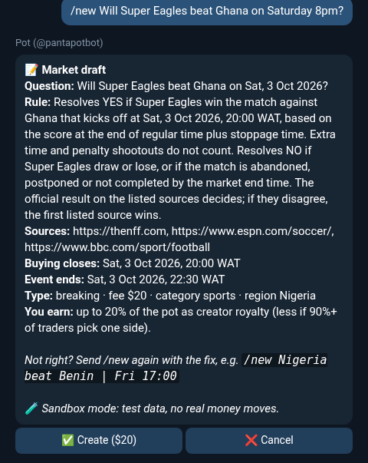
POT · powered by Panta
The AI writes a fair market, and says no to bad ones
Buying closes at kick-off
Checked on the server. If the start time is unknown, Pot asks.
Personal bets get a polite no
"Will Tolu pay me back?" can't be settled by a public source, so Pot suggests one that can.
Big questions get split
"Who wins BBNaija?" becomes a few YES/NO markets the admin picks, because Panta markets are binary.
A /new draft in Telegram (practice mode)
Panta API Sidetrack · Colosseum Crypto World's Fair
4

Slide 5
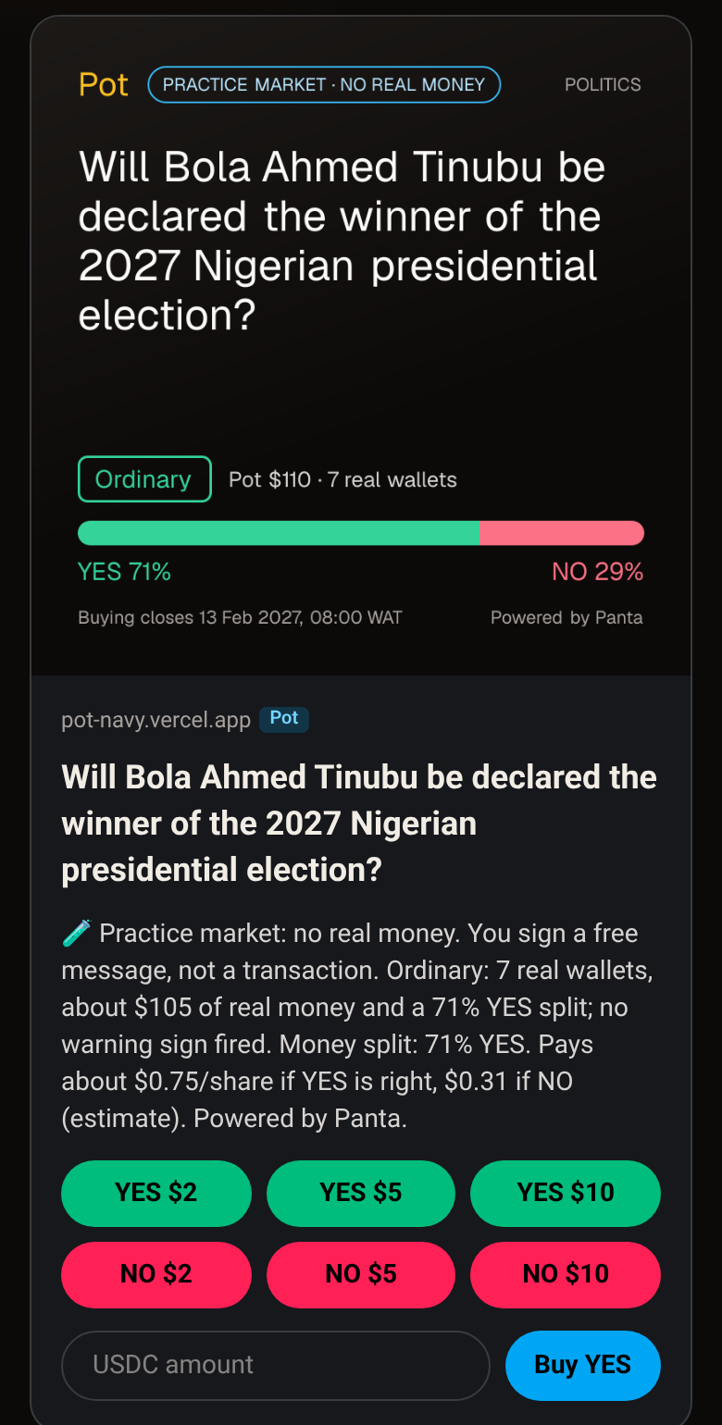
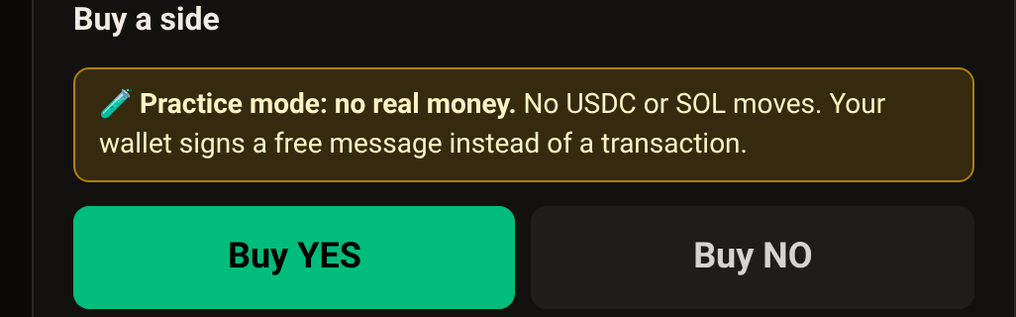
POT · powered by Panta
Buy from the chat, the website, or a post on X
Phantom on the web page. Tap YES or NO, pick $2, $5, $10 or any amount, sign. "Open in Phantom" on mobile.
A Blink on X. Share the market link and Phantom or Backpack users see buy buttons right inside the post. Pot serves its own Solana Actions.
Credit for bringing people. Every buy carries the group's or member's link, which feeds the /top leaderboard.
Blink preview (practice market, demo data)
Panta API Sidetrack · Colosseum Crypto World's Fair
5

Slide 6
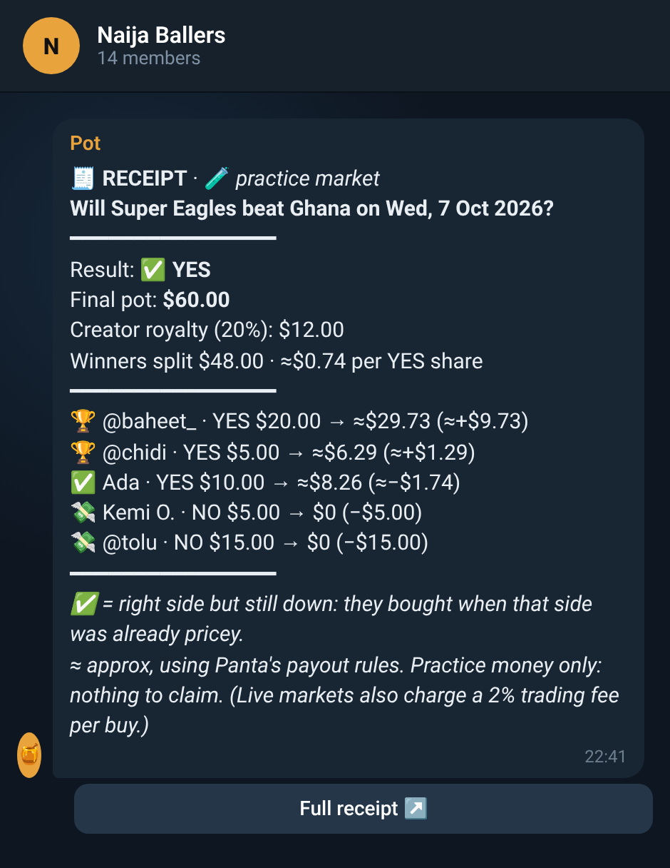
POT · powered by Panta
The receipt is the product
When a market settles, Pot posts one receipt in the group: the result, the final pot, the creator's cut, and every member's side, stake and payout.
It turns "I told you so" into proof people screenshot.
Payout maths follows Panta's rules, marked "approx" until Panta's 1-hour dispute window ends.
One-sided markets get honest wording: nobody won or lost.
Demo receipt from Pot's test group (practice money).
Panta API Sidetrack · Colosseum Crypto World's Fair
6

Slide 7
POT · powered by Panta
Built on Panta's API for the whole life of a market
16
Read | GET /markets/ · /markets/{id}/ · /markets/{id}/trades/ · /positions/ · /wallets/{w}/trades/ · /trades/{sig}/
Buy | primaryorderquote → primaryorderbuild → wallet signs → primaryordersubmit → primaryorderverify → /trades/ (credits the group's link)
Create | markets/create/quote → markets/create/build → admin signs and pays → markets/register
Claim | claim/build (winnings) · claim/creator-fees/build (creator's cut) → /trades/ report
Panta endpoints used, from making a market to claiming the creator's cut
Rate-limited and cached reads. Only allow-listed writes. A second lock blocks every live write until it's switched on.
Panta API Sidetrack · Colosseum Crypto World's Fair
7

Slide 8
POT · powered by Panta
Every Telegram group becomes a Panta venue
Football fan groups
Community owner
earns the creator's cut on every market
POT
PANTA
Crypto trading chats
Members
bot + website + Blinks
markets on Solana
play with friends, from their phones
Campus and church groups
Panta
Influencer communities
new people, local markets, real volume
Pot doesn't compete with Panta's website. It brings people to Panta from where they already spend time.
Panta API Sidetrack · Colosseum Crypto World's Fair
8

Slide 9
POT · powered by Panta
Practice mode today. Live mode is one command away.
 | Practice (running now) | Live (built, switched off)
Money | None. Wallets sign a free message | Real USDC on Solana
Markets | Tracked by Pot with Panta's payout rules | Created on Panta by the admin
Result | Group admin runs /settle yes|no | Panta's own result, then receipt
Checked | Real people, real groups, real phones | Read-only calls to Panta's live API
Practice run with a real community
[N]
practice markets
[N]
people who bought
[N]
buys from a shared link or Blink
Switch: scripts/go-live.sh · Back: scripts/rollback-to-practice.sh
[N]
receipts posted
[GROUP NAME], [MEMBERS] members. Replace before submitting.
Panta API Sidetrack · Colosseum Crypto World's Fair
9

Slide 10
POT · powered by Panta
What's next
1
Go live in one group: the ~$21 smoke test in GO-LIVE.md, then one real market.
2
Bring in 2-3 Nigerian football and crypto communities, then influencer communities.
3
Faster receipts, one-tap match-day markets, and an owner dashboard.
4
WhatsApp communities and Discord servers next. The core isn't tied to Telegram.
Try it: @pantapotbot on Telegram · pot-navy.vercel.app · github.com/Baheet18/pot
Not financial advice. Payouts shown are estimates. Powered by Panta.
Panta API Sidetrack · Colosseum Crypto World's Fair
10

