Slide 1
Neural Network

Slide 2
1-Optimizer in Neural Network
An optimizer is a crucial element that fine-tunes a neural network’s parameters during training.
It is a function or an algorithm that adjusts the attributes of the neural network, such as weights and learning rates.
It helps in reducing the overall loss and improving accuracy.

Slide 3
Cont…
RMS Prop (Root Mean Square):
It resolves the problem of varying gradients.
The problem with the gradients is that some of them were small while others may be huge.
RMS uses the gradient sign, adapting the step size individually for each weight.
In this algorithm, the two gradients are first compared for signs.
If they have the same sign, increasing the step size by a small fraction.
If they have opposite signs, we must decrease the step size.
Then we limit the step size and can now go for the weight update.

Slide 4
2-Loss Function in Neural Network
Measures how good a neural network model is in performing a certain task, which in most cases is regression or classification.
We must minimize the value of the loss function during the backpropagation step in order to make the neural network better.
We only use the cross-entropy loss function in classification tasks when we want the neural network to predict probabilities.
For regression tasks, when we want the network to predict continuous numbers, we must use the mean squared error loss function.

Slide 5
Cont…
It have 3 types :
Mean Squared Error Loss Function
Cross-Entropy Loss Function
Mean Absolute Percentage Error

Slide 6
Cont…
Mean Squared Error Loss Function
It is the sum of squared differences between the entries in the prediction vector y and the ground truth vector y_hat.
The mean squared error loss function is the perfect loss function if you're dealing with a regression problem.

Slide 7
Cont…
Cross-Entropy Loss Function
It is a loss function that can measure the error between a predicted probability and the label which represents the actual class.

Slide 8
Cont…
Mean Absolute Percentage Error
We use it to measure the performance of a neural network during demand forecasting tasks.
Demand forecasting is the area of predictive analytics dedicated to predicting the expected demand for a good or service in the near future.

Slide 9
3-Metrics
Evaluation metrics are quantitative measures used to assess the performance and effectiveness of a statistical or machine learning model.
These metrics provide insights into how well the model is performing and help in comparing different models or algorithms.

Slide 10
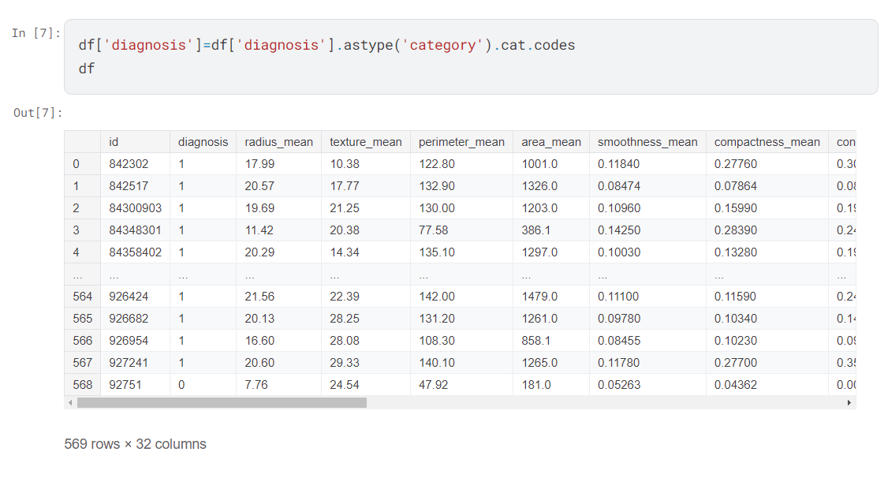
Way to encode data in dataset :

