Slide 1
BCA
Principal Component Analysis

Slide 2
PCA
Comes under the Unsupervised Machine Learning category.
Reducing the number of variables in a data collection while retaining as much information as feasible is the main goal of PCA.
Principal component analysis in machine learning can be mainly used for Dimensionality Reduction and also for important feature selection.
Correlated features to Independent features.

Slide 3
PCA
The principal components are vectors, but they are not chosen at random.
The first principal component is computed so that it explains the greatest amount of variance in the original features.
The second component is orthogonal to the first, and it explains the greatest amount of variance left after the first principal component.

Slide 4
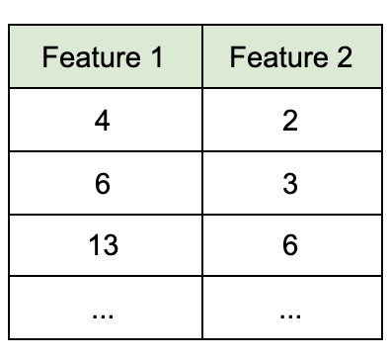
Example:
Imagine we have a 2-dimensional dataset.
Each dimension can be represented as a feature column:

Slide 5
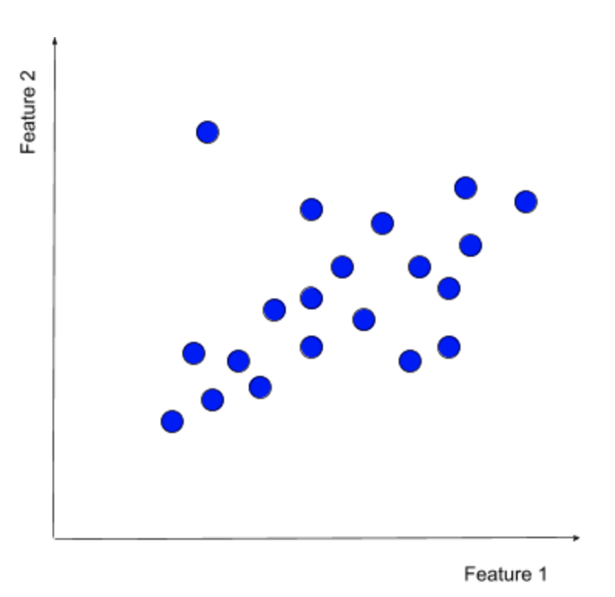
Example:
We can represent the same dataset as a scatterplot:

Slide 6
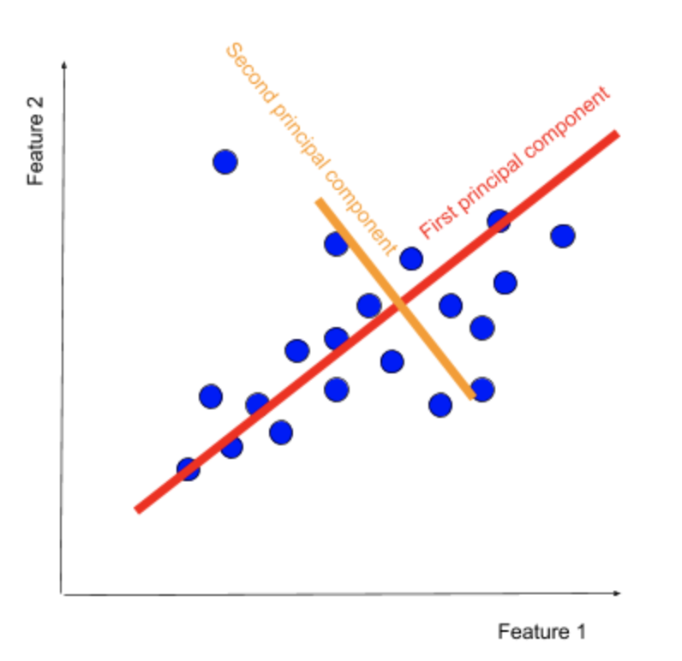
Example
The main aim of PCA is to find such principal components, which can describe the data points with a set of features well, principal components.

Slide 7
PCA
In very large datasets (where the number of dimensions can surpass 100 different variables), principal components remove noise by reducing a large number of features to just a couple of principal components.
In theory, PCA produces the same number of principal components as there are features in the training dataset.
In practice, though, we do not keep all of the principal components.
Each successive principal component explains the variance that is left after its preceding component, so picking just a few of the first components sufficiently approximates the original dataset without the need for additional features.

Slide 8
What is PCA used for?
PCA is used across a variety of use cases:
Visualize multidimensional data:
Data visualizations are a great tool for communicating multidimensional data as 2- or 3-dimensional plots.
Compress information:
Principal Component Analysis is used to compress information to store and transmit data more efficiently.
Simplify complex business decisions:
PCA has been employed to simplify traditionally complex business decisions. For example, traders use over 300 financial instruments to manage portfolios.
The algorithm has proven successful in the risk management of interest rate derivative portfolios, lowering the number of financial instruments from more than 300 to just 3-4 principal components.
Clarify convoluted scientific processes:
The algorithm has been applied extensively in the understanding of convoluted and multidirectional factors, which increase the probability of neural ensembles to trigger action potentials.

Slide 9
What is PCA used for?
When PCA is used as part of preprocessing, the algorithm is applied to:
Reduce the number of dimensions in the training dataset.
De-noise the data

Slide 10
How is PCA calculated?
There are multiple ways to calculate PCA:
Eigen decomposition of the covariance matrix
Singular value decomposition of the data matrix
Eigenvalue approximation via power iterative computation
Non-linear iterative partial least squares (NIPALS) computation
… and more.

Slide 11
Eigen decomposition of the covariance matrix:
The steps to compute PCA:
Feature standardization:
We standardize each feature to have a mean of 0 and a variance of 1.
Obtain the covariance matrix computation:
The covariance matrix is a square matrix, of d x d dimensions. It shows the pairwise feature correlation between each feature.
Calculate the eigen decomposition of the covariance matrix:
We calculate the eigenvectors (unit vectors) and their associated eigenvalues (scalars by which we multiply the eigenvector) of the covariance matrix.
Sort the eigenvectors from the highest eigenvalue to the lowest.
Select the number of principal components:
Select the top N eigenvectors (based on their eigenvalues) to become the N principal components.

Slide 12
Advantages of pca
Easy to compute:
PCA is based on linear algebra, which is computationally easy to solve by computers.
Speeds up other machine learning algorithms:
Machine learning algorithms converge faster when trained on principal components instead of the original dataset.
Counteracts the issues of high-dimensional data:
High-dimensional data causes regression-based algorithms to overfit easily. By using PCA beforehand to lower the dimensions of the training dataset, we prevent the predictive algorithms from overfitting.

Slide 13
disadvantages of pca
Low interpretability of principal components:
Principal components are linear combinations of the features from the original data, but they are not as easy to interpret.
The trade-off between information loss and dimensionality reduction
Although dimensionality reduction is useful, it comes at a cost. Information loss is a necessary part of PCA. Balancing the trade-off between dimensionality reduction and information loss is unfortunately a necessary compromise that we have to make when using PCA.

