Slide 1

International Bioinformatics Workshop on Molecular Epidemiology and Phylodynamics
Instructors:
Justin Bahl: justin.bahl@uga.edu
Lambodhar Damodaran: Lambodhar.Damodaran@uga.edu

Slide 2
Intros
Justin Bahl, PhD.
Associate Professor, University of Georgia
Center for Ecology of Infectious Diseases
Infectious Disease
Epidemiology and Biostatistics
Bioinformatics
PhD Molecular evolution and systematics, University of Hong Kong
Post-Doc Molecular Epidemiology (Yi Guan, HKU)
Post-Doc Infectious Disease Dynamics (Gavin Smith, Duke-NUS)

Slide 3
Intros
Lambodhar Damodaran (Lambo)
PhD student in BAHL lab, University of Georgia
Bioinformatics
Molecular Systematics and Infectious disease phylodynamics
Undergrad. Bioinformatics, University of North Carolina Charlotte

Slide 4
Course Overview
Goal of this workshop
Introduce theory and tools of molecular epidemiology
How to you analyze pathogen genetic data to answer epidemiological questions?
You will be able to identify questions that can be answered with pathogen genetic data
You will be introduced to BEAST

Slide 5
Survey -
Introduce yourself!
Mac or PC?
Has anyone made a phylogenetic tree?
Have you done a molecular epi study?
Do you have a question that you’d like to know how to answer?
Do you have data?
Is there a tool, method or approach that you’d like to learn?

Slide 6
Schedule – Day 1
Topic 1: Course overview
What is Molecular Epidemiology?
Topic 2: What is a phylogenetic tree/Study Design
Topic 3: Molecular Epidemiology for public health
Discussion: Project topics, study design and data sources, install software

Slide 7
Day 2: The analytical pipeline - Practical
Topic 1: Databases
Topic 2: Multiple Sequence Alignments and Data Management
Topic 3: Descriptive Stats
Practical: build datasets and run through analytical pipeline, extract descriptive statistics

Slide 8
Day 3: Ecological and Epidemiological Inference from Phylogenetic Trees
Topic 1: Intro to Statistical Phylogenetics
Topic 2: Intro to BEAST
Project Day – Review pipeline and datasets, define testable hypothesis

Slide 9
Day 4: Building Evolutionary Trees and Hypothesis testing using BEAST
Topic 1: Statistical Phylogenetics
Topic 2: Phylogeography and Ancestral Trait Reconstruction
Practical: Run discrete state analysis, compute concensus tree, annotate

Slide 10
Day 5: Topic Recap

Slide 11
Introduction to molecular epidemiology

Slide 12
What is molecular epidemiology?

Slide 13
Etymology
epi (upon) + demos (people) + logos (study)
Epidemiology
“the study of what is upon the people”

Slide 14
Epidemiology defined
Epidemiology is the scientific study of the distribution and determinants of health-related states or events in human populations, and the application of this study to the prevention and control health problems.

Slide 15
Epidemiology defined - outcomes
Epidemiology is the scientific study of the distribution and determinants of health-related states or events in human populations, and the application of this study to the prevention and control health problems.
Epidemiological studies rely heavily on surveillance data
Molecular surveillance of disease to measure geographical and temporal distribution of disease and risk factors. Characterizing the evolution of pathogens and classification of new pathogen threats

Slide 16
What is molecular epidemiology
Molecular epidemiology is a branch of epidemiology developed by merging molecular biology into epidemiological studies.
Molecular epidemiology studies identify infectious diseases’ causation and pathogenesis, and unravel infectious agents’ sources, reservoirs, circulation pattern, transmission pattern, transmission probability, and transmission order.

Slide 17
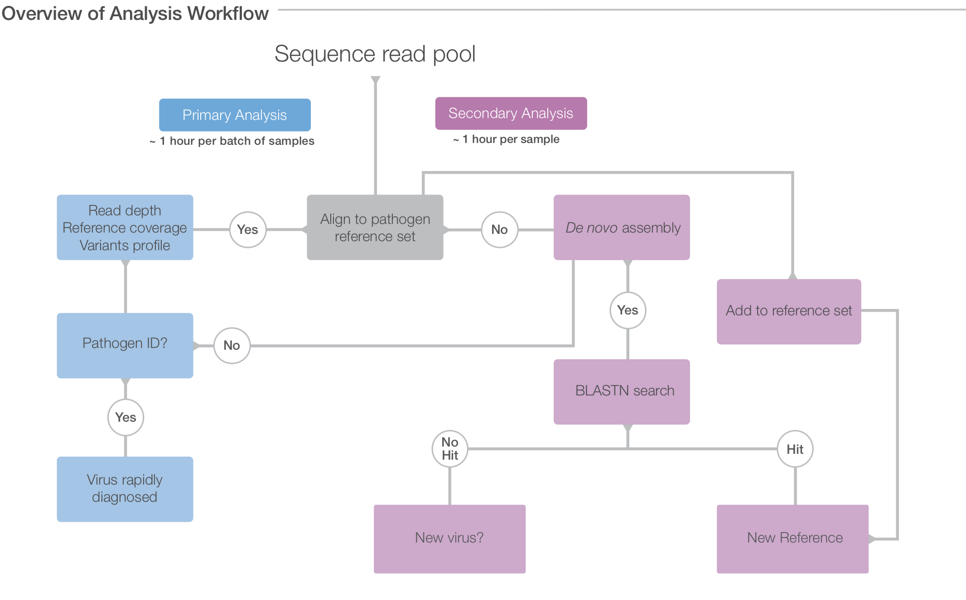

Slide 18
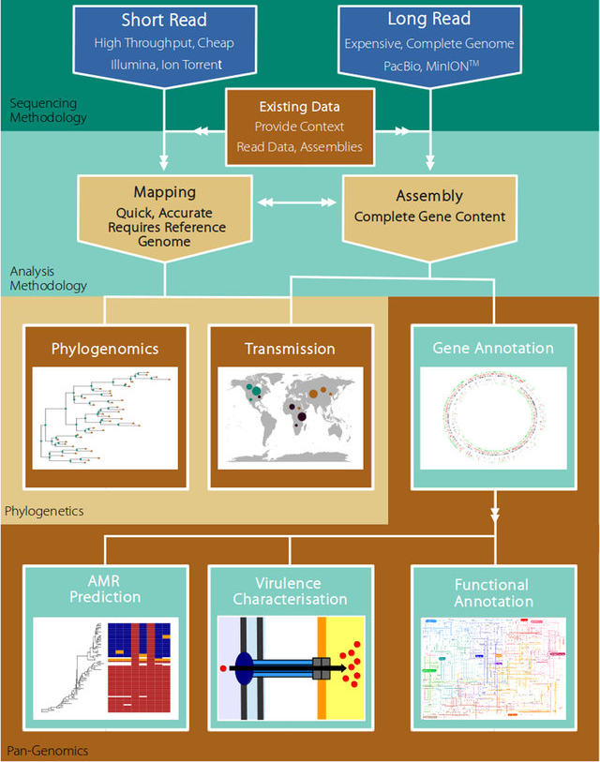

Slide 19
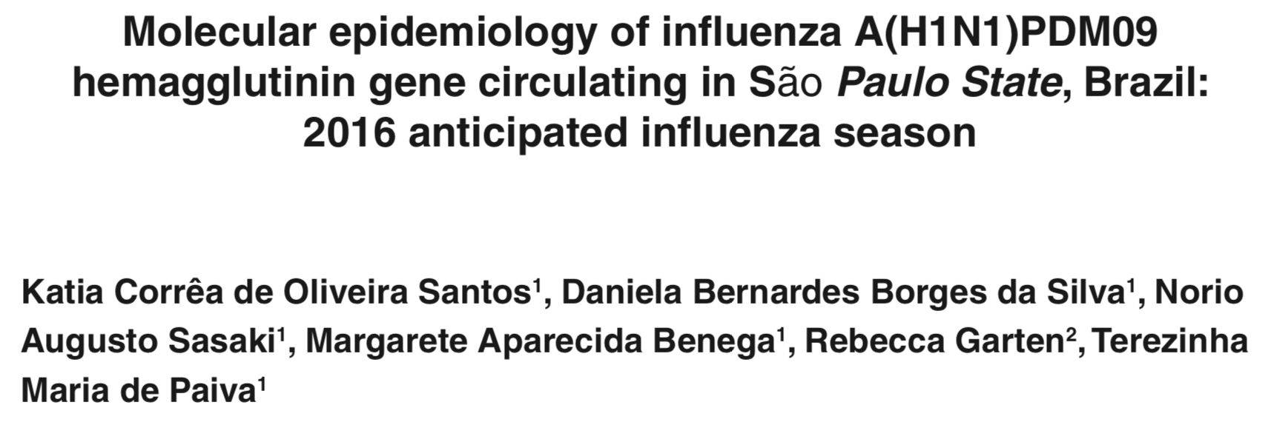
Investigate the genetic pattern of influenza A(H1N1)pdm09 in the State of Sao Paulo

Slide 20
