Slide 1
What is a phylogenetic tree?
Justin Bahl

Slide 2
Evolutionary processes give rise to diversity
There are four basic mechanisms by which biological evolution takes place. These include mutation, migration, genetic drift, and natural selection.

Slide 3
Evolutionary processes give rise to diversity
There are four basic mechanisms by which biological evolution takes place. These include mutation, migration, genetic drift, and natural selection.
When we sequence a population of viruses we are observing genetic diversity resulting from those processes

Slide 4
Wikipedia
A phylogenetic tree or evolutionary tree is a branching diagram or "tree" showing the inferred evolutionary relationships among various biological species or other entities based upon similarities and differences in their physical and/or genetic characteristics.

Slide 5
A phylogenetic tree is
is an evolutionary hypothesis showing the history and relationships (common descent) of the observed (genetic) diversity

Slide 6
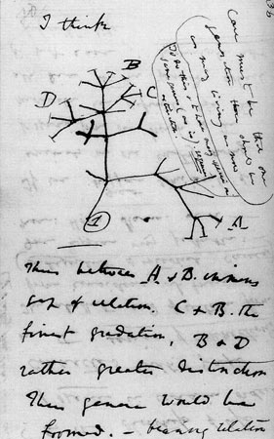
Ecology, Evolution and Epidemiology of Influenza A virus
Darwin and Wallace formulate a theory of evolution by common descent
1859 Darwin publishes The Origin of Species
Modern Synthesis (1920-40)

Slide 7
Ecology, Evolution and Epidemiology of Influenza A virus
Modern Synthesis (1920-40) establishes natural selection as the central tenet of evolutionary biology
Natural selection acts on populations
1950-80 Discovery of DNA, Molecular clock hypothesis, neutral theory of evolution, comparative genetics
Gene is the unit of evolution
Darwin and Wallace formulate a theory of evolution by common descent
1859 Darwin publishes The Origin of Species
Modern Synthesis (1920-40)

Slide 8
Ecology, Evolution and Epidemiology of Influenza A virus
Ecology proposes mechanisms for genetic variation between populations
Epidemiology studies the patterns, causes and effects of disease on populations
An ecological study is an epidemiological study in which the unit of analysis is a population rather than an individual
Darwin and Wallace formulate a theory of evolution by common descent
1859 Darwin publishes The Origin of Species
Modern Synthesis (1920-40)

Slide 9
Ecology, Evolution and Epidemiology of Influenza A virus
LAST TEN YEARS….
Lots of sequence data
Increased computational power
Theoretical and analytical advances
2004 – Phylodynamics: describe how pathogen genetic variation is affected by host immunity, spatial transmission and epidemic dynamics
Darwin and Wallace formulate a theory of evolution by common descent
1859 Darwin publishes The Origin of Species
Modern Synthesis (1920-40)

Slide 10
Our Toy Tree

Slide 11
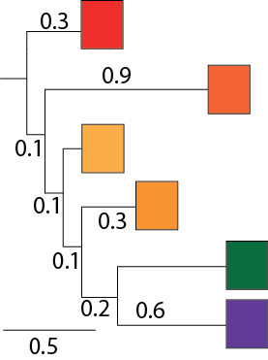
Dimensions

Slide 12
Dimensions
Vertical dimension has no meaning

Slide 13
Dimensions
Vertical dimension has no meaning
Horizontal dimension gives the amount of genetic change
Horizontal lines show evolutionary changes in lineages over time (i.e. branch lengths are informative)

Slide 14
Dimensions
Vertical dimension has no meaning
Horizontal dimension gives the amount of genetic change
Horizontal lines show evolutionary changes in lineages over time (i.e. branch lengths are informative)
Scale bar shows the length of branch equivalent to
0.5 nucleotide substitutions/site

Slide 15
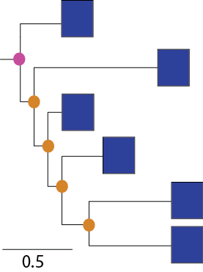
Structure

Slide 16
Structure
Tip/Taxon/Virus/Leave
-Sequenced Viruses
-we also know date and
location of isolation,
host and clinical features

Slide 17
Structure
Tip/Taxon/Virus/Leave
-Sequenced Viruses
-we also know date and
location of isolation,
host and clinical features
Internal Node
Putative common Ancestor

Slide 18
Structure
Tip/Taxon/Virus/Leave
-Sequenced Viruses
-we also know date and
location of isolation,
host and clinical features
Internal Node
Putative common Ancestor
Root – provides an order for sequence of events leading to observation (sequenced
virus)

Slide 19
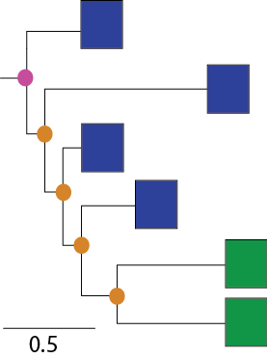
Terminology
Monophyletic group
(Clade) = all members share common
ancestry

Slide 20
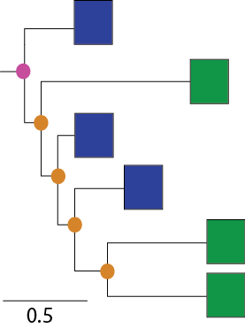
Terminology
Paraphyletic = a group of organisms descended from a common ancestor, but not including all the descendant groups

Slide 21
Tree topology
is the product of historical processes

Slide 22
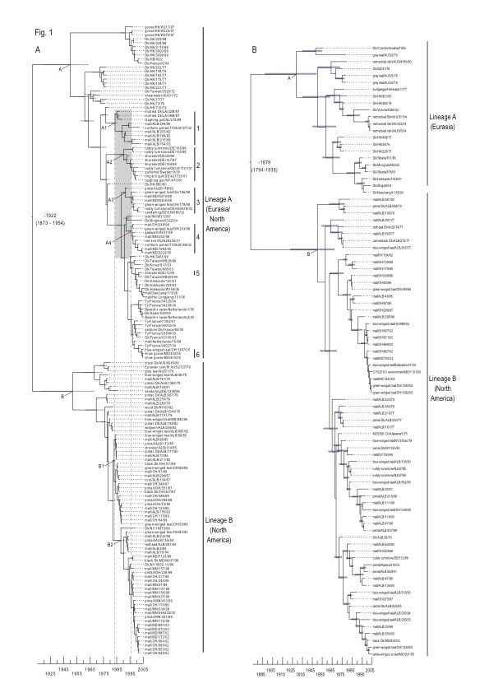
Tree topology
is the product of historical processes
Phylogenetic clustering is due to geographical and ecological separation of wild bird hosts in North America and Eurasia

Slide 23
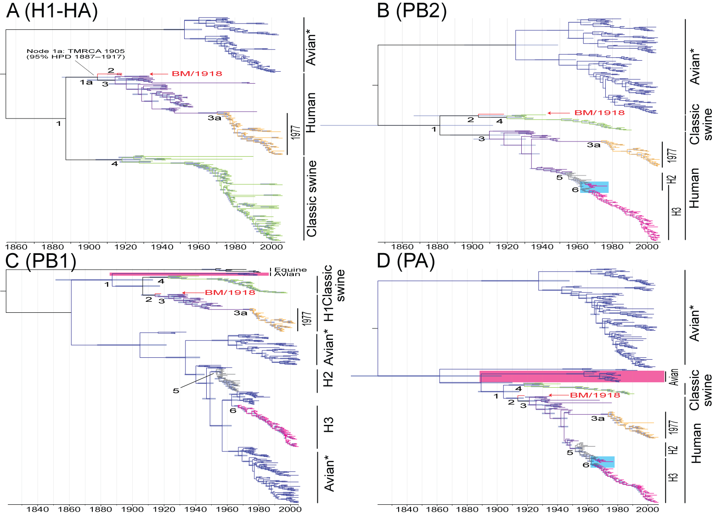
Tree topology
is the product of historical processes
Emergence of host specific lineages that persist over time (pandemic and seasonal influenza) are monophyletic

Slide 24
Rapid Viral Evolution
The phylogenetic signal of mutation, migration, selection, genetic drift are carried in the gene sequences

Slide 25
Rapid Viral Evolution
The phylogenetic signal of mutation, migration, selection, genetic drift are carried in the gene sequences
We can make inference of past events based on branching patterns and branch lengths

Slide 26
Geographic movement
Wang, et al. J Virol. (2008). 82: 3405-14

Slide 27
Geographic movement
Wang, et al. J Virol. (2008). 82: 3405-14

Slide 28
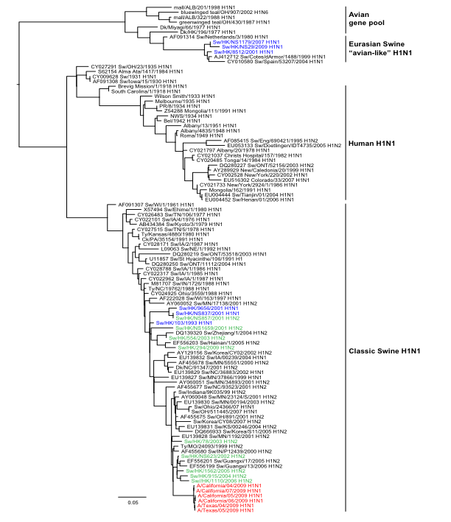
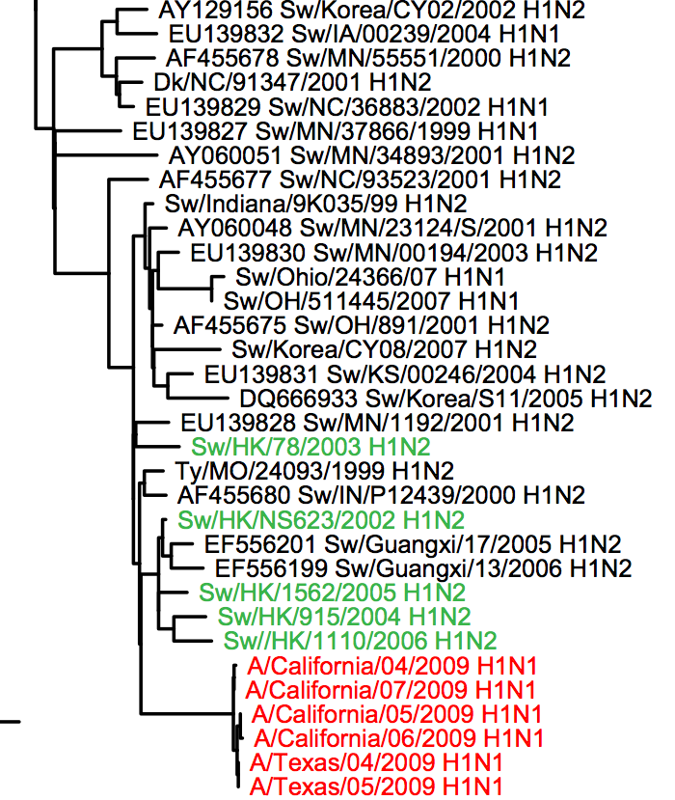
Interspecies transmission

Slide 29
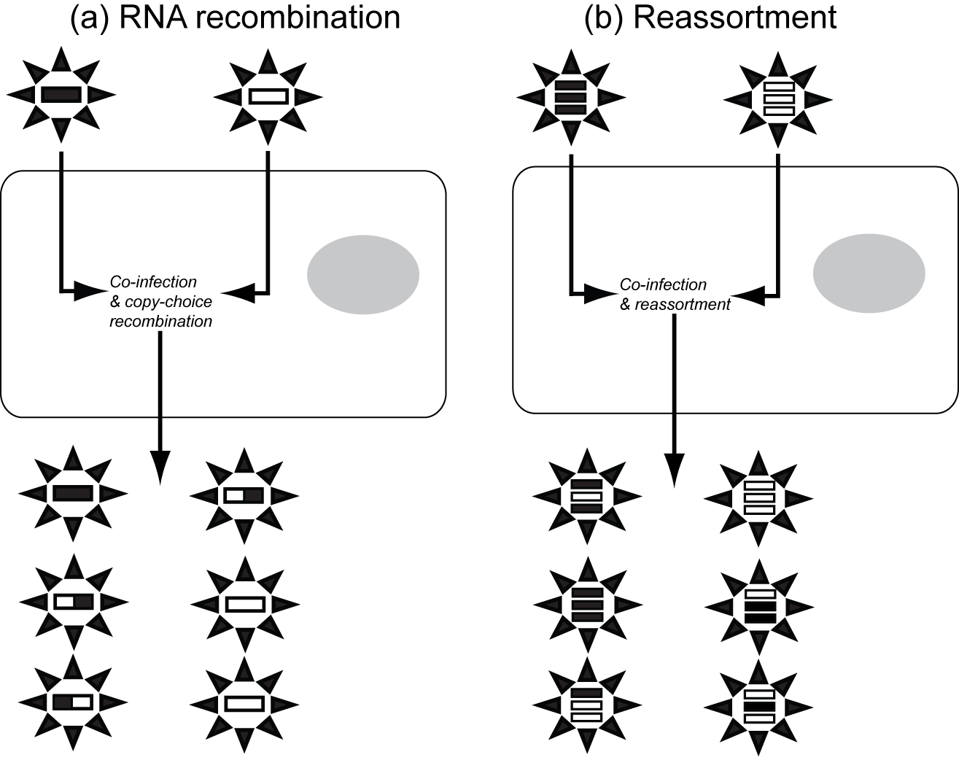
Courtesy of Eddie Holmes

Slide 30
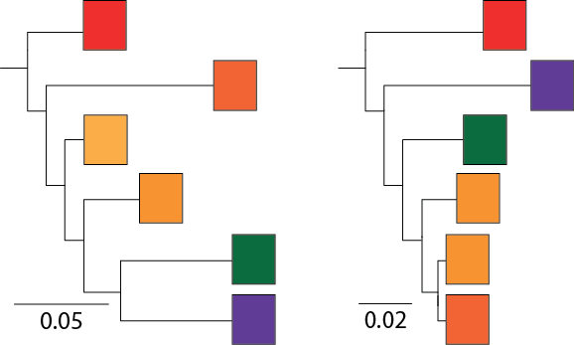
Reassortment and gene tree discordance

Slide 31
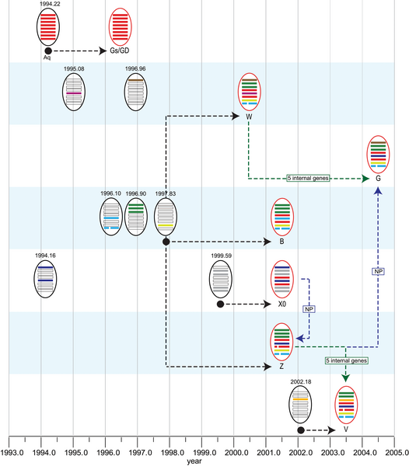
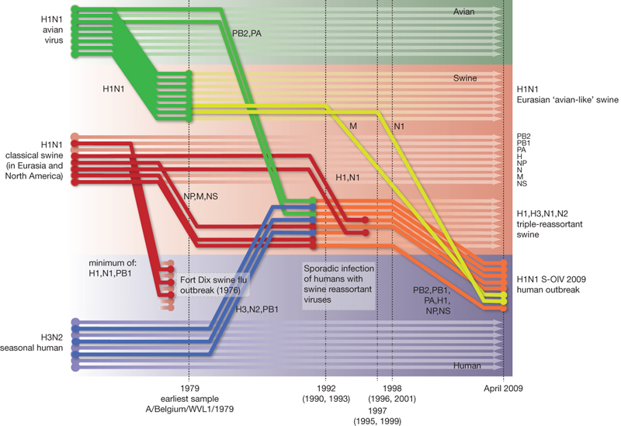
Reconstruction of reassortment events and gene flow between populations
Reassortment history of panzootic H5N1
Emergence of pandemic H1N1/09

Slide 32
A phylogenetic tree is
a diagram showing common ancestry based upon similarities and differences

Slide 33
A phylogenetic tree is
a diagram showing common ancestry based upon similarities and differences
Evolutionary processes give rise to diversity

Slide 34
A phylogenetic tree is
a diagram showing common ancestry based upon similarities and differences
Evolutionary processes give rise to diversity
The branching patterns and branch lengths are the result of evolutionary processes

Slide 35
Ecological, Epidemiological and Evolutionary Inference
A phylogenetic tree is an estimate of the evolutionary history showing possible ecological bottlenecks, transmission history and host shifts that most likely explains the observed genetic diversity of the viruses isolated

Slide 36
Phylodynamics
Viral phylodynamics is the study of how epidemiological, immunological, and evolutionary processes act and potentially interact to shape viral phylogenies.

