Slide 1
Fundamentals of viral molecular evolution
Justin Bahl

Slide 2
a simple phylogenetic analyses work flow!
Think of a biological question to ask!
Choose set of related sequences
Multiple sequence alignment
Apply evolutionary model
Build phylogenetic tree (Yaaay!)
Infer phylogeny and write a paper!

Slide 3

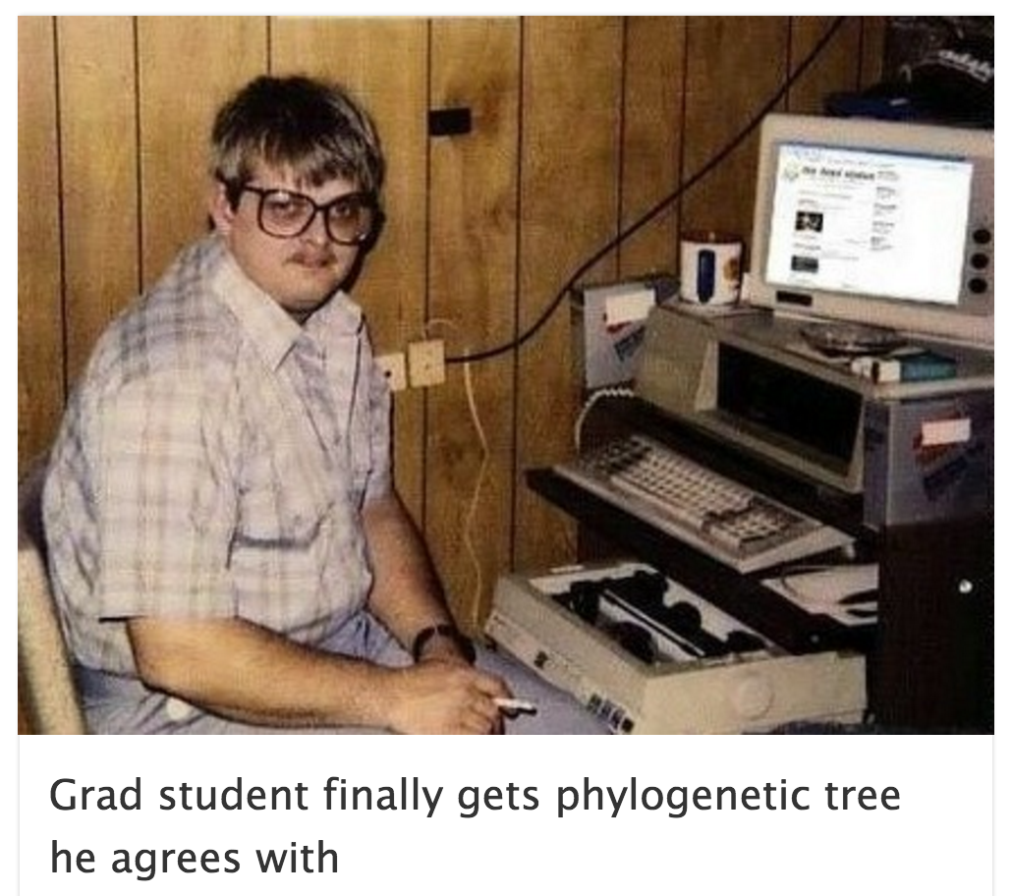
Process is time consuming
Difficult to assess uncertainty
The software is not easy to use

Slide 4
Multiple Sequence Alignments (MSA)
Why carry out MSA?
Basic principles of sequence alignments
Software that automates these algorithms
Uses of MSA
Pairwise and multiple sequence alignments
Tools

Slide 5
Uses of MSA
Prediction of structural similarities in unknown proteins based on known proteins in the alignment
Searches for sequences for an unknown genome, e.g. for the design of a specific probe
Contig assembly
Identify residues important for function (Molecular characterization)
Phylogenetic inference
If the MSA is incorrect, all the above inferences will be incorrect

Slide 6
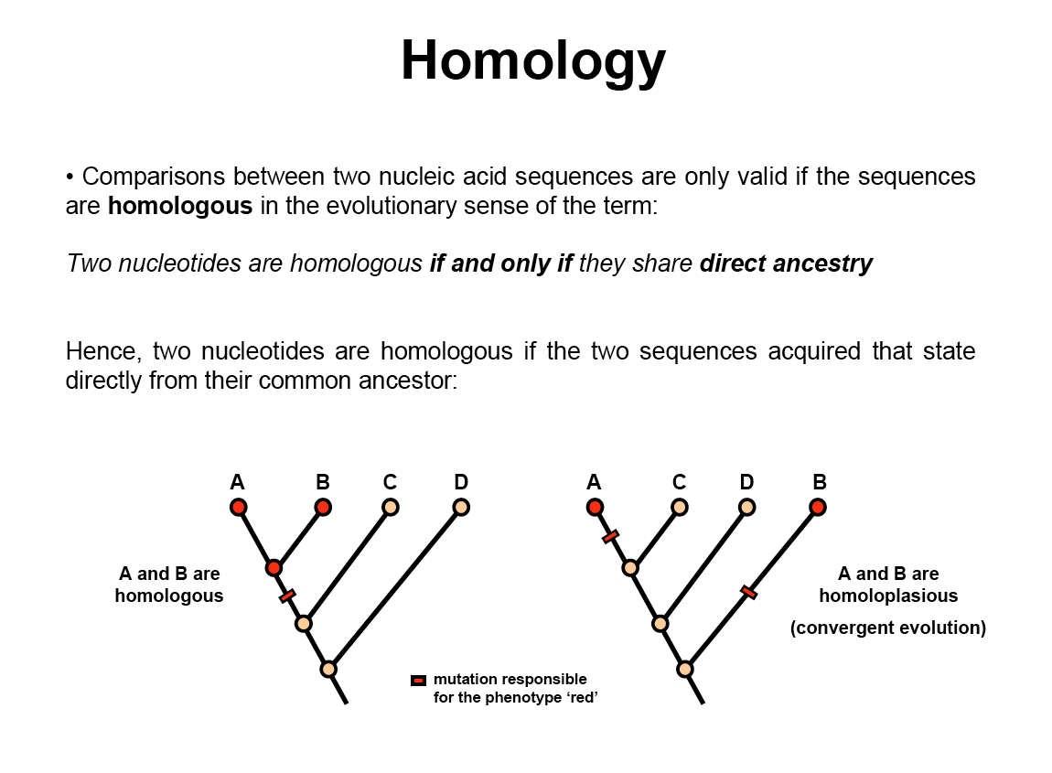
Dr. Stéphane Hué
UCL, London

Slide 7
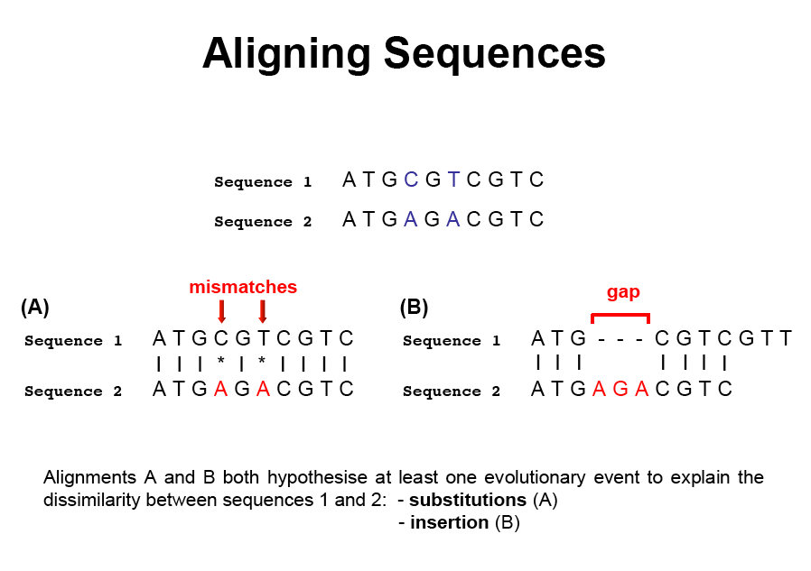
Dr. Stéphane Hué
UCL, London

Slide 8
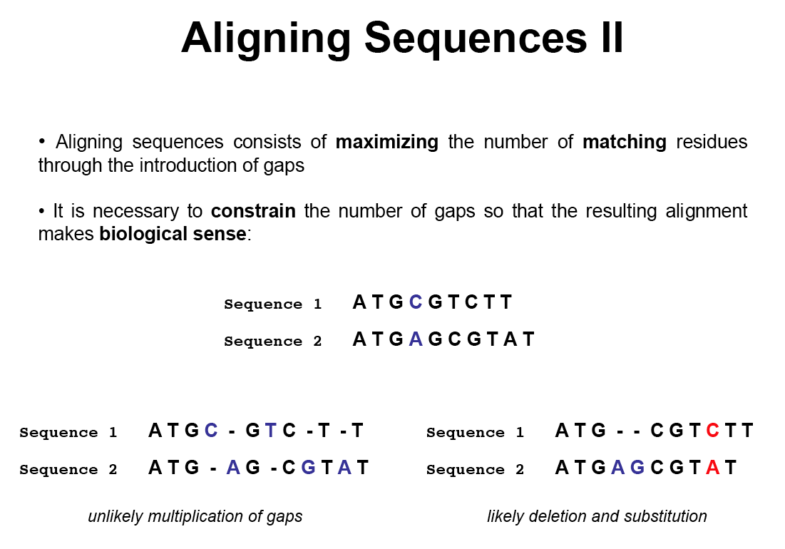
Dr. Stéphane Hué
UCL, London

Slide 9
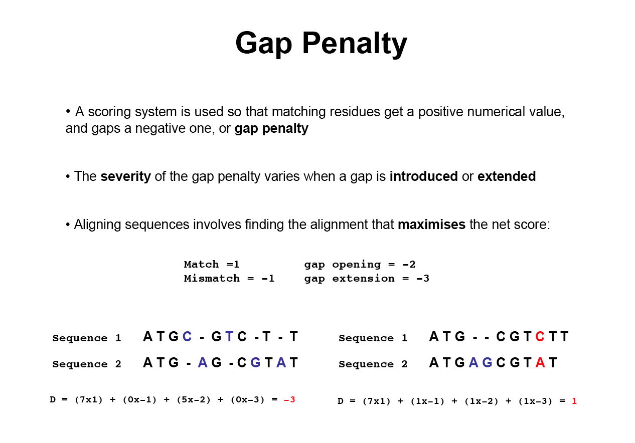
Dr. Stéphane Hué
UCL, London

Slide 10
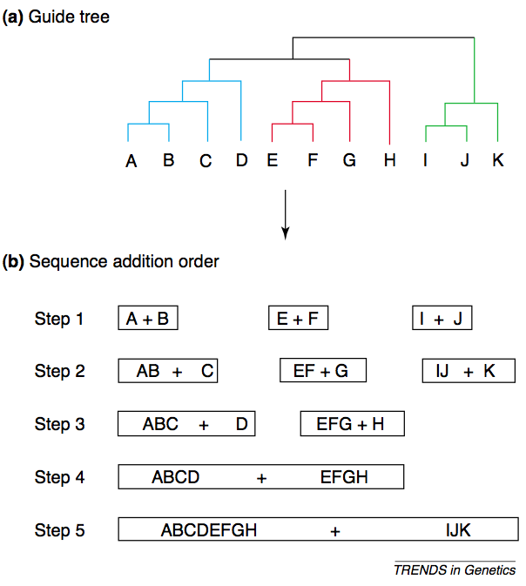
Clustal W
Based on phylogenetic tree
A phylogenetic tree is created using a pairwise distance matrix and nearest-neighbor algorithm
The most closely related pair of sequences are aligned using dynamic programming
Each alignment is analyzed and a profile of it is created.
Each of these profiles are then created to create a MSA
“W” in ClustalW - weighing of sequences based on how far it is from the root
Thompson, J.D., Higgins, D.G. and Gibson, T.J. (1994). CLUSTAL W: improving the sensitivity of progressive multiple sequence alignment through sequence weighting, positions-specific gap penalties and weight matrix choice. Nucleic Acids Research, 22:4673-4680.

Slide 11
Clustal W
The Guide tree is included as part of the alignment output, but only to show the user how the alignment was assembled.
Do NOT use it!
ftp://ftp-igbmc.u-strasbg.fr/pub/ClustalX/
Built into BIOEDIT

Slide 12


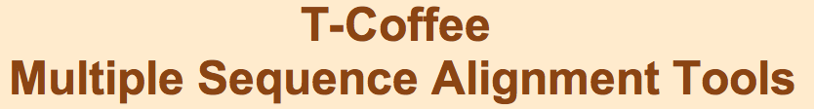
Other popular MSA software

Slide 13
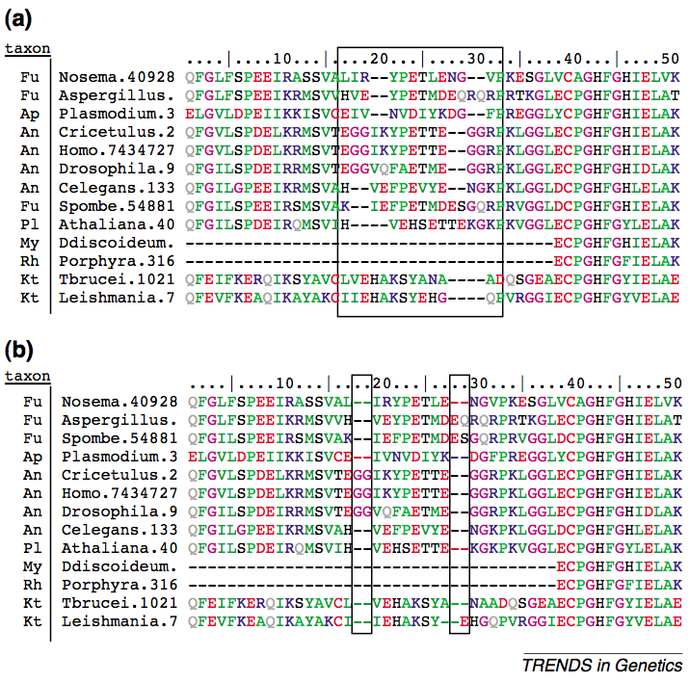
Manual optimization
Essential to check and manually improve computer-generated alignments
Recommended for short or conserved datasets
Can be time consuming, but most robust
Distantly related sequences are easier to translate to AA and then back translate.

Slide 14
Evolutionary models

Slide 15
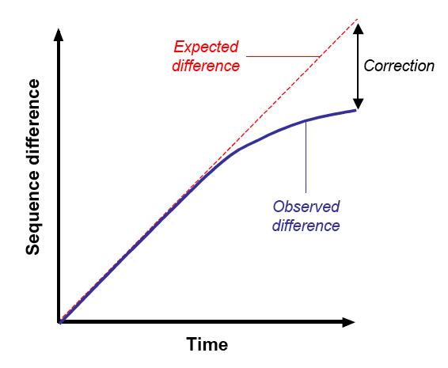
Saturation and distance correction
As substitutions are accumulated between two sequences, they become saturated: most of the changing sites have changed before
The observed differences between two sequences is not linear with time, due to multiple substitutions
Observed genetic differences need to be ‘corrected’ to recover the changes overprinted by multiple hits
Page and Holmes. 2001

Slide 16
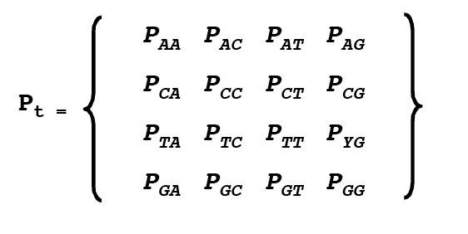
Models of evolution
Several probabilistic models of evolution have been developed to convert observed distances into measures of actual evolutionary distances
The relative complexity of these models is a function of the extent of the biological, biochemical ad evolutionary assumptions (i.e. parameters) they incorporate
Substitutions are usually described as probabilities of mutational events, mathematically modelled by matrices of relative rates:

Slide 17
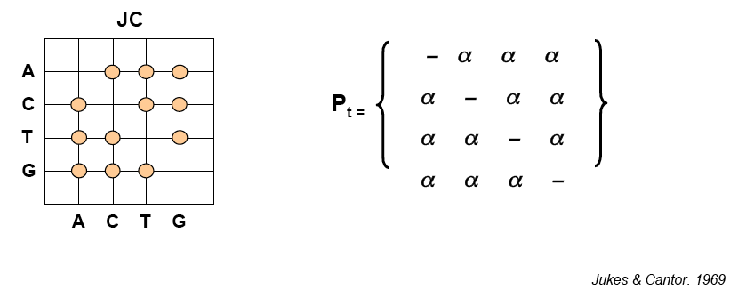
Jukes-Cantor (JC)
First proposed model
It assumes that the four bases have equal frequencies and all substitutions are equally likely

Slide 18
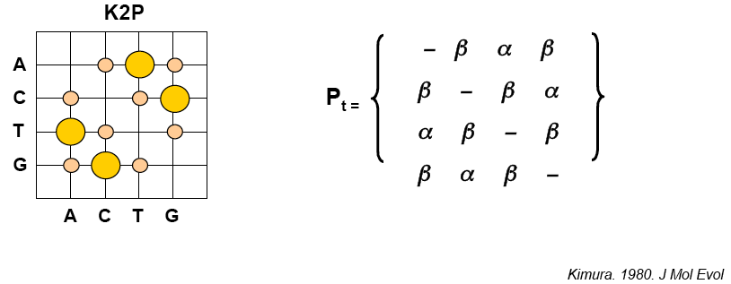
Kimura’s 2 parameter
Transitions are generally more frequent than transversions
K2P model assumes that the rate of transitions per site (α) differs from the rate of transversions per site (β)

Slide 19
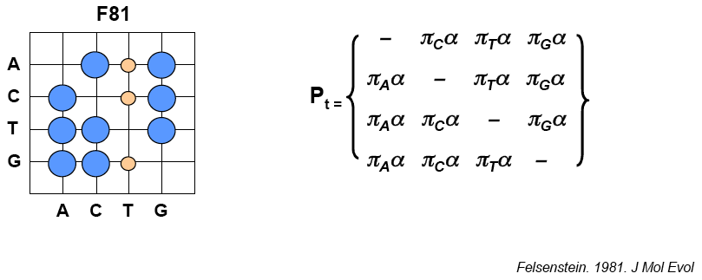
Felsenstein (1981)
If some substitutions are more common in one sequence than others, some substitutions may be more frequent than others
F81 model allows the frequency (π) of the four nucleotides to be different

Slide 20
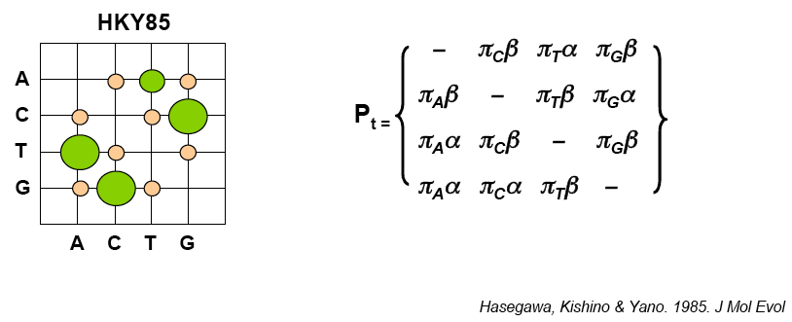
Hasegawa, Kishino and Yano
The HKY85 model allows rates of transitions and transversions to differ and base frequencies to vary

Slide 21
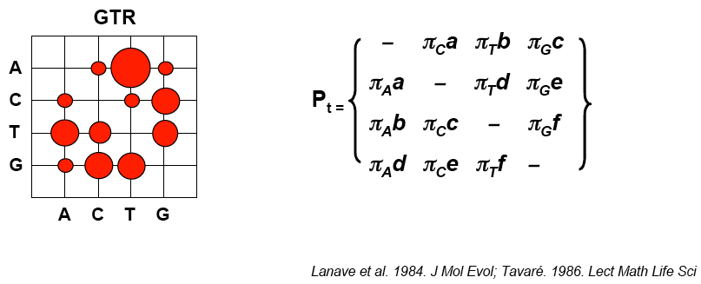
General Time Reversible
The GTR/REV model allows each possible substitution to have its own probability
Substitutions are reversible (i.e. substitutions from i to j has the same probability as a substitution from j to i)

Slide 22
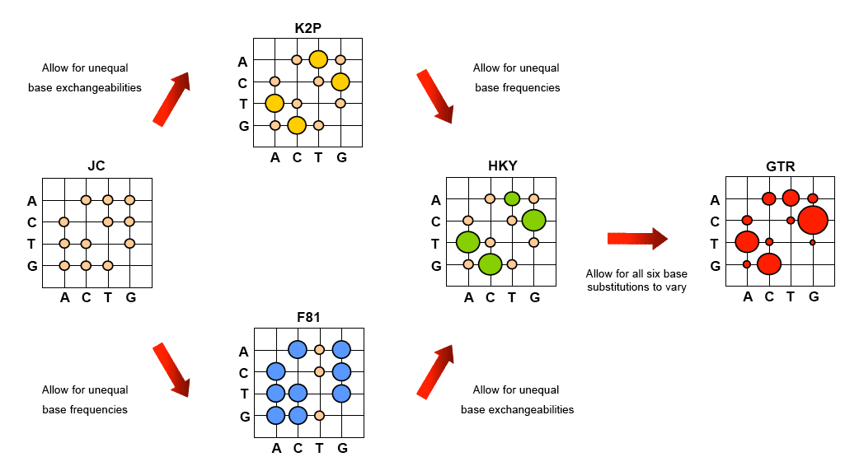
After Whelan et al. 2001

Slide 23
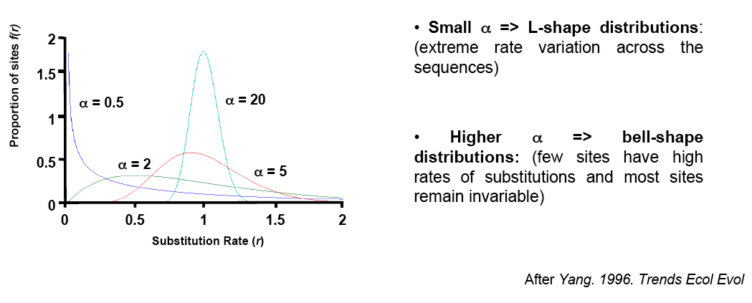
Rate heterogeneity
Different regions of RNA/DNA may have different probabilities of change, and variable rates of substitution can have considerable impact on sequence divergence
Typically, a gamma distribution is used to describe heterogeneity in nucleotide substitution rate across sequences
The range of rate variation among sites is dictated by the shape parameter α of the distribution
Yang 1996. TREE

Slide 24

Model comparison
A complex model is not necessarily better than a simpler one: it is critical to select the best-fitting model of evolution for an optimal phylogenetic reconstruction
The choice of model can be achieved by statistical hypothesis testing, such as likelihood ratio testing (LRT)
LRT yields a likelihood ratio statistic Δ, which corresponds to the ratio of the likelihood of the alternative hypothesis (i.e. model 1) to the null hypothesis (i.e. model 0)

Slide 25
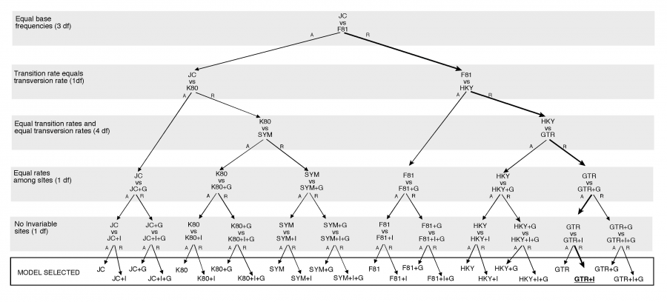

Slide 26
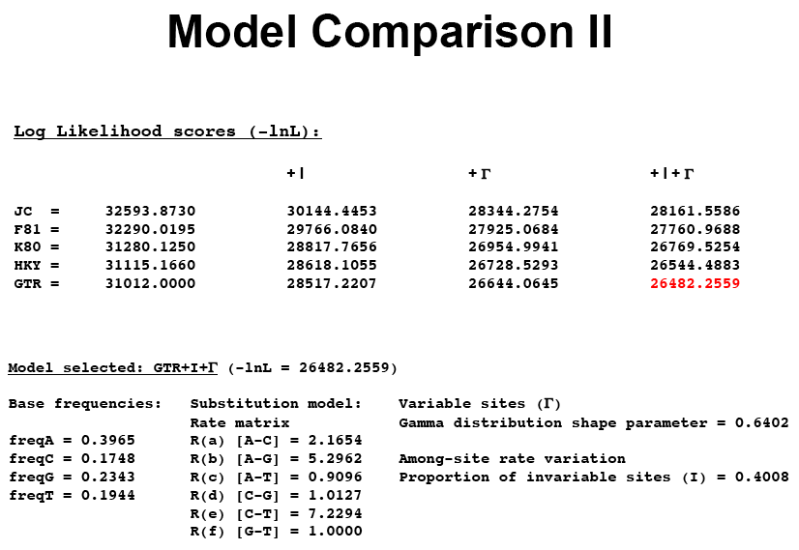

Slide 27
Summary
Models of evolution correct for the underestimation in observed genetic distance when comparing sequences
They incorporate various assumptions about:
- Base frequencies
- Relative rates of nucleotide exchangeability
- Substitution rate heterogeneity
- Proportion of invariable sites
Complex models traditionally perform better but the addition of parameters increases estimation errors
When sequences are closely related, estimates obtained using different models tend to be similar to one another

Slide 28
Discussion – Types of biological questions
Virological surveillance and determining source of virus population.
Disease tracking
Evolutionary dynamics
Classification

Slide 29
Programs for building trees – Maximum Likelihood
MEGA – not great. Takes short cuts in building trees. Can't customize Model
PAUP – flexible. Model based tree building is slow and not optimal
RxML – Fast and accurate. Command line exectution. Only implements GTR model

Slide 30
Programs for building trees – Bayesian
MrBayes – Flexible, widely used, and no estimates time trees
BEAST – very flexible, can implement epidemiological models and phylogeographic models. Will demonstrate on Thursday

