Slide 1
Molecular epidemiology in public health response to pandemic influenza
Justin Bahl

Slide 2
Background
Pandemic influenza viruses periodically emerge
potentially catastrophic
Three major pandemics have occurred in the 20th century
1918, 1957, 1968
Cause of significant mortality and morbidity in humans
Swine Origin Influenza Virus is the first influenza pandemic of the 21st century

Slide 3
Influenza
Segmented RNA virus
Orthomyxoviridae
Contains 8 gene segments
PB1, PB2, PA, HA, NP, NA, M, NS
Coding for 10-13 proteins
Classified based on HA and NA reactivity properties
16 HA subtypes and 9 NA subtypes

Slide 4


Slide 5


Slide 6
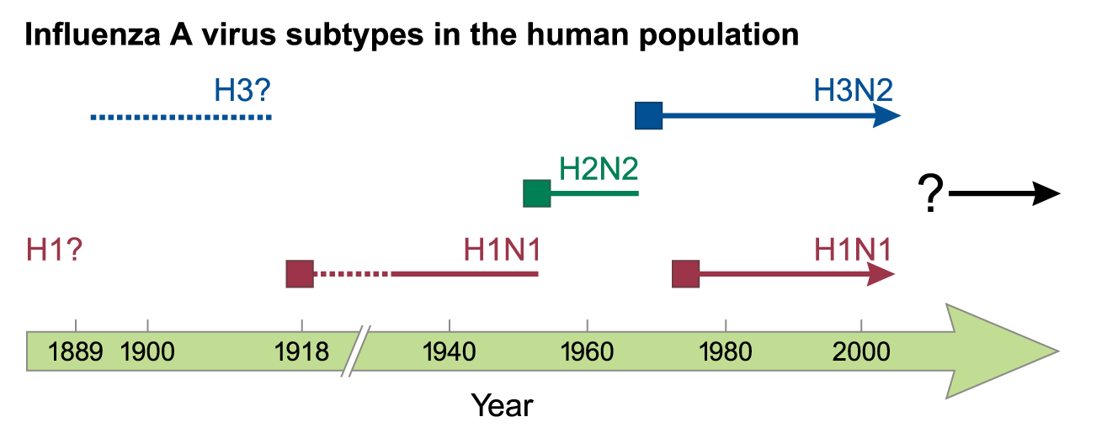
Palese. Nature Medicine 2004

Slide 7
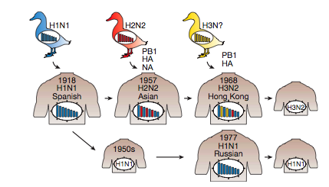
Neumann, Noda and Kawaoka. Nature 2009

Slide 8
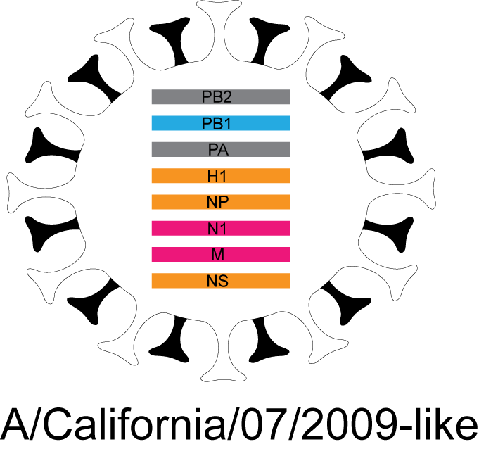

Slide 9

Reassortment

Slide 10
Swine Origin Influenza Virus (H1N1pdm)

Slide 11
Timeline
April 15 and April 17, 2009, novel swine-origin influenza A (H1N1) virus (S-OIV) was identified in two epidemiologically unlinked patients in the United States
The same strain of the virus was identified in Mexico, Canada
Spread across the globe in weeks
Global network of scientists was made aware of the new threat April 23/24th
First sequences of the novel influenza virus was available April 25th

Slide 12
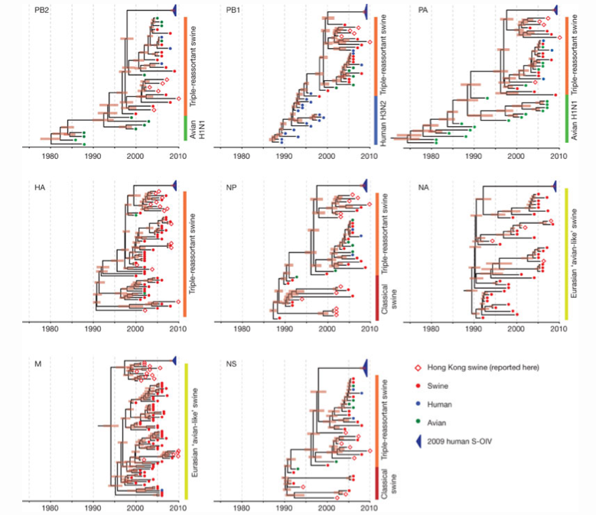

Slide 13
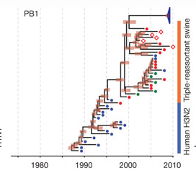

Slide 14
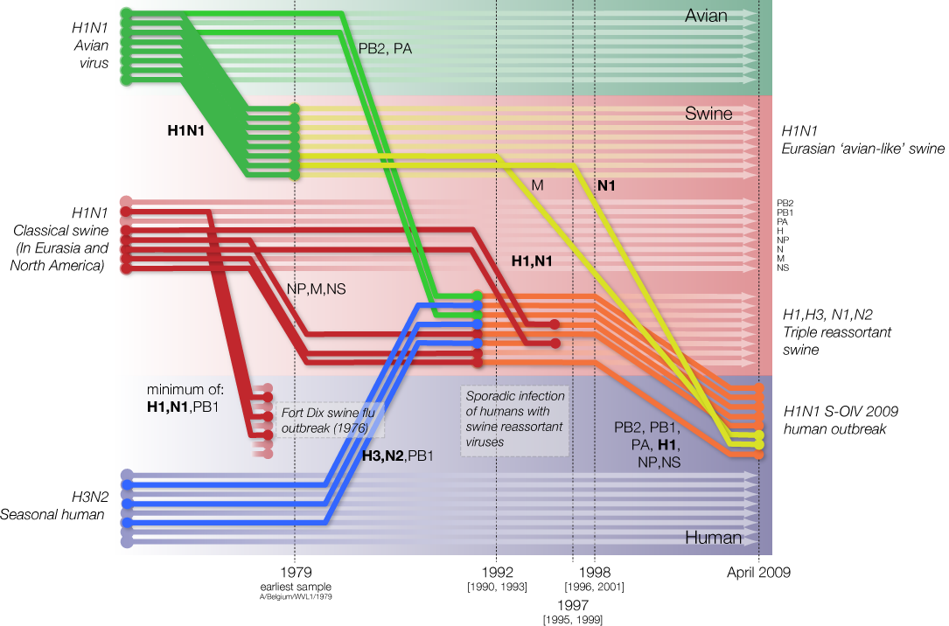
H1N1pdm

Slide 15
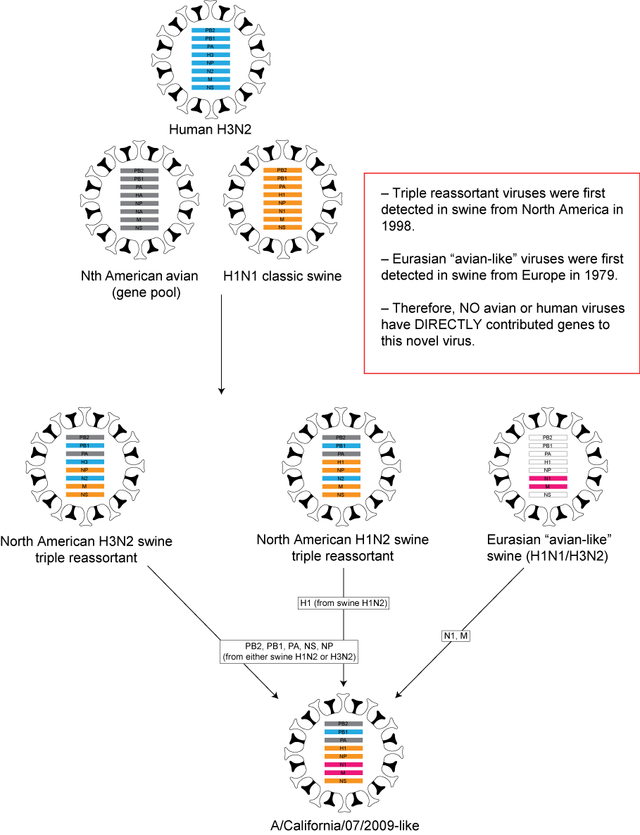
H1N1pdm

Slide 16


Slide 17
6 Weeks after start of pandemic
Back calculation model based on passenger flows from Mexico
SEIR model maximum-likelihood fitting
Bayesian coalescent model

Slide 18
Back calculation method
intense surveillance for ILI in those returning from Mexico
ascertainment of early cases in newly affected countries likely more complete and rapid than local surveillance of mild cases in Mexico.
Passenger flow out of Mexico shows correlation with the frequency of detected confirmed cases worldwide

Slide 19
Back calculation method
Use data on cases among travelers and back calculation methods to estimate the total number of people infected in Mexico.
Key underlying assumptions are that population mixing in Mexico is equally likely between Mexican residents and tourists, and tourists and Mexican residents are at equal risk of infection (despite demographic and other differences).

Slide 20
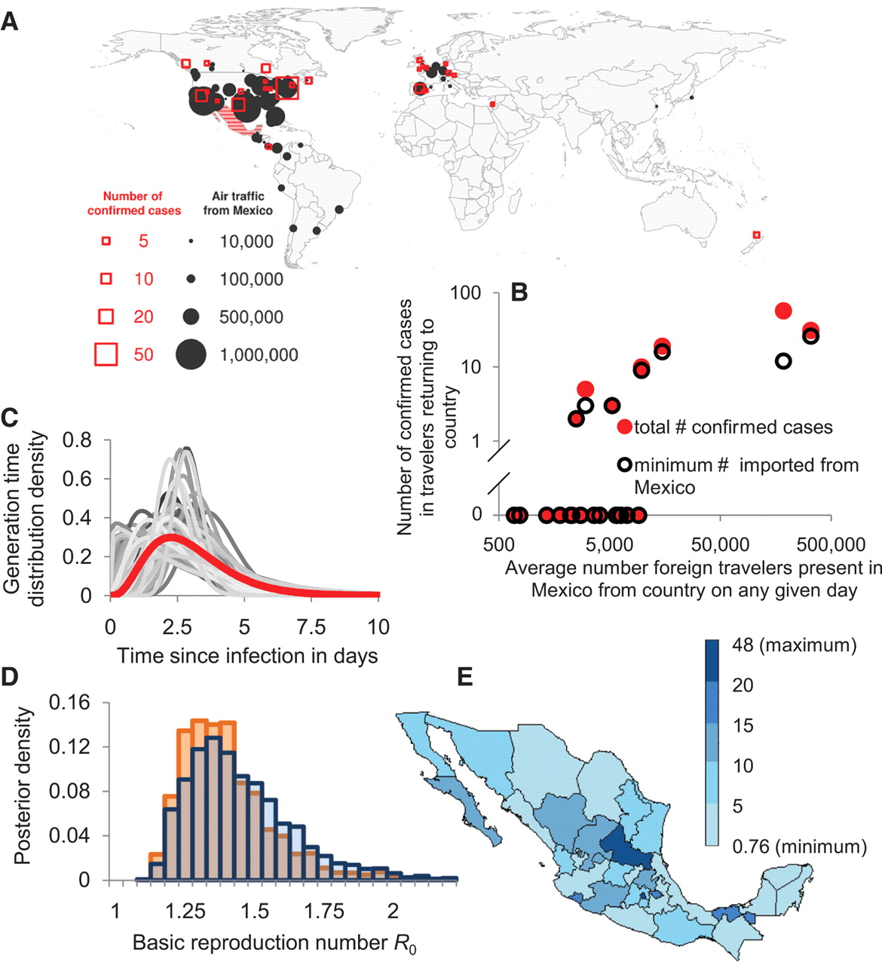

Fig. 1 (A).
Christophe Fraser et al. Science 2009;324:1557-1561
Published by AAAS
Notes:
(A). The number of passengers flying out of Mexico by actual destination and the number of confirmed cases as reported on 30 April 2009. (B) The number of cases exported to country j as reported on 30 April 2009 as a function of the estimated average number of foreign travelers in Mexico from country j on any given day in March or April. Black circles: minimal number based on one exposure per epidemiological cluster; filled red circles, total number of confirmed cases. (C) Mean assumed generation time distribution (red) and 100 illustrative draws from the prior distribution, and (D) corresponding posterior distribution of R0 estimates for a stochastic model of an epidemic within Mexico with travelers infected at a rate proportional to the estimated density of travelers per local resident. The two bar charts correspond to a 7-day delay between infection and confirmation (blue) and no delay (orange) in cases among travelers. (E) Number of acute respiratory infection cases per 100,000 inhabitants by state as reported on 5 May 2009 (1), demonstrating spatial distribution of disease within Mexico.

Slide 21
Back calculation method
If infections are concentrated away from traveler destinations, the number of people infected in Mexico will be underestimated, and conversely will be overestimated if the epidemic has disproportionately affected geographical zones visited by travelers.

Slide 22
Epidemic timing
Need to know the start of the epidemic
Investigations suggest it started 15 Feb, 2009
Alternative approach – look at genetic diversity of virus sequences collected from confirmed cases assuming diversity accumulates according to a molecular clock
time of most recent common ancestor of 12 January 2009
doubling time of the epidemic of 10 days

Slide 23
R0
assuming exponential growth, the growth rate of the epidemic (r) can be inferred from estimates of the current cumulative number of infections and estimated start date and size for the outbreak.

Slide 24
R0
assuming exponential growth, the growth rate of the epidemic (r) can be inferred from estimates of the current cumulative number of infections and estimated start date and size for the outbreak.
R0 can be estimated from the exponential growth rate if one also assumes that the generation time for the new H1N1 strain is similar to that of other strains of seasonal and pandemic viruses

Slide 25
Simple deterministic model
Y_{f}= Y₀(exp(r(t_{f}-t₀))-1)/r,
where Y_{f} is the final outbreak size
t_{f} is date of last outbreak case
r is growth rate
R₀ = (1 + r/b)ª
where a and b are the parameters of the Gamma distribution a= μ²/σ² and b = μ /σ² where μ and σ are the mean and standard deviation of the distribution respectively).

Slide 26
