Slide 1
Solving Phylogenetic Trees
Justin Bahl

Slide 2
Topics Covered
How do we find the right tree?
Optimization Methods (Maximum Likelihood/Bayesian)

Slide 3
Each unrooted tree theoretically can be rooted anywhere along any of its branches
A
C
x
=
B
D
C
A
D
B
E
C
A
D
B
F
E
(2N - 3)!! = # unrooted trees for N taxa

Slide 4
Types of computational methods:
Clustering algorithms: Use pairwise distances. Are purely algorithmic methods, in which the algorithm itself defines the the tree selection criterion. Tend to be very fast programs that produce singular trees rooted by distance. No objective function to compare to other trees, even if numerous other trees could explain the data equally well. Warning: Finding a singular tree is not necessarily the same as finding the "true” evolutionary tree.
Optimality approaches: Use either character or distance data. First define an optimality criterion (minimum branch lengths, fewest number of events, highest likelihood), and then use a specific algorithm for finding trees with the best value for the objective function. Can identify many equally optimal trees, if such exist. Warning: Finding an optimal tree is not necessarily the same as finding the "true” tree.

Slide 5
Clustering methods (UPGMA & N-J)
Optimality criterion: NONE. The algorithm itself builds
‘the’ tree.
Advantages:
Can be used on indirectly-measured distances (immunological, hybridization).
Distances can be ‘corrected’ for unseen events.
The fastest of the methods available (N-J is screamingly fast!).
Can therefore analyze very large datasets quickly (needed for HIV, etc.).
Can be used for some types of rate and date analysis.
Disadvantages:
Similarity and relationship are not necessarily the same thing, so clustering by
similarity does not necessarily give an evolutionary tree.
Cannot be used for character analysis!
Have no explicit optimization criteria, so one cannot even know if the program
worked properly to find the correct tree for the method.

Slide 6
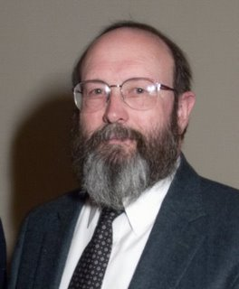

Maximum Likelihood Phylogenetics
Joe Felsenstein

Slide 7
Maximum Likelihood: The explanation that makes the observed outcome the most likely
L = Pr(D|H)
Probability of the data, given an hypothesis
The hypothesis is a tree topology, its branch-lengths and a model under which the data evolved
First use in phylogenetics: Cavalli-Sforza and Edwards (1967) for gene frequency data; Felsenstein (1981) for DNA sequences

Slide 8
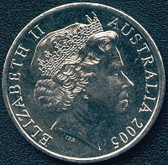
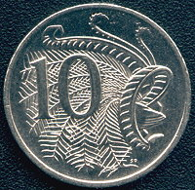
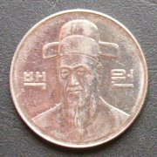
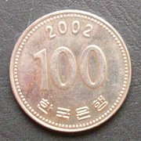
example
Suppose you are flipping coins and counting the number of times “heads” appear – This is your data. You throw the coin twice and observe “heads” both times. You might have two hypotheses to explain these data.
“heads” “tails”
“heads” “tails”

Slide 9
H1 is the hypothesis that the coin is normal: “heads” on one side, “tails” on the other and each has the same probability, p = 0.5, of appearing.
H2 is the hypothesis that the coin is rigged with an 80% chance of getting a head , p = 0.8.
What is the likelihood of H1?
What is the likelihood of H2?

Slide 10
The probability of observing “heads” in each of two flips under H1 is: L(H1|data) = 0.5 × 0.5 = 0·25
The probability of observing “heads” in each of two flips under H2 is:
L(H2|data) = 0.8 × 0.8 = 0.64

Slide 11
Since the probability of observing the data under H2 is greater than under H1, you might argue that the “rigged” coin hypothesis is the more likely.
However, if you flipped the same coin 20 times and got “heads” 8 times, would H2 still be the better explanation of the data?

Slide 12
Note that you could flip “heads” and “tails” in different orders
E.g. HTHHTHTTHTTTTHHTTHTT
Or HHHHHHHHTTTTTTTTTTTT
There are actually 20 choose 8 ways to do this

Slide 13
The likelihood for H1 of observing 8 “heads” and 12 “tails” (where each has an equal chance of appearing) under H1 is:
L(H1 data) =
₂₀C₈ × (0.5)⁸(0.5)¹²
20 ×19 ×18….2×1
=
× (0.5)⁸(0.5)¹²
(8 ×7 ×6….2×1)(12×11×10….2×1)

Slide 14
Numbers can be very low, so normally take natural logs lnL(H1)= −2.119
The likelihood for H2 of observing 8 “heads” and 12 “tails” (where “heads has a probability of 0.8 of appearing) under H2 is:
L(H2 data) =
₂₀C₈ × (0.8)⁸(0.2)¹²
lnL(H2)= −9.355
Maximum likelihood is less likely to be misleading with more data

Slide 15
The maximum likelihood estimate (MLE)
Plotting likelihood (or –lnL) values for different parameter values (e.g. equilibrium base frequency for Adenine, π_{A}) gives the likelihood surface. The best score on this surface (the lowest point) identifies the maximum likelihood estimate (MLE), and indicates the hypothesis best supported by the data.
Here the MLE for π_{A} ≈ 0.35
π_{A}

Slide 16
In phylogenetics, the hypothesis is a tree topology, its branch-lengths and a model under which the data evolved
Sheep Goat
Branch-lengths as expected numbers of substitutions per site
0.10
0.14
0.32
0.05
0.08
Cow Bison
Parsimony seeks to minimise the number of substitutions
Likelihood seeks to estimate the actual number of substitutions

Slide 17
Likelihood assumes that sites evolve independently, but by common mechanisms
Oak ATGACCGCTGCCAG Ash ACGCTCGCCATCAG Maple ATGCTCGCTACCGG
Purines
A G
Transitions at six sites, only one transversion is observed
Hence, an ML model should allow for different transition and transversion substitution rates
C T
Pyrimidines
Transitions
Transversions

Slide 18
The model is reversible, ie. p(A→G) = p(G→A), so the root can be placed at any node
Pattern probability = p(G →G) × p(G →G) × p(G →A) × p(A →A) × p(A →A)
A A
G
A
G
G
Root

Slide 19
A A
A A
A A
A A
A A
A A
A G C T A G
A A A A C C
G G
G G
G G
G G
G G
G G
A A
A A
A A
A A
A A
C T A G C
The site likelihood is the sum of the probabilities for the 16 possible site patterns = 0.0333
C C T T T
G G
G G
G G
G G
G G
A A
A A
A A
A A
A A
T A G C T
T G G G G
G G
G G
G G
G G
G G
Hence, the site −lnL = 3.402

Slide 20
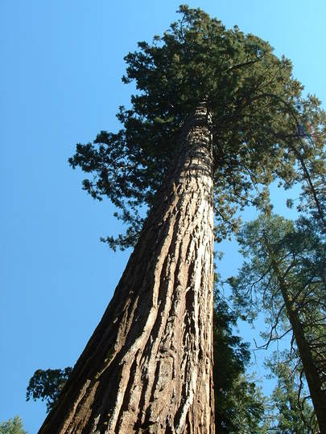
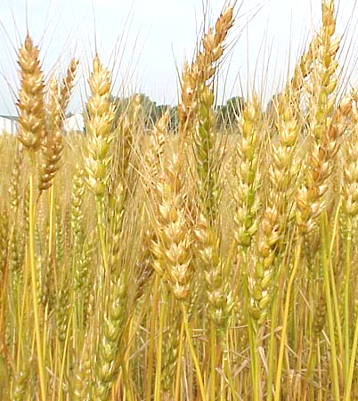


The likelihood of a tree is the product of the site likelihoods. Taken as natural logs, the site likelihoods can be summed to give the log likelihood: the tree with the highest likelihood (lowest –lnL) is the ML tree.
Tree 1 Tree 2
Site –lnL(1) –lnL(2)
2.457 2.891
2 1.568 1.943
. .. ..
. .. ..
Tree 2 is the ML tree by 8.801 –lnL units
1206 2.541 1.943
2052.456 2043.655

