Slide 1
Project Name
Comprehensive Analysis over World Happiness Report

Slide 2
Team Introduction
Name: Bahram Khodabandehlouee
Name: Tyler Edwards
Name: Ramar Huntley
Name: Kim Dineen

Slide 3
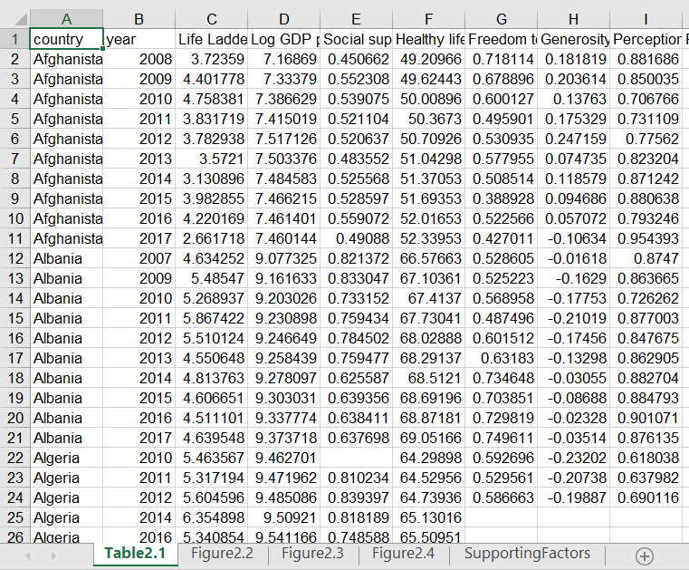
Our Dataset
Notes:
The World Happiness Report is a publication of the Sustainable Development Solutions Network, powered by the Gallup World Poll data. Happiness is an important part of our lives and can provide us with a wide range of benefits such as better performance, health, and relationships (5). Knowing more about what contributes to happiness is important to help us improve our lifestyles. Especially with increased depression symptoms with the onset of COVID-19 (6), it is necessary to learn more about how to guide people and countries in leading happier lives. As Our World in Data states, there are potentially many factors such as life expectancy, economic growth, culture, and freedom that can be correlated with happiness (1). There are also numerous studies that suggest nurturing relationships and communities help us live longer and be happier (2)

Slide 4
What we will do
data cleaning
basic statistics on dataset
Find correlation between features to implement some ML models
Notes:
We will start with data cleaning and then we will do some basic statistics on dataset and provide tables that are easier for our audience to understand. Then, we will import Matplot, Seaborn and few other visualization libraries to plot relations between features. Also, we will use scikit-learn (`sklearn`) library for doing machine learning, and specifically in this project, classification. In order to do this classification, we will use other sheets provided in this dataset and concatenate their data to our dataset. In this classification, we will train our machine to predict the region of a country based on the data from other features.

Slide 5
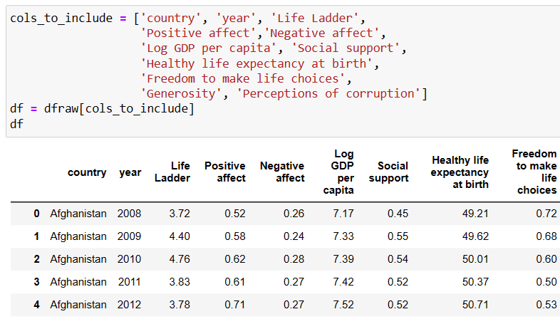
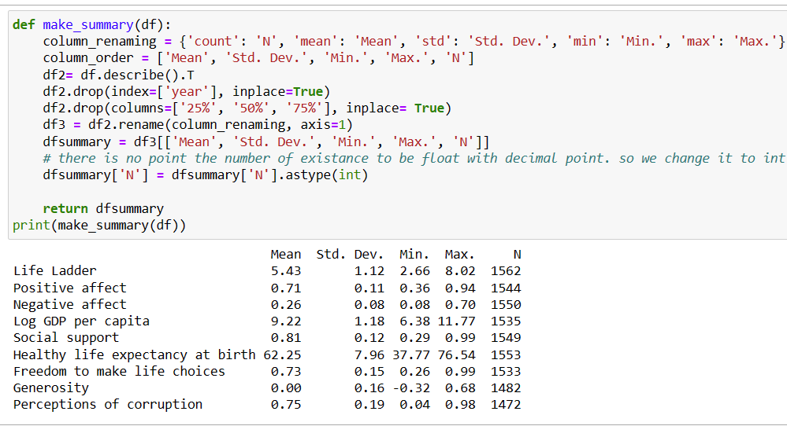
Data cleaning:
Notes:
we move data categories to rows and statistics as features in columns and remove unimportant statistics . To have generalizability, we write a function that takes the table and returns a dataframe of statistics that is more informative.

Slide 6
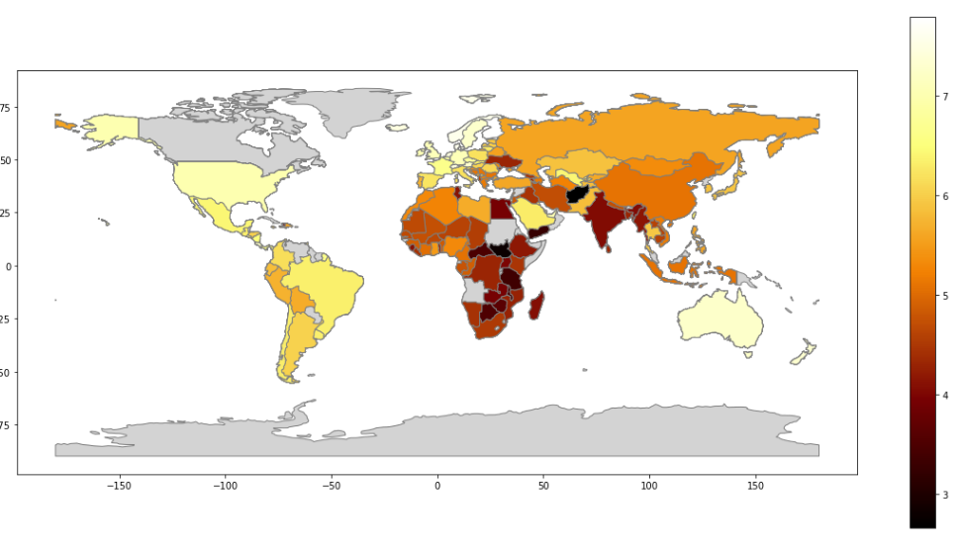
Geopanda
Map-heatmap
Gray countries are those with unmatch names, needs data cleaning
Notes:
In world happiness report, as it is about some many statistics among all countries in the world, we found it useful to kind of show the happiness measures on the map. So, We represent the Happiness data by color-coding its value via a heatmap. We have used a specific year for this map,. To do this we have used geopandas. As we see some of the countries are still gray that is due to the mismatch in names in geopandas and our dataset. So the majority of it will be fixed by matching names. Also, this map is made for a specific year, if we change the year, colors might slightly change.

Slide 7
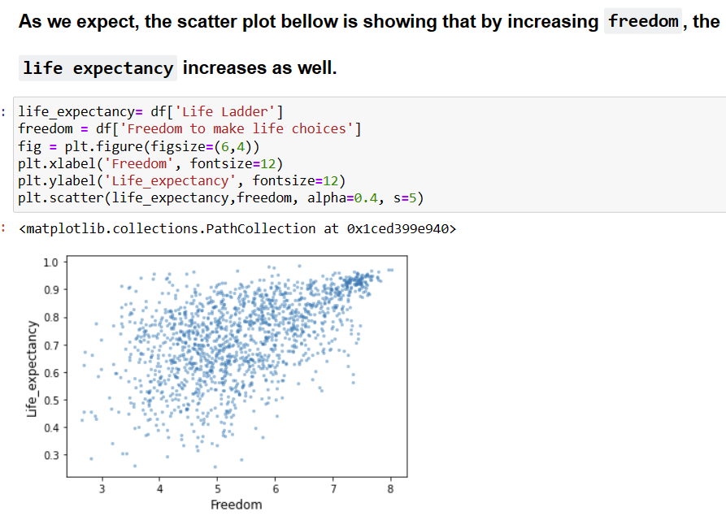
Finding correlations:
Notes:
As we expect, the scatter plot bellow is showing that by increasing freedom, the
life expectancy increases as well.¶

Slide 8
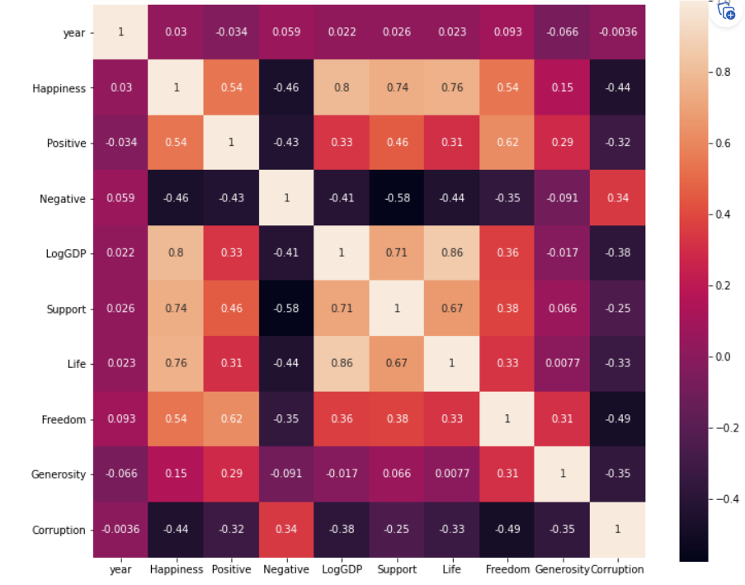
Finding correlations:

Slide 9
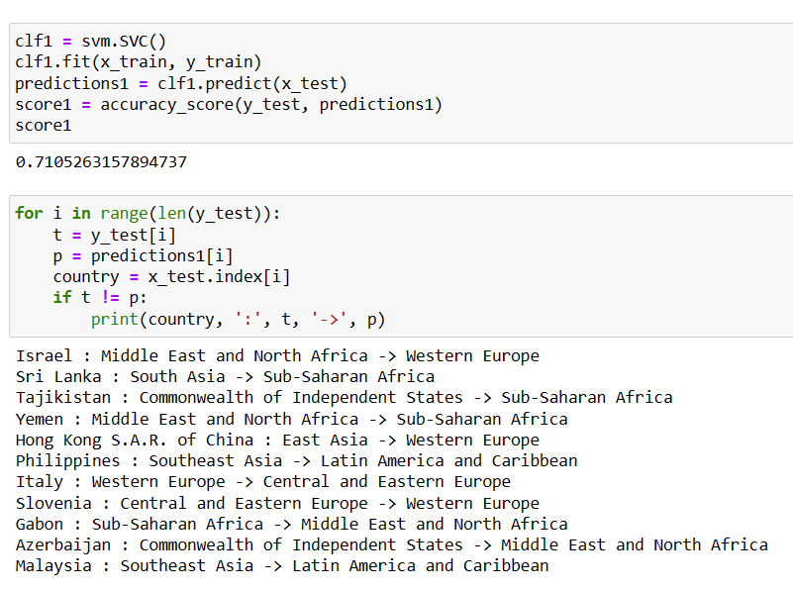
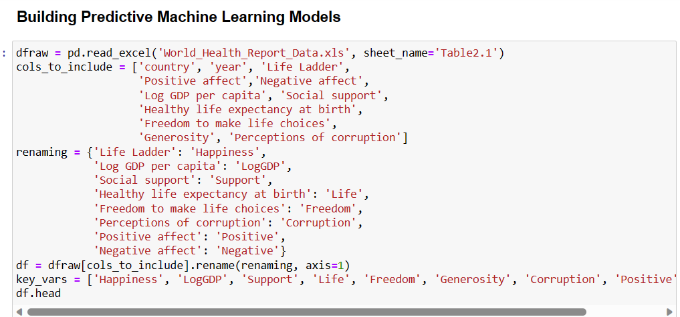
ML:
predicting the geographical location of a country based on some key variable

